Slide 1

Income effects of trade destruction and deflection in post-2022 Russia
A Structural Decomposition Analysis
Diogo N. Sousa
PhD Candidate at University of Coimbra
João Pedro Ferreira
University of Virginia

Slide 2
Motivation
The full-scale invasion of Ukraine (Feb 2022) further isolated Russian economy, amid unprecedent trade and financial sanctions;
Initial projections pointed to a shapt GDP contraction (WEO-IMF, 2022 -> -8.5%), but GDP contraction in 2022 was -2.3%. Why?
One reason might relate to trade diversion (Early, 2015; Haidar, 2017).

Slide 3
Motivation – ALL BUBLE AT THE SAME COLOR
Russian trade share with key trading partners (2021-2024) (% total exports/imports)
Exports: mining + refined petroleum | Imports: medium-high/high-tech inputs
Source: Asian Development Bank and own calculations.

Slide 4
Literature gap
Ex-ante simulations: reduced trade flows with westerns economies would generate sizeable losses for Russia exceeding those incurred by sanctioning countries, particularly via oil sector (e.g. Borin et al., 2023; Chepeliev et al., 2022; Felbermayr et al., 2023.
The impact of post-2022 trade shocks in Russia remains contested.
  GDP growth outperformed initial projections (WEO-IMF, 2022 -> -8.5%), but GDP contraction in 2022 was -2.3%.
  Evidence of trade deflection and trade flows through intermediary economies Chupilkin et al., 2023; Partsvaniya et al., 2024) in the case of imports, and India in the case of exports (Babina et al, 2023).
  Evidence of significant sectoral-level costs amid reduced the availability of critical inputs and reliance on a narrower set of trading partners (Borio et al., 2022; Simachev et al., 2023; Egorov, 2025).
The link between country–sector trade reallocation and aggregate income remains only partially characterised in the empirical literature.

Slide 5
Income effects of trade destruction and deflection in post-2022 Russia
Objective: To measure the impact the loss of international trade had in Russia national income and assess how trade deflection diminish this cost.
Empirical strategy: Input-Output Structural Decomposition Analysis (SDA);
Dataset: Asian Development Bank 2021-2024, constant prices;
Contributions:
. Understanding how country–sector trade reallocation translated into aggregate income. From a policy perspective, this is important to understand how the trade shock triggered by sanction eroded Russian economic base.
. First time using SDA techniques in the context of major trade reallocation amid economic warfare.

Slide 6
Empirical strategy
 |  | RU |  |  |  | Sanctioning countries |  |  |  | Non-sanctioning countries
 |  | 1 | 2 | 3 | FD | 1 | 2 | 3 | FD | 1 | 2 | 3 | FD
RU | 1
 | 2
 | 3
 | VA
Sanctioning countries | 1
 | 2
 | 3
 | VA
Non-sanctioning countries | 1
 | 2
 | 3
 | VA

Slide 7
Empirical strategy
SC bans oil imports from RU
 |  | RU |  |  |  | Sanctioning countries |  |  |  | Non-sanctioning countries
 |  | 1 | 2 | 3 | FD | 1 | 2 | 3 | FD | 1 | 2 | 3 | FD
RU | 1
 | OIL
 | 3
 | VA
Sanctioning countries | 1
 | 2
 | 3
 | VA
Non-sanctioning countries | 1
 | 2
 | 3
 | VA

Slide 8
Empirical strategy
SC bans oil imports from RU
Trade destruction
 |  | RU |  |  |  | Sanctioning countries |  |  |  | Non-sanctioning countries
 |  | 1 | 2 | 3 | FD | 1 | 2 | 3 | FD | 1 | 2 | 3 | FD
RU | 1
 | OIL |  |  |  |  | - | - | - | -
 | 3
 | VA
Sanctioning countries | 1
 | 2
 | 3
 | VA
Non-sanctioning countries | 1
 | 2
 | 3
 | VA

Slide 9
Empirical strategy
SC bans oil imports from RU
Trade destruction
Trade deflection
 |  | RU |  |  |  | Sanctioning countries |  |  |  | Non-sanctioning countries
 |  | 1 | 2 | 3 | FD | 1 | 2 | 3 | FD | 1 | 2 | 3 | FD
RU | 1
 | OIL |  |  |  |  | - | - | - | - | + | + | + | +
 | 3
 | VA
Sanctioning countries | 1
 | 2
 | 3
 | VA
Non-sanctioning countries | 1
 | 2
 | 3
 | VA

Slide 10
Empirical strategy
SC bans high tech goods exports to RU
Trade destruction
Trade deflection
 |  | RU |  |  |  | Sanctioning countries |  |  |  | Non-sanctioning countries
 |  | 1 | 2 | 3 | FD | 1 | 2 | 3 | FD | 1 | 2 | 3 | FD
RU | 1
 | 2
 | 3
 | VA
Sanctioning countries | 1
 | High tech | - | - | - | -
 | 3
 | VA
Non-sanctioning countries | 1
 | High tech | + | + | + | +
 | 3
 | VA

Slide 11
Empirical strategy
SC bans goods exports RU oil industry
Trade destruction
Trade deflection
 |  | RU |  |  |  | Sanctioning countries |  |  |  | Non-sanctioning countries
 |  | 1 | OIL | 3 | FD | 1 | 2 | 3 | FD | 1 | 2 | 3 | FD
RU | 1
 | 2
 | 3
 | N+1
Sanctioning countries | 1 |  | -
 | 2 |  | -
 | 3 |  | -
 | N+1 |  | -
Non-sanctioning countries | 1 |  | +
 | 2 |  | +
 | 3 |  | +
 | N+1 |  | +

Slide 12
Empirical strategy – our case study
SC bans oil imports from RU
Trade destruction
Trade deflection
 |  | RU |  |  |  | Sanctioning countries |  |  |  | Non-sanctioning countries
 |  | 1 | 2 | 3 | N+1 | 1 | 2 | 3 | N+1 | 1 | 2 | 3 | N+1
RU | 1
 | 2
 | 3
 | N+1
Sanctioning countries | 1
 | 2
 | 3
 | N+1
Non-sanctioning countries | 1
 | 2
 | 3
 | N+1

Slide 13
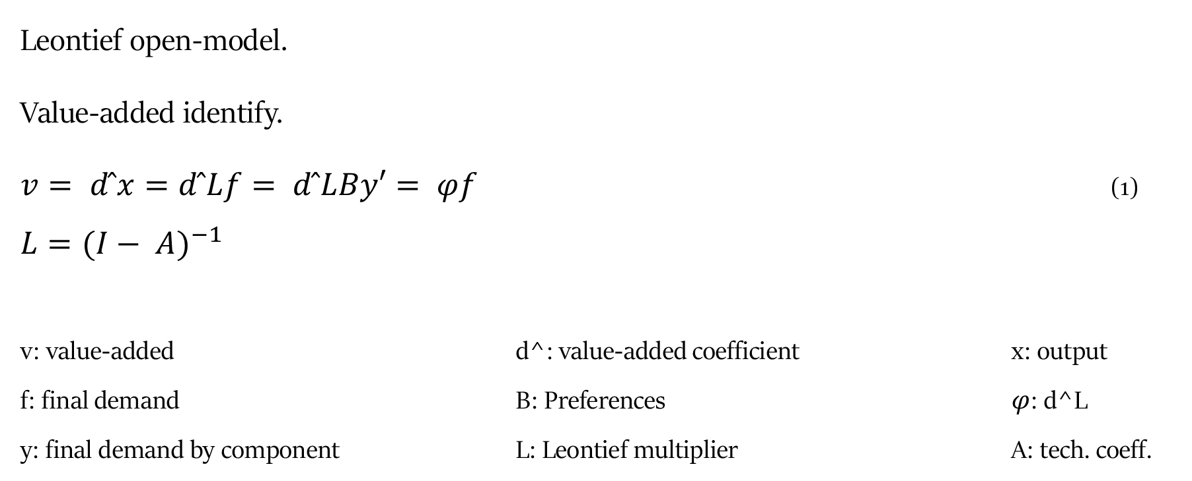
Empirical strategy – Structural Decomposition
Leontief open-model.
Value-added identify.
$v= d ̂x=d ̂Lf= d ̂LBy′= φf$ (1)
$$L={(I− A)}^{−1}$$
v: value-added d^: value-added coefficient x: output
f: final demand B: Preferences $φ$: d^L
y: final demand by component L: Leontief multiplier A: tech. coeff.

Slide 14
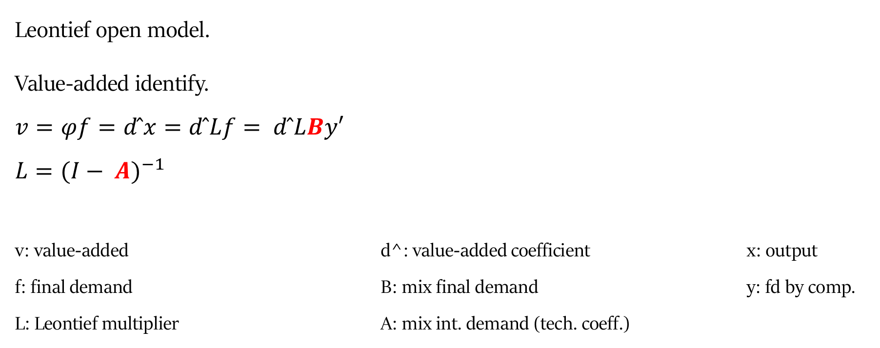
Empirical strategy – Structural Decomposition
Leontief open model.
Value-added identify.
$$v=φf=d ̂x=d ̂Lf= d ̂LBy′$$
$$L={(I− A)}^{−1}$$
v: value-added d^: value-added coefficient x: output
f: final demand B: mix final demand y: fd by comp.
L: Leontief multiplier A: mix int. demand (tech. coeff.)

Slide 15
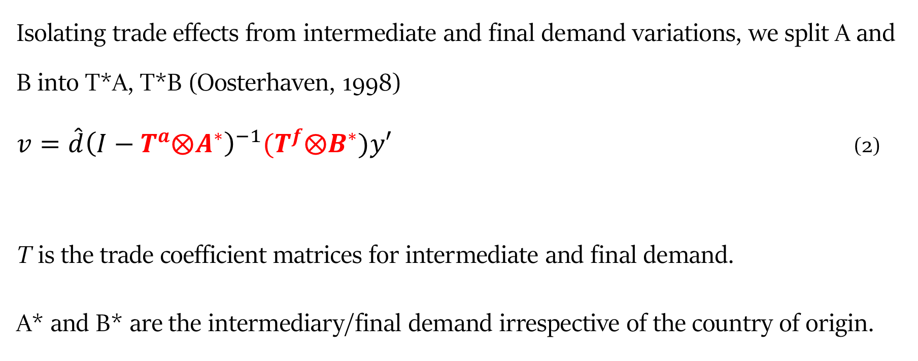
Empirical strategy – Structural Decomposition
Isolating trade effects from intermediate and final demand variations, we split A and B into T*A, T*B (Oosterhaven, 1998)
$v=\hat{d}{\left(I−T^{a}⨂A^{∗}\right)}^{−1}{(T}^{f}⨂B^{∗})y′$ (2)
T is the trade coefficient matrices for intermediate and final demand.
A* and B* are the intermediary/final demand irrespective of the country of origin.

Slide 16
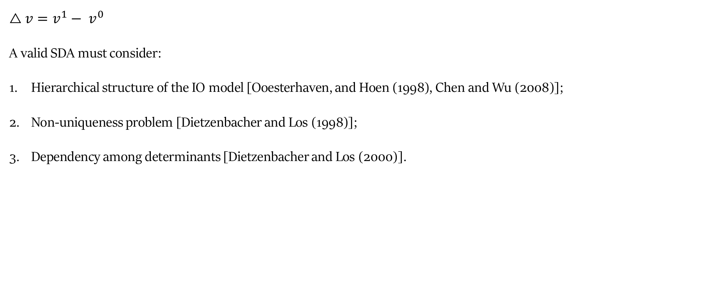
Empirical strategy - Structural Decomposition
$$△v=v^{1}− v^{0}$$
A valid SDA must consider:
Hierarchical structure of the IO model [Ooesterhaven, and Hoen (1998), Chen and Wu (2008)];
Non-uniqueness problem [Dietzenbacher and Los (1998)];
Dependency among determinants [Dietzenbacher and Los (2000)].

Slide 17
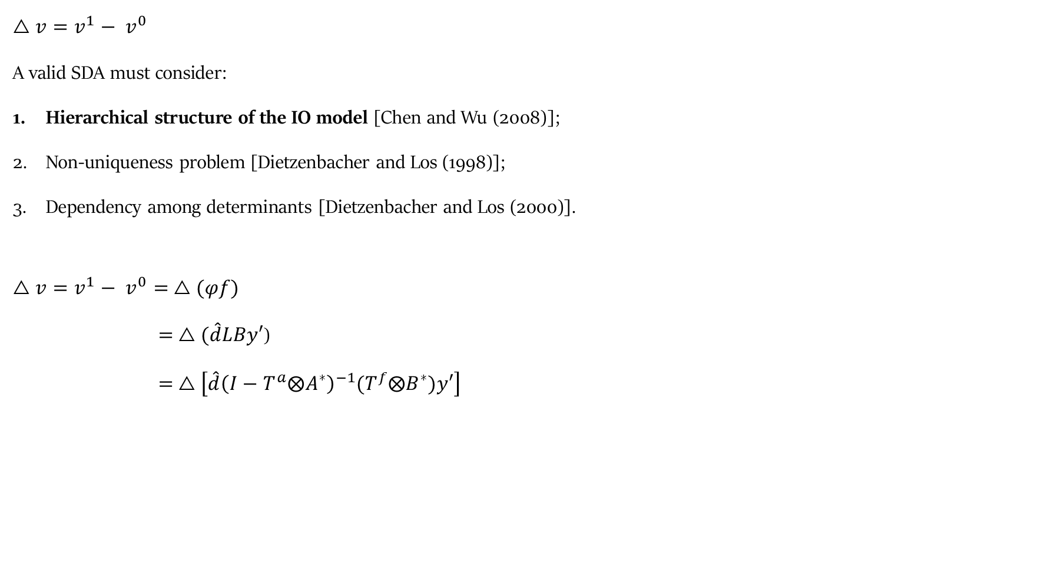
Empirical strategy - Structural Decomposition
$$△v=v^{1}− v^{0}$$
A valid SDA must consider:
Hierarchical structure of the IO model [Chen and Wu (2008)];
Non-uniqueness problem [Dietzenbacher and Los (1998)];
Dependency among determinants [Dietzenbacher and Los (2000)].
$$△v=v^{1}− v^{0}= △(φf)$$
$= △(\hat{d}LBy′$)
$= △\left[{\hat{d}\left(I−T^{a}⨂A^{∗}\right)}^{−1}{(T}^{f}⨂B^{∗})y′\right]$

Slide 18
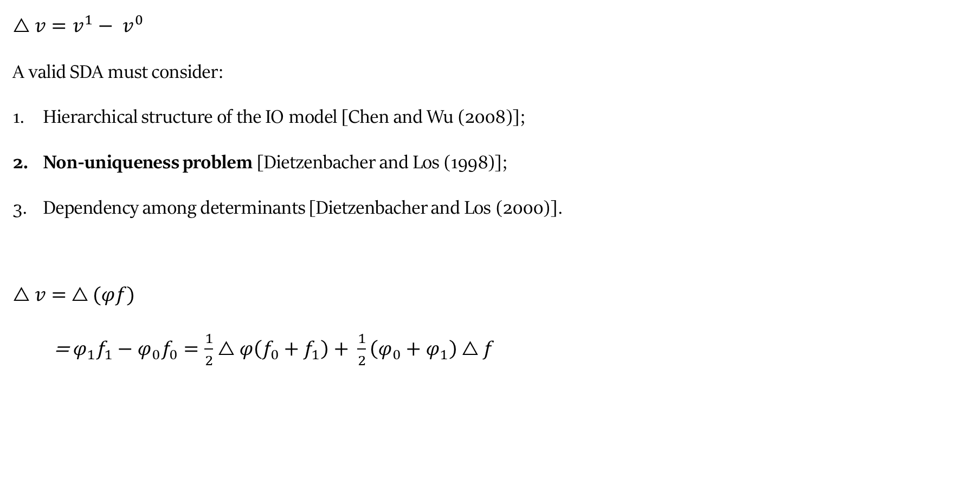
Empirical strategy - Structural Decomposition
$$△v=v^{1}− v^{0}$$
A valid SDA must consider:
Hierarchical structure of the IO model [Chen and Wu (2008)];
Non-uniqueness problem [Dietzenbacher and Los (1998)];
Dependency among determinants [Dietzenbacher and Los (2000)].
$△v=$ $△(φf)$
= $φ_{1}f_{1}−φ_{0}f_{0}=\frac{1}{2}△φ\left(f_{0}+f_{1}\right)+ \frac{1}{2}\left(φ_{0}+φ_{1}\right)△f$

Slide 19
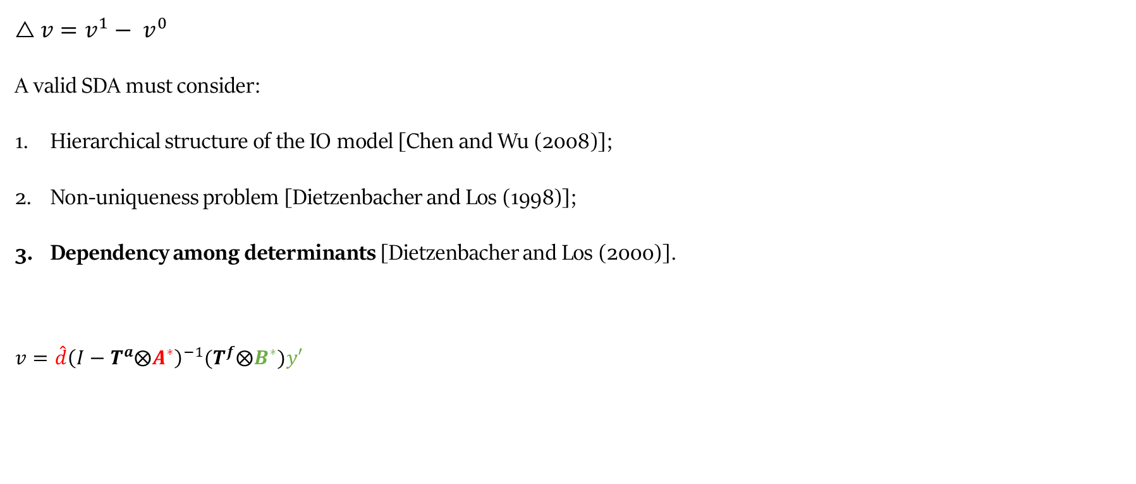
Empirical strategy - Structural Decomposition
$$△v=v^{1}− v^{0}$$
A valid SDA must consider:
Hierarchical structure of the IO model [Chen and Wu (2008)];
Non-uniqueness problem [Dietzenbacher and Los (1998)];
Dependency among determinants [Dietzenbacher and Los (2000)].
$v=\hat{d}{\left(I−T^{a}⨂A^{∗}\right)}^{−1}{(T}^{f}⨂B^{∗})y′$

Slide 20
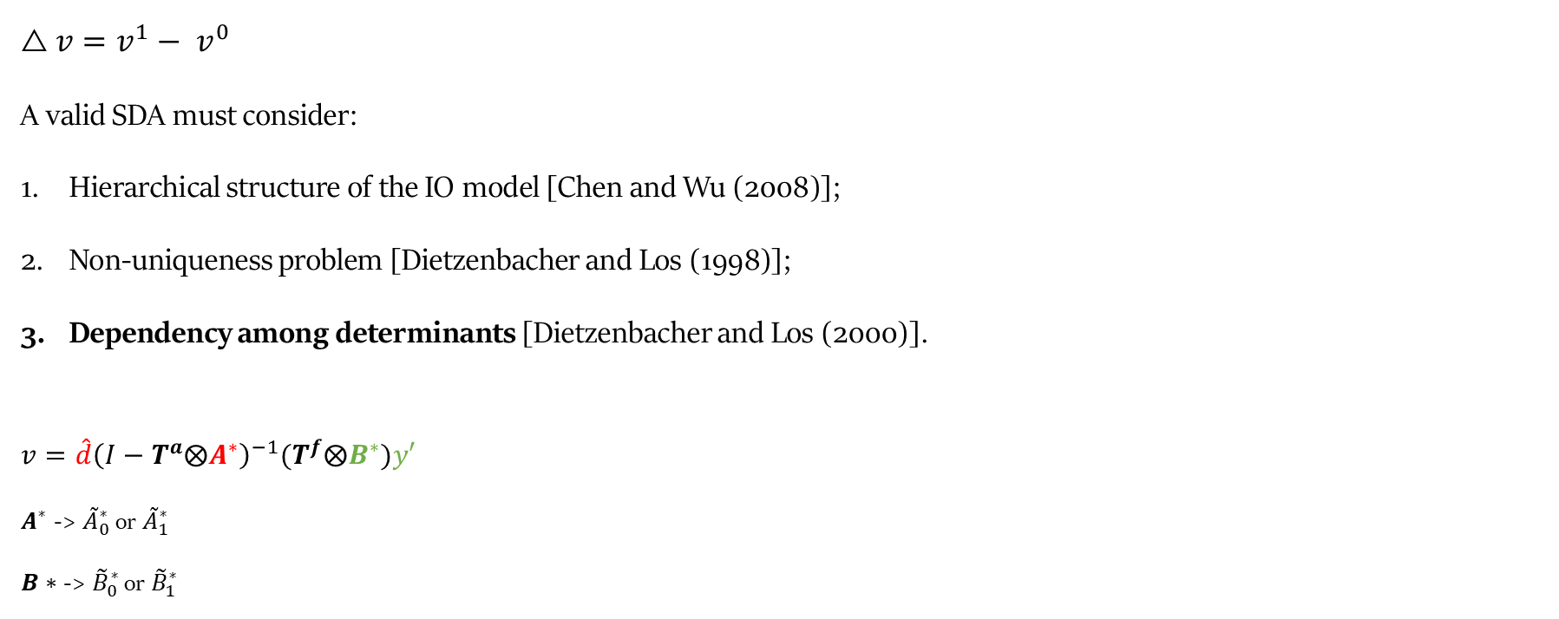
Empirical strategy - Structural Decomposition
$$△v=v^{1}− v^{0}$$
A valid SDA must consider:
Hierarchical structure of the IO model [Chen and Wu (2008)];
Non-uniqueness problem [Dietzenbacher and Los (1998)];
Dependency among determinants [Dietzenbacher and Los (2000)].
$$v=\hat{d}{\left(I−T^{a}⨂A^{∗}\right)}^{−1}{(T}^{f}⨂B^{∗})y′$$
$A^{∗}$ -> ${\tilde{A}}_{0}^{∗}$ or ${\tilde{A}}_{1}^{∗}$
$B∗$ -> ${\tilde{B}}_{0}^{∗}$ or ${\tilde{B}}_{1}^{∗}$

Slide 21
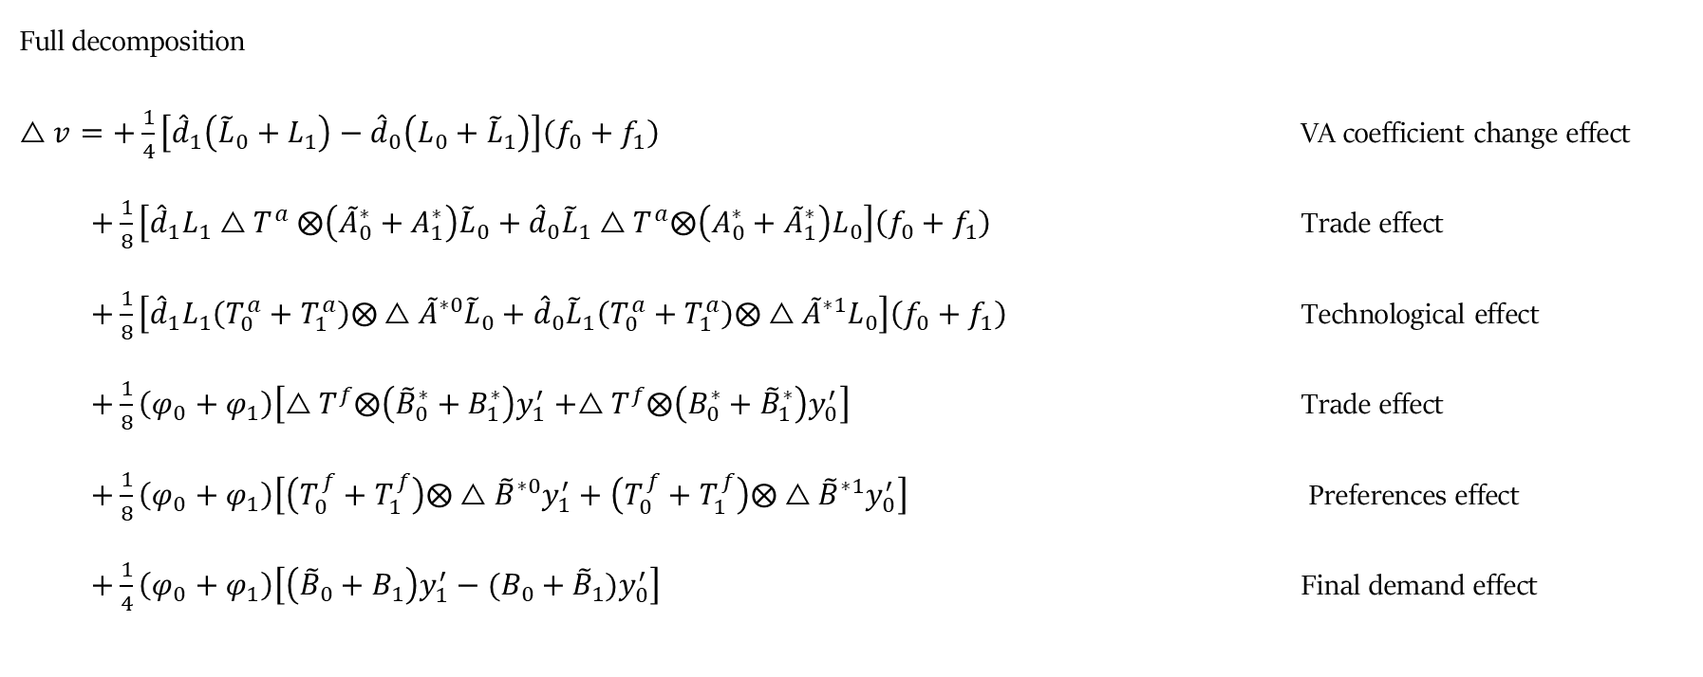
Empirical strategy
Full decomposition
$△v=+\frac{1}{4}\left[{\hat{d}}_{1}\left({{\tilde{L}}_{0}+L}_{1}\right)−{\hat{d}}_{0}\left(L_{0}+{\tilde{L}}_{1}\right)\right]\left(f_{0}+f_{1}\right)$ VA coefficient change effect
  $+\frac{1}{8}\left[{\hat{d}}_{1}L_{1}{△T}^{a}⨂\left({\tilde{A}}_{0}^{∗}+A_{1}^{∗}\right){\tilde{L}}_{0}+{\hat{d}}_{0}{\tilde{L}}_{1}△T^{a}⨂\left(A_{0}^{∗}+{\tilde{A}}_{1}^{∗}\right)L_{0}\right]\left(f_{0}+f_{1}\right)$ Trade effect
  $+\frac{1}{8}\left[{\hat{d}}_{1}L_{1}\left(T_{0}^{a}+T_{1}^{a}\right)⨂△{\tilde{A}}^{∗0}{\tilde{L}}_{0}+{\hat{d}}_{0}{\tilde{L}}_{1}\left(T_{0}^{a}+T_{1}^{a}\right)⨂△{\tilde{A}}^{∗1}L_{0}\right]\left(f_{0}+f_{1}\right)$ Technological effect
  $+\frac{1}{8}\left(φ_{0}+φ_{1}\right)\left[△T^{f}⨂\left({\tilde{B}}_{0}^{∗}+B_{1}^{∗}\right)y_{1}^{′}+△T^{f}⨂\left(B_{0}^{∗}+{\tilde{B}}_{1}^{∗}\right)y_{0}^{′}\right]$` Trade effect
  $+\frac{1}{8}\left(φ_{0}+φ_{1}\right)\left[\left(T_{0}^{f}+T_{1}^{f}\right)⨂△{\tilde{B}}^{∗0}y_{1}^{′}+\left(T_{0}^{f}+T_{1}^{f}\right)⨂△{\tilde{B}}^{∗1}y_{0}^{′}\right]$ Preferences effect
  $+\frac{1}{4}\left(φ_{0}+φ_{1}\right)\left[\left({{\tilde{B}}_{0}+B}_{1}\right)y_{1}^{′}−(B_{0}+{\tilde{B}}_{1})y_{0}^{′}\right]$ Final demand effect

Slide 22
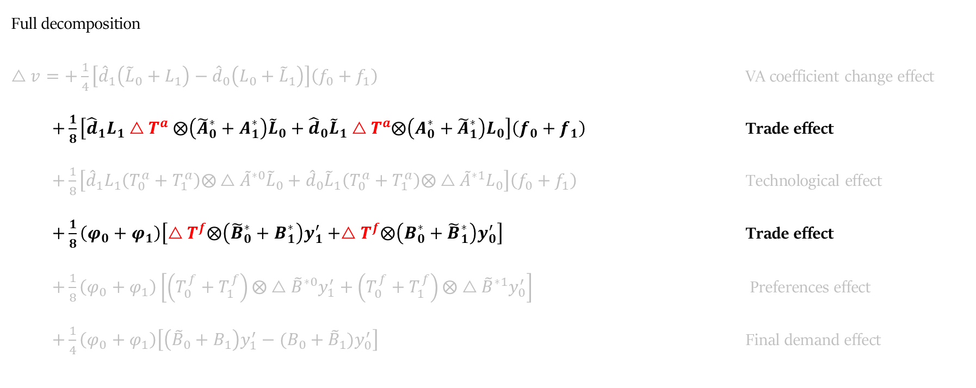
Empirical strategy
Full decomposition
$△v=+\frac{1}{4}\left[{\hat{d}}_{1}\left({{\tilde{L}}_{0}+L}_{1}\right)−{\hat{d}}_{0}\left(L_{0}+{\tilde{L}}_{1}\right)\right]\left(f_{0}+f_{1}\right)$ VA coefficient change effect
  $+\frac{1}{8}\left[{\hat{d}}_{1}L_{1}{△T}^{a}⨂\left({\tilde{A}}_{0}^{∗}+A_{1}^{∗}\right){\tilde{L}}_{0}+{\hat{d}}_{0}{\tilde{L}}_{1}△T^{a}⨂\left(A_{0}^{∗}+{\tilde{A}}_{1}^{∗}\right)L_{0}\right]\left(f_{0}+f_{1}\right)$ Trade effect
  $+\frac{1}{8}\left[{\hat{d}}_{1}L_{1}\left(T_{0}^{a}+T_{1}^{a}\right)⨂△{\tilde{A}}^{∗0}{\tilde{L}}_{0}+{\hat{d}}_{0}{\tilde{L}}_{1}\left(T_{0}^{a}+T_{1}^{a}\right)⨂△{\tilde{A}}^{∗1}L_{0}\right]\left(f_{0}+f_{1}\right)$ Technological effect
  $+\frac{1}{8}\left(φ_{0}+φ_{1}\right)\left[△T^{f}⨂\left({\tilde{B}}_{0}^{∗}+B_{1}^{∗}\right)y_{1}^{′}+△T^{f}⨂\left(B_{0}^{∗}+{\tilde{B}}_{1}^{∗}\right)y_{0}^{′}\right]$` Trade effect
  $+\frac{1}{8}\left(φ_{0}+φ_{1}\right)\left[\left(T_{0}^{f}+T_{1}^{f}\right)⨂△{\tilde{B}}^{∗0}y_{1}^{′}+\left(T_{0}^{f}+T_{1}^{f}\right)⨂△{\tilde{B}}^{∗1}y_{0}^{′}\right]$ Preferences effect
  $+\frac{1}{4}\left(φ_{0}+φ_{1}\right)\left[\left({{\tilde{B}}_{0}+B}_{1}\right)y_{1}^{′}−(B_{0}+{\tilde{B}}_{1})y_{0}^{′}\right]$ Final demand effect

Slide 23
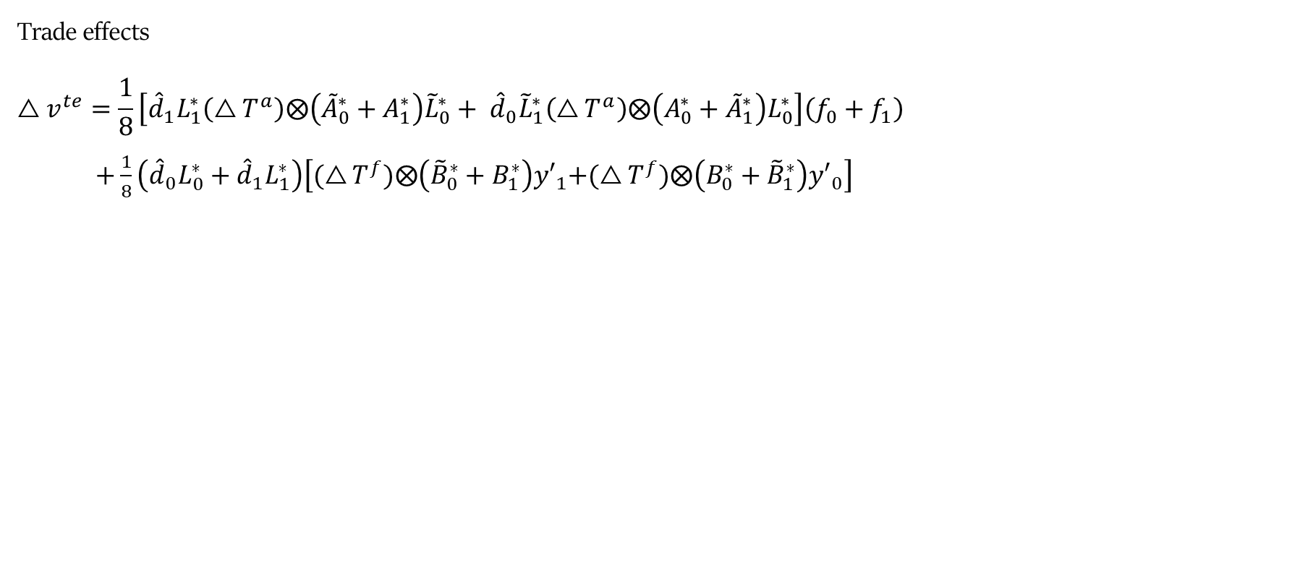
Empirical strategy
Trade effects
$$△v^{te}=\frac{1}{8}\left[{\hat{d}}_{1}L_{1}^{∗}\left(△T^{a}\right)⨂\left({\tilde{A}}_{0}^{∗}+A_{1}^{∗}\right){\tilde{L}}_{0}^{∗}+ {\hat{d}}_{0}{\tilde{L}}_{1}^{∗}\left(△T^{a}\right)⨂\left(A_{0}^{∗}+{\tilde{A}}_{1}^{∗}\right)L_{0}^{∗}\right]\left(f_{0}+f_{1}\right)$$
$+\frac{1}{8}\left({\hat{d}}_{0}L_{0}^{∗}+{\hat{d}}_{1}L_{1}^{∗}\right)\left[{(△T^{f})⨂\left({\tilde{B}}_{0}^{∗}+B_{1}^{∗}\right)y′}_{1}+(△T^{f})⨂\left(B_{0}^{∗}+{\tilde{B}}_{1}^{∗}\right){y′}_{0}\right]$ (7)
$$+ \left(\frac{1}{4}\right)\left[{\tilde{L}}^{1}\left(Q^{0}+ Q^{1}\right)\left(△\tilde{A}\right){\tilde{L}}^{0}\right]\left(W^{0}{\tilde{f}}^{0}+W^{1}{\tilde{f}}^{1}\right)$$
$$+ \left(\frac{1}{2}\right)\left[{\tilde{L}}^{0}\left(△W\right){\tilde{f}}^{1}+{\tilde{L}}^{1}\left(△W\right){\tilde{f}}^{0}\right]$$
$$+ \left(\frac{1}{2}\right)\left({\tilde{L}}^{0}W^{0}+ {\tilde{L}}^{1}W^{1}\right)\left(△\tilde{f}\right)$$

Slide 24
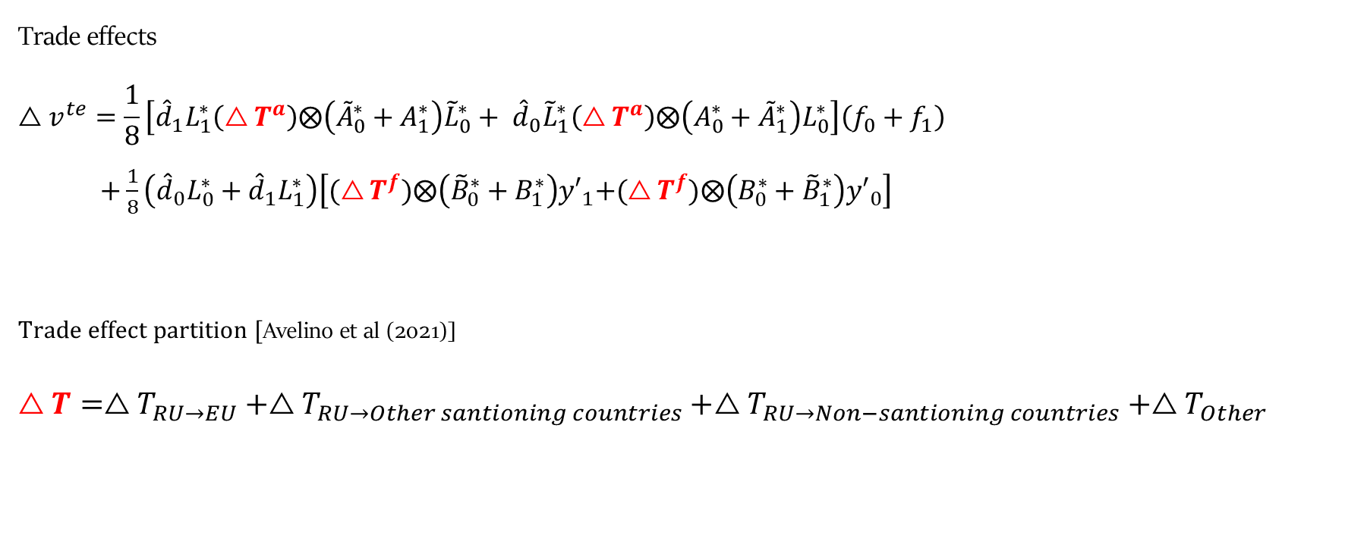
Empirical strategy
Trade effects
$$△v^{te}=\frac{1}{8}\left[{\hat{d}}_{1}L_{1}^{∗}\left(△T^{a}\right)⨂\left({\tilde{A}}_{0}^{∗}+A_{1}^{∗}\right){\tilde{L}}_{0}^{∗}+ {\hat{d}}_{0}{\tilde{L}}_{1}^{∗}\left(△T^{a}\right)⨂\left(A_{0}^{∗}+{\tilde{A}}_{1}^{∗}\right)L_{0}^{∗}\right]\left(f_{0}+f_{1}\right)$$
$+\frac{1}{8}\left({\hat{d}}_{0}L_{0}^{∗}+{\hat{d}}_{1}L_{1}^{∗}\right)\left[{(△T^{f})⨂\left({\tilde{B}}_{0}^{∗}+B_{1}^{∗}\right)y′}_{1}+(△T^{f})⨂\left(B_{0}^{∗}+{\tilde{B}}_{1}^{∗}\right){y′}_{0}\right]$ (7)
Trade effect partition [Avelino et al (2021)]
$$△T=△T_{RU→EU}+△T_{RU→Other santioning countries}+△T_{RU→Non−santioning countries}+△T_{Other}$$

Slide 25
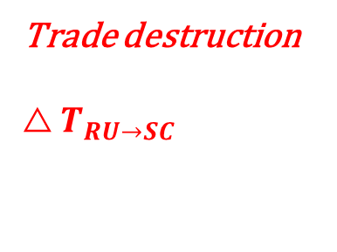
Empirical strategy
$△v^{te}=\frac{1}{8}\left[{\hat{d}}_{1}L_{1}^{∗}\left(△T^{a}\right)⨂\left({\tilde{A}}_{0}^{∗}+A_{1}^{∗}\right){\tilde{L}}_{0}^{∗}+ {\hat{d}}_{0}{\tilde{L}}_{1}^{∗}\left(△T^{a}\right)⨂\left(A_{0}^{∗}+{\tilde{A}}_{1}^{∗}\right)L_{0}^{∗}\right]\left(f_{0}+f_{1}\right)$ + $\frac{1}{8}\left({\hat{d}}_{0}L_{0}^{∗}+{\hat{d}}_{1}L_{1}^{∗}\right)\left[{(△T^{f})⨂\left({\tilde{B}}_{0}^{∗}+B_{1}^{∗}\right)y′}_{1}+(△T^{f})⨂\left(B_{0}^{∗}+{\tilde{B}}_{1}^{∗}\right){y′}_{0}\right]$
Trade destruction
$$△T_{RU→SC}$$
 |  | RU |  |  |  | Sanctioning countries |  |  |  | Non-sanctioning countries
 |  | 1 | 2 | 3 | N+1 | 1 | 2 | 3 | N+1 | 1 | 2 | 3 | N+1
RU | 1 | 0 | 0 | 0 | 0 | 0 | 0 | 0 | 0 | 0 | 0 | 0 | 0
 | OIL | 0 | 0 | 0 | 0 |  |  |  |  | 0 | 0 | 0 | 0
 | 3 | 0 | 0 | 0 | 0 | 0 | 0 | 0 | 0 | 0 | 0 | 0 | 0
 | N+1 | 0 | 0 | 0 | 0 | 0 | 0 | 0 | 0 | 0 | 0 | 0 | 0
Other sanctioning countries | 1 | 0 | 0 | 0 | 0 | 0 | 0 | 0 | 0 | 0 | 0 | 0 | 0
 | 2 | 0 | 0 | 0 | 0 | 0 | 0 | 0 | 0 | 0 | 0 | 0 | 0
 | 3 | 0 | 0 | 0 | 0 | 0 | 0 | 0 | 0 | 0 | 0 | 0 | 0
 | N+1 | 0 | 0 | 0 | 0 | 0 | 0 | 0 | 0 | 0 | 0 | 0 | 0
Non-sanctioning countries | 1 | 0 | 0 | 0 | 0 | 0 | 0 | 0 | 0 | 0 | 0 | 0 | 0
 | 2 | 0 | 0 | 0 | 0 | 0 | 0 | 0 | 0 | 0 | 0 | 0 | 0
 | 3 | 0 | 0 | 0 | 0 | 0 | 0 | 0 | 0 | 0 | 0 | 0 | 0
 | N+1 | 0 | 0 | 0 | 0 | 0 | 0 | 0 | 0 | 0 | 0 | 0 | 0

Slide 26
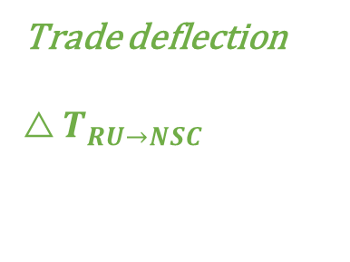
Empirical strategy
$△v^{te}=\frac{1}{8}\left[{\hat{d}}_{1}L_{1}^{∗}\left(△T^{a}\right)⨂\left({\tilde{A}}_{0}^{∗}+A_{1}^{∗}\right){\tilde{L}}_{0}^{∗}+ {\hat{d}}_{0}{\tilde{L}}_{1}^{∗}\left(△T^{a}\right)⨂\left(A_{0}^{∗}+{\tilde{A}}_{1}^{∗}\right)L_{0}^{∗}\right]\left(f_{0}+f_{1}\right)$ + $\frac{1}{8}\left({\hat{d}}_{0}L_{0}^{∗}+{\hat{d}}_{1}L_{1}^{∗}\right)\left[{(△T^{f})⨂\left({\tilde{B}}_{0}^{∗}+B_{1}^{∗}\right)y′}_{1}+(△T^{f})⨂\left(B_{0}^{∗}+{\tilde{B}}_{1}^{∗}\right){y′}_{0}\right]$
Trade deflection
$$△T_{RU→NSC}$$
 |  | RU |  |  |  | Sanctioning countries |  |  |  | Non-sanctioning countries
 |  | 1 | 2 | 3 | N+1 | 1 | 2 | 3 | N+1 | 1 | 2 | 3 | N+1
RU | 1 | 0 | 0 | 0 | 0 | 0 | 0 | 0 | 0 | 0 | 0 | 0 | 0
 | OIL | 0 | 0 | 0 | 0 | 0 | 0 | 0 | 0
 | 3 | 0 | 0 | 0 | 0 | 0 | 0 | 0 | 0 | 0 | 0 | 0 | 0
 | N+1 | 0 | 0 | 0 | 0 | 0 | 0 | 0 | 0 | 0 | 0 | 0 | 0
Other sanctioning countries | 1 | 0 | 0 | 0 | 0 | 0 | 0 | 0 | 0 | 0 | 0 | 0 | 0
 | 2 | 0 | 0 | 0 | 0 | 0 | 0 | 0 | 0 | 0 | 0 | 0 | 0
 | 3 | 0 | 0 | 0 | 0 | 0 | 0 | 0 | 0 | 0 | 0 | 0 | 0
 | N+1 | 0 | 0 | 0 | 0 | 0 | 0 | 0 | 0 | 0 | 0 | 0 | 0
Non-sanctioning countries | 1 | 0 | 0 | 0 | 0 | 0 | 0 | 0 | 0 | 0 | 0 | 0 | 0
 | 2 | 0 | 0 | 0 | 0 | 0 | 0 | 0 | 0 | 0 | 0 | 0 | 0
 | 3 | 0 | 0 | 0 | 0 | 0 | 0 | 0 | 0 | 0 | 0 | 0 | 0
 | N+1 | 0 | 0 | 0 | 0 | 0 | 0 | 0 | 0 | 0 | 0 | 0 | 0
Notes:
We would then apply the same principle for every country/region pair we are interested to study.
For trade diversion with non sanctioning countries, etc

Slide 27
Empirical strategy – our case study
SC bans oil imports from RU
Trade destruction
Trade deflection
 |  | RU |  |  |  | Sanctioning countries |  |  |  | Non-sanctioning countries
 |  | 1 | 2 | 3 | N+1 | 1 | 2 | 3 | N+1 | 1 | 2 | 3 | N+1
RU | 1
 | 2
 | 3
 | N+1
Sanctioning countries | 1
 | 2
 | 3
 | N+1
Non-sanctioning countries | 1
 | 2
 | 3
 | N+1

Slide 28
Empirical strategy – our case study
Group | Countries
Sanctioning countries | European Union member states; Australia; Canada; Switzerland; United Kingdom; Japan; South Korea; Norway; United States; Singapore
Non-sanctioning countries | Brazil; China; Indonesia; India; Mexico; Turkey; China–Taiwan; Bangladesh; Malaysia; Philippines; Thailand; Vietnam; Kazakhstan; Mongolia; Sri Lanka; Pakistan; Fiji; Laos; Brunei; Bhutan; Kyrgyzstan; Cambodia; Moldova; Nepal; China–Hong Kong, Rest of the world
^{[1]} While predominantly composed of non-sanctioning economies, the “Rest of the World” aggregate also includes a small number of sanctioning countries not separately identified in the ADB dataset: North Macedonia, Albania, Kosovo, Bosnia and Herzegovina, Montenegro, Liechtenstein, Monaco, and Iceland.

Slide 29
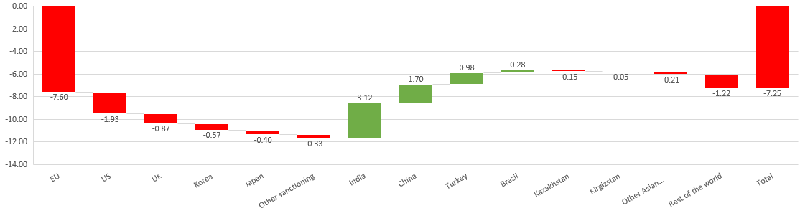
Results – exports
Trade effects in Russia – Exports 2021-2024 in % 2021 Russia GVA
Total trade effects – exports
Source: Asian Development Bank; Own calculations.

Slide 30
Results – exports
Trade effects in Russia – Exports 2021-2024 in % 2021 Russia GVA
Total trade effects – exports
Source: Asian Development Bank; Own calculations.
Total Sanctioning: - 11.7%
Total Non- sanctioning: - 4.45%

Slide 31
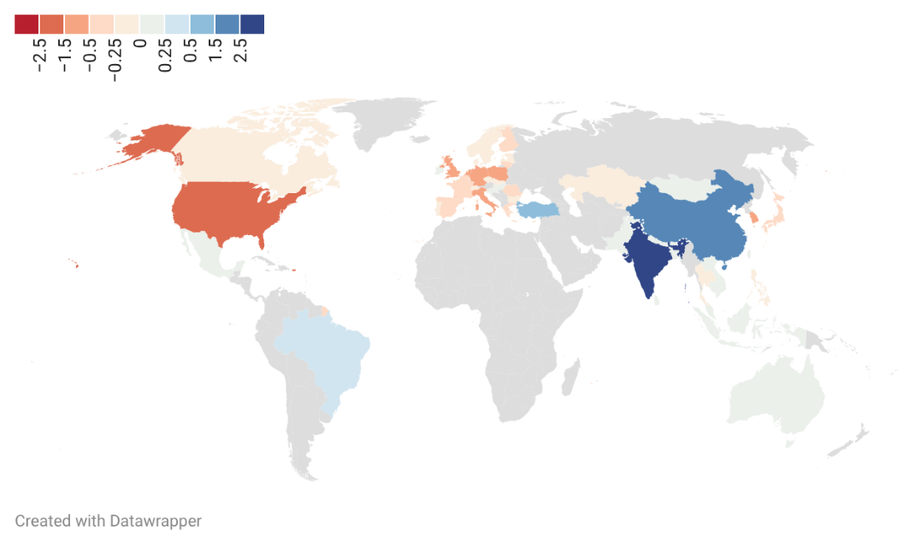
Results – exports
Trade effects in Russia – Total exports 2021-2024 – country overview in % 2021 Russia GVA
Source: Asian Development Bank; Own calculations.

Slide 32
Results – exports
Trade effects in Russia – Total exports 2021-2024 – Sanctioning countries’ detail in % 2021 Russia GVA
Source: Asian Development Bank; Own calculations.

Slide 33
Results – exports
Trade effects in Russia – Total exports 2021-2024: Non-sanctioning countries’ detail in % 2021 Russia GVA
Source: Asian Development Bank; Own calculations.

Slide 34
Results
Trade effects in Russia – Total exports 2021-2024: Non-sanctioning countries’ detail in % 2021 Russia GVA
Source: Asian Development Bank; Own calculations.

Slide 35
Results
Trade effects in Russia – Total exports 2021-2024: Non-sanctioning countries’ detail in % 2021 Russia GVA
Source: Asian Development Bank; Own calculations.
Medium-low tech detail
High-tech detail

Slide 36
Results – exports
Export effects in Russia (2021-2024)
in % 2021 Russia GVA
 | All sectors (1) | Agriculture (2) | Mining and utilities (3) | Manufacturing |  |  |  |  |  |  | Services
 |  |  |  | Low tech (4) | Medium-low tech (5) | of which, Coke, refined petro (5.1) | of which, Basic and fabricated metals (5.2) | Medium-high and high tech (6) | of which, Chemicals (6.1) | of which, Transport equip. (6.2) | Transport and communication (7) | Other services (8)
Sanctioning countries | -11.70 | -0.07 | -4.65 | -0.84 | -4.83 | -2.96 | -1.75 | -0.64 | -0.40 | -0.08 | -0.36 | -0.30
EU | -7.60 | -0.04 | -3.66 | -0.49 | -2.48 | -1.61 | -0.77 | -0.49 | -0.32 | -0.03 | -0.27 | -0.17
US | -1.93 | -0.01 | -0.32 | -0.13 | -1.35 | -0.93 | -0.42 | -0.07 | -0.03 | -0.02 | -0.02 | -0.02
UK | -0.87 | -0.01 | -0.16 | -0.03 | -0.63 | -0.25 | -0.38 | -0.02 | -0.01 | -0.00 | -0.02 | -0.00
Korea | -0.57 | -0.01 | -0.24 | -0.07 | -0.20 | -0.16 | -0.04 | -0.02 | -0.01 | -0.01 | -0.00 | -0.02
Japan | -0.40 | -0.00 | -0.24 | -0.06 | -0.07 | -0.01 | -0.05 | -0.00 | -0.00 | -0.00 | -0.01 | -0.03
Other sanctioning | -0.33 | -0.00 | -0.03 | -0.06 | -0.09 | 0.01 | -0.09 | -0.05 | -0.04 | -0.00 | -0.05 | -0.05
Non-sanctioning countries | 4.45 | -0.19 | 0.36 | 0.17 | 4.92 | 4.04 | 0.77 | -0.24 | -0.36 | -0.16 | -0.18 | -0.40
India | 3.12 | 0.01 | 2.61 | 0.08 | 0.36 | 0.35 | 0.01 | 0.05 | 0.06 | -0.01 | 0.02 | -0.00
China | 1.70 | 0.00 | -0.94 | 0.25 | 1.39 | 0.96 | 0.43 | 0.88 | 0.13 | 0.54 | 0.17 | -0.05
Turkey | 0.98 | -0.03 | 0.03 | 0.02 | 0.87 | 0.67 | 0.20 | 0.10 | 0.03 | -0.00 | -0.02 | 0.01
Brazil | 0.28 | 0.01 | -0.07 | -0.01 | 0.43 | 0.46 | -0.03 | -0.11 | -0.11 | -0.00 | 0.01 | 0.03
Kazakhstan | -0.15 | -0.00 | 0.04 | -0.10 | 0.03 | 0.03 | 0.02 | -0.13 | -0.03 | -0.04 | -0.01 | 0.01
Kirgizstan | -0.05 | -0.00 | -0.00 | -0.02 | -0.01 | -0.00 | -0.01 | -0.01 | -0.00 | -0.01 | -0.01 | 0.00
Other Asian countries | -0.21 | 0.01 | -0.15 | -0.05 | -0.06 | 0.09 | -0.15 | 0.05 | 0.02 | 0.03 | 0.01 | -0.02
Rest of the world | -1.22 | -0.18 | -1.15 | 0.01 | 1.93 | 1.49 | 0.30 | -1.07 | -0.45 | -0.67 | -0.34 | -0.37
Total | -7.25 | -0.26 | -4.29 | -0.67 | 0.09 | 1.08 | -0.99 | -0.88 | -0.75 | -0.24 | -0.54 | -0.70

Slide 37
Results – exports
Export effects in Russian sectors (2021-2024)
in % 2021 sectorial GVA

Slide 38
Results – Imports
Import effects in Russian sectors (2021-2024)
in % 2021 sectorial GVA

Slide 39
Results – Imports
Import effects in Russian by type of import and import partner (2021-2024)
in % of the sanctioning/non-sanctioning effect

Slide 40
Conclusions
Post-2022 trade reconfiguration caused a large negative shock to Russian GVA.
Main driver: collapse of exports to sanctioning economies, especially the EU. Import effects were smaller, even at the sectorial level.
Trade deflection softened the shock, but did not offset it in most sectors. Alternative markets — mainly India, China, Turkey and Brazil — could not fully replace the income content of pre-war trade.
Uneven losses:
  Mining and quarrying: largest and least compensated losses.
  Refined petroleum: stronger substitution through non-sanctioning markets.
  China became the broadest substitute partner, both for exports and imports, namely technology-intensive imports.
Overall, sanctions eroded Russia’s external income base while increasing reliance on a narrower set of partners, namely China for both exports and imports.

Slide 41
Limitations
Limited application to sanctions due to sectorial and temporal mismatch
Statistical limitation, manipulation and shadow trade;

Slide 42
Possible extensions
Zoom out geographical scope (reciprocal effects in the EU, for instance).
Analyze final demand effect – Public consumption growth amid transition to war economy.

Slide 43
Income effects of trade destruction and deflection in post-2022 Russia
A Structural Decomposition Analysis
Diogo N. Sousa
PhD Candidate at University of Coimbra
João Pedro Ferreira
University of Virginia

