Slide 1
Economic Effects and Transmission Mechanisms of China's Digital Economy Industries
Presenter: Yufei Jia
Date:June26,2026
32nd International Input-Output Association Conference

Slide 2
Contents
01 Research Background
02 Research Questions and Scope
03 Methodology
04 Empirical Results
05 Conclusions and Policy Implications

Slide 3
01
Research Background
Empirical Context and Theoretical Basis

Slide 4
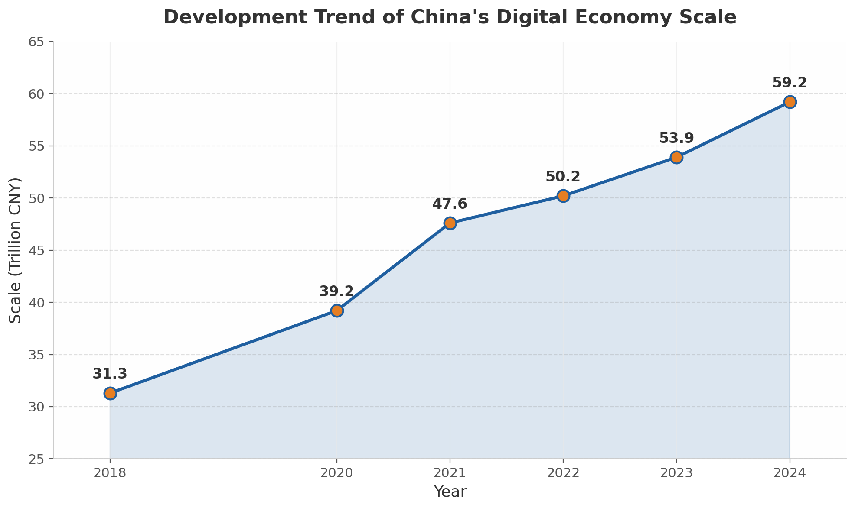

Empirical Context: The Digital Economy as a Strategic Driver of Economic Growth
National Strategic Priorities
• The 15th Five-Year Plan incorporates the expansion of core digital economy industries into major national strategies
• The reform agenda calls for institutional arrangements that deepen digital-real economy integration
• The digital economy has become deeply embedded across the national economy
Development Trends
From the 13th to the 14th and now the 15th Five-Year Plan, developing the digital economy and building Digital China have remained major national strategic objectives.
• In 2024, the digital economy reached RMB 59.2 trillion, accounting for 43.8% of GDP
• Value added of core industries reached RMB 14.1 trillion, accounting for 10.5% of GDP
• The contribution of total factor productivity increased from 16.30% to 23.75%
4

Slide 5
Theoretical Basis: Contributions and Gaps in the Literature
Main Strands of Existing Research
Limitations of Existing Studies
Statistical Measurement
Composite indicator systems; value-added measurement based on national accounts; industrial linkage measurement within an input-output framework
1
Traditional IO models focus mainly on production linkages and cannot readily incorporate factor-income distribution, corporate income, and household-consumption feedback within a unified circular-flow framework
Economic Effects
Cross-country studies reveal substantial heterogeneity; evidence for China shows positive effects on sustainable development, industrial upgrading, and regional growth
2
Most existing studies rely on single-year or static cross-sectional data, making it difficult to trace dynamic changes in the channels through which the digital economy drives aggregate output
Research Entry Point:This study introduces the Social Accounting Matrix (SAM) and Structural Path Analysis (SPA) to measure the economic effects of the digital economy and unpack its transmission mechanisms, extending the analysis from production linkages to the economy-wide circular flow.
5

Slide 6
02
Research Questions and Scope
Core Questions and Analytical Framework

Slide 7
Research Question: How Are the Macroeconomic Effects of the Digital Economy Transmitted?
1
Evolution of Scale and Structure
How have the scale, structure, and degree of digitalization of China's digital economy industries evolved?
2
Heterogeneity in Multiplier Effects
What are the macroeconomic multiplier effects of the digital economy, and how do they vary across sector types?
3
Identification of Transmission Paths
What are the specific transmission paths and mechanisms through which the digital economy affects the macroeconomy?
Analytical Progression:From scale measurement to effect evaluation and then to mechanism identification, progressively revealing the macroeconomic impacts of the digital economy
7

Slide 8
Research Scope: A Four-Dimensional Analytical Framework
1
Scale Share
2
Degree of Digitalization
Measure the relative share and trend of total output in digital sectors
Measure the contribution of digital sectors to total backward linkages
induced by each sector
3
SAM Multiplier Effects
4
Structural Path Analysis
Decompose the aggregate macroeconomic stimulus of digital economy
sectors and its transmission sources
Identify how exogenous demand shocks to digital sectors diffuse through
the account system
Data and Analytical Tools
• Data source: Input-output tables released by the National Bureau of Statistics for 2018-2023
• Core data: Industrial boundaries are defined according to the Statistical Classification of the Digital Economy and Its Core Industries (2021), with digital-economy separation coefficients used to isolate partially digital sectors.
• Analytical tools: Digital-economy SAMs are constructed for the three benchmark years, covering commodities, activities, factors, institutions, capital, inventory changes, and the rest of the world.
8

Slide 9
03
Methodology
SAM Multiplier Model and Structural Path Analysis

Slide 10
Research Object: Four Categories of Core Digital Economy Industries Classification
Classification basis: Statistical Classification of the Digital Economy and Its Core Industries (2021), National Bureau of Statistics
Digital Product Manufacturing
Digital Product Services
Digital Technology Applications
Digital-Factor-Driven
Industries
Digital Product Manufacturing
Digital Product Services
Digital Technology Applications
Core role: Manufacturing sectors that provide the material foundation for the digital economy
Representative industries:
• Manufacturing of computers and components
• Manufacturing of communication terminal equipment
• Manufacturing of smart consumer devices
• Electronic components and specialized materials
Core role: Distribution and service support for digital products
Representative industries:
• Wholesale, retail, and leasing of digital products
• Repair services for digital products
• After-sales services related to digital products
Core role: Application of digital technologies to empower industries
Representative industries:
• Software development and information technology services
• Internet-related services
• Telecommunications, broadcasting, television, and satellite transmission
• Emerging information technology services
Digital-Factor-Driven Industries
Core role: Innovation and financial services driven by data resources
Representative industries:
• Internet production and service platforms
• Data-resource and property-rights trading
• Digital content and media services
The four-category classification captures the full value-chain hierarchy from hardware support -> distribution services -> technology applications -> data-driven activities.
10

Slide 11
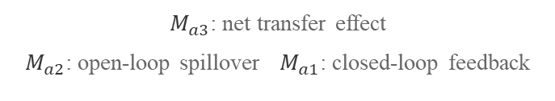
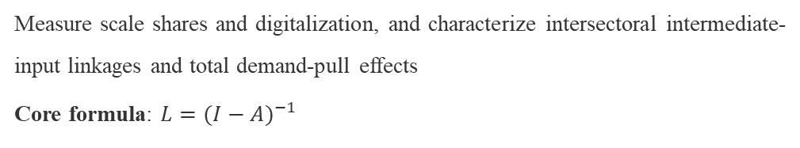

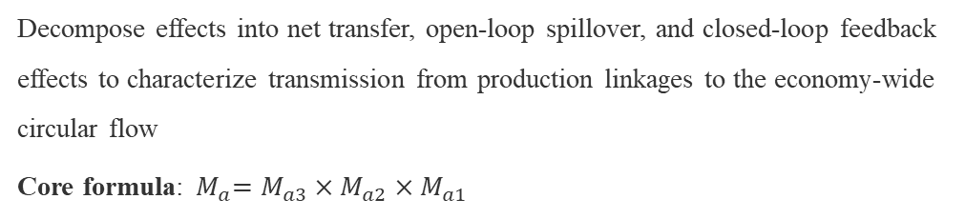




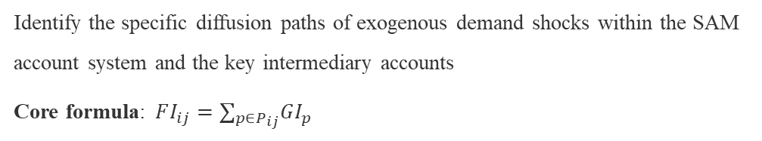
Analytical Framework: From the IO Model to SAM-Based General Equilibrium
1
IO Model
Scale Share
$$D_{t}=∑_{i∈Ω_{d}}X_{i}/∑_{j=1}^{n}X_{j}×100\%$$
Measure scale shares and digitalization, and characterize intersectoral intermediate-input linkages and total demand-pull effects
Core formula: ${L=(I−A)}^{−1}$
Degree of Digitalization
$$dig_{j}=∑_{i∈Ω_{d}}b_{ij}⋅f_{j}/∑_{i=1}^{n}b_{ij}⋅f_{j}$$
2
SAM Multiplier Decomposition
Multiplier decomposition
$${ M}_{a}=M_{a3}×M_{a2}×M_{a1}$$
Decompose effects into net transfer, open-loop spillover, and closed-loop feedback effects to characterize transmission from production linkages to the economy-wide circular flow
Core formula:${ M}_{a}=M_{a3}×M_{a2}×M_{a1}$
$M_{a3}$: net transfer effect
$M_{a2}$: open-loop spillover $M_{a1}$: closed-loop feedback
3
Structural Path Analysis
Path decomposition
$$FI_{ij}=∑_{p∈P_{ij}}GI_{p}$$
Identify the specific diffusion paths of exogenous demand shocks within the SAM account system and the key intermediary accounts
Core formula:$FI_{ij}=∑_{p∈P_{ij}}GI_{p}$
$FI_{ij}$: total influence
$GI_{p}$: global influence${ P}_{ij}$: path set
11

Slide 12
04
Empirical Results
Empirical Findings Based on the SAM Model

Slide 13
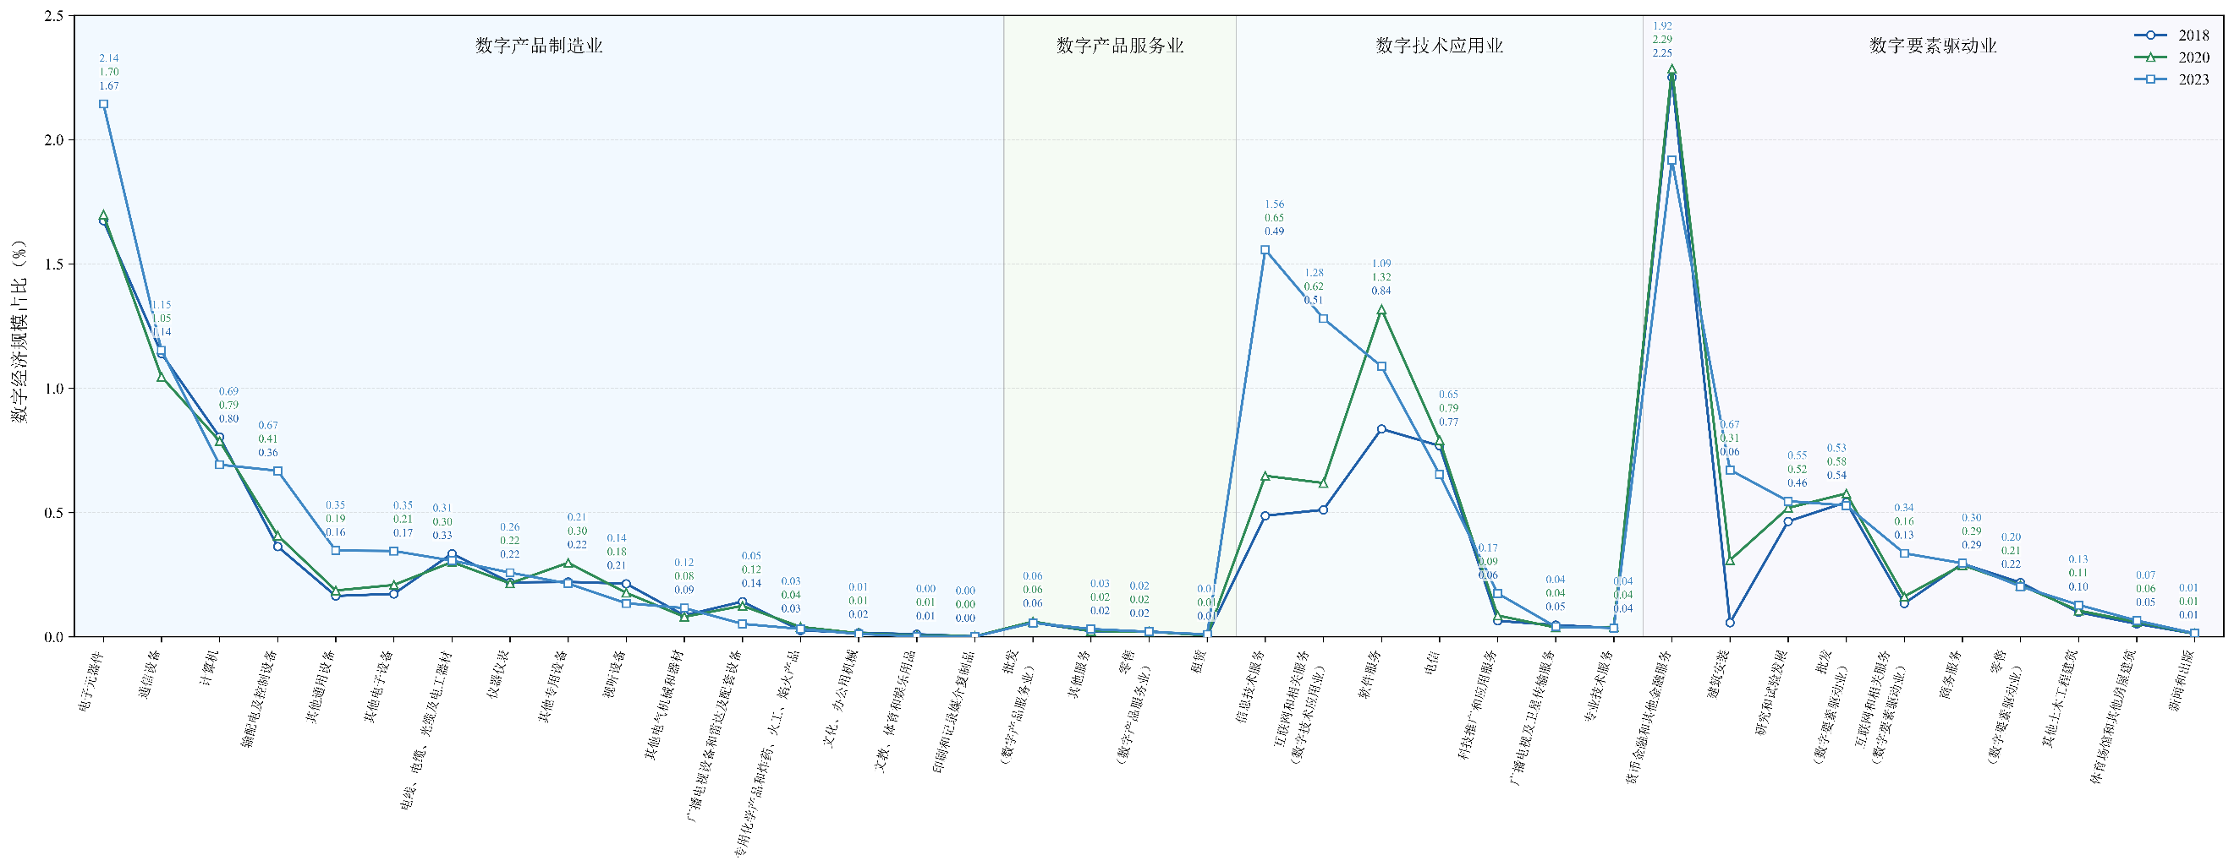
Finding 1: Evolution of the Scale Structure of Digital Economy Sub-sectors
Key Findings
During 2018-2023, China's digital economy scale share continued to rise, from 2018: 12.57% to 2020: 13.77%, and by 2023 further increased to 16.13%.
Digital Product Services maintained a relatively limited sharerising only from 0.11% to 0.12% during 2018-2023, indicating a limited relative weight in the digital economy scale structure.
Digital Technology Applications recorded the most pronounced increase in shareand showed the largest share gain among the four categories, indicating that it has become a core force driving structural change.
Digital Product Manufacturing its share rose from 2018: 5.59% to 2023: 6.48%, ranking first , suggesting that electronic components, communication equipment, computers, and related sectors remain important components of the digital economy industrial structure.
Digital-Factor-Driven Industries changed relatively steadily overall, suggesting that monetary and other financial services, R&D, and business services remain important supports within the digital economy industrial structure.
13

Slide 14
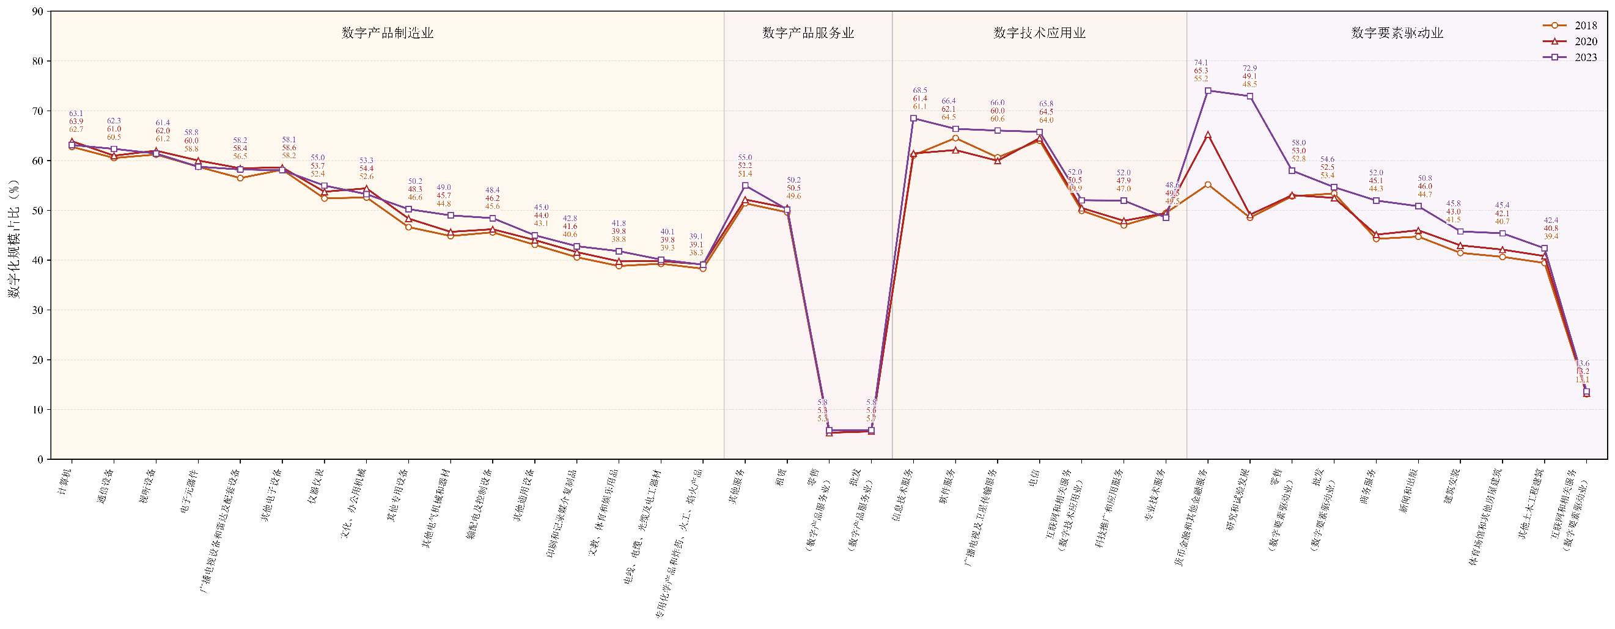
Finding 2: Evolution of Digitalization across Digital Economy Sub-sectors
Key Findings
During 2018-2023, China's degree of digitalization continued to increase, indicating that digital economy sectors contributed a rising share to the total backward linkages induced by final demand, and that their embedded support for upstream industrial chains strengthened.
Digital Technology Applications show the highest degree of digitalization; Digital Product Manufacturing remains at a high level; Digital-Factor-Driven Industries improve most markedly; and Digital Product Services remain relatively low.
Finding 1 and Finding 2 together show that, during 2018-2023, the digital economy expanded not only in its own scale share but also in its support for the industrial chains of related sectors.
14

Slide 15
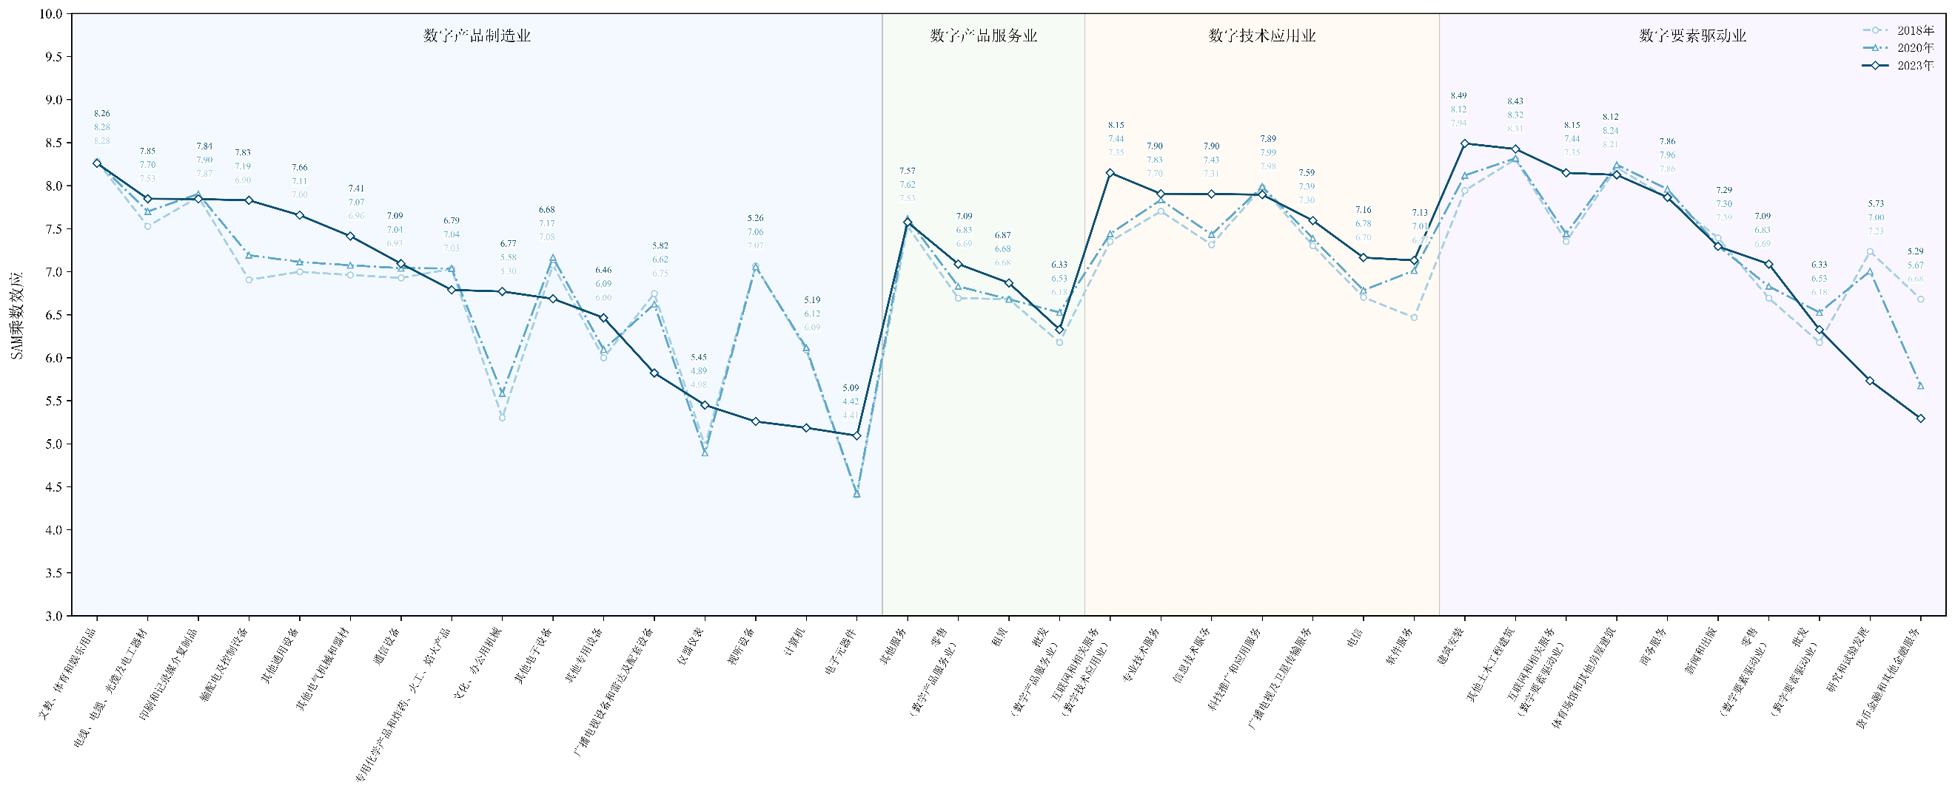
Finding 3: SAM Multiplier Effects of the Digital Economy, 2018-2023
Key Findings
During 2018-2023, SAM multipliers for digital economy sub-sectors generally ranged from 4.4 to 8.5, remaining high overall but showing no uniform upward or downward trend, with clear sectoral heterogeneity.
Digital Technology Applications and Digital Product Manufacturing exhibit relatively strong multiplier effects.
Digital Product Services and Digital-Factor-Driven Industries show weaker but steadily improving multiplier effects.
15

Slide 16
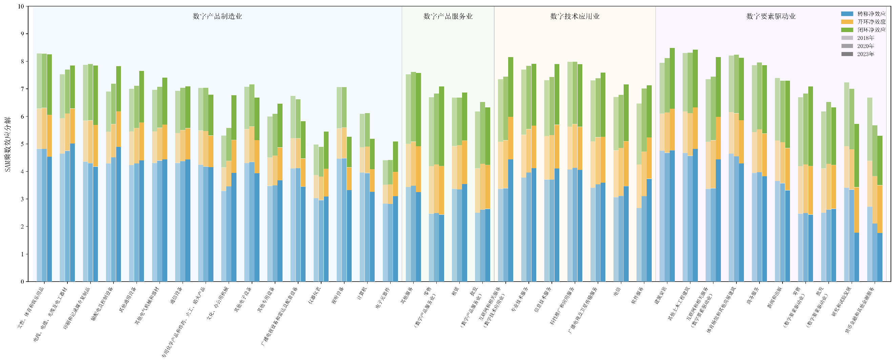
Finding 4: Decomposition of Digital Economy SAM Multiplier Effects, 2018-2023
Key Findings
Net transfer effects (production linkages) constitute the main transmission channel; open-loop net effects (income spillovers) and closed-loop net effects (consumption feedback) contribute differently across sectors.
Digital Product Manufacturing is mainly characterized by production-linkage transmission; Digital Product Services and Digital-Factor-Driven Industries show more pronounced income-consumption feedback; while Digital Technology Applications combine rising scale shares, a high degree of digitalization, and strong aggregate multiplier effects.
The macroeconomic impacts of digital economy sectors are highly heterogeneous; these impacts are transmitted through production linkages, factor allocation, corporate income, and household-income feedback, i.e., multiple channels, which jointly shape the overall effect.Different sector types therefore play distinct roles within the economic circular flow.
16

Slide 17
Finding 5: Differentiated Transmission Mechanisms across Four Digital Economy Categories
Production-Linkage Type
Consumption-Feedback Type
Integrated-Transmission Type
Factor-Diffusion Type
Digital Product Manufacturing
Digital Product Services
Digital Technology Applications
Digital-Factor-Driven
Industries
Forms industrial linkages through key components and basic raw materials
Core path: telecommunications -> electronic components -> equipment manufacturing
Reflects strong production linkages between equipment manufacturing and core electronic components
Generates income feedback by transmitting labor compensation into household accounts
Core path: internet services -> household income -> consumption -> production
Reflects the linkage mechanism between service sectors and household consumption
Combines production linkages with account-feedback transmission
Core path: software -> corporate income -> investment -> output
Connects digital services, hardware manufacturing, and factor-income accounts
Diffuses mainly through skilled labor and capital accounts
Core path: finance -> capital -> skilled labor -> output
Reflects the transmission of innovation-factor inputs and skilled-labor compensation
The macroeconomic impacts of the digital economy are jointly generated through production linkages, factor allocation, corporate income, and household-income feedback and other channels.
Notes on SPA Method: The path search starts from 34 digital-economy activity accounts and ends at 176 activity, factor, household, and enterprise accounts. The maximum path length is set to eight layers, with branch-pruning and total-influence significance thresholds applied. Core paths are selected until the cumulative contribution reaches 80%. The differentiated transmission mechanisms provide evidence for targeted policy design.
17

Slide 18
05
Conclusions and Recommendations
Promoting Deep Digital-Real Economy Integration through Targeted Policies

Slide 19
Policy Implications: Targeted Policies for Deep Digital-Real Economy Integration
Digital Product
Manufacturing
Digital Product
Services
Digital Technology
Applications
Digital-Factor-Driven
Industries
Strengthen the core manufacturing base, improve key intermediate goods and supporting equipment, and enhance the autonomy and resilience of industrial chains.
Enhance the income-generating role of service sectors and smooth the channels through which service supply feeds back into household consumption.
Strengthen digital empowerment of the real economy and promote deeper penetration of digital services into manufacturing, construction, and other traditional industries.
Strengthen support from R&D, innovation, and financial services, and improve the allocation efficiency of capital, technology, talent, and other factors.
Identifying differentiated transmission mechanisms provides decision support for coordinated industrial development strategies, deep digital-real economy integration and high-quality economic development.
19

Slide 20
Thank You
Comments and Suggestions Are Welcome
A Study on the Economic Effects and Transmission Mechanisms of China's Digital Economy Industries
32nd International Input-Output Association Conference

