Slide 1

Do Water Endowments Shape Trade in Agri-Food Virtual Water? A Heckscher-Ohlin-Vanek Test for Finland
Yue Fu, Xavier Irz
Department of Economics and Management, University of Helsinki
IIOA conference presentation

Slide 2
INTRODUCTION
The increasing importance of virtual water trade
Climate change exaggerates water scarcity issue for agricultural production
Agrifood trade redistributes water use globally through virtual water trade (VWT)
Over the past three decades, global VWT has tripled, with agriculture accounting for roughly 66% (Mekonnen et al., 2024)
Understanding drivers and distributional effects of VWT is important for sustainable water management and food security
→ Among possible VWT drivers, water endowment is an intuitive starting point

Slide 3

INTRODUCTION
Water endowment as a driver of specialization and VWT
Rooted in economic theory of trade (Ansink, 2010):
Empirical findings are mixed,
e.g. Delbourg & Dinar (2020), Fracasso et al. (2016)
Heckscher-Ohlin-Vanek (HOV) theorem:
countries which are relatively abundant in water are net exporters of virtual water
Endowment measures
• Relative to world absorption
renewable water per capita
precipitation per capita
• Direct VWT assessment (factor content of trade)
• Enable test of “VWT claim”
→ overestimation & absolute abundance
• Rare application to water
Slide 2 of 2

Slide 4
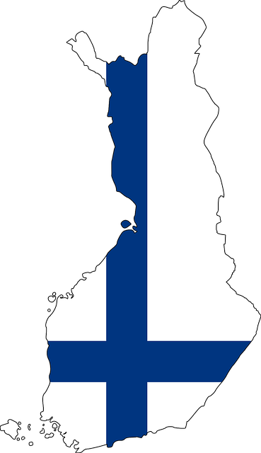
INTRODUCTION
Contributions and Novelty
Empirical study of water endowments in explaining VWT patterns under the HOV framework
Two novel aspects:
💧 Water endowment measures
🌎 Focus on water abundant regions
Production-based
endowment
Natural
endowment
Why Finland
Water actually used for production
Water potentially available for production
rich in water resources,
but net importer of virtual water
↓
VWT adjustment potential

Slide 5
INTRODUCTION
Research questions
What is the patterns of VWT at country level and Finnish bilateral level?
Can water endowments explain these VWT patterns?
Empirical scope:
Global + Finnish bilateral
Whole economy + agrifood sector
What are the endowment-based VWT adjustment potentials?
How are they linked to countries’ water stress?

Slide 6

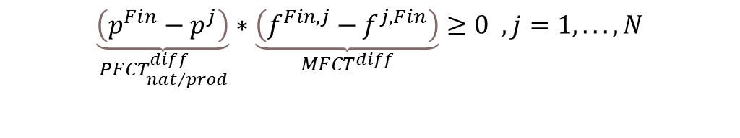
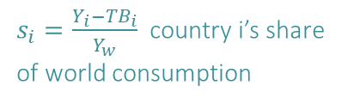


METHODS & DATA
HOV framework applied to water
Method from: Trefler and Zhu (2010), Davis et al. (1997)
HOV theorem: countries which are relatively abundant in water are net exporters of water
Vi = water endowment
Predicted factor content of trade
$$\left(PFCT\right) V^{i}−\frac{s^{i}}{s^{J}}V^{J} ≡ F^{i}=AT^{i}\left(MFCT\right)$$
Measured factor content of trade
$s_{i}=\frac{Y_{i}−{TB}_{i}}{Y_{w}}$ country i’s share of world consumption
factor requirement
$A=D∗L$
Constructed with production-based and natural water endowments respectively
Leontief inverse
direct factor requirement
In efficiency transformed (Liboreiro, 2025)
(bilateral version): whether greater water abundance in Finland relative to country j implies net exports of virtual water from Finland to country j
Method from: Yan et al. (2020)
$$\underset{{PFCT}_{nat/prod}^{diff}}{\underbrace{\left(p^{Fin}−p^{j}\right)}}∗\underset{{MFCT}^{diff}}{\underbrace{\left(f^{Fin,j}−f^{j,Fin}\right)}}≥0 , j=1,..., N$$
$$p^{i}=\frac{{V^{i}}/{V^{J}}}{{s^{i}}/{s^{J}}}$$
Relative water abundance (PFCT)
Bilateral trade flow (MFCT)

Slide 7
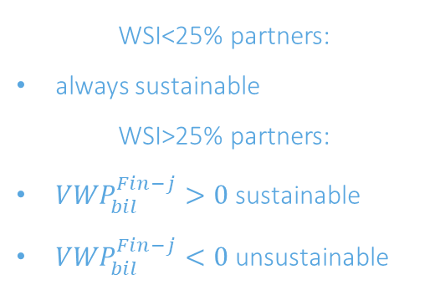
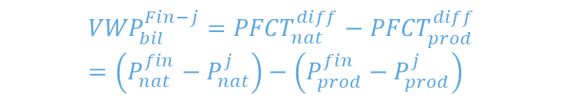
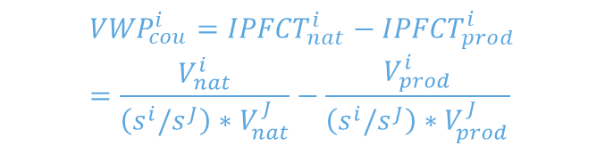
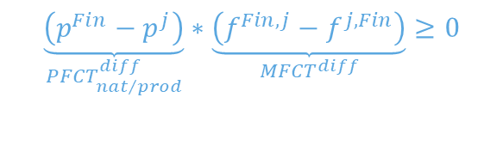
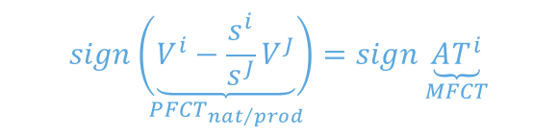
METHODS & DATA
Research questions & Implementation
Q1. Can water endowment explain current VWT patterns?
Q2. What are the endowment-based VWT adjustment potentials (VWP)?
Q3. How are these adjustments linked to local water stress?
Compare PFCT & MFCT
VWP = PECT_nat – PFCT_prod
=> six types of directional VWT adjustments
Compare VWP & partner’s water stress indicator (WSI)
=> Directionally sustainable / unsustainable
Sign test
Kendall rank correlation (Bowen et al., 1987)
$$sign\underset{{PFCT}_{nat/prod}}{\left(\underbrace{V^{i}−\frac{s^{i}}{s^{J}}V^{J}}\right)}=sign\underset{MFCT}{\underbrace{AT^{i}}}$$
$${VWP}_{cou}^{i}={IPFCT}_{nat}^{i}−{IPFCT}_{prod}^{i}=\frac{V_{nat}^{i}}{\left(s^{i}/s^{J}\right)∗V_{nat}^{J}}−\frac{V_{prod}^{i}}{\left(s^{i}/s^{J}\right)∗V_{prod}^{J}}$$
WSI<25% partners:
always sustainable
WSI>25% partners:
${VWP}_{bil}^{Fin−j}>0$ sustainable
${VWP}_{bil}^{Fin−j}<0$ unsustainable
Country level
$$\underset{{PFCT}_{nat/prod}^{diff}}{\underbrace{\left(p^{Fin}−p^{j}\right)}}∗\underset{{MFCT}^{diff}}{\underbrace{\left(f^{Fin,j}−f^{j,Fin}\right)}}≥0$$
$${VWP}_{bil}^{Fin−j}={PFCT}_{nat}^{diff}−{PFCT}_{prod}^{diff}=\left(P_{nat}^{fin}−P_{nat}^{j}\right)−\left(P_{prod}^{fin}−P_{prod}^{j}\right)$$
Finnish bilateral

Slide 8


METHODS & DATA
Data sources
Bilateral trade: EXIOBASE3 (Version 3.9.6) (Stadler et al., 2025)
product-by-product monetary MRIO table, year 2019
200 products, incl. 22 agrifood products => 13 agriproduct categories
44 countries + 5 rest-of-world regions
Blue water
Water endowment
Production-based endowment (water account in EXIOBASE3):
    sum of direct water use across all goods produced in a country
Natural endowment (literature):
    Green (Schyns et al., 2019): total available green water flow minus the share reserved for nature
    Blue (Vanham et al., 2022): natural renewable water minus environmental flow (EF)
Total (green + blue) water
set at 80% of natural flow (high EF protection)
Water stress indicator (SDG6.4.2): freshwater withdrawal / available freshwater resources (Vanham et al., 2018)

Slide 9
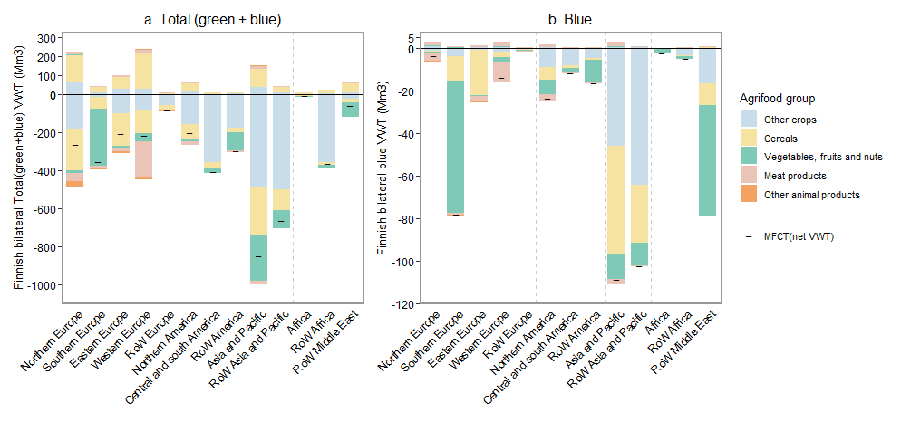
RESULTS
Finnish VWT patterns at whole economy & agrifood level
Table 1. Finnish VWT at whole economy and agrisector level, for total (green and blue) water and blue water.
 | Whole economy |  | agrifood sector
 | Total water | Blue water | Total water | Blue water
Finnish VW export (Mm3) | 1108.1 | 128.1 | 994.6 | 14.6
Finnish VW import (Mm3) | 5070.9 | 605.8 | 4948.7 | 483.7
Finnish net VWT (Mm3) | -3962.8 | -477.7 | -3954.1 | -469.1
Imported VW as share of total VW required to sustain domestic demand | 72.2% | 91.1% | 72.1% | 95.5%
Net importer of both total (green + blue) and blue virtual water
Large water import reliance
Finnish bilateral agriproduct VWT
net importer of total and blue VW across trading regions
Net VWT with trading region
Figure 1. Finnish bilateral a. total (green + blue) and b. blue virtual water export (above x-axis), import (below x-axis), and net VWT (or MFCT), at agrifood products level aggregated by trading region.

Slide 10
RESULTS
HOV test in terms of water
(Q1: Can water endowment explain the patterns of VWT?)
Table 2. HOV sign test and Kendall rank correlation results for country-level and Finland’s bilateral virtual water trade at the whole-economy and agrisector levels
Table 3. Sign test result at Finnish bilateral agriproduct level and Kendall correlation between PFCT and MFCT, with production and natural endowment
 | Type of test | Sign test result |  |  |  | Kendall correlation PFCT & MFCT
 |  | Total _prod | Total _nat | Blue _ prod | Blue _ nat | Total _ prod | Total _nat | Blue _ prod | Blue _ nat
Country level | Whole economy | 0.76 | 0.59 | 0.88 | 0.53 | 0.53*** | 0.32*** | 0.60*** | 0.04
 | Agrisector | 0.82 | 0.67 | 0.90 | 0.71 | 0.42*** | 0.35*** | 0.56*** | 0.21**
Finland Bilateral | Whole economy | 0.98 | 0.33 | 0.81 | 0.44 | 0.48*** | 0.20** | 0.62*** | 0.08***
 | Agrisector | 0.88 | 0.25 | 0.92 | 0.6 | 0.42*** | 0.19* | 0.63*** | 0.25**
 | Sign test result |  |  |  | Kendall correlation PFCT & MFCT
Agriproduct | Total_ prod | Total_ nat | Blue_ prod | Blue_ nat | Total_ prod | Total_ nat | Blue_ prod | Blue_ nat
rice | 1.00 | 1.00 | 1.00 | 1.00 | 0.39** | 0.37** | 0.41*** | 0.24*
wheat | 0.77 | 0.40 | 1.00 | 1.00 | 0.62*** | 0.4*** | 0.79*** | 0.68***
cereal | 0.69 | 0.50 | 0.98 | 0.81 | 0.37*** | 0.25** | 0.76*** | 0.59***
vege_fru_nut | 0.98 | 0.50 | 0.81 | 0.60 | 0.34*** | 0.21** | 0.62*** | 0.38***
oilseed | 0.79 | 0.38 | 0.92 | 0.81 | 0.62*** | 0.43*** | 0.71*** | 0.47***
sugar | 0.75 | 0.50 | 0.88 | 0.48 | 0.48*** | 0.29*** | 0.65*** | 0.48***
fiber | 1.00 | 1.00 | 1.00 | 1.00 | 0.65*** | 0.56*** | 0.73*** | 0.42***
crop_oth | 0.85 | 0.38 | 0.92 | 0.56 | 0.51*** | 0.35*** | 0.61*** | 0.46***
cattle_beef | 0.69 | 0.54 | 0.71 | 0.75 | 0.47*** | 0.17* | 0.37*** | 0.3***
pig_pork | 0.79 | 0.52 | 0.65 | 0.54 | 0.53*** | 0.10 | 0.35*** | 0.13
poultry | 0.96 | 0.52 | 1.00 | 0.71 | 0.59*** | 0.34*** | 0.52*** | 0.29***
aniprod_oth | 0.71 | 0.35 | 0.81 | 0.29 | 0.47*** | 0.23** | 0.34*** | 0.12
milk_dairy | 0.77 | 0.52 | 0.79 | 0.60 | 0.45*** | 0.22** | 0.60*** | 0.36***
Average | 0.80 | 0.46 | 0.85 | 0.62 | 0.50 | 0.30 | 0.57 | 0.38
Results for production-based water endowments
Explain the direction of VWT pattern well, both at country and Finnish bilateral level
higher relative water endowment difference between Finland and trading partner is associated with larger MFCT gap
Note: _prod and _nat means result with production and natural based water endowment. 0 trade flows are excluded

Slide 11
RESULTS
HOV test in terms of water
(Q1: Can water endowment explain the patterns of VWT?)
Table 2. HOV sign test and Kendall rank correlation results for country-level and Finland’s bilateral virtual water trade at the whole-economy and agrisector levels
Table 3. Sign test result at Finnish bilateral agriproduct level and Kendall correlation between PFCT and MFCT, with production and natural endowment
 | Type of test | Sign test result |  |  |  | Kendall correlation PFCT & MFCT
 |  | Total _prod | Total _nat | Blue _ prod | Blue _ nat | Total _ prod | Total _nat | Blue _ prod | Blue _ nat
Country level | Whole economy | 0.76 | 0.59 | 0.88 | 0.53 | 0.53*** | 0.32*** | 0.60*** | 0.04
 | Agrisector | 0.82 | 0.67 | 0.90 | 0.71 | 0.42*** | 0.35*** | 0.56*** | 0.21**
Finland Bilateral | Whole economy | 0.98 | 0.33 | 0.81 | 0.44 | 0.48*** | 0.20** | 0.62*** | 0.08***
 | Agrisector | 0.88 | 0.25 | 0.92 | 0.6 | 0.42*** | 0.19* | 0.63*** | 0.25**
 | Sign test result |  |  |  | Kendall correlation PFCT & MFCT
Agriproduct | Total_ prod | Total_ nat | Blue_ prod | Blue_ nat | Total_ prod | Total_ nat | Blue_ prod | Blue_ nat
rice | 1.00 | 1.00 | 1.00 | 1.00 | 0.39** | 0.37** | 0.41*** | 0.24*
wheat | 0.77 | 0.40 | 1.00 | 1.00 | 0.62*** | 0.4*** | 0.79*** | 0.68***
cereal | 0.69 | 0.50 | 0.98 | 0.81 | 0.37*** | 0.25** | 0.76*** | 0.59***
vege_fru_nut | 0.98 | 0.50 | 0.81 | 0.60 | 0.34*** | 0.21** | 0.62*** | 0.38***
oilseed | 0.79 | 0.38 | 0.92 | 0.81 | 0.62*** | 0.43*** | 0.71*** | 0.47***
sugar | 0.75 | 0.50 | 0.88 | 0.48 | 0.48*** | 0.29*** | 0.65*** | 0.48***
fiber | 1.00 | 1.00 | 1.00 | 1.00 | 0.65*** | 0.56*** | 0.73*** | 0.42***
crop_oth | 0.85 | 0.38 | 0.92 | 0.56 | 0.51*** | 0.35*** | 0.61*** | 0.46***
cattle_beef | 0.69 | 0.54 | 0.71 | 0.75 | 0.47*** | 0.17* | 0.37*** | 0.3***
pig_pork | 0.79 | 0.52 | 0.65 | 0.54 | 0.53*** | 0.10 | 0.35*** | 0.13
poultry | 0.96 | 0.52 | 1.00 | 0.71 | 0.59*** | 0.34*** | 0.52*** | 0.29***
aniprod_oth | 0.71 | 0.35 | 0.81 | 0.29 | 0.47*** | 0.23** | 0.34*** | 0.12
milk_dairy | 0.77 | 0.52 | 0.79 | 0.60 | 0.45*** | 0.22** | 0.60*** | 0.36***
Average | 0.80 | 0.46 | 0.85 | 0.62 | 0.50 | 0.30 | 0.57 | 0.38
Compare with natural water endowments
yield a much poorer fit than with production endowments in all cases
Note: _prod and _nat means result with production and natural based water endowment. 0 trade flows are excluded

Slide 12
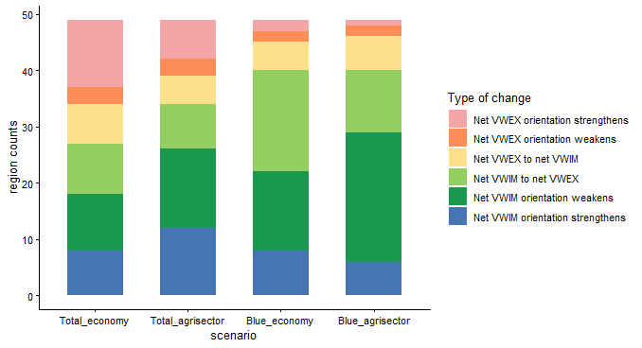
RESULTS
Trade adjustment potential and water sustainability (Q2&Q3) – Country level
Country level
Aggregate adjustment
Finnish net directional VWT adjustments
 | Whole economy | Agrisector
Total water | net VWIM → net VWEX | net VWIM → net VWEX
Blue water | net VWIM → net VWEX | net VWIM weakens
Bilateral level
Adjustment by partners
the type of change can vary across scenarios for a country
over 60% of cases show a VWEX-oriented adjustment potential across all scenarios
Figure 2. Distribution of directional country-level net VWT adjustment types at whole-economy and agrisector levels, for total and blue water.

Slide 13
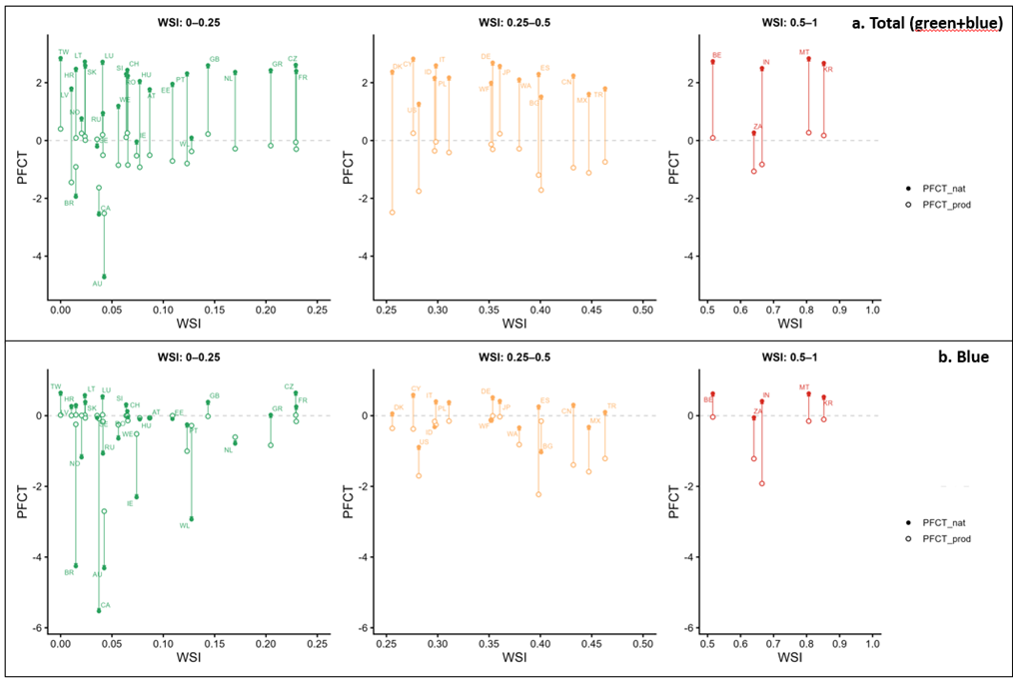
RESULTS
Trade adjustment potential and water sustainability (Q2&3) – Finnish Bilateral (Agrisector)
Bilateral patterns broadly consistent with the aggregate result
Total water: Finland moves toward net VW export with most partners
Blue water: similar to total water, but more mixed for WSI < 0.25 partners
Upward shifts toward higher-WSI partners are directionally consistent with water sustainability
Figure 3. Potential Finnish agrisector bilateral a. Total (green + blue) and b. blue net VW export adjustment pattern, separated by status of countries’ water stress.
Direction of VWT adjustment: PFCT_prod to PFCT_nat
Upward shift = Finland move towards net VWEX with trading partner

Slide 14
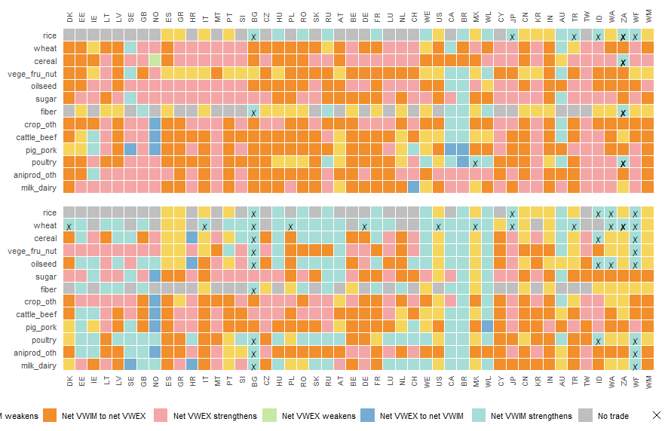
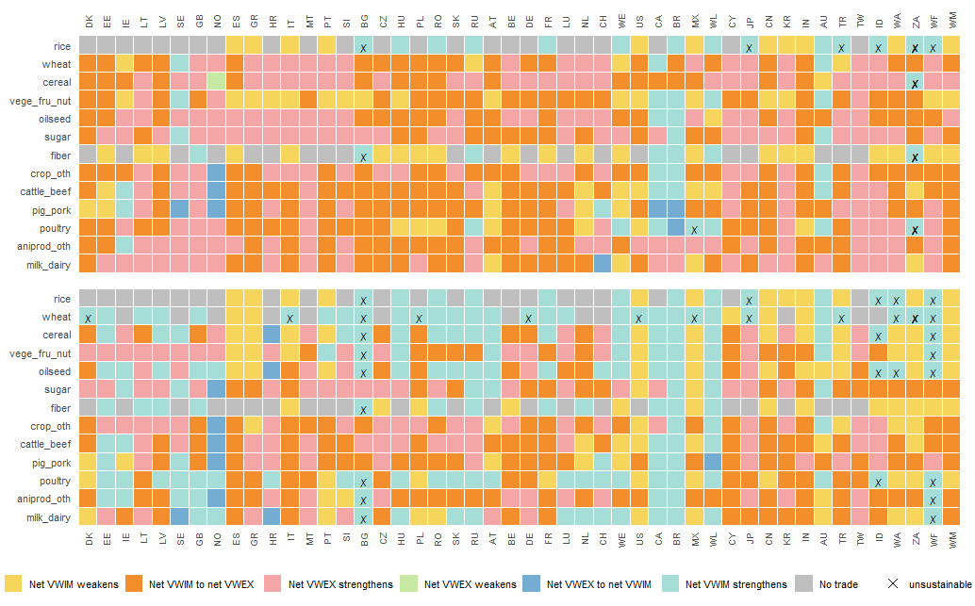
RESULTS
Trade adjustment potential and water sustainability (Q2&3) – Finnish Bilateral (Agriproduct)
Northern Europe
Southern Europe
Eastern Europe
Western Europe
RoW Europe
America
Asia and Pacific
Africa
RoW
Mid.East
Trade adjustment potential:
89.5% and 68.4% of current bilateral total and blue water show a net VWEX-oriented adjustment for Finland towards its trading partners
a. Total (blue+green)
b. Blue
Figure 4. Potential Finnish bilateral a. Total (green + blue) and b. blue net VWT adjustment patterns and water sustainability, at 13 agriproduct level.

Slide 15
RESULTS
Trade adjustment potential and water sustainability (Q2&3) – Finnish Bilateral (Agriproduct)
Northern Europe
Southern Europe
Eastern Europe
Western Europe
RoW Europe
America
Asia and Pacific
Africa
RoW
Mid.East
Trade adjustment potential:
89.5% and 68.4% of current bilateral total and blue water show a net VWEX-oriented adjustment for Finland towards its trading partners
Water sustainability (blue water):
sustainable in 94.0% of the cases
(example) Staple crops: redirects import away from water-stressed to less stressed regions
a. Total (blue+green)
b. Blue
Figure 4. Potential Finnish bilateral a. Total (green + blue) and b. blue net VWT adjustment patterns and water sustainability, at 13 agriproduct level.

Slide 16
DISCUSSION & CONCLUSIONS
Discussion and conclusions
Conclusion1: Production-based water endowments explain current VWT patterns better than natural endowments
Misalignment between current water use and natural water resources
Finnish case: scarce in production-based endowment (net VW inflow) V.S. abundant in natural water endowment
Conclusion2: Overall Finland shows potential to adjust towards a net virtual water exporter, with most patterns being directionally sustainable
More diversified adjustments at bilateral level
Implications & Applications
Water abundant regions may support more sustainable VWT
Provide understanding of VWT patterns from water endowment perspective, and support integrating water sustainability into future trade decisions
Feasibility of adjustment:
water endowment alone can’t determine realistic VWT patterns, other production factors and economic-geographical factors also matter
future extension: gravity model (e.g., Debaere (2014))

Slide 17
DISCUSSION & CONCLUSIONS
Limitations & Future research
Only provides directional VWT adjustment, not exact volumes of adjustment
=> quantitative methods (e.g. econometrics)
Limited regional disaggregation, especially five RoW (rest-of-the-world) regions
Green and blue water are analyzed separately
=> coupling of hydrological and economic models (e.g. LPJmL + GTAP-W)

Slide 18
References
Ansink, E. (2010). Refuting two claims about virtual water trade. Ecological Economics, 69(10), 2027-2032. https://doi.org/https://doi.org/10.1016/j.ecolecon.2010.06.001
Bowen, H. P., Leamer, E. E., & Sveikauskas, L. (1987). Multicountry, Multifactor Tests of the Factor Abundance Theory. The American Economic Review, 77(5), 791-809. http://www.jstor.org/stable/1810209
Davis, D. R., Weinstein, D. E., Bradford, S. C., & Shimpo, K. (1997). Using International and Japanese Regional Data to Determine When the Factor Abundance Theory of Trade Works. The American Economic Review, 87(3), 421-446. http://www.jstor.org/stable/2951353
Delbourg, E., & Dinar, S. (2020). The globalization of virtual water flows: Explaining trade patterns of a scarce resource. World Development, 131, 104917. https://doi.org/https://doi.org/10.1016/j.worlddev.2020.104917
Debaere, P. (2014). The Global Economics of Water: Is Water a Source of Comparative Advantage? American Economic Journal: Applied Economics, 6(2), 32–48. https://doi.org/10.1257/app.6.2.32
Fracasso, A., Sartori, M., & Schiavo, S. (2016). Determinants of virtual water flows in the Mediterranean. Science of The Total Environment, 543, 1054-1062. https://doi.org/https://doi.org/10.1016/j.scitotenv.2015.02.059
Liboreiro, P. R. (2025). Multi-factor, multi-country testing of the Heckscher-Ohlin theorem without factor price equalization: A critical view. Structural Change and Economic Dynamics, 73, 354-367. https://doi.org/https://doi.org/10.1016/j.strueco.2025.02.002
Mekonnen, M. M., Kebede, M. M., Demeke, B. W., Carr, J. A., Chapagain, A., Dalin, C., Debaere, P., D’Odorico, P., Marston, L., Ray, C., Rosa, L., & Zhuo, L. (2024). Trends and environmental impacts of virtual water trade. Nature Reviews Earth & Environment, 5(12), 890-905. https://doi.org/10.1038/s43017-024-00605-2
Stadler, K., Wood, R., Bulavskaya, T., Södersten, C. J., Simas, M., Schmidt, S., Usubiaga, A., Acosta-Fernández, J., Kuenen, J., Bruckner, M., Giljum, S., Lutter, S., Merciai, S., Schmidt, J. H., Theurl, M. C., Plutzar, C., Kastner, T., Eisenmenger, N., Erb, K. H., . . . Tukker, A. (2025). EXIOBASE 3 (3.9.6) Version 3.9.6) Zenodo. https://doi.org/10.5281/zenodo.15689391
Schyns, J. F., Hoekstra, A. Y., Booij, M. J., Hogeboom, R. J., & Mekonnen, M. M. (2019). Limits to the world’s green water resources for food, feed, fiber, timber, and bioenergy. Proceedings of the National Academy of Sciences, 116(11), 4893-4898. https://doi.org/doi:10.1073/pnas.1817380116
Trefler, D., & Zhu, S. C. (2010). The structure of factor content predictions. Journal of International Economics, 82(2), 195-207. https://doi.org/https://doi.org/10.1016/j.jinteco.2010.07.006
Vanham, D., Alfieri, L., & Feyen, L. (2022). National water shortage for low to high environmental flow protection. Scientific Reports, 12(1), 3037. https://doi.org/10.1038/s41598-022-06978-y
Vanham, D., Hoekstra, A. Y., Wada, Y., Bouraoui, F., de Roo, A., Mekonnen, M. M., van de Bund, W. J., Batelaan, O., Pavelic, P., Bastiaanssen, W. G. M., Kummu, M., Rockström, J., Liu, J., Bisselink, B., Ronco, P., Pistocchi, A., & Bidoglio, G. (2018). Physical water scarcity metrics for monitoring progress towards SDG target 6.4: An evaluation of indicator 6.4.2 “Level of water stress”. Science of The Total Environment, 613-614, 218-232. https://doi.org/https://doi.org/10.1016/j.scitotenv.2017.09.056
Yan, Y., Wang, R., Zheng, X., & Zhao, Z. (2020). Carbon endowment and trade-embodied carbon emissions in global value chains: Evidence from China. Applied Energy, 277, 115592. https://doi.org/https://doi.org/10.1016/j.apenergy.2020.115592

Slide 19
THANK YOU!
Contact: yue.fu@helsinki.fi
Any questions? Comments?
Acknowledgements
This work was supported by the Water & Food Futures project funded by the Strategic Research Council of Finland (SRC). We thank Matti Kummu and Mika Jalava for advice on the measurement of natural water endowments.

