Slide 1

Approaches to calculate subnational consumption-based emissions
Review and recommendations to local authorities in Sweden
Julia Gutke & Göran Finnveden
Notes:
Hi
Name, PhD, KTH
Currently involved in a project where we collaborate with a local authroity in Sweden to adress their CBE
The project is ongoing, and today I will present the first phase where we have reviewed approaches to calculate subnational CBE

Slide 2
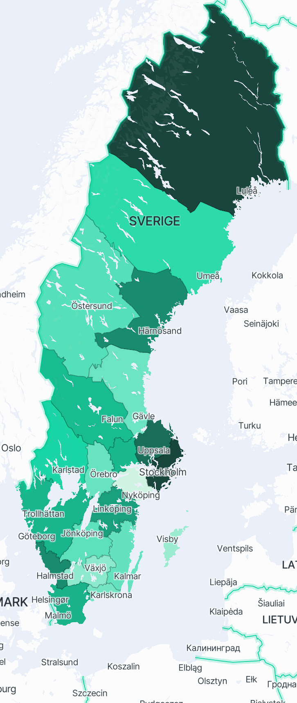
Background
Consumption-based emission?
National emissions are calculated regularly, subnational methods are much less developed
Some identified gaps to address
  Ability to assess mitigation measures
  Alternatives to confidential data to allow external development
  Update regularly to facilitate follow ups
Picture taken from the online tool “Konsumtionskompassen” (the consumption compass): konsumtionskompassen.se →
Notes:
I assume most people here are familiar with consumption-based emissions, but if some is not, it is the total value chain emissions assigned to the final consumption of goods and services
CBE are typcakky calculated on the national level on a regular basis, methods to do so are well established
However, there is no official statistics nor emthod on how subnational emissions should be caluclated. Methods are much less developed
This has become an issue as both cities and municipalities in Sweden has set CBE target, but face a lack of guidelines and methods for how to follow these targets up.
There was recently an online tool develoepd to adress this: its called the consumption compass, developed by SEI, and that can be used to display regional emissions and identify hotspots – this picture is taken from there.
This tool provides good start to understand regional emissions, but it has some limitations
1. Users cannot test and evaluate different mitiagtion measures
2. It build on confidential (consumption) data, which hinders external developer to develop or add to the tool.
4. It was built during a project, and is hence not updated regularly
These are limitations that we want to adress during this project
The outcomes are not intended to replace the availabel tool, but rather provide guidance on how to work beyond it, or be used to develop the tool (or any other) further

Slide 3
Aim
identify different approaches to calculate subnational consumption-based emissions
Identify how subnational emissions are used and what is required from such data
Based on findings, recommend approaches suitable for further evaluation
Notes:
Explicitly, the aims are the following:
Identify what different approaches there exist
Identify requirements from users and developers in sweden
Based on the previous two points, identify which approaches that SHOULD be EVALUATED in the next phase, and ideally provide recommendations

Slide 4

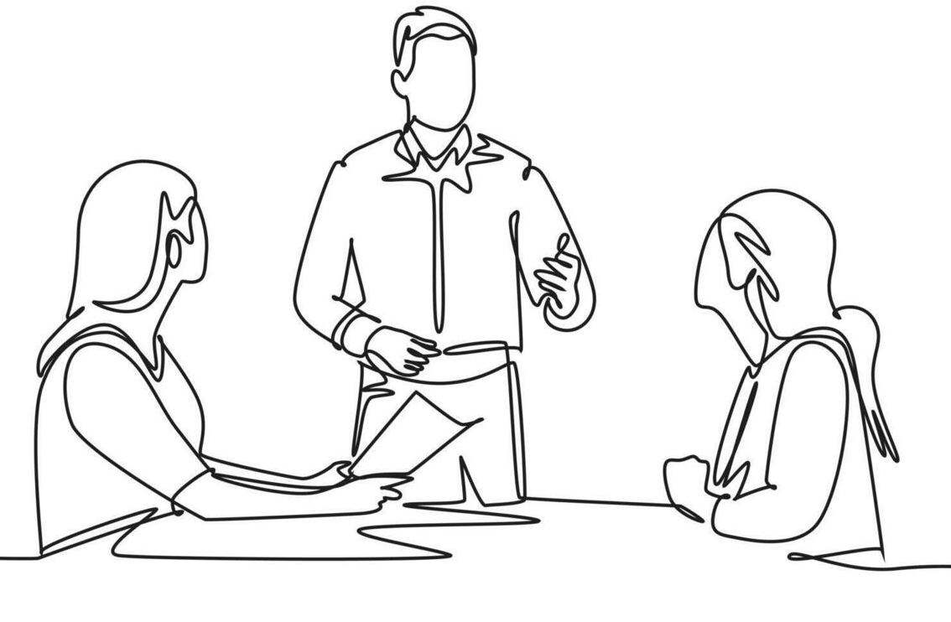
Method
Literature review: identify different approaches
Worskshop with stakeholders
  Stockholm Region and City of Stockholm
  Stockholm Environment Institute
  Swedish society for nature conservation (NGO)
  Swedish Environmental Protection Agency
  Statistics Sweden
Notes:
To adress the first question, we conducted a literature review targeting studies that in some way calculated subnational CBE, from which we categorized 3 approaches
To adress the second aim, we gathered stakeholders from …… to discuss how this data is and could be used, as well as what they required or wanted from such data.

Slide 5
Three categories of approaches
Regionalize demand but use national emission intensities
Regionalise also production and trade – develop subnational tables
Bottom-up, process-based LCA
Notes:
From the review, we categorized the studies into three different approaches, and I will go through them before moving ont o outcomes of the workshop

Slide 6
Regionalize demand
Global
EE-MRIO
Subnational demand
Core concept: Use national models, but disaggregate demand. Different data can be used to regionalize demand
Close to (current) national models
Assumes nationally homogenous production and trade
 | C1 | C2 | C3
C1
C2
C3
a | b | c
References: Dawkins et al., (2024), Lee et al., (2023 and 2021), Gill & Moeller (2028), Harris et al., (2020), Ivanova et al., (2017), Moran et al., (2018), Lenk et al., (2021), Lylykangas et al., (2023), Millward-Hopkins et al., (2017), Minx et al., (2013), Trendl et al., (2013)
Notes:
The first group consist of studies that in different ways disaggregate demand, but use national level emission intensities
Different data can be used to regionalize demand: HBS, commercial, income – other?
Advantage: close to national models and data, muc data is available
A drawback is that it does not account for regional differences in production, and could be accused for being too inprecise in detail by local policy makers
The consumption compass build on a study by Dawkins et al., that applied this approach.

Slide 7
Develop and nest subnational IOTs
Core concept: regionalize production/trade, using collected data and/or approximations. Regionalized tables can be “nested” in global models to account for global value chains
Account for regional characteristics – credibility among local agents
Subnational tables not produced in Sweden
Resource intensive to process survey data
Subnational production and trade data is typically not available
 | C1 | C2 | C3 | r11 | r12
C1 | 0 | 0 | 0 | 0 | 0
C2 | 0
C3 | 0
r11 | 0
r12 | 0
References: Anderstig et al., (2023), Cai (2016), Towa et al., (2022), Kortleve et al., (2026), Jiang et al., (2020), Sato & Narita, (2023), Caron et al., (2017), Straatman at al., (2018), Thissen et al., (2018) and Wilting et al., (2020)
Notes:
The second approach are studies that use or develop subnational tables, meaning that they also to regionalize production and trade.
If you have or develop subnational IOTs, these can be nested
An advantage here is that regional characteristics are better taken into account → which could create credibility among policy makers and allow for a more detailed analysis
A drawback is that there are currently no subnational tables developed in Sweden
Has been effort – no regular practice established
Acknowledged in literature and in workshop that survey is time-consuming, and that data is not available, currently not an option
One way could instead be to use proxy data like employment to regionalize, but it is questionable if this would be percieved as significantly more credible from a policy point fo view

Slide 8
Process-based LCA
Region X
Core concept: apply traditional LCA methodology where region represent your system boundary. Include high-impact categories.
Flexible, and can mirror local characteristics
Time-consuming data collection, reduced comparability, cut-off error
Food
Housing
Transport
…
Dorr et al., (2022), Larsson & Bolin (2014), Nuss et al., (2023), Ghaemi & Smith (2020)
Notes:
The third category are studies that, instead of using top-down MRIO, apply a bottom-up approach based on traditional LCA methods.
These studies collect data and calculate footprints for each included category. They only include a selected number of high impact categories for practical reasons.
An advantage is that it is flexible…
Drawbacks include that additional data collection needs to be conducted, that comparability is reduced if individual studies are conducted, and the inherent cut-of problem
JRCs Consumption Footpirnt Platform

Slide 9
How can subnational emission data be used?
Inform and support citizens, companies, and other actors
Develop KPIs
Develop and evaluate scenarios in urban planning
Explore potential of future scenarios
Identify hot-spots to prioritize mitigation efforts
Evaluate efficiency of measures
Use cases
Follow up implemented measures
Set requirements for public purchases
Report achieved changes
Understand the origin of emissions
Set targets for mitigation
Set internal carbon prices
Notes:
Moving on to the otcomes from the workshop
There were several different use cases discussed, but because of the time constraint I will focus on the uses that were percieved as gaps – things that participants wanted to do but percieved they were not able to

Slide 10
How can subnational emission data be used?
Inform and support citizens, companies, and other actors
Develop KPIs
Develop and evaluate scenarios in urban planning
Explore potential of future scenarios
Gaps:
Evaluate different measures
Explore scenarios
Follow upp implemented policies
Identify hot-spots to prioritize mitigation efforts
Evaluate efficiency of measures
Use cases
Follow up implemented measures
Set requirements for public purchases
Report achieved changes
Understand the origin of emissions
Set targets for mitigation
Set internal carbon prices
Notes:
These gaps are all somehow related to mitigating identified emissions.
Participants emphasized that they would like to test different measures and scenarios to understand which ones that were efficient to implement, which both require that they can interact with the data
And they also raised that they want to be able to see effects and follow up measures, which require regular updates but also that they implement policies with visual effects

Slide 11
What is required from the data?
Include different impact categories
Not to data-or resource intensive
Include biogenic emissions
Emission factors for different consumption categories
Accompany numbers with analysis to enhance understanding
Differentiate regional (geography) and regional (organization)
Requirements
Easy and accessible recommendations to hh
That regional data is available
Data should mirror local characteristics / achievements – credibility
Sum of regional should match national emissions
Notes:
The same goes for the requirements, many different apsects were brought up
I will highlight some major takeaways from this discussion

Slide 12
What is required from the data?
Include different impact categories
Not to data-or resource intensive
Include biogenic emissions
Emission factors for different consumption categories
Accompany numbers with analysis to enhance understanding
Differentiate regional (geography) and regional (organization)
Requirements
Easy and accessible recommendations to hh
That regional data is available
Data should mirror local characteristics / achievements – credibility
Sum of regional should match national emissions
Notes:
There is a tension between the desire to mirror local conditions and the resourec constraints regarding available time and resources for data collection and management
While local representation is brought up as a desire, or maybe necessaity to catch politicians ears, time and reosurecs are mentioned as constraints. – without additional resources, they can’t collect much additional data or manage large models, but with current context maybe more feasible to work with as much available data as possible

Slide 13
What is required from the data?
Include different impact categories
Not to data-or resource intensive
Include biogenic emissions
Emission factors for different consumption categories
Accompany numbers with analysis to enhance understanding
Differentiate regional (geography) and regional (organization)
Requirements
Easy and accessible recommendations to hh
That regional data is available
Data should mirror local characteristics / achievements – credibility
Sum of regional should match national emissions
Notes:
Another take away was that partcipants that limited knowledge about consumptio-based emission and underlying data emphasized the necessity to have easy and accessible tools, explanations, and accompany numbers with analysis to help understanding

Slide 14
Conclusions and Next steps
Survey-based regionalization and LCA-based approaches are considered too resource demanding for continuous monitoring
Test, compare, and evaluate approaches:
  Downscale demand based on available, open data, like HBSs. Income could be evaluated as a proxy.
  Regionalize table using non-survey proxy (e.g., employment)
Notes:
As I mentioned in the beginning, this exploration has been an initial step where we explored different options, pros, cons, and requirements
from which we conclude that given the context, methods that imply additional data collection and management beyond available resources are not feasible, and will not be further explored
The next steps will be to test two approaches: downscale and regionalize using proxy data, and compare to published data. Eventually we also aim to explore different policy measures suitable at subnational level
Since we are early in the project, we are of course very interested in any inputs regarding additional approaches or perspectives, thought etc.

Slide 15


Thank you! Inputs/questions/comments?
Notes:
We are of course very interested in inputs about if there are other approaches or inputs that we have not covered! We also welcome inputs from similar kind of calculations covering other environmental impacts as this is a future interest to include as well
Thank a lot for listening, and I’m happy for any feedback and willd o my best to answer your quetsions if you have any ☺

