Slide 1

Improving the confidentiality treatment in the production of inter-country supply, use, and input-output tables:
The FIGARO experience
32nd International Input-Output Association Conference
Seville, Spain,
24 June 2026
Johannes Buck – Eurostat Unit C2

Slide 2
What is FIGARO?
Full International and Global Accounts for Research in input-Output analysis
EU inter-country Supply, Use and Input-Output tables and applications (environment, economic globalisation)
EU perspective + countries perspective
Long-term cooperation between Eurostat and
the European Commission’s Joint Research Centre
Since 2021, FIGARO published annually as European statistics (last release July 2025)
Allow deep analyses of the socio-economic and environmental effects of globalisation
https://ec.europa.eu/eurostat/web/esa-supply-use-input-tables/database

Slide 3





























Who are the main actors?
National statistical institutes collect and verify data
Use common definitions and methods
Send data to Eurostat
ESS
EU Regulations for data transmission
Consolidate data
Produces European aggregates
Publish official statistics for Europe as open data
Eurostat
Methodological support
Economic modelling
Development of additional FIGARO applications
JRC
Figaro

Slide 4
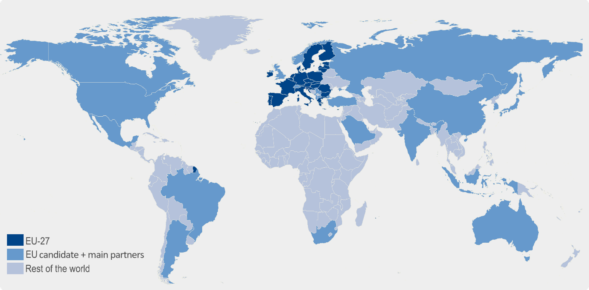
What are its main characteristics?
FIGARO 2010-2024 to be released 20 July 2026
EU-27 +
2 EFTA +
5 EU candidate
countries
15 main
trading
partners
+ RoW
+
=
Figaro
49 + RoW
Globally balanced view of National Accounts Main Aggregates, adjusted to latest national GDP main aggregates
Fully aligned with countries’ National Accounts official statistics
Build upon available data from National Accounts and balanced international trade statistics
  64 industry and product categories (NACE Rev.2: A*64 / CPA 2.1: P*64)
  Time series from 2010 to year T-2

Slide 5
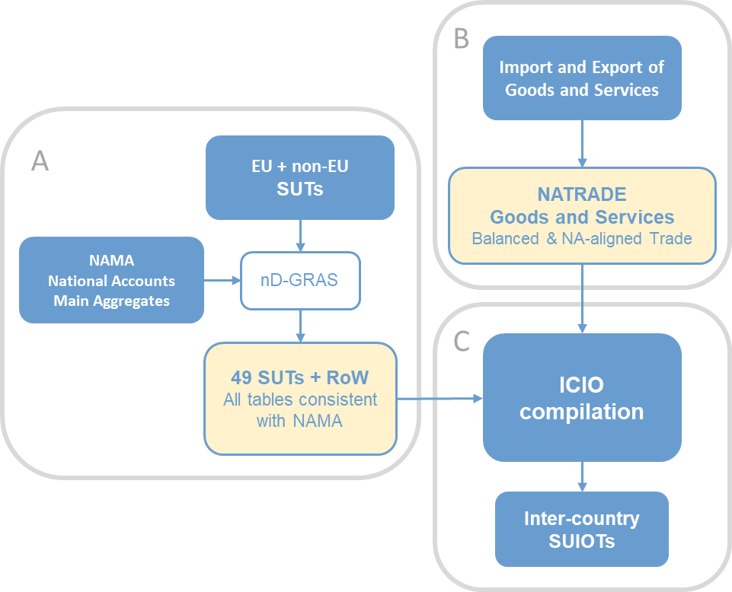
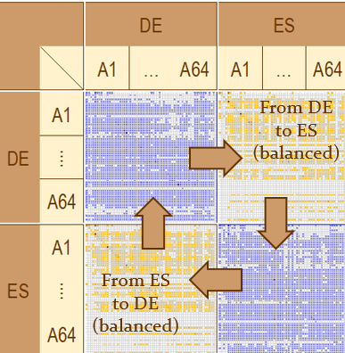
How is it produced?
Figaro

Slide 6
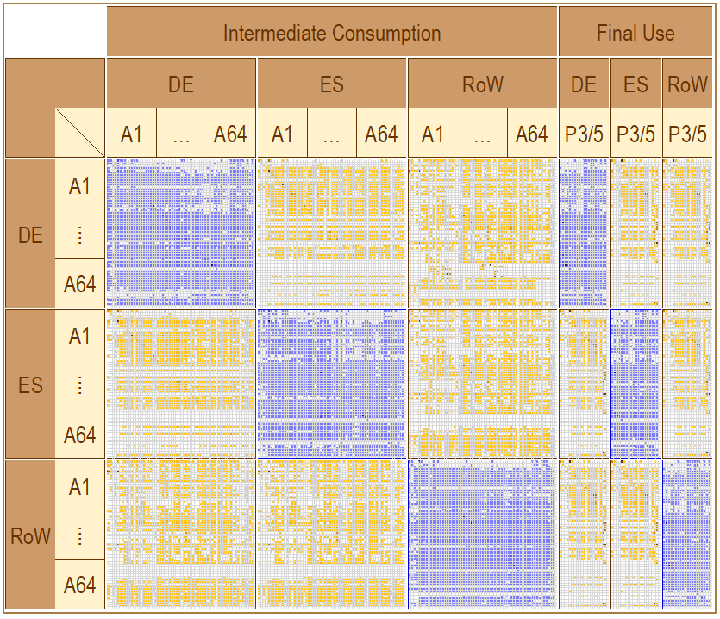


Methodological overview
Tables
Process
Global National Accounts Main Aggregates (benchmark)
RAS methods
National Supply and Use tables (purchaser’s prices, CIF)
Figaro
Trade and transport margin, TLS
National Supply and Use tables (basic prices, FOB)
Balanced View of trade (geographical distribution)
Inter-Country SUT (Benchmarked to National Accounts)
Balanced view of trade in goods (QDR methodology)
Balanced view of trade in services
Adjustments for goods sent abroad for processing, and merchanting
Direct purchases abroad
Technology/Sales Assumptions
Inter-Country
Input-Output tables

Slide 7
FIGARO applications
Macroeconomic globalisation indicators
Environmental footprints (GHG)
FIGARO-NAM: Multi-Country National Accounting Matrices that link data on production and consumption with data on income and saving
European space economy thematic account
Potentially in the future, a defence economy thematic account
Extended FIGARO tables by ownership

Slide 8
Challenges of Confidentiality Protection in FIGARO
National statistical institutes provide confidential primary data
FIGARO tables must remain fully balanced and economically consistent
Simple suppression or random perturbation breaks row and column totals
⇒ We need a method that protects confidential cells while preserving the consistency of the Supply and Use Tables

Slide 9
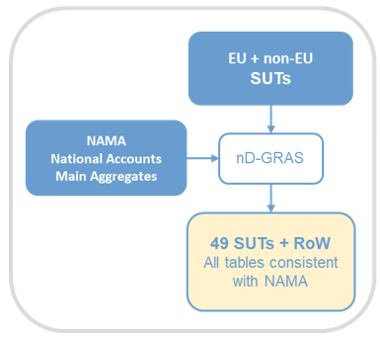
FIGARO Confidentiality
Confidential data can come from two sources:
  EU National Accounts Main Aggregates Data
  EU SUTs
Both sources need to be masked separately
⇒ Idea: Mask the NAMA values first and then find an algorithm that masks the SUTs without running nD-GRAS
Illustration of the initial step of the FIGARO compilation

Slide 10
Masking of NAMA values
The following NAMA values are collected by NACE Rev.2 A*64 breakdown:
  P1 (Output)
  P2 (Intermediate consumption)
  B1_G (Gross value added)
  D1 (Compensation of employees)
  B2G_B3G (Gross operating surplus and mixed income)
  D29_D39 (Other taxes less subsidies on production)

Slide 11
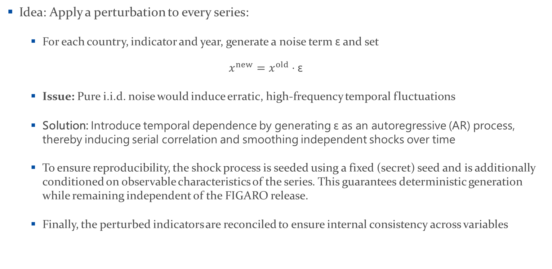
Masking of NAMA values
Idea: Apply a perturbation to every series:
  For each country, indicator and year, generate a noise term $\text{ε}$ and set
  $$x^{new}=x^{old}⋅\text{ε}$$
  Issue: Pure i.i.d. noise would induce erratic, high-frequency temporal fluctuations
  Solution: Introduce temporal dependence by generating ε as an autoregressive (AR) process, thereby inducing serial correlation and smoothing independent shocks over time
  To ensure reproducibility, the shock process is seeded using a fixed (secret) seed and is additionally conditioned on observable characteristics of the series. This guarantees deterministic generation while remaining independent of the FIGARO release.
  Finally, the perturbed indicators are reconciled to ensure internal consistency across variables

Slide 12
Masking of SUTs
Idea: Apply Controlled Tabular Adjustment (CTA):
CTA is a statistical disclosure control method that protects confidential cells while preserving the consistency of a table
Instead of suppressing confidential values, CTA adjusts (perturbs) selected cells so that:
  Confidential values cannot be inferred
  Row and column totals remain unchanged
  The overall structure of the table is preserved
  Changes to non-confidential cells are kept as small as possible

Slide 13
Masking of SUTs
Minimise the overall modifications to the table
subject to
  Row totals remain fixed
  Column totals remain fixed
  Confidential cells differ sufficiently from their original values
  Additional constraints (e.g. non-negativity) are respected
Key challenge: CTA is traditionally formulated as a mixed-integer optimisation problem, making it computationally expensive for large Supply and Use Tables

Slide 14
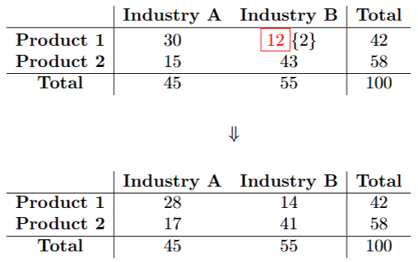
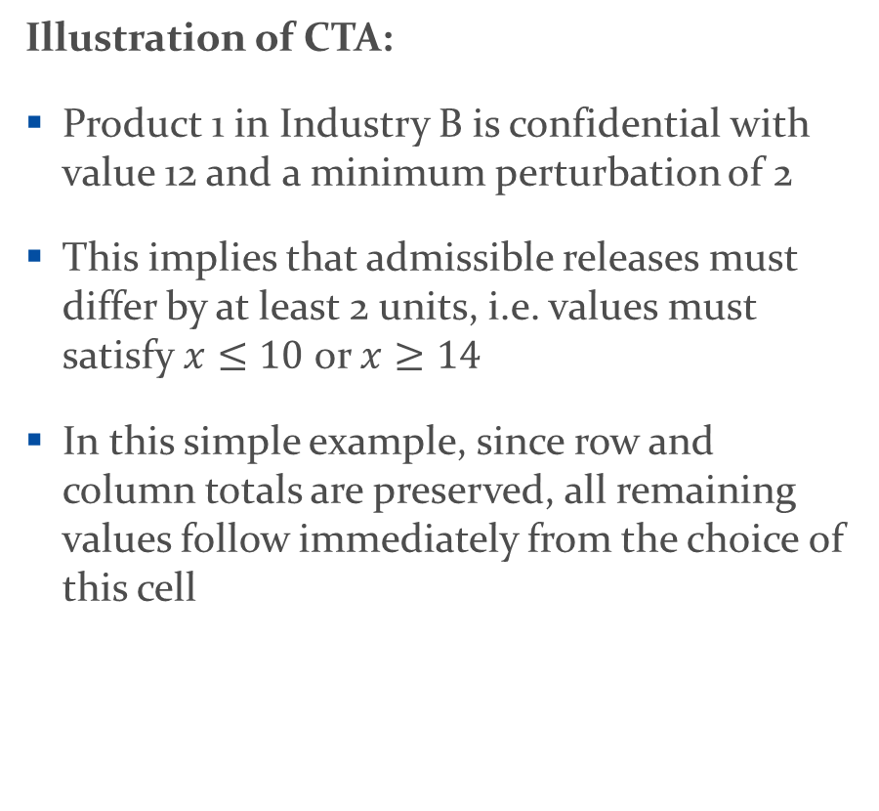
Example
Illustration of CTA:
Product 1 in Industry B is confidential with value 12 and a minimum perturbation of 2
This implies that admissible releases must differ by at least 2 units, i.e. values must satisfy $x≤10$ or $x≥14$
In this simple example, since row and column totals are preserved, all remaining values follow immediately from the choice of this cell

Slide 15
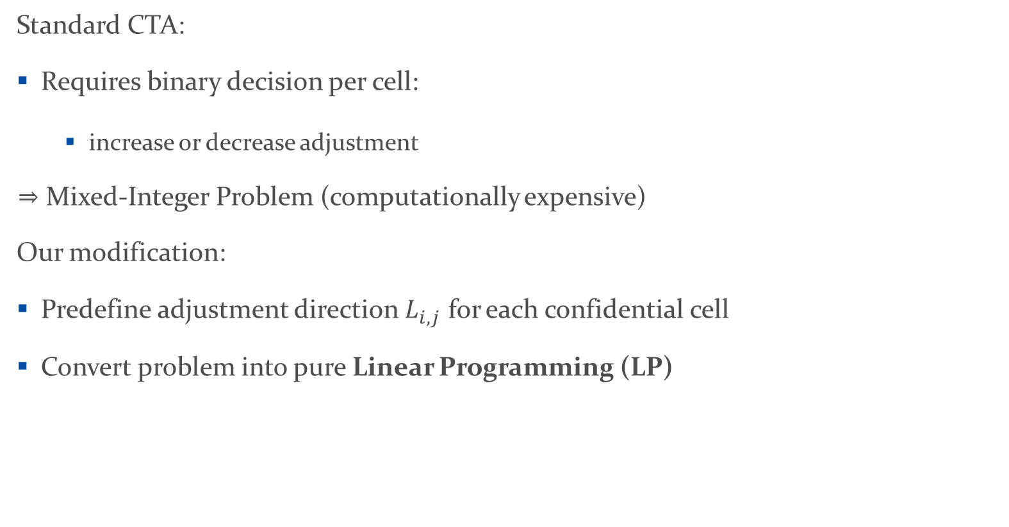
Key Idea – Relaxation to a Linear Program
Standard CTA:
Requires binary decision per cell:
  increase or decrease adjustment
⇒ Mixed-Integer Problem (computationally expensive)
Our modification:
Predefine adjustment direction $L_{i,j}$ for each confidential cell
Convert problem into pure Linear Programming (LP)

Slide 16
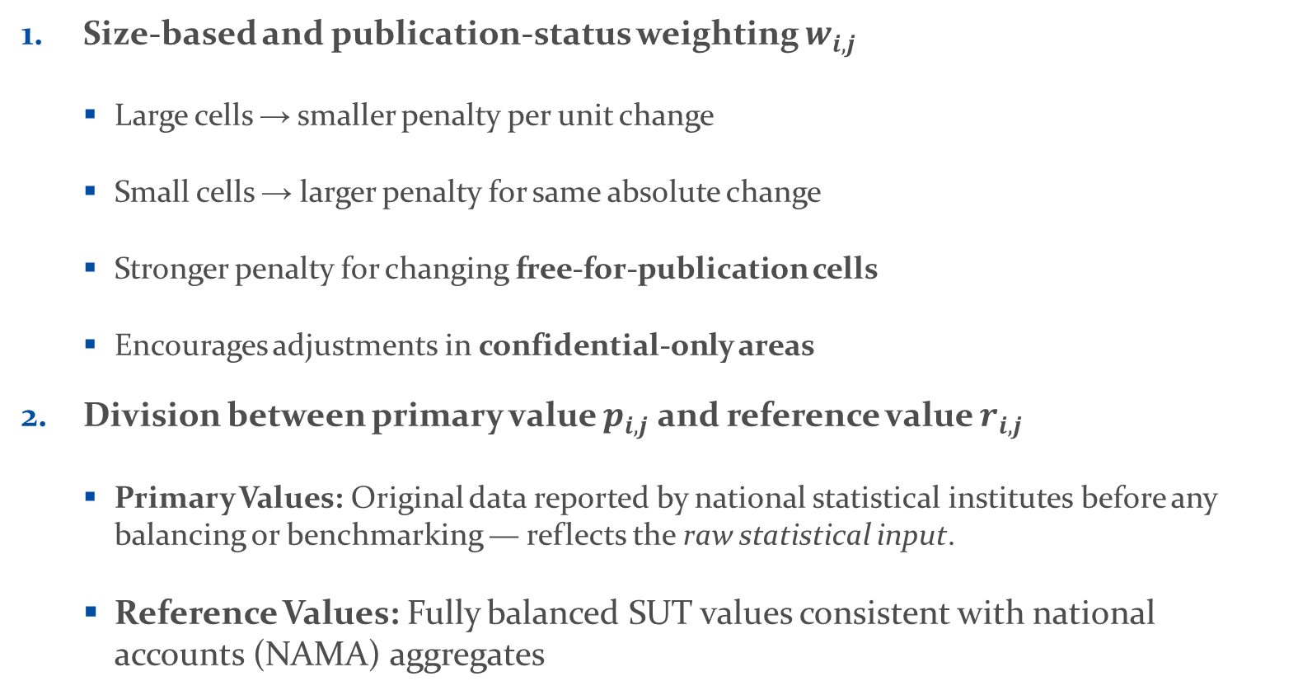
Weighted Adjustment Strategy
Size-based and publication-status weighting $w_{i,j}$
  Large cells → smaller penalty per unit change
  Small cells → larger penalty for same absolute change
  Stronger penalty for changing free-for-publication cells
  Encourages adjustments in confidential-only areas
Division between primary value $p_{i,j}$ and reference value $r_{i,j}$
  Primary Values: Original data reported by national statistical institutes before any balancing or benchmarking — reflects the raw statistical input.
  Reference Values: Fully balanced SUT values consistent with national accounts (NAMA) aggregates

Slide 17

Formulation of the LP
$$\text{minimize}\sum_{i=1}^{n_{row}}{\sum_{j=1}^{n_{col}}{w_{i,j}\left|x_{i,j}−r_{i,j}\right|}}$$
$$\text{subject} \text{to}\sum_{j=1}^{n_{col}}{x_{i,j}=R_{i} ∀i} and \sum_{i=1}^{n_{row}}{x_{i,j}=C_{j} ∀j}$$
$$L_{i,j}∈\{−1,1\} \text{if} \text{cell} \left(i,j\right) \text{is} \text{confidential} and L_{i,j}=0 \text{if} \text{cell} \left(i,j\right) \text{is} \text{not} \text{confidential}$$
$$x_{i,j}−p_{i,j}≥δ_{i,j} \text{if} \text{cell} \left(i,j\right) \text{is} \text{confidential} \text{and} L_{i,j}=1$$
$$p_{i,j}−x_{i,j}≥δ_{i,j} \text{if} \text{cell} \left(i,j\right) \text{is} \text{confidential} \text{and} L_{i,j}=−1$$
$$x_{i,j}−r_{i,j}≤π_{i,j} \text{for} \text{all} \text{cells} \left(i,j\right)$$
$$r_{i,j}−x_{i,j}≤π_{i,j} \text{for} \text{all} \text{cells} \left(i,j\right)$$
$$x_{i,j}≥0 \text{if} p_{i,j}≥0 \text{and} \text{column} \text{is} \text{not} \text{P}\text{5}\text{M}$$
$$x_{i,j}=0 \text{if} p_{i,j}=0$$

Slide 18
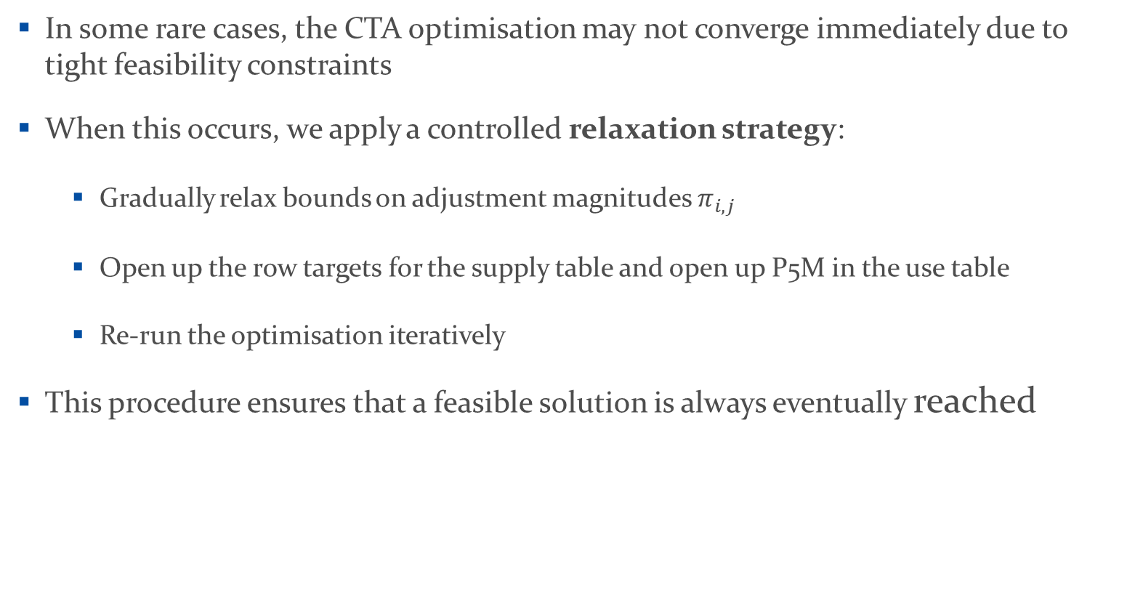
Ensuring Convergence via Gradual Relaxation
In some rare cases, the CTA optimisation may not converge immediately due to tight feasibility constraints
When this occurs, we apply a controlled relaxation strategy:
  Gradually relax bounds on adjustment magnitudes $π_{i,j}$
  Open up the row targets for the supply table and open up P5M in the use table
  Re-run the optimisation iteratively
This procedure ensures that a feasible solution is always eventually reached

Slide 19
Results
To preserve confidentiality, country identifiers are anonymised and randomly relabelled
⇒ Ordering is purely random and contains no economic meaning.
Results are reported in relative terms, as some implementation details (e.g. exact perturbation thresholds) cannot be disclosed.
The results combine:
  effects from masked NAMA aggregates (column constraints) and cell-level CTA adjustments (SUT balancing)
  ⇒ Therefore, changes in SUTs reflect the full integrated framework, not only cell-level adjustments.

Slide 20

Results
The table below presents, by country, the share of free-for-publication cells that remain unchanged.
A cell is counted as unchanged if
$$\text{∣}\text{REFERENCE}\text{​−}\text{DISSEMINATION}\text{∣<0.001 }\text{million}$$
Table | C01 | C02 | C03 | C04 | C05 | C06 | C07 | C08 | C09 | C10 | C11 | C12 | C13 | C14 | C15 | C16 | C17 | C18 | C19
T1500 | 100 | 98.01 | 97.66 | 98.88 | 98.61 | 100 | 98.27 | 100 | 99.09 | 98.34 | 97.19 | 98.41 | 98.59 | 98.06 | 97.85 | 99.99 | 97.72 | 99.89 | 98.52
T1611 | 100 | 97.72 | 97.74 | 94.89 | 97.67 | 100 | 98.25 | 100 | 99.50 | 98.02 | 97.53 | 97.51 | 97.72 | 98.19 | 97.78 | 100.00 | 98.43 | 99.80 | 97.26
T1612 | 100 | 98.04 | 97.51 | 97.65 | 98.04 | 100 | 98.18 | 100 | 99.19 | 98.11 | 97.52 | 97.66 | 97.49 | 97.25 | 98.17 | 100.00 | 97.48 | 99.84 | 97.87

Slide 21
Results
Size | Table | Revision Indicator | C02 | C03 | C04 | C05 | C07 | C09 | C10 | C11 | C13 | C14 | C15 | C19
small | T1500 | <1 | 90.29 | 91.03 | 99.44 | 84.80 | 72.41 | 100.00 | 72.35 | 89.92 | 74.39 | 90.68 | 90.47 | 96.10
 | T1500 | <3 | 93.74 | 95.03 | 99.78 | 88.00 | 74.14 | 100.00 | 78.80 | 92.76 | 85.98 | 93.66 | 94.41 | 98.52
 | T1500 | <5 | 95.28 | 97.28 | 99.79 | 90.40 | 74.14 | 100.00 | 83.41 | 94.36 | 90.85 | 94.41 | 95.97 | 99.34
 | T1611 | <1 | 95.34 | 97.69 | 95.85 | 77.78 | 92.56 | 99.32 | 93.46 | 90.27 | 72.09 | 85.58 | 89.84 | 98.20
 | T1611 | <3 | 98.10 | 99.26 | 99.93 | 88.27 | 95.84 | 99.61 | 96.39 | 93.21 | 83.14 | 89.74 | 95.52 | 99.19
 | T1611 | <5 | 98.87 | 99.66 | 99.93 | 91.36 | 96.06 | 99.61 | 97.29 | 95.03 | 88.95 | 93.06 | 97.26 | 99.49
 | T1612 | <1 | 97.05 | 97.47 | 96.72 | 88.59 | 79.26 | 99.12 | 90.92 | 93.43 | 79.90 | 85.71 | 90.70 | 98.97
 | T1612 | <3 | 98.99 | 99.30 | 99.76 | 92.62 | 82.47 | 99.91 | 96.26 | 95.76 | 85.78 | 90.79 | 96.17 | 99.70
 | T1612 | <5 | 99.49 | 99.62 | 99.95 | 95.30 | 83.21 | 99.94 | 98.20 | 96.66 | 89.22 | 94.20 | 97.29 | 99.87
medium | T1500 | Mean | 2.77 | 2.90 | 1.28 | 3.32 | 5.84 | 0.94 | 1.59 | 4.35 | 3.70 | 3.65 | 2.53 | 1.88
 | T1500 | 75% | 1.71 | 2.78 | 1.00 | 2.62 | 11.46 | 1.00 | 1.25 | 6.06 | 4.02 | 2.57 | 1.62 | 1.19
 | T1500 | 95% | 12.28 | 12.89 | 1.26 | 12.23 | 19.62 | 1.07 | 3.50 | 15.12 | 13.17 | 14.22 | 10.97 | 7.98
 | T1611 | Mean | 2.26 | 3.31 | 0.56 | 3.10 | 2.20 | 0.70 | 2.72 | 3.14 | 2.39 | 2.59 | 2.02 | 4.68
 | T1611 | 75% | 2.81 | 3.30 | 0.92 | 3.00 | 2.13 | 1.14 | 3.21 | 4.25 | 3.34 | 3.84 | 2.99 | 4.93
 | T1611 | 95% | 6.85 | 17.43 | 2.39 | 14.76 | 8.39 | 2.81 | 8.15 | 9.67 | 7.80 | 8.39 | 7.93 | 18.45
 | T1612 | Mean | 2.49 | 6.83 | 0.91 | 1.59 | 4.03 | 0.83 | 2.97 | 4.55 | 3.20 | 2.85 | 2.37 | 2.75
 | T1612 | 75% | 3.65 | 9.04 | 1.46 | 2.97 | 5.97 | 1.29 | 4.25 | 7.23 | 4.50 | 4.40 | 3.16 | 3.21
 | T1612 | 95% | 7.41 | 25.98 | 3.13 | 5.90 | 12.05 | 3.67 | 7.25 | 13.70 | 10.64 | 9.72 | 9.60 | 10.13
large | T1500 | Mean | 0.51 | 0.74 | 1.03 | 0.92 | 2.09 | 0.72 | 0.78 | 1.70 | 2.02 | 1.74 | 1.25 | 0.94
 | T1500 | 75% | 0.76 | 1.07 | 0.88 | 0.89 | 1.62 | 1.02 | 1.00 | 1.27 | 1.52 | 1.44 | 1.04 | 1.25
 | T1500 | 95% | 1.19 | 2.58 | 2.90 | 5.18 | 11.25 | 1.47 | 1.00 | 9.55 | 9.54 | 7.88 | 9.35 | 2.33
 | T1611 | Mean | 1.19 | 4.04 | 0.74 | 0.72 | 1.05 | 1.26 | 1.06 | 1.92 | 1.25 | 0.82 | 1.02 | 1.68
 | T1611 | 75% | 1.44 | 2.70 | 0.83 | 1.23 | 1.20 | 1.56 | 1.04 | 3.01 | 1.48 | 1.09 | 1.28 | 2.25
 | T1611 | 95% | 1.56 | 21.46 | 3.38 | 1.44 | 1.38 | 5.26 | 1.16 | 3.99 | 4.08 | 1.46 | 3.75 | 3.37
 | T1612 | Mean | 0.65 | 2.34 | 1.21 | 1.19 | 1.59 | 1.13 | 1.00 | 2.13 | 1.35 | 1.81 | 1.57 | 1.01
 | T1612 | 75% | 0.80 | 2.10 | 1.34 | 1.08 | 1.24 | 1.58 | 1.01 | 3.34 | 1.53 | 1.39 | 1.68 | 1.59
 | T1612 | 95% | 1.69 | 4.81 | 5.61 | 3.76 | 4.95 | 4.45 | 1.02 | 9.09 | 3.48 | 8.03 | 4.14 | 2.47

Slide 22
Conclusions
We propose a Controlled Tabular Adjustment (CTA)-based framework for confidentiality protection in large-scale SUT compilation
The key innovation is the pre-determination of adjustment directions, which transforms the original mixed-integer CTA problem into a computationally tractable linear program
The method preserves:
  full accounting consistency (row and column totals)
  strong confidentiality protection and
  minimal distortion of non-confidential data
Empirically, the approach shows good numerical stability and feasibility performance, with the direction refinement and feasibility checks ensuring convergence in practice
Overall, the method delivers a scalable and operational solution for production-level SUT systems, making large-scale implementation feasible without compromising data quality

Slide 23

Thank you
© European Union 2020
Unless otherwise noted the reuse of this presentation is authorised under the CC BY 4.0 license. For any use or reproduction of elements that are not owned by the EU, permission may need to be sought directly from the respective right holders.
Notes:
Update/add/delete parts of the copy right notice where appropriate.
More information: https://myintracomm.ec.europa.eu/corp/intellectual-property/Documents/2019_Reuse-guidelines%28CC-BY%29.pdf

