Slide 1
Disentangling Cost-Push Pressures of EU Inflation (2021–2022): A Country-Sector Structural Decomposition in a Global Leontief Price Model
Diogo Sousa, PhD candidate – Universidade Coimbra
Vicente Ferreira, Universidade de Lisboa
João Pedro Ferreira, University of Virginia

Slide 2
Motivation
2021-2022 interrupted a period price stability in EU countries, amid post covid supply chains bottlenecks and war in Ukraine (2022).
Sources: Eurostat, Haver Analytics and own calculations.

Slide 3
Motivation
2021-2022 interrupted a period price stability in EU countries, amid post covid supply chains bottlenecks and war in Ukraine (2022).
Sources: Eurostat, Haver Analytics and own calculations.

Slide 4
Motivation
2021-2022 interrupted a period price stability in EU countries, amid post covid supply chains bottlenecks and war in Ukraine (2022).
Sources: Eurostat, Haver Analytics and own calculations.

Slide 5
Motivation -literature
Literature suggests that this phenomenon resulted from supply-side factors, and limited evidence for wage-inflation.
Arce et al. (2024): inflation surge predominantly driven by energy shocks, supply bottlenecks and imported cost pressures [Bernanke & Blanchard (2023) framework].
Ferreira et al. (2025): stress the transmission of energy and imported input costs through production network.
Hansen et al. (2023) and Nabernegg et al. (2024): Using deflator decompositions for EA and DE, show strong inflationary pressures from imported prices, profits, stressing the role of market power.

Slide 6
Motivation -literature
Recent inflation has revived interest in cost-push and sectoral approaches to aggregate price dynamics using Input-Output.
Weber et al. (2024) identify “systemically significant sectors” by simulating cost shocks in a static single-year IO framework for the US.
Ferreira et al. (2025b) and Ipsen et al. (2025) extend this IO-based approach to the EU.
Static single-year IO simulations are ex ante counterfactual exercises: they show where inflation could propagate, but not what actual costs that pushed the observed inflation.

Slide 7
Motivation – literature
Multi-year IO tables allow us to move from ex ante shock simulations to an ex-post decomposition of observed inflation.
Applications of SDA to price models remain rare. Exception: Fujikawa & Milana (2002) – Sectoral Price Gaps Japan-China
Compared with deflator decompositions and index decomposition, IO-SDA offers a more detailed account of the upstream country sector origin of cost pressures and their pass-through through production networks.

Slide 8
Disentangling Cost-Push Pressures of EU Inflation (2021–2022): A Country-Sector Structural Decomposition in a Global Leontief Price Model
Objective: quantify the cost-push pressures behind EU price dynamics in 2021–2022.
Starting point: evidence suggest EU (2021-2022) was mainly cost-push.
Research question: which cost pressures mattered most for EU Inflation (2021–2022)?
Empirical strategy: IO-SDA applied to a Leontief price model.
Dataset: FIGARO, 2025 edition.
Contribution:
Account of country–sector cost pressures, moving beyond deflator decompositions by tracing cost pressures within a production network.
Moving beyond static ex-ante IO shock simulations to an ex-post decomposition of observed price changes.
Applying IO-SDA to a price, a still rare empirical approach.

Slide 9
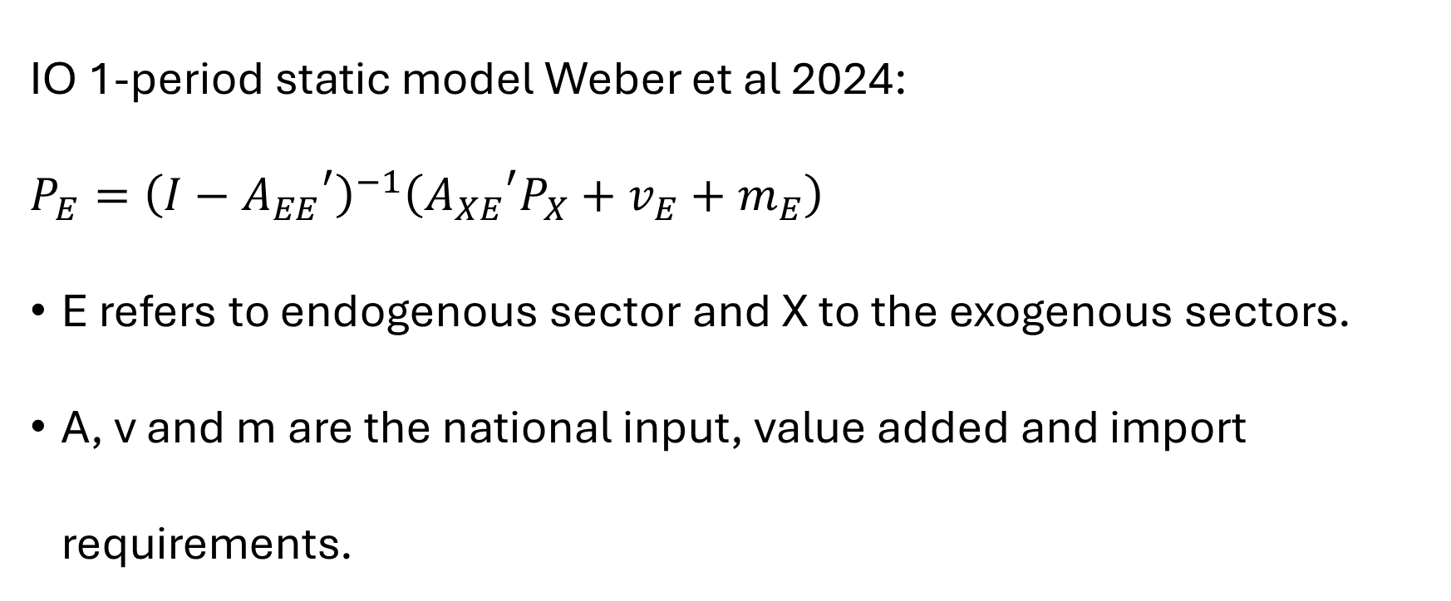
Empirical strategy
IO 1-period static model Weber et al 2024:
$$P_{E}={\left(I−{A_{EE}}^{′}\right)}^{−1}\left({A_{XE}}^{′}P_{X}+v_{E}+m_{E}\right)$$
E refers to endogenous sector and X to the exogenous sectors.
A, v and m are the national input, value added and import requirements.

Slide 10
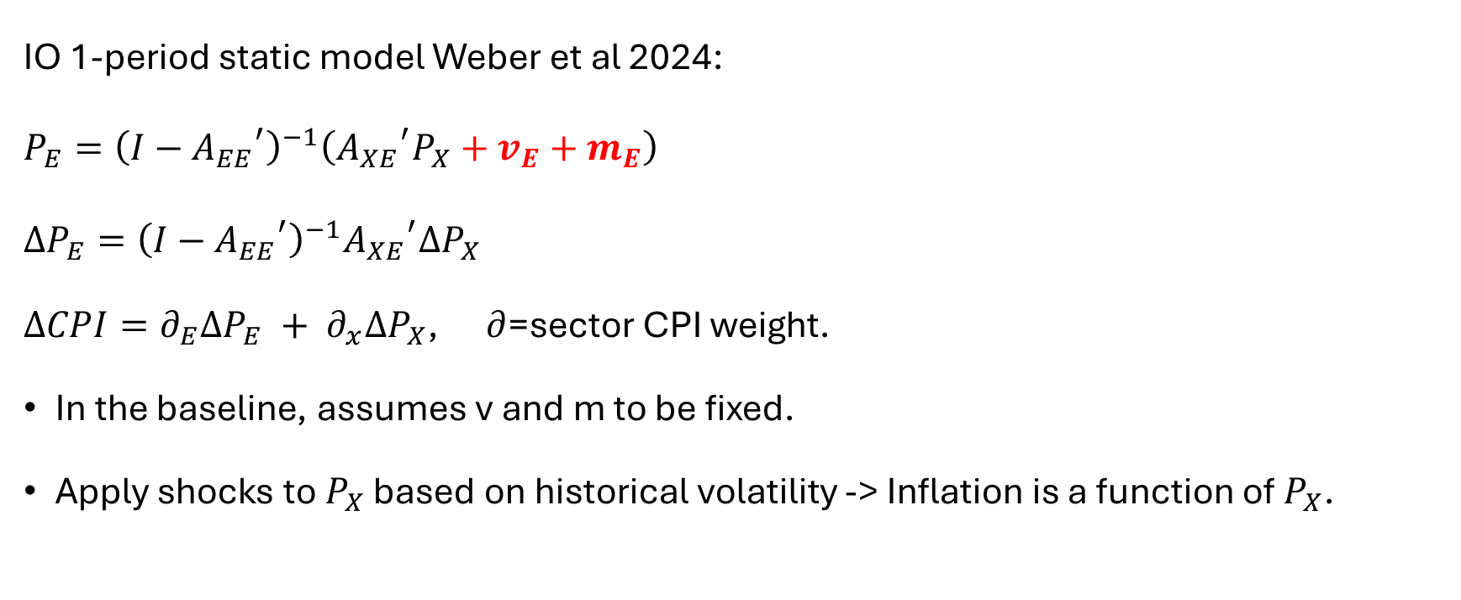
Empirical strategy
IO 1-period static model Weber et al 2024:
$$P_{E}={\left(I−{A_{EE}}^{′}\right)}^{−1}\left({A_{XE}}^{′}P_{X}+v_{E}+m_{E}\right)$$
$$ΔP_{E}={\left(I−{A_{EE}}^{′}\right)}^{−1}{A_{XE}}^{′}ΔP_{X}$$
$ΔCPI=∂_{E}ΔP_{E} + ∂_{x}ΔP_{X}$, $∂$=sector CPI weight.
In the baseline, assumes v and m to be fixed.
Apply shocks to $P_{X}$ based on historical volatility -> Inflation is a function of $P_{X}$.

Slide 11
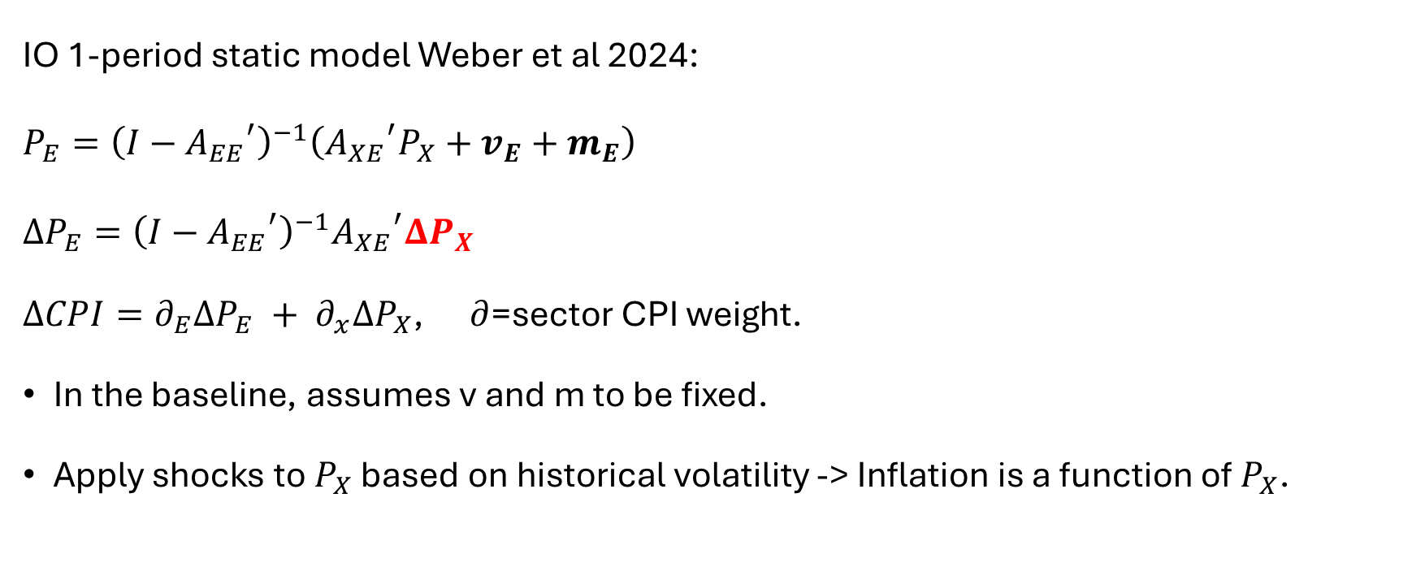
Empirical strategy
IO 1-period static model Weber et al 2024:
$$P_{E}={\left(I−{A_{EE}}^{′}\right)}^{−1}\left({A_{XE}}^{′}P_{X}+v_{E}+m_{E}\right)$$
$$ΔP_{E}={\left(I−{A_{EE}}^{′}\right)}^{−1}{A_{XE}}^{′}ΔP_{X}$$
$ΔCPI=∂_{E}ΔP_{E} + ∂_{x}ΔP_{X}$, $∂$=sector CPI weight.
In the baseline, assumes v and m to be fixed.
Apply shocks to $P_{X}$ based on historical volatility -> Inflation is a function of $P_{X}$.

Slide 12

Empirical strategy
IO 2-period SDA :
$$ΔP_{Et}=P_{Et=1}{− P}_{Et=0}$$
We assess the marginal contribution of each component of the price account.
Notes:
.

Slide 13
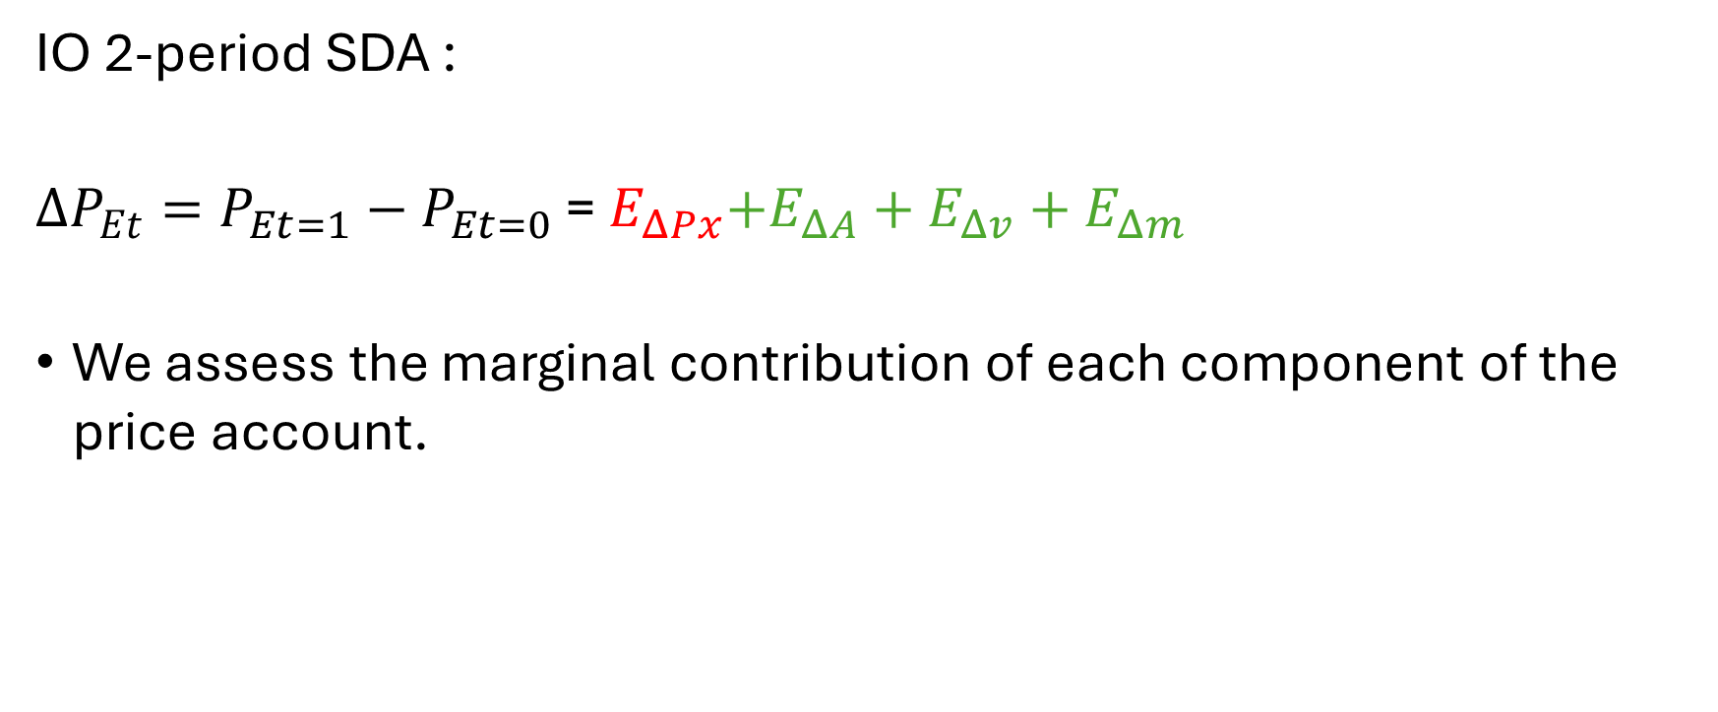
Empirical strategy
IO 2-period SDA :
$ΔP_{Et}=P_{Et=1}{− P}_{Et=0}$ =${ E}_{ΔPx}+E_{ΔA}+E_{Δv}+E_{Δm}$
We assess the marginal contribution of each component of the price account.
Notes:
.

Slide 14
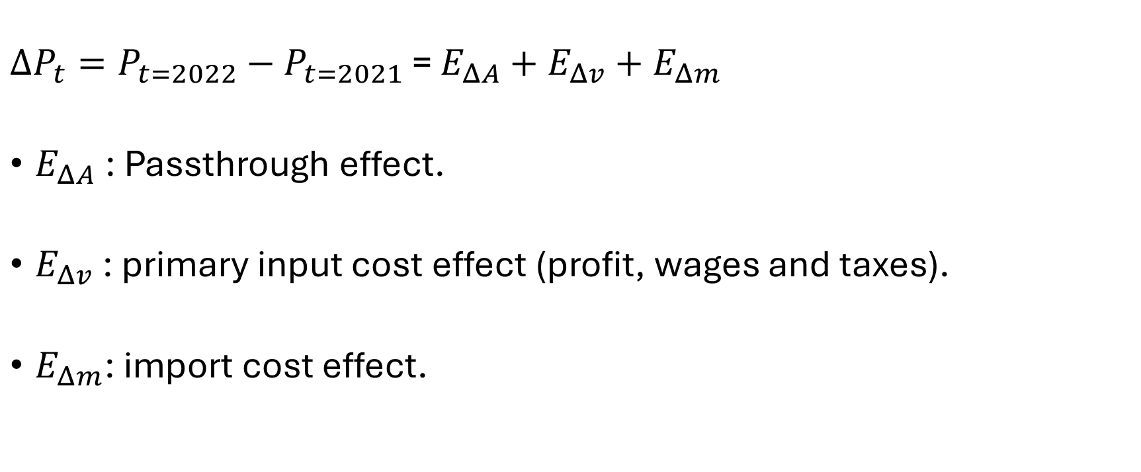
Empirical strategy
$ΔP_{t}=P_{t=2022}{− P}_{t=2021}$ = $E_{ΔA}+E_{Δv}+E_{Δm}$
$E_{ΔA}$: Passthrough effect.
$E_{Δv}$: primary input cost effect (profit, wages and taxes).
$E_{Δm}$: import cost effect.

Slide 15
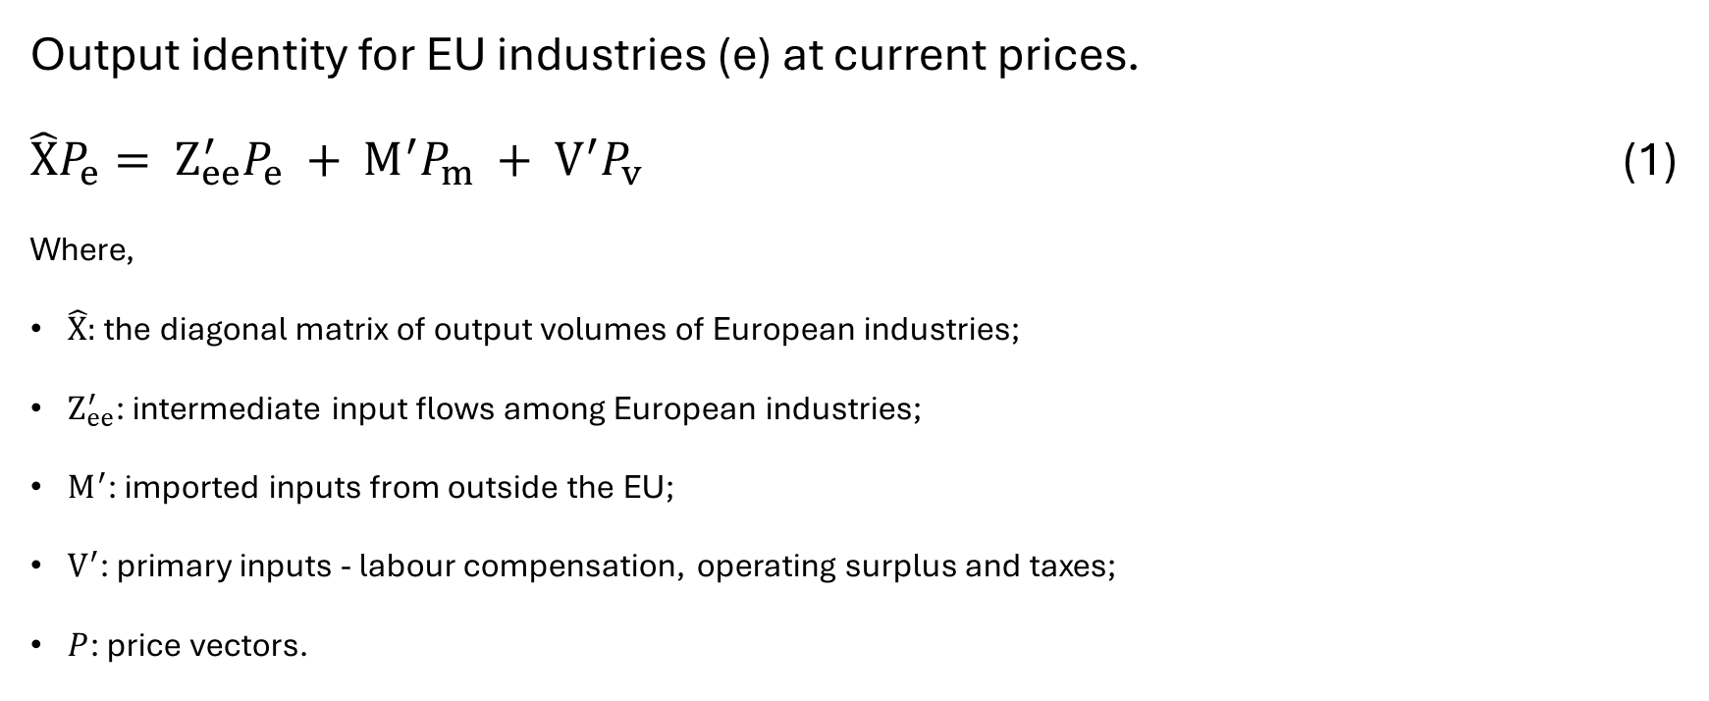
Empirical strategy
Output identity for EU industries (e) at current prices.
$\hat{X}P_{e}= Z_{ee}^{′}P_{e} + M^{′}P_{m} + V^{′}P_{v}$ (1)
Where,
$\hat{X}:$ the diagonal matrix of output volumes of European industries;
​$Z_{ee}^{′}$: intermediate input flows among European industries;
$M^{′}$: imported inputs from outside the EU;
$V^{′}$: primary inputs - labour compensation, operating surplus and taxes;
$P$:​ price vectors.

Slide 16

Empirical strategy
${\hat{X}}^{−1}\hat{X}P_{e}=Z_{ee}^{′}P_{e} + M^{′}P_{m} + V^{′}P_{v}$

Slide 17
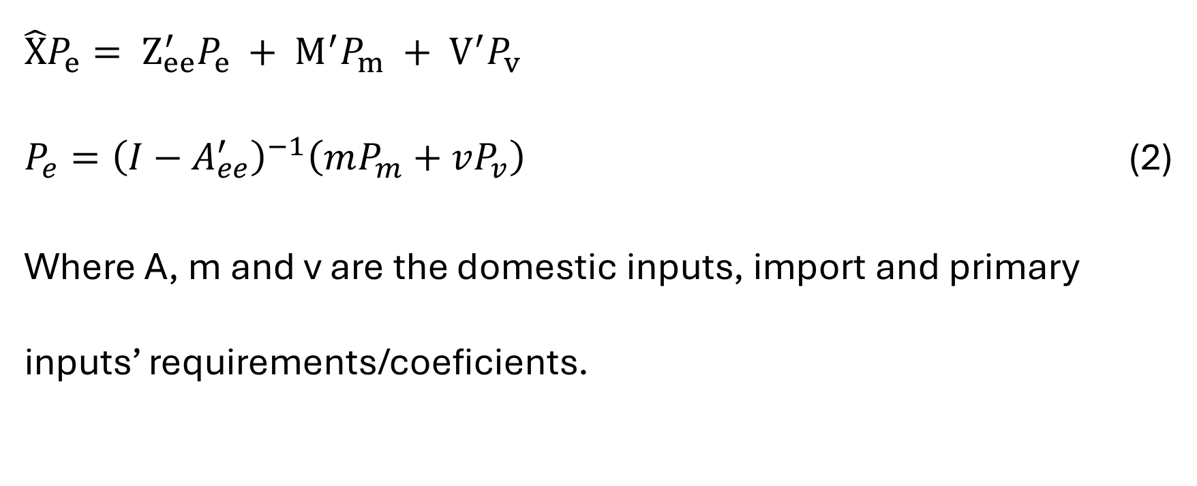
Empirical strategy
$\hat{X}P_{e}= Z_{ee}^{′}P_{e} + M^{′}P_{m} + V^{′}P_{v}$
$P_{e}={\left(I−A_{ee}^{′}\right)}^{−1}\left(mP_{m}+vP_{v}\right)$ (2)
Where A, m and v are the domestic inputs, import and primary inputs’ requirements/coeficients.

Slide 18
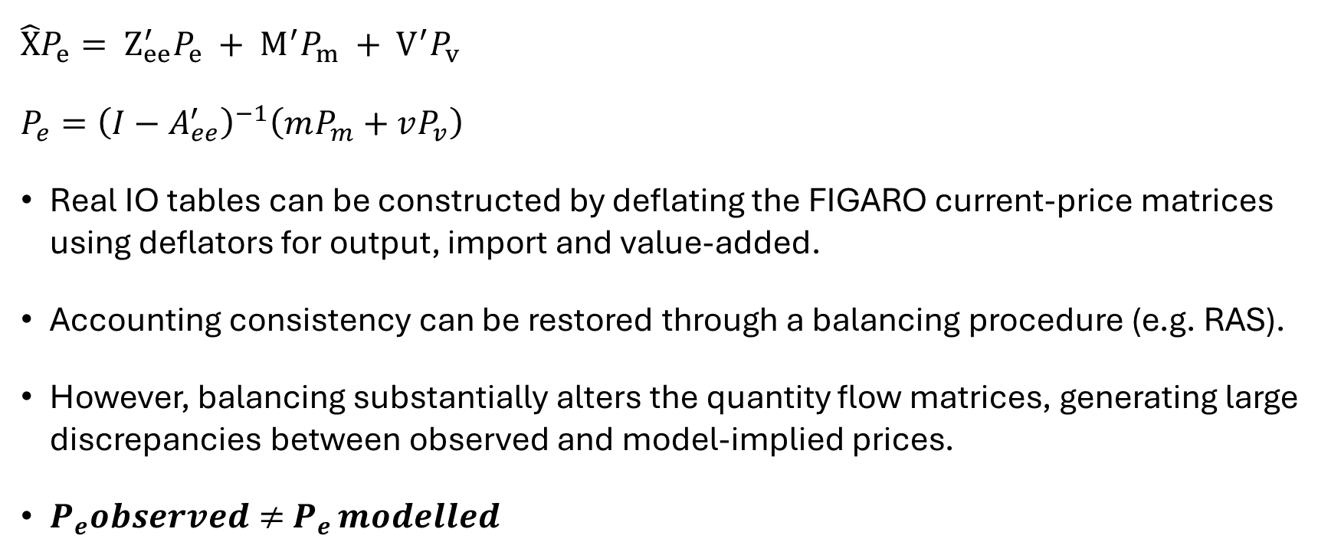
Empirical strategy
$\hat{X}P_{e}= Z_{ee}^{′}P_{e} + M^{′}P_{m} + V^{′}P_{v}$
$P_{e}={\left(I−A_{ee}^{′}\right)}^{−1}\left(mP_{m}+vP_{v}\right)$
Real IO tables can be constructed by deflating the FIGARO current-price matrices using deflators for output, import and value-added.
Accounting consistency can be restored through a balancing procedure (e.g. RAS).
However, balancing substantially alters the quantity flow matrices, generating large discrepancies between observed and model-implied prices.
$P_{e}observed≠$ $P_{e }modelled$

Slide 19

Empirical strategy
1. Deflation
$Z_{ee}^{nominal} →Z_{ee}^{real}$ using $P_{e}$
$M^{nominal}→$ $M^{real}$ using $P_{m}$
$V^{nominal}→$ $V^{real}$ using $P_{v}$

Slide 20

Empirical strategy
1. Deflation
$Z_{ee}^{nominal} →Z_{ee}^{real}$ using $P_{e}$
$M^{nominal}→$ $M^{real}$ using $P_{m}$
$V^{nominal}→$ $V^{real}$ using $P_{v}$
$X^{nominal}→$ $X^{real}$ using $P_{e}$
 | 1 | 2 | 3 | FD | X
1
2
3
M
VA
X

Slide 21

Empirical strategy
1. Deflation
$Z_{ee}^{nominal} →Z_{ee}^{real}$
$M^{nominal}→$ $M^{real}$
$V^{nominal}→$ $V^{real}$
$X^{nominal}→$ $X^{real}$
$$X^{′}≠X$$
 | 1 | 2 | 3 | FD | X
1
2
3
M
VA
X’

Slide 22

Empirical strategy
2. Balancing
B$alance Z_{ee}^{real}$ such that:
$$X^{′}=X$$
 | 1 | 2 | 3 | FD | X
1
2
3
M
VA
X’

Slide 23
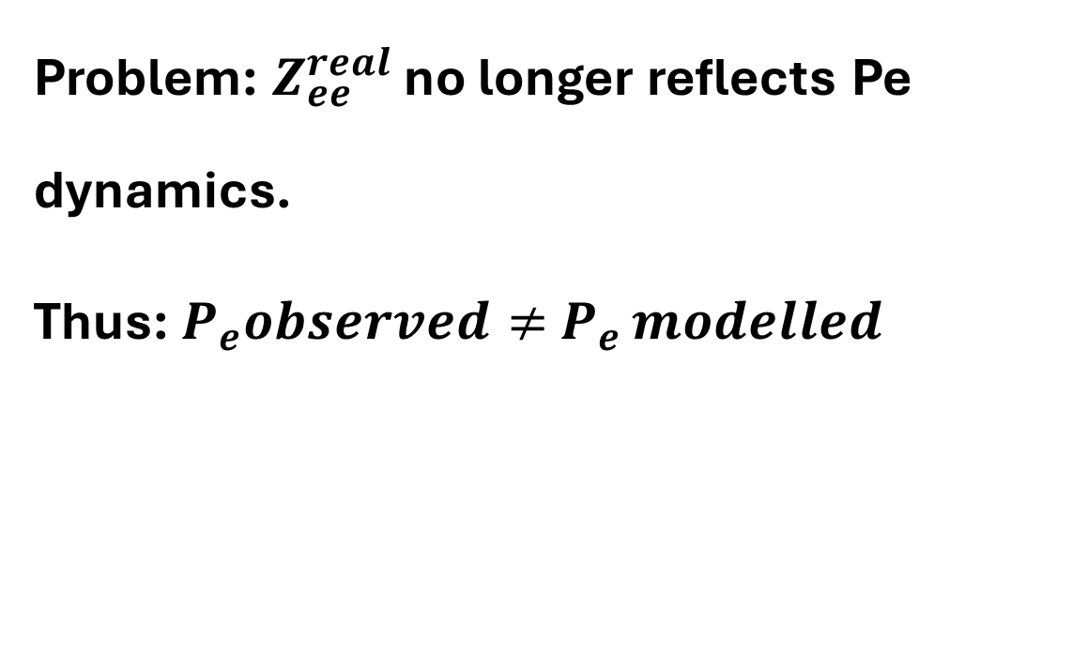
Empirical strategy
Problem: $Z_{ee}^{real}$ no longer reflects Pe dynamics.
Thus: $P_{e}observed≠$ $P_{e }modelled$
 | 1 | 2 | 3 | FD | X
1
2
3
M
VA
X’

Slide 24
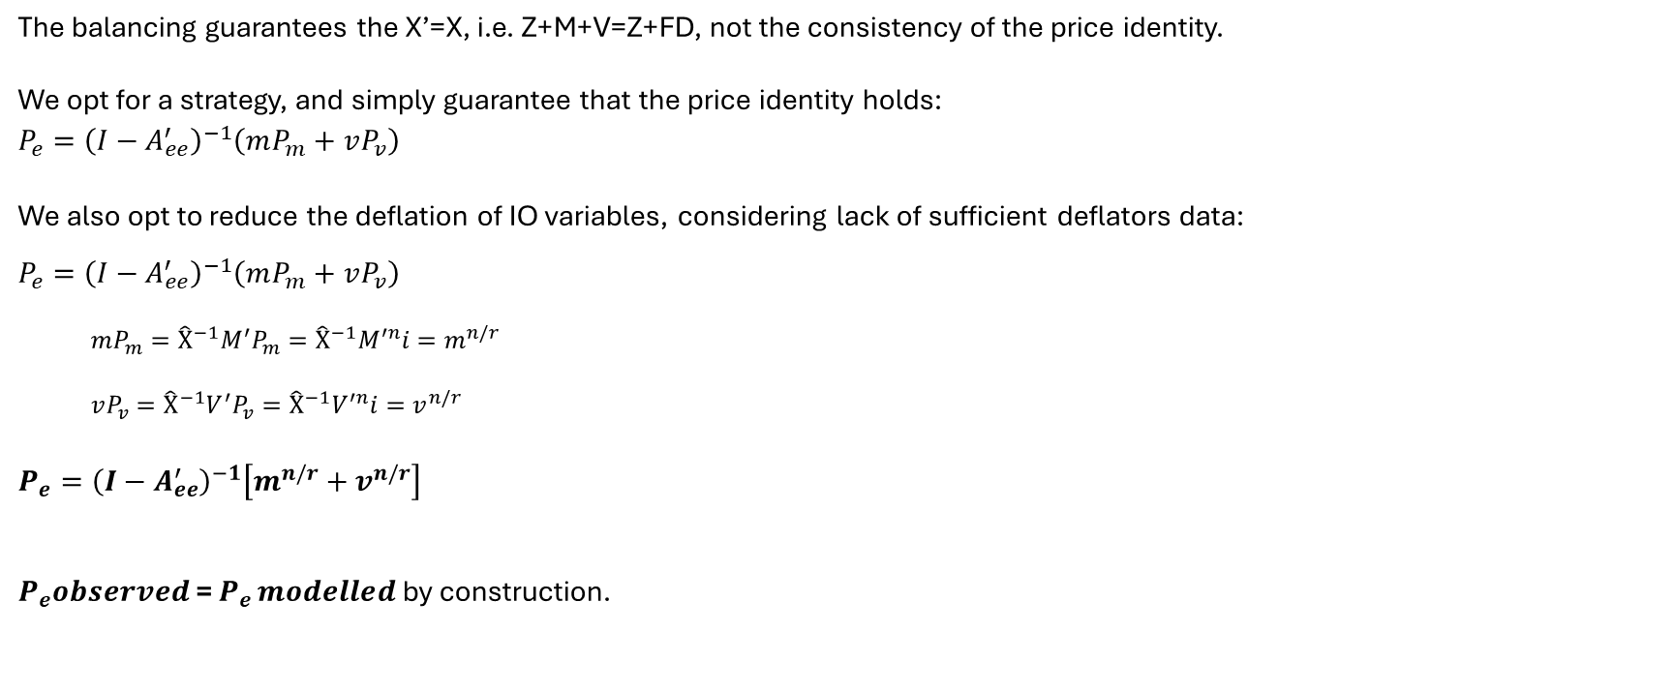
Empirical strategy - we could have deflated M and V no problem. We only do not do it to simplify.
The balancing guarantees the X’=X, i.e. Z+M+V=Z+FD, not the consistency of the price identity.
We opt for a strategy, and simply guarantee that the price identity holds:
$$P_{e}={\left(I−A_{ee}^{′}\right)}^{−1}\left(mP_{m}+vP_{v}\right)$$
We also opt to reduce the deflation of IO variables, considering lack of sufficient deflators data:
$P_{e}={\left(I−A_{ee}^{′}\right)}^{−1}\left(mP_{m}+vP_{v}\right)$
  $$mP_{m}={{\hat{X}}^{−1}M}^{′}P_{m}={\hat{X}}^{−1}M^{′n}i=m^{n/r}$$
  $$vP_{v}={{\hat{X}}^{−1}V}^{′}P_{v}={\hat{X}}^{−1}V^{′n}i=v^{n/r}$$
$$P_{e}={\left(I−A_{ee}^{′}\right)}^{−1}\left[m^{n/r}+v^{n/r}\right]$$
$P_{e}observed$= $P_{e }modelled$ by construction.

Slide 25

Empirical strategy - SDA
$$P_{t}=L_{t}^{′}C_{t}⇒{CPI}_{t}={∂_{t}L}_{t}^{′}C_{t}$$
where $C_{t}$ is the direct cost vector: $C_{t}=m_{t}^{n/r}+v_{t}^{n/r}$
and $L_{t}^{′}$ the Leontief multiplier: $L_{t}^{′}={\left(I−A_{ee,t}^{′}\right)}^{−1}$
$∂_{t}$ is the CPI weights matrix.
Ignoring variations in $∂_{t}$ between 2021-2022…
$$ΔP=P_{1}−P_{0}=L_{1}C_{1}−L_{0}C_{0}$$

Slide 26

Empirical strategy
$$ΔP=E_{A}+E_{m}+E_{v}$$
Following Dietzenbacher and Los (1998) to address non uniqueness:
$$E_{A}=\frac{1}{2}\left(L_{1}−L_{0}\right)\left(C_{0}+C_{1}\right)$$
$$E_{m}=\frac{1}{2}\left(L_{0}+L_{1}\right)\left(m_{1}^{n/r}−m_{0}^{n/r}\right)$$
$$E_{v}=\frac{1}{2}\left(L_{0}+L_{1}\right)\left(v_{1}^{n/r}−v_{0}^{n/r}\right)$$

Slide 27
Preliminary results
15 countries. Several countries lack sufficient deflators’ data, namely for key sectors like C19 – coke and refined petroleum.

Slide 28
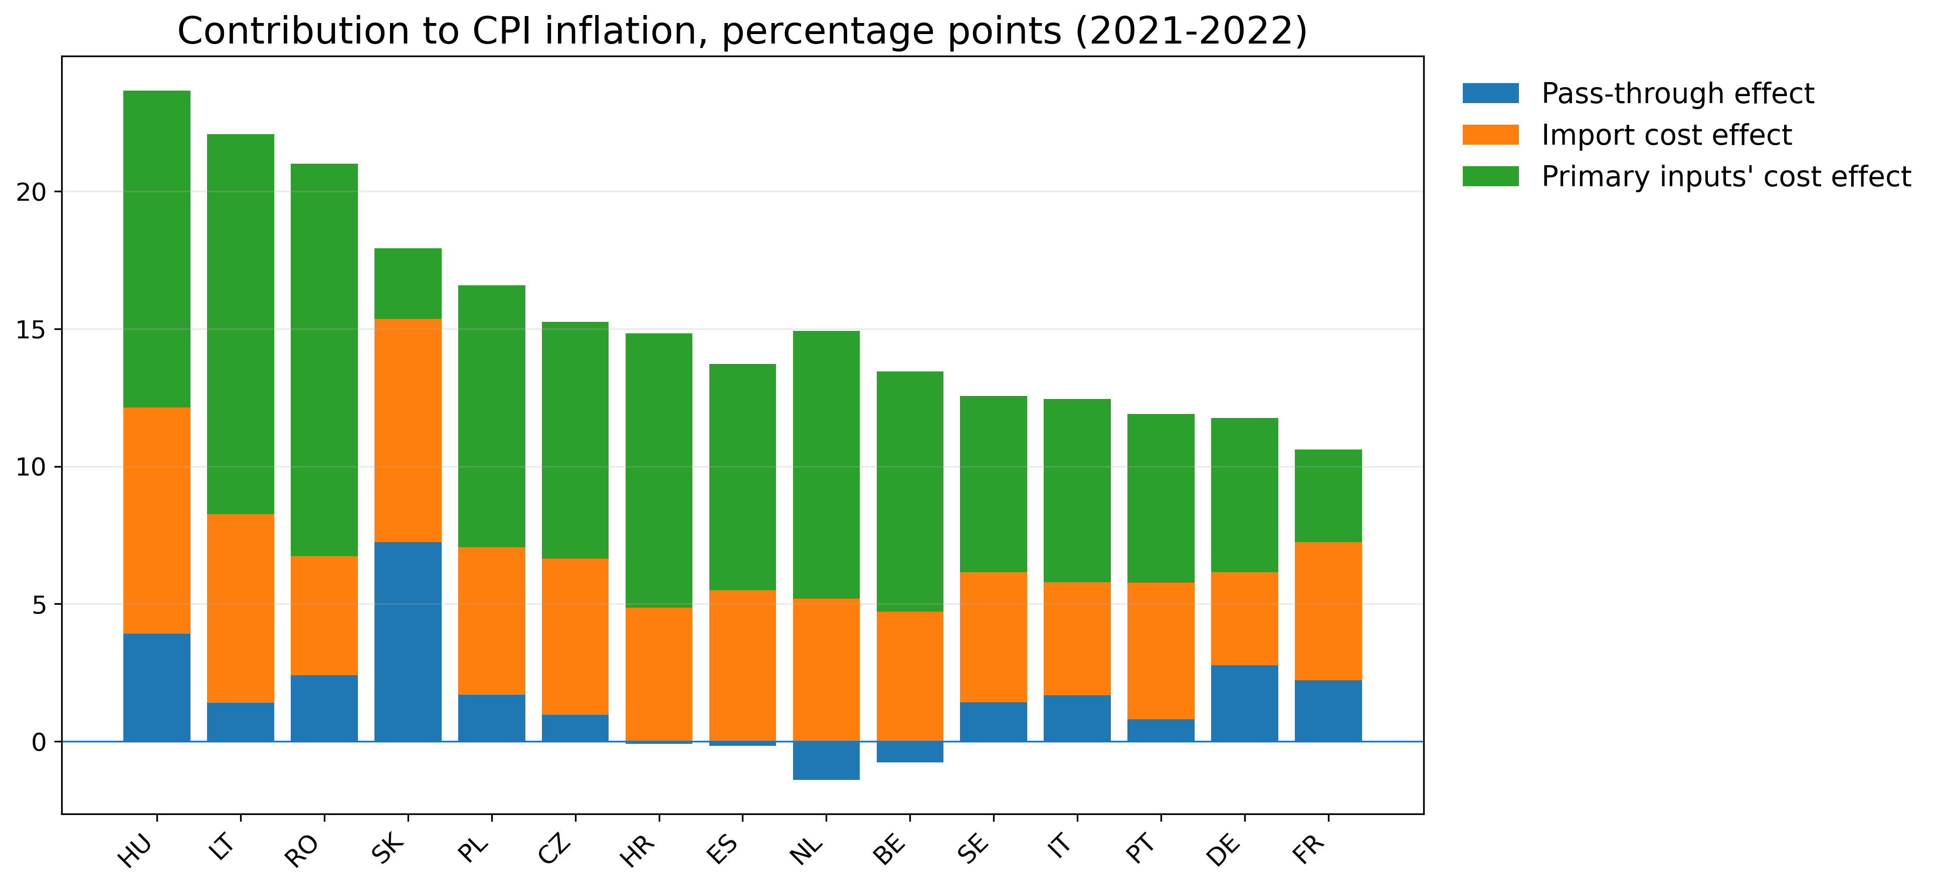

Slide 29
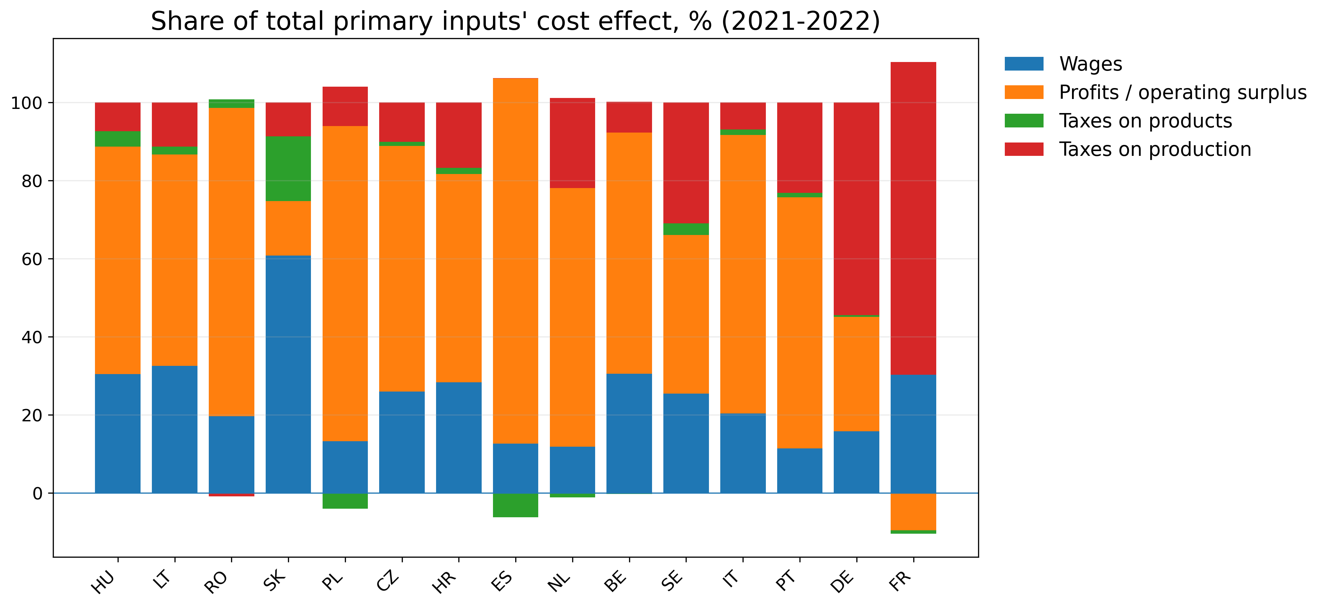

Slide 30
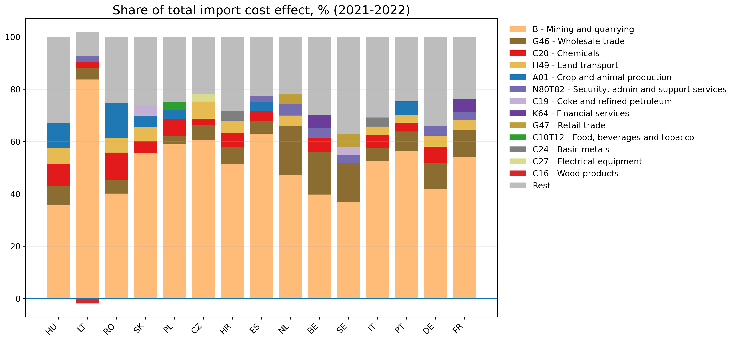

Slide 31
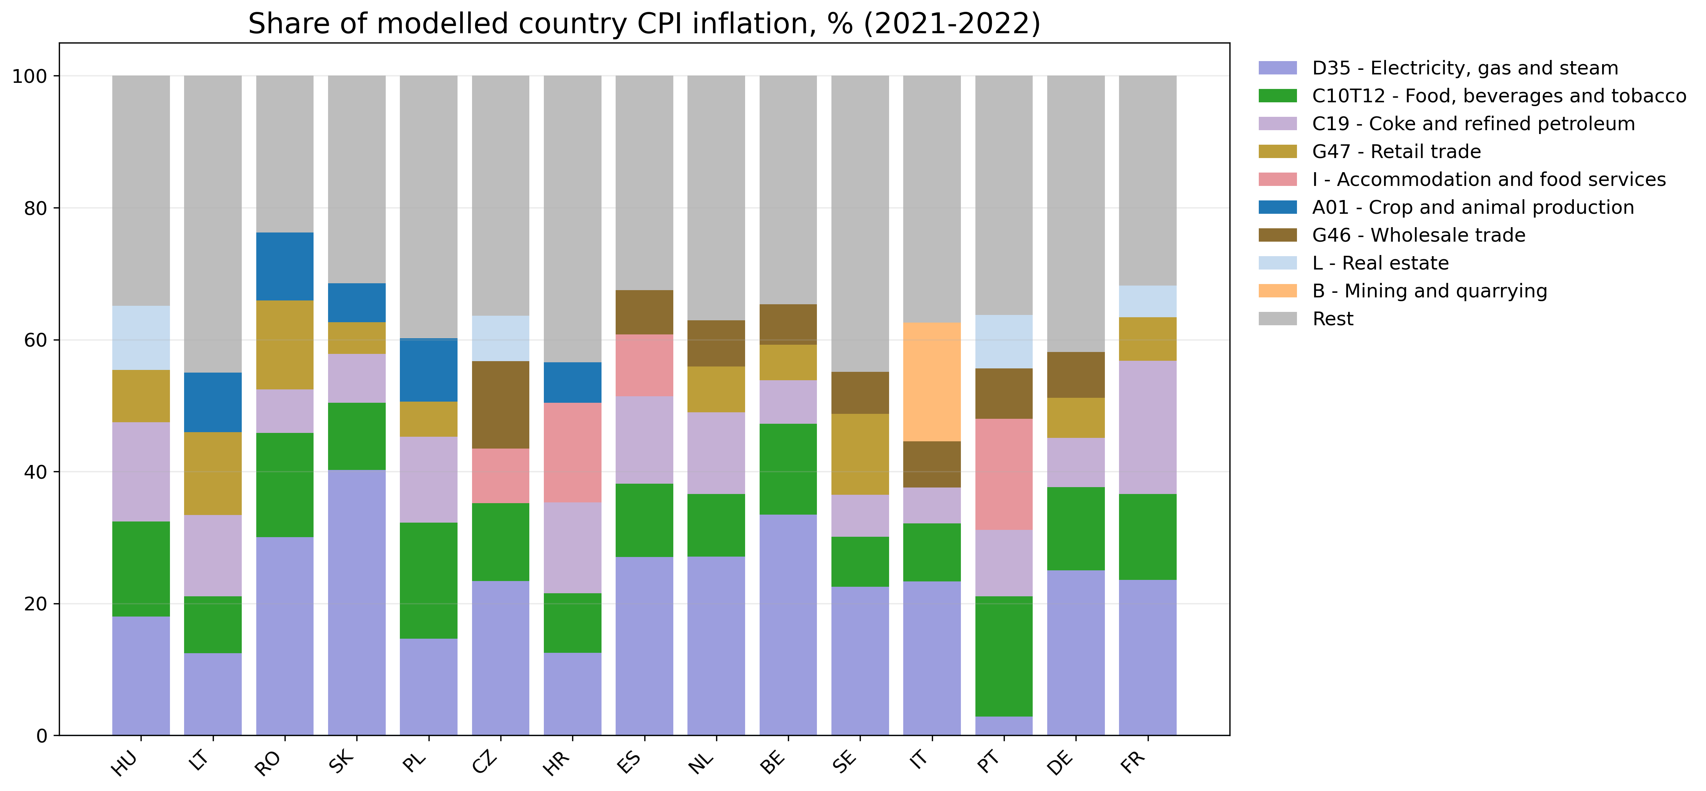

Slide 32
Country sector detail - Portugal
 | Total Effect | A | m | m Agro | m Mining | m chemicals | m other goods | m wholesaletrade | m Land transport | m Other services | v | v Wages | v Profits | v taxes production | v taxes products
Total - Portugal | 11.91 | 0.81 | 4.97 | 0.26 | 2.80 | 0.17 | 0.70 | 0.37 | 0.15 | 0.52 | 6.13 | 0.70 | 3.94 | 1.42 | 0.07
A01 - Crop and animal production | 0.47 | 0.22 | 0.15 | 0.02 | 0.05 | 0.01 | 0.02 | 0.01 | 0.01 | 0.02 | 0.11 | 0.07 | 0.04 | -0.03 | 0.03
C10T12 - Food, beverages and tobacco | 2.17 | 0.79 | 0.75 | 0.17 | 0.21 | 0.03 | 0.15 | 0.06 | 0.04 | 0.09 | 0.63 | 0.25 | 0.32 | 0.02 | 0.05
C19 - Coke and refined petroleum | 1.20 | -0.09 | 1.07 | 0.00 | 1.04 | 0.00 | 0.00 | 0.00 | 0.00 | 0.02 | 0.22 | 0.00 | 0.20 | 0.01 | 0.01
G46 - Wholesale trade | 0.91 | 0.20 | 0.19 | 0.00 | 0.06 | 0.00 | 0.02 | 0.08 | 0.01 | 0.03 | 0.51 | 0.19 | 0.29 | 0.05 | -0.01
G47 - Retail trade | 0.80 | 0.13 | 0.23 | 0.00 | 0.11 | 0.01 | 0.02 | 0.04 | 0.01 | 0.04 | 0.44 | 0.25 | 0.04 | 0.17 | -0.02
I - Accommodation and food services | 2.00 | -0.12 | 0.42 | 0.04 | 0.17 | 0.02 | 0.07 | 0.04 | 0.01 | 0.07 | 1.69 | -0.29 | 1.02 | 0.93 | 0.05
L - Real estate | 0.96 | 0.03 | 0.06 | 0.00 | 0.03 | 0.00 | 0.01 | 0.00 | 0.00 | 0.02 | 0.87 | 0.08 | 0.76 | 0.03 | 0.01

Slide 33
Open questions
How to interpret A? -> A may also reflect input relative price change.
How to interpret taxes on production, sector L and I?

Slide 34
Disentangling Cost-Push Pressures of EU Inflation (2021–2022): A Country-Sector Structural Decomposition in a Global Leontief Price Model
Diogo Sousa, PhD candidate – Universidade Coimbra
Vicente Ferreira, Universidade de Lisboa
João Pedro Ferreira, University of Virginia

