Slide 1
A study on the coordinated development of China's digital economy and energy structure before and after the entry into force of RCEP
SUN YUXUAN¹, ISHIRO TAKU², ZHU MINGJI¹
1: Yokohama National University Graduate School of International Social Sciences，Japan
2: Yokohama National University，Japan
Notes:
Good afternoon, everyone. My name is Yuxuan Sun, and I am a Ph.D. candidate at Yokohama National University in Japan. It is my great pleasure to present my research today. The title of my presentation is “A Study on the Coordinated Development of China’s Digital Economy and Energy Structure Before and After the Entry into Force of RCEP.”

Slide 2
Content
Introduction
Theoretical analysis and research hypotheses
Research design
Empirical results and analysis
Conclusion
Notes:
Today, my presentation is organized into five parts.

Slide 3
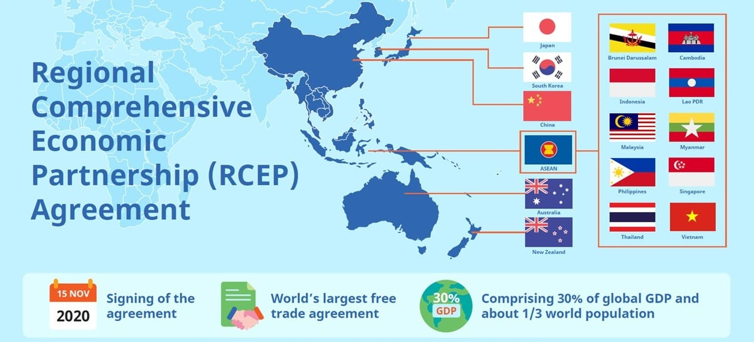
Part 1. Introduction

Slide 4

Signing Background
After multiple rounds of negotiations that commenced in 2012, the Regional Comprehensive Economic Partnership (RCEP) was signed on November 15, 2020.
Coverage
RCEP is a comprehensive agreement aimed at broadening and deepening free trade among the Association of Southeast Asian Nations (ASEAN) and its existing partners, namely the so-called "+3" countries—the People's Republic of China, Japan, and the Republic of Korea—as well as Australia and New Zealand.
The 15 RCEP participants collectively account for approximately 29% (USD 25.8 trillion) of the global gross domestic product (GDP), 30% (2.3 billion) of the world's population, and 25% (USD 12.7 trillion) of global trade in goods and services. In terms of GDP, RCEP will be the world's largest free trade agreement, surpassing the Comprehensive and Progressive Agreement for Trans-Pacific Partnership (CPTPP), the European Union (EU), the Southern Common Market (MERCOSUR), and the recently concluded United States-Mexico-Canada Agreement. RCEP is the first multilateral agreement to include China and establishes the first free trade agreements between China and Japan, and between China and the Republic of Korea.
Significance
At a time when regional economies are recovering from the economic slowdown caused by the COVID-19 pandemic, the implementation of RCEP has created new opportunities for regional trade, investment, and industrial cooperation. By promoting trade liberalization and strengthening regional production networks, RCEP enhances economic connectivity among member countries and deepens regional value chain integration. The agreement not only facilitates the development of digital industries and cross-border digital trade but also reshapes energy-related industrial linkages through increased economic interaction. Therefore, RCEP provides an important institutional framework for examining the coordinated development of China’s digital economy and energy structure and their spillover effects within the regional economy.
Notes:
the Regional Comprehensive Economic Partnership (RCEP) was signed on November 15, 2020.
RCEP is a comprehensive agreement aimed at broadening and deepening free trade among the Association of Southeast Asian Nations (ASEAN) and its existing partners.

Slide 5
In recent years, the digital economy has become an important driving force for economic growth, industrial upgrading, and regional economic integration. With the rapid development of digital technologies such as big data, cloud computing, artificial intelligence, the Internet of Things, and digital platforms, digital transformation has increasingly penetrated traditional industries and reshaped production methods, trade patterns, and value chain structures. For China, the digital economy not only provides new momentum for high-quality economic development but also plays an important role in promoting industrial modernization and enhancing international competitiveness.
At the same time, energy remains a fundamental input for economic and industrial development. The expansion of the digital economy depends heavily on stable energy supply, as digital infrastructure, data centers, communication networks, electronic information manufacturing, and intelligent manufacturing systems all require continuous energy support. Therefore, the development of the digital economy is closely related to the adjustment of energy structure. On the one hand, digital technologies can improve energy efficiency, optimize energy allocation, and promote the intelligent and low-carbon transformation of the energy system. On the other hand, the rapid expansion of digital industries may also increase energy consumption and impose additional pressure on the environment if the energy structure remains highly dependent on fossil fuels. Thus, the relationship between the digital economy and energy structure is not only mutually reinforcing, but also subject to environmental constraints.
Notes:
In recent years, the digital economy has become an important driving force for economic growth, industrial upgrading, and regional economic integration. With the rapid development of digital technologies such as big data, cloud computing, artificial intelligence, the Internet of Things, and digital platforms, digital transformation has increasingly penetrated traditional industries and reshaped production methods, trade patterns, and value chain structures.

Slide 6
The entry into force of the Regional Comprehensive Economic Partnership Agreement has further strengthened economic and industrial linkages between China and other RCEP member countries. Through trade liberalization, regional production networks, and cross-border industrial cooperation, RCEP has created new opportunities for the development of China’s digital economy and energy-related industries. In this context, China’s digital economy may generate spillover effects on other RCEP economies through digital products, technological services, intermediate goods trade, and industrial chain cooperation. Meanwhile, the economic activities of RCEP countries may also generate reverse driving effects on China’s digital economy and energy sectors. These interactions indicate that the coordinated development of China’s digital economy and energy structure is no longer only a domestic issue but is increasingly embedded in regional value chains.
Notes:
China’s digital economy may generate spillover effects on other RCEP economies through digital products, technological services, intermediate goods trade, and industrial chain cooperation. Meanwhile, the economic activities of RCEP countries may also generate reverse driving effects on China’s digital economy and energy sectors.

Slide 7
Part 2. Theoretical analysis and research hypotheses

Slide 8
The China Academy of Information and Communications Technology (CAICT), in its Research Report on the Development of China’s Digital Economy, provides a detailed explanation of what the digital economy is. The digital economy is a new form of economy that takes digital knowledge and information as key factors of production, digital technology as the core driving force, and modern information networks as important carriers. Through the deep integration of digital technology with the real economy, it continuously improves the digitalized, networked, and intelligent level of economic and social development, and accelerates the restructuring of economic development and governance models.
Specifically, it consists of four major components.
First, digital industrialization, namely the information and communications industry, which specifically includes the electronic information manufacturing industry, the telecommunications industry, the software and information technology services industry, and the Internet industry, among others.
Second, industrial digitalization, which refers to the increase in output and improvement in efficiency brought about by the application of digital technologies in traditional industries, including but not limited to integrated new industries, new models, and new business forms such as the industrial Internet, intelligent manufacturing, the Internet of Vehicles, and the platform economy.
Third, digital governance, including but not limited to pluralistic governance, the integration of technology and management characterized by “digital technology + governance,” and digital public services.
Fourth, data valorization, including but not limited to data collection, data standards, data ownership confirmation, data annotation, data pricing, data transactions, data circulation, and data protection.
Notes:
The China Academy of Information and Communications Technology (CAICT), in its Research Report on the Development of China’s Digital Economy, provides a detailed definition of the digital economy. Specifically, the digital economy consists of four major components. First, digital industrialization. Second, industrial digitalization. Third, digital governance. Fourth, data valorization.

Slide 9


Notes:
This study mainly focuses on China and the other 11 RCEP member countries for which the agreement entered into force at an earlier stage.

Slide 10
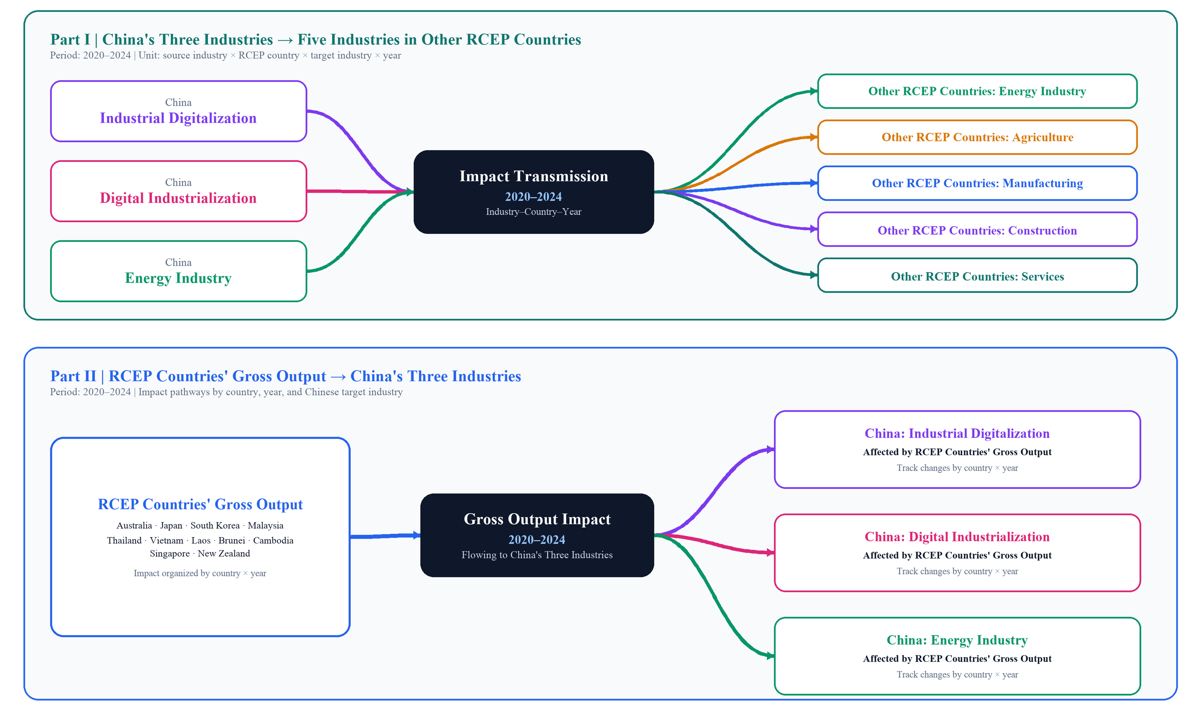
Notes:
The analysis in this study consists of two main parts. First, it examines the impacts of China’s industrial digitalization, digital industrialization, and energy industries on the total output of the energy, agriculture, manufacturing, construction, and service sectors in other RCEP member countries. Second, it investigates the impacts of economic activities in RCEP countries on the total output of China’s industrial digitalization, digital industrialization, and energy industries. Through this two-way analysis, the study reveals the industrial linkages and mutual economic effects between China and other RCEP member countries under the framework of regional economic integration.

Slide 11
Part 3. Research design

Slide 12
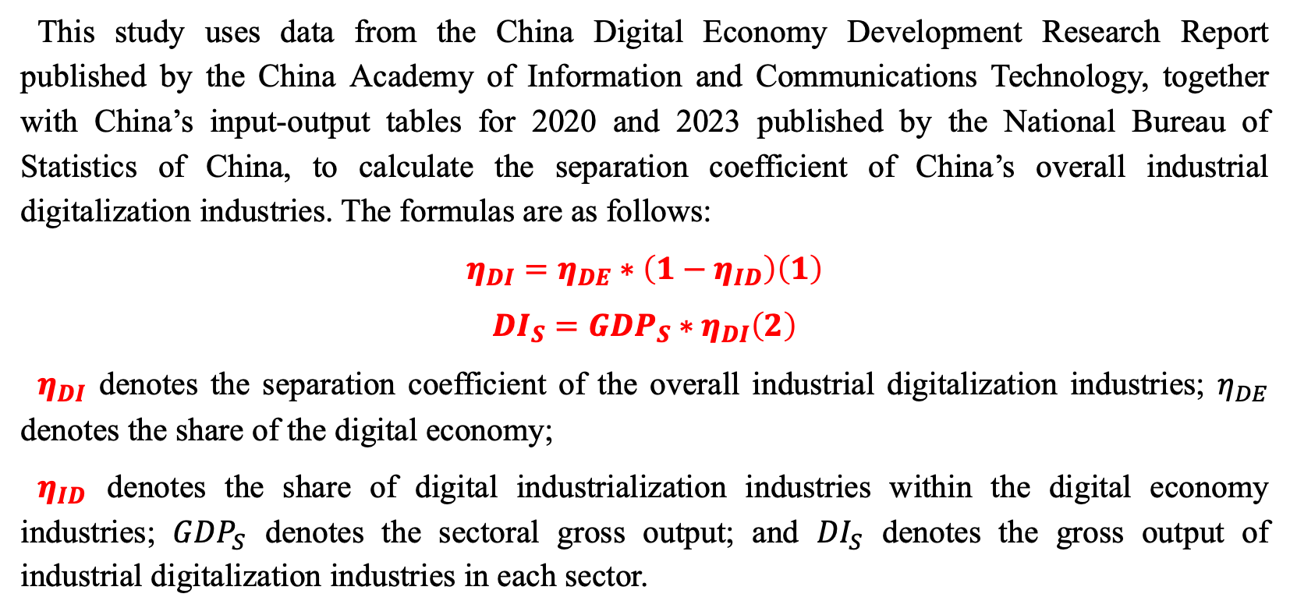
Calculation Method for the Separation Coefficient of Industrial Digitalization Industries
This study uses data from the China Digital Economy Development Research Report published by the China Academy of Information and Communications Technology, together with China’s input-output tables for 2020 and 2023 published by the National Bureau of Statistics of China, to calculate the separation coefficient of China’s overall industrial digitalization industries. The formulas are as follows:
$$\begin{aligned}η_{DI}=η_{DE}∗\left(1−η_{ID}\right)\#\left(1\right)\end{aligned}$$
$$\begin{aligned}{DI}_{S}={GDP}_{S}∗η_{DI}\#\left(2\right)\end{aligned}$$
$η_{DI}$ denotes the separation coefficient of the overall industrial digitalization industries; $η_{DE}$ denotes the share of the digital economy;
$η_{ID}$ denotes the share of digital industrialization industries within the digital economy industries; ${GDP}_{S}$ denotes the sectoral gross output; and ${DI}_{S}$ denotes the gross output of industrial digitalization industries in each sector.
Notes:
This study uses data from the China Digital Economy Development Research Report published by the China Academy of Information and Communications Technology, together with China’s input-output tables for 2020 and 2023 published by the National Bureau of Statistics of China, to calculate the separation coefficient of China’s overall industrial digitalization industries. The formulas are as follows:

Slide 13
Establishment of the Input-Output Model
Table 1. Model Based on an International Input-Output Table
Notes:
This table illustrates the input-output model framework designed for this study. As shown in thetable, China is divided into seven industrial sectors, including industrial digitalization, digital industrialization, the energy industry, agriculture, manufacturing, construction, and services. These sectors are used to analyze the economic linkages between China and other RCEP member countries.

Slide 14
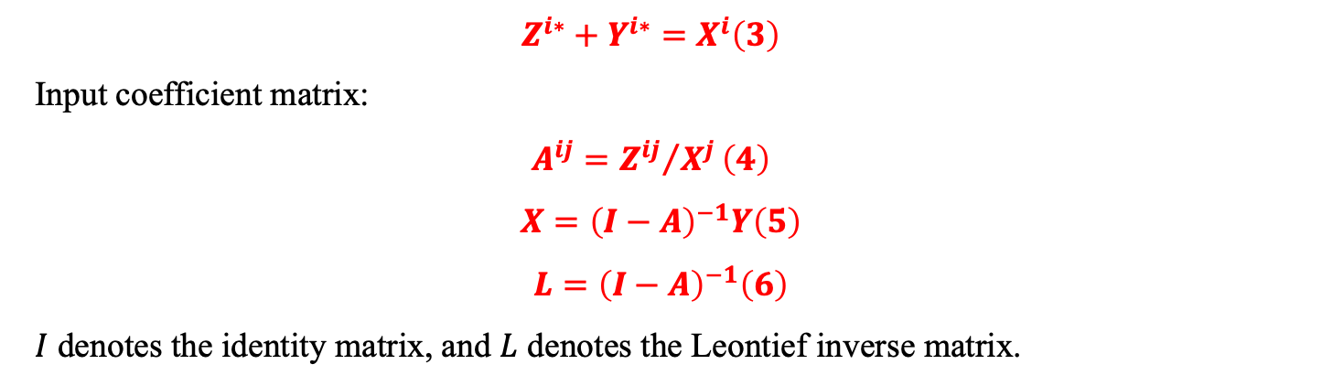
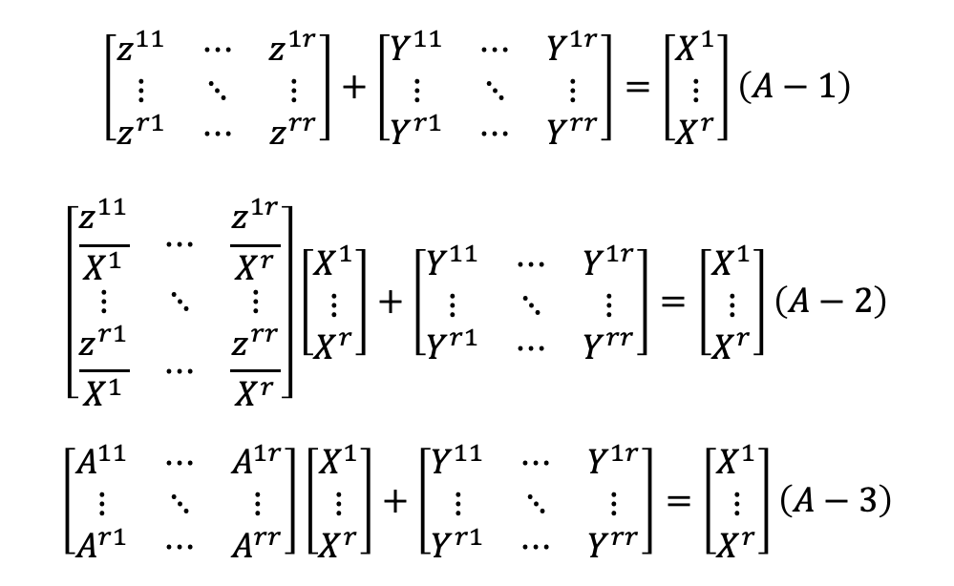
$$\begin{aligned}Z^{i∗}+Y^{i∗}=X^{i}\#\left(3\right)\end{aligned}$$
Input coefficient matrix:
$$\begin{aligned}A^{ij}={Z^{ij}}/{X^{j}}\#\left(4\right)\end{aligned}$$
$$\begin{aligned}X={\left(I−A\right)}^{−1}Y\#\left(5\right)\end{aligned}$$
$$\begin{aligned}L={\left(I−A\right)}^{−1}\#\left(6\right)\end{aligned}$$
$I$ denotes the identity matrix, and $L$ denotes the Leontief inverse matrix.
$$\begin{aligned}\left[\begin{matrix}z^{11} & ⋯ & z^{1r} \\ ⋮ & ⋱ & ⋮ \\ z^{r1} & ⋯ & z^{rr}\end{matrix}\right]+\left[\begin{matrix}Y^{11} & ⋯ & Y^{1r} \\ ⋮ & ⋱ & ⋮ \\ Y^{r1} & ⋯ & Y^{rr}\end{matrix}\right]=\left[\begin{matrix}X^{1} \\ ⋮ \\ X^{r}\end{matrix}\right]\#\left(A−1\right)\end{aligned}$$
$$\begin{aligned}\left[\begin{matrix}\frac{z^{11}}{X^{1}} & ⋯ & \frac{z^{1r}}{X^{r}} \\ ⋮ & ⋱ & ⋮ \\ \frac{z^{r1}}{X^{1}} & ⋯ & \frac{z^{rr}}{X^{r}}\end{matrix}\right]\left[\begin{matrix}X^{1} \\ ⋮ \\ X^{r}\end{matrix}\right]+\left[\begin{matrix}Y^{11} & ⋯ & Y^{1r} \\ ⋮ & ⋱ & ⋮ \\ Y^{r1} & ⋯ & Y^{rr}\end{matrix}\right]=\left[\begin{matrix}X^{1} \\ ⋮ \\ X^{r}\end{matrix}\right]\#\left(A−2\right)\end{aligned}$$
$$\begin{aligned}\left[\begin{matrix}A^{11} & ⋯ & A^{1r} \\ ⋮ & ⋱ & ⋮ \\ A^{r1} & ⋯ & A^{rr}\end{matrix}\right]\left[\begin{matrix}X^{1} \\ ⋮ \\ X^{r}\end{matrix}\right]+\left[\begin{matrix}Y^{11} & ⋯ & Y^{1r} \\ ⋮ & ⋱ & ⋮ \\ Y^{r1} & ⋯ & Y^{rr}\end{matrix}\right]=\left[\begin{matrix}X^{1} \\ ⋮ \\ X^{r}\end{matrix}\right]\#\left(A−3\right)\end{aligned}$$
Notes:
The following equation presents the basic input-output model used in this study. To facilitate understanding and presentation, I have also expressed the model in matrix form below.

Slide 15
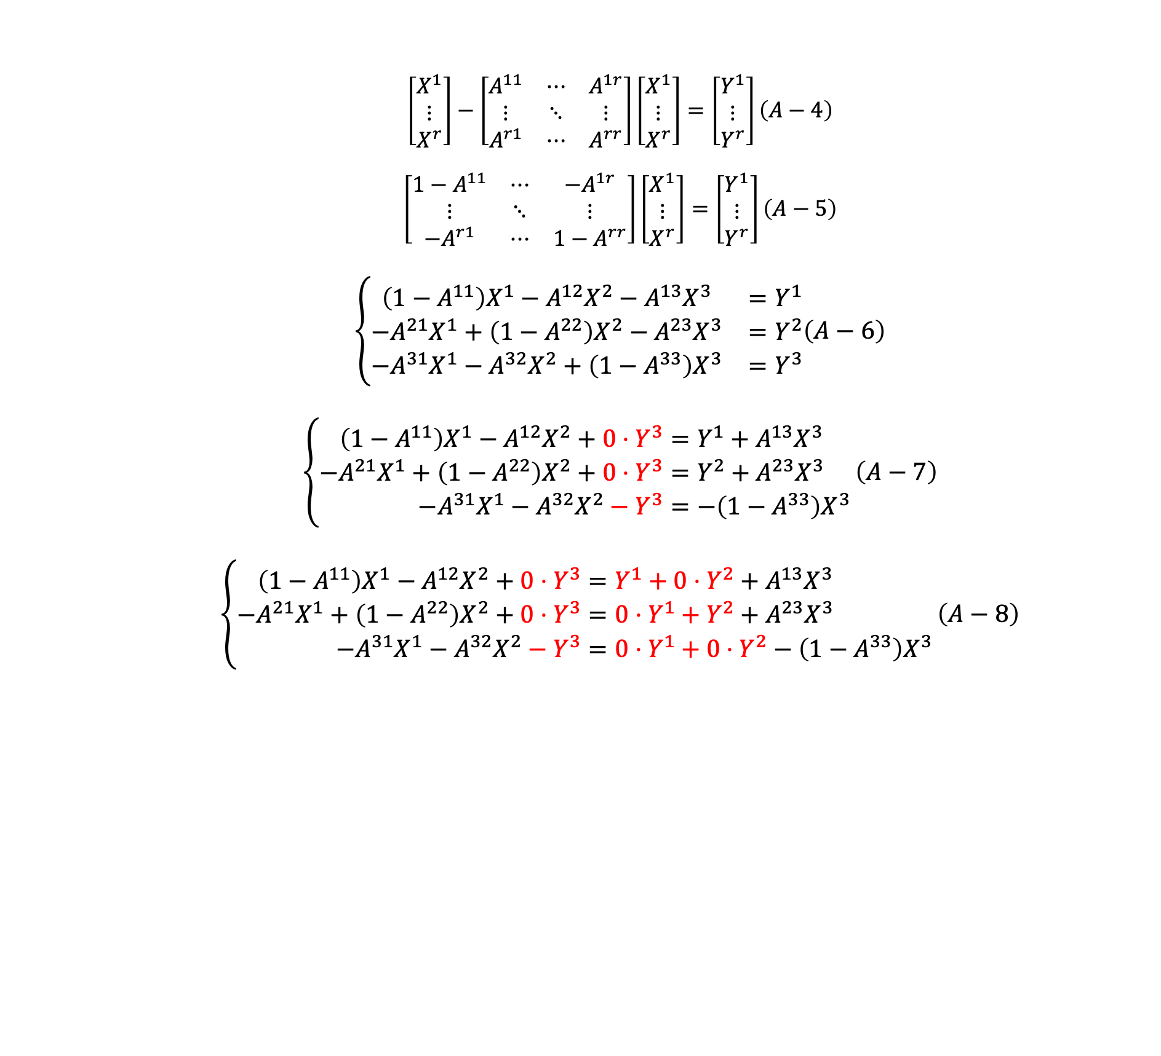
$$\begin{aligned}\left[\begin{matrix}X^{1} \\ ⋮ \\ X^{r}\end{matrix}\right]−\left[\begin{matrix}A^{11} & ⋯ & A^{1r} \\ ⋮ & ⋱ & ⋮ \\ A^{r1} & ⋯ & A^{rr}\end{matrix}\right]\left[\begin{matrix}X^{1} \\ ⋮ \\ X^{r}\end{matrix}\right]=\left[\begin{matrix}Y^{1} \\ ⋮ \\ Y^{r}\end{matrix}\right]\#\left(A−4\right)\end{aligned}$$
$$\begin{aligned}\left[\begin{matrix}1−A^{11} & ⋯ & −A^{1r} \\ ⋮ & ⋱ & ⋮ \\ {−A}^{r1} & ⋯ & {1−A}^{rr}\end{matrix}\right]\left[\begin{matrix}X^{1} \\ ⋮ \\ X^{r}\end{matrix}\right]=\left[\begin{matrix}Y^{1} \\ ⋮ \\ Y^{r}\end{matrix}\right]\#\left(A−5\right)\end{aligned}$$
$$\begin{aligned}\begin{aligned}\left\{\begin{matrix}\left(1−A^{11}\right)X^{1}−A^{12}X^{2}−A^{13}X^{3} & =Y^{1} \\ −A^{21}X^{1}+\left(1−A^{22}\right)X^{2}−A^{23}X^{3} & =Y^{2} \\ −A^{31}X^{1}−A^{32}X^{2}+\left(1−A^{33}\right)X^{3} & =Y^{3}\end{matrix}\right.\#\#\#\end{aligned}\#\left(A−6\right)\end{aligned}$$
$$\begin{aligned}\left\{\begin{aligned}\left(1−A^{11}\right)X^{1}−A^{12}X^{2}+0⋅Y^{3}&=Y^{1}+A^{13}X^{3} \\ −A^{21}X^{1}+\left(1−A^{22}\right)X^{2}+0⋅Y^{3}&=Y^{2}+A^{23}X^{3} \\ −A^{31}X^{1}−A^{32}X^{2}−Y^{3}&=−\left(1−A^{33}\right)X^{3}\end{aligned}\right.\#\left(A−7\right)\end{aligned}$$
$$\begin{aligned}\left\{\begin{aligned}\left(1−A^{11}\right)X^{1}−A^{12}X^{2}+0⋅Y^{3}&=Y^{1}+0⋅Y^{2}+A^{13}X^{3} \\ −A^{21}X^{1}+\left(1−A^{22}\right)X^{2}+0⋅Y^{3}&=0⋅Y^{1}+Y^{2}+A^{23}X^{3} \\ −A^{31}X^{1}−A^{32}X^{2}−Y^{3}&=0⋅Y^{1}+0⋅Y^{2}−\left(1−A^{33}\right)X^{3}\end{aligned}\right.\#\left(A−8\right)\end{aligned}$$
Notes:
Since this study mainly focuses on the effects of external factors, I use a simplified framework with three sectors to illustrate the derivation process. As shown here, we can observe the changes in the positions of X_3 and Y_3, which represent the endogenous and exogenous adjustments within the input-output system.

Slide 16
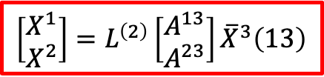
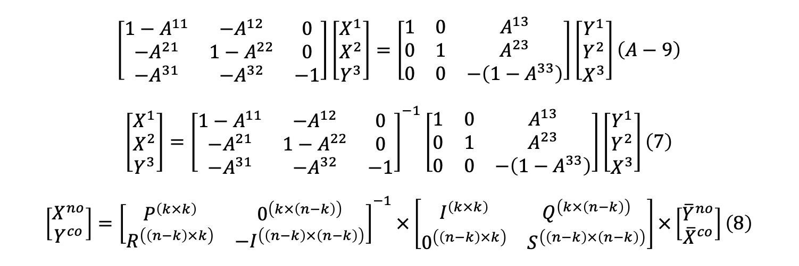
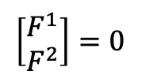
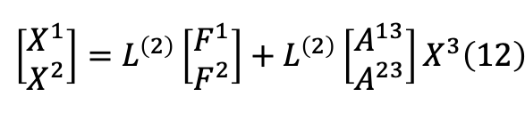
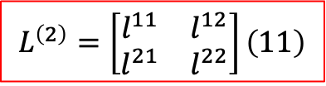
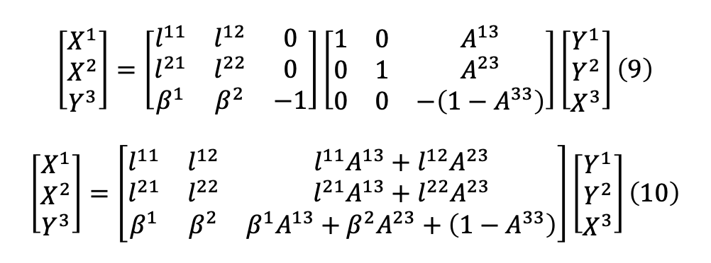
$$\begin{aligned}\left[\begin{matrix}1−A^{11} & {−A}^{12} & 0 \\ {−A}^{21} & 1−A^{22} & 0 \\ {−A}^{31} & {−A}^{32} & −1\end{matrix}\right]\left[\begin{matrix}X^{1} \\ X^{2} \\ Y^{3}\end{matrix}\right]=\left[\begin{matrix}1 & 0 & A^{13} \\ 0 & 1 & A^{23} \\ 0 & 0 & −\left(1−A^{33}\right)\end{matrix}\right]\left[\begin{matrix}Y^{1} \\ Y^{2} \\ X^{3}\end{matrix}\right]\#\left(A−9\right)\end{aligned}$$
$$\begin{aligned}\left[\begin{matrix}X^{1} \\ X^{2} \\ Y^{3}\end{matrix}\right]={\left[\begin{matrix}1−A^{11} & {−A}^{12} & 0 \\ {−A}^{21} & 1−A^{22} & 0 \\ {−A}^{31} & {−A}^{32} & −1\end{matrix}\right]}^{−1}\left[\begin{matrix}1 & 0 & A^{13} \\ 0 & 1 & A^{23} \\ 0 & 0 & −\left(1−A^{33}\right)\end{matrix}\right]\left[\begin{matrix}Y^{1} \\ Y^{2} \\ X^{3}\end{matrix}\right]\#\left(7\right)\end{aligned}$$
$$\begin{aligned}\left[\begin{matrix}X^{no} \\ Y^{co}\end{matrix}\right]={\left[\begin{matrix}P^{\left(k×k\right)} & 0^{\left(k×\left(n−k\right)\right)} \\ R^{\left(\left(n−k\right)×k\right)} & {−I}^{\left(\left(n−k\right)×\left(n−k\right)\right)}\end{matrix}\right]}^{−1}×\left[\begin{matrix}I^{\left(k×k\right)} & Q^{\left(k×\left(n−k\right)\right)} \\ 0^{\left(\left(n−k\right)×k\right)} & S^{\left(\left(n−k\right)×\left(n−k\right)\right)}\end{matrix}\right]×\left[\begin{matrix}{\overline{Y}}^{no} \\ {\overline{X}}^{co}\end{matrix}\right]\#\left(8\right)\end{aligned}$$
$$\begin{aligned}\left[\begin{matrix}X^{1} \\ X^{2} \\ Y^{3}\end{matrix}\right]=\left[\begin{matrix}l^{11} & l^{12} & 0 \\ l^{21} & l^{22} & 0 \\ β^{1} & β^{2} & −1\end{matrix}\right]\left[\begin{matrix}1 & 0 & A^{13} \\ 0 & 1 & A^{23} \\ 0 & 0 & −\left(1−A^{33}\right)\end{matrix}\right]\left[\begin{matrix}Y^{1} \\ Y^{2} \\ X^{3}\end{matrix}\right]\#\left(9\right)\end{aligned}$$
$$\begin{aligned}\left[\begin{matrix}X^{1} \\ X^{2} \\ Y^{3}\end{matrix}\right]=\left[\begin{matrix}l^{11} & l^{12} & l^{11}A^{13}+l^{12}A^{23} \\ l^{21} & l^{22} & l^{21}A^{13}+l^{22}A^{23} \\ β^{1} & β^{2} & β^{1}A^{13}+β^{2}A^{23}+\left(1−A^{33}\right)\end{matrix}\right]\left[\begin{matrix}Y^{1} \\ Y^{2} \\ X^{3}\end{matrix}\right]\#\left(10\right)\end{aligned}$$
$$\begin{aligned}&L^{\left(2\right)}=\left[\begin{matrix}l^{11} & l^{12} \\ l^{21} & l^{22}\end{matrix}\right]\#\left(11\right)\end{aligned}$$
$$\begin{aligned}\left[\begin{matrix}X^{1} \\ X^{2}\end{matrix}\right]=L^{\left(2\right)}\left[\begin{matrix}F^{1} \\ F^{2}\end{matrix}\right]+L^{\left(2\right)}\left[\begin{matrix}A^{13} \\ A^{23}\end{matrix}\right]X^{3}\#\left(12\right)\end{aligned}$$
$$\left[\begin{matrix}F^{1} \\ F^{2}\end{matrix}\right]=0$$
$$\begin{aligned}&\left[\begin{matrix}X^{1} \\ X^{2}\end{matrix}\right]=L^{\left(2\right)}\left[\begin{matrix}A^{13} \\ A^{23}\end{matrix}\right]{\overline{X}}^{3}\#\left(13\right)\end{aligned}$$
Notes:
Equation (8) is a simplified version of the model. Then, by substituting Equation (11) into Equation (10), we obtain Equation (12). To clearly demonstrate the influence of Sector 3 on Sectors 1 and 2, we assume that F_1 and F_2 are equal to zero. Under this assumption, Equation (13) can be derived.

Slide 17
Part 4. Empirical results and analysis

Slide 18
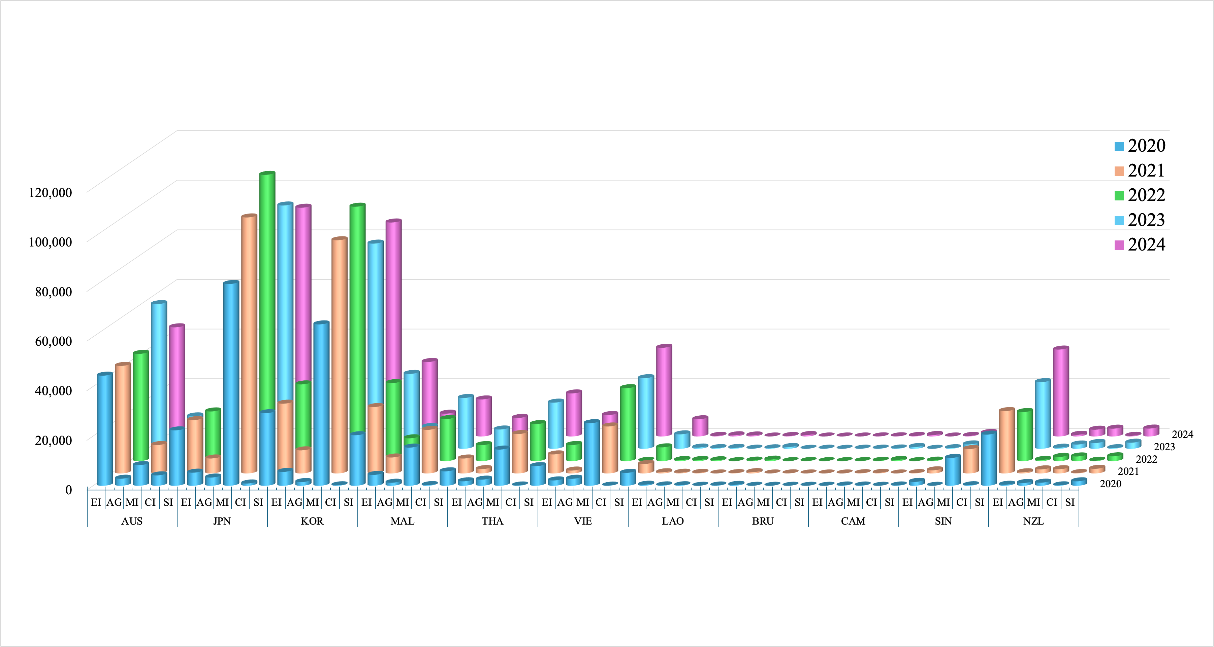
Industrial sector | Code
Industrial Digitalization | DI
Digital Industrialization | ID
Energy Industry | EI
Agriculture | AG
Manufacturing | MI
Construction | CI
Service Industry | SI
Fig.1 The Economic Impact of Industrial Digitalization on Other RCEP Countries （Unit: Million USD）
Notes:
From the perspective of total value, the value added generated by China’s industrial digitalization in RCEP countries increased from approximately USD 424.465 billion in 2020 to USD 518.985 billion in 2024, representing an increase of about 22.3%. The total reached a temporary peak in 2023, at around USD 534.203 billion, indicating that the spillover effect of China’s industrial digitalization on the RCEP regional economy further strengthened after the RCEP came into effect. However, the total value declined slightly in 2024 compared with 2023.
At the country level, Japan, South Korea, and Australia were the countries that most significantly affected by China’s industrial digitalization. In 2024, South Korea received the largest amount of value added, at approximately USD 135.423 billion, followed by Japan at around USD 127.461 billion and Australia at approximately USD 82.839 billion. This suggests that China’s industrial digitalization has strong industrial linkages with Northeast Asian economies and resource-based economies. South Korea’s value added increased from USD 92.710 billion in 2020 to USD 135.423 billion in 2024, representing growth of about 46.1%. This indicates that South Korea’s manufacturing, energy, and service sectors have become increasingly connected with China’s industrial digitalization through input-output linkages.

Slide 19
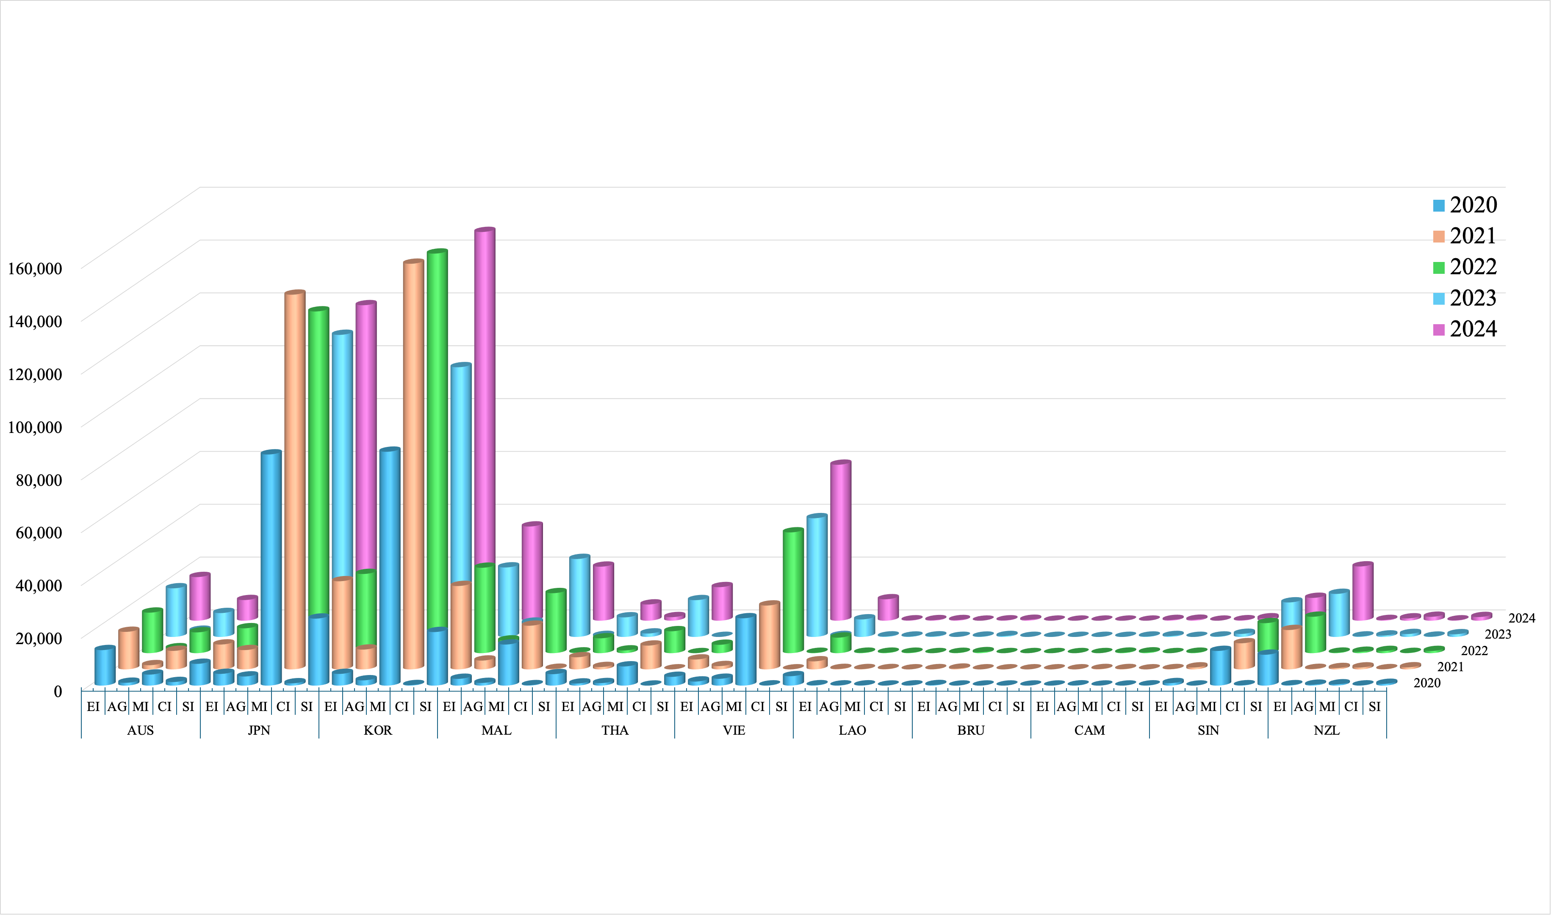
Industrial sector | Code
Industrial Digitalization | DI
Digital Industrialization | ID
Energy Industry | EI
Agriculture | AG
Manufacturing | MI
Construction | CI
Service Industry | SI
Fig.2 The Economic Impact of Digital Industrialization on Other RCEP Countries
Notes:
The results in the Fig.2 reflect the value-added impact generated by the development of China’s digital industrialization on different sectors in RCEP member countries from 2020 to 2024. Overall, China’s digital industrialization has had a significant driving effect on value added in RCEP countries, and its impact is mainly concentrated in sectors such as manufacturing, services, and energy. Compared with agriculture and construction, manufacturing and services are the main sectors absorbing the spillover effects of China’s digital industrialization.
From the perspective of overall changes, in 2024, China’s digital industrialization generated approximately USD 567.351 billion in value added for RCEP countries. Among them, South Korea, Japan, and Vietnam were the most significantly affected countries. In 2024, South Korea received approximately USD 204.379 billion in value added, ranking first among all RCEP countries; Japan received approximately USD 157.779 billion, ranking second; and Vietnam received approximately USD 76.861 billion, also showing strong growth. This indicates that the development of China’s digital industrialization has not only exerted a significant impact on Northeast Asian countries but has also generated a strong driving effect on ASEAN countries through regional production networks and industrial chain division of labor.

Slide 20
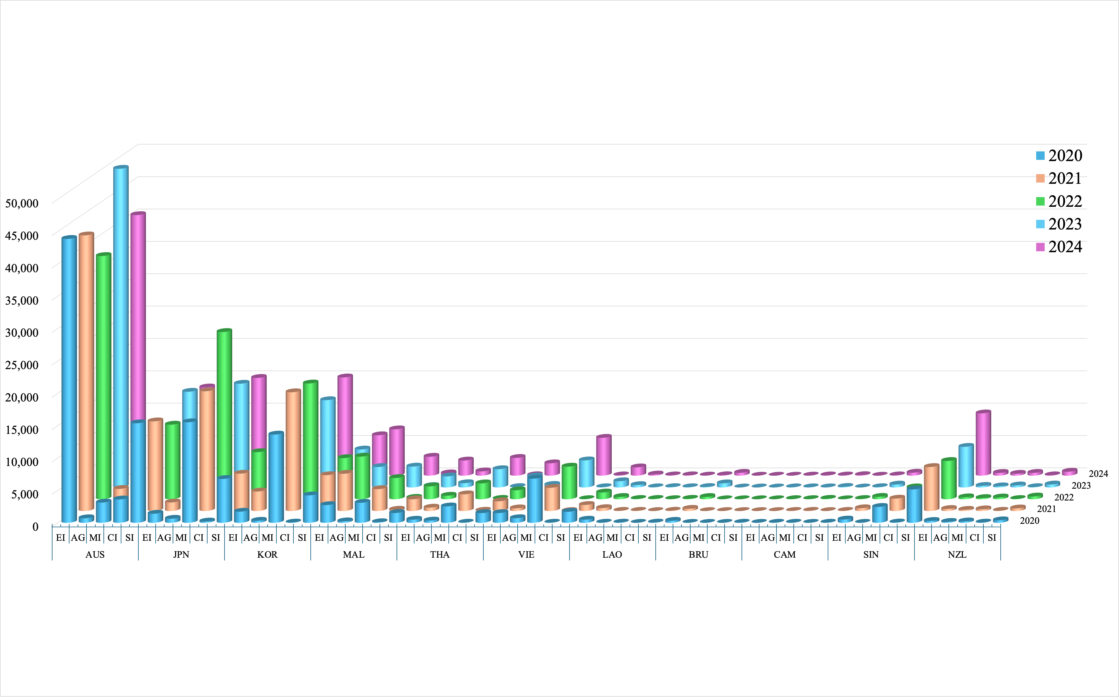
Industrial sector | Code
Industrial Digitalization | DI
Digital Industrialization | ID
Energy Industry | EI
Agriculture | AG
Manufacturing | MI
Construction | CI
Service Industry | SI
Fig.3 The Economic Impact of the Energy Industry on Other RCEP Countries
Notes:
The results in the Fig.3 reflect the value-added impact generated by the development of China’s energy industry on different sectors in RCEP member countries from 2020 to 2024. Overall, China’s energy industry has a clear economic driving effect on RCEP countries, but this impact varies significantly across countries and sectors. Compared with China’s digital industrialization and industrial digitalization, the impact of the energy industry is more concentrated in resource supply, manufacturing production, and service support.
From the perspective of overall scale, in 2024, China’s energy industry generated approximately USD 151.041 billion in value added for RCEP countries. Among them, Australia, South Korea, Japan, Malaysia, and Singapore were the countries that most significantly affected. In 2024, Australia received approximately USD 60.300 billion in value added, ranking first among RCEP countries; South Korea received approximately USD 26.217 billion; Japan approximately USD 22.267 billion; Malaysia approximately USD 13.040 billion; and Singapore approximately USD 12.041 billion. This indicates that the development of China’s energy industry affects not only energy- and resource-based countries but also generates spillover effects on other regional economies through manufacturing and service-sector linkages.

Slide 21
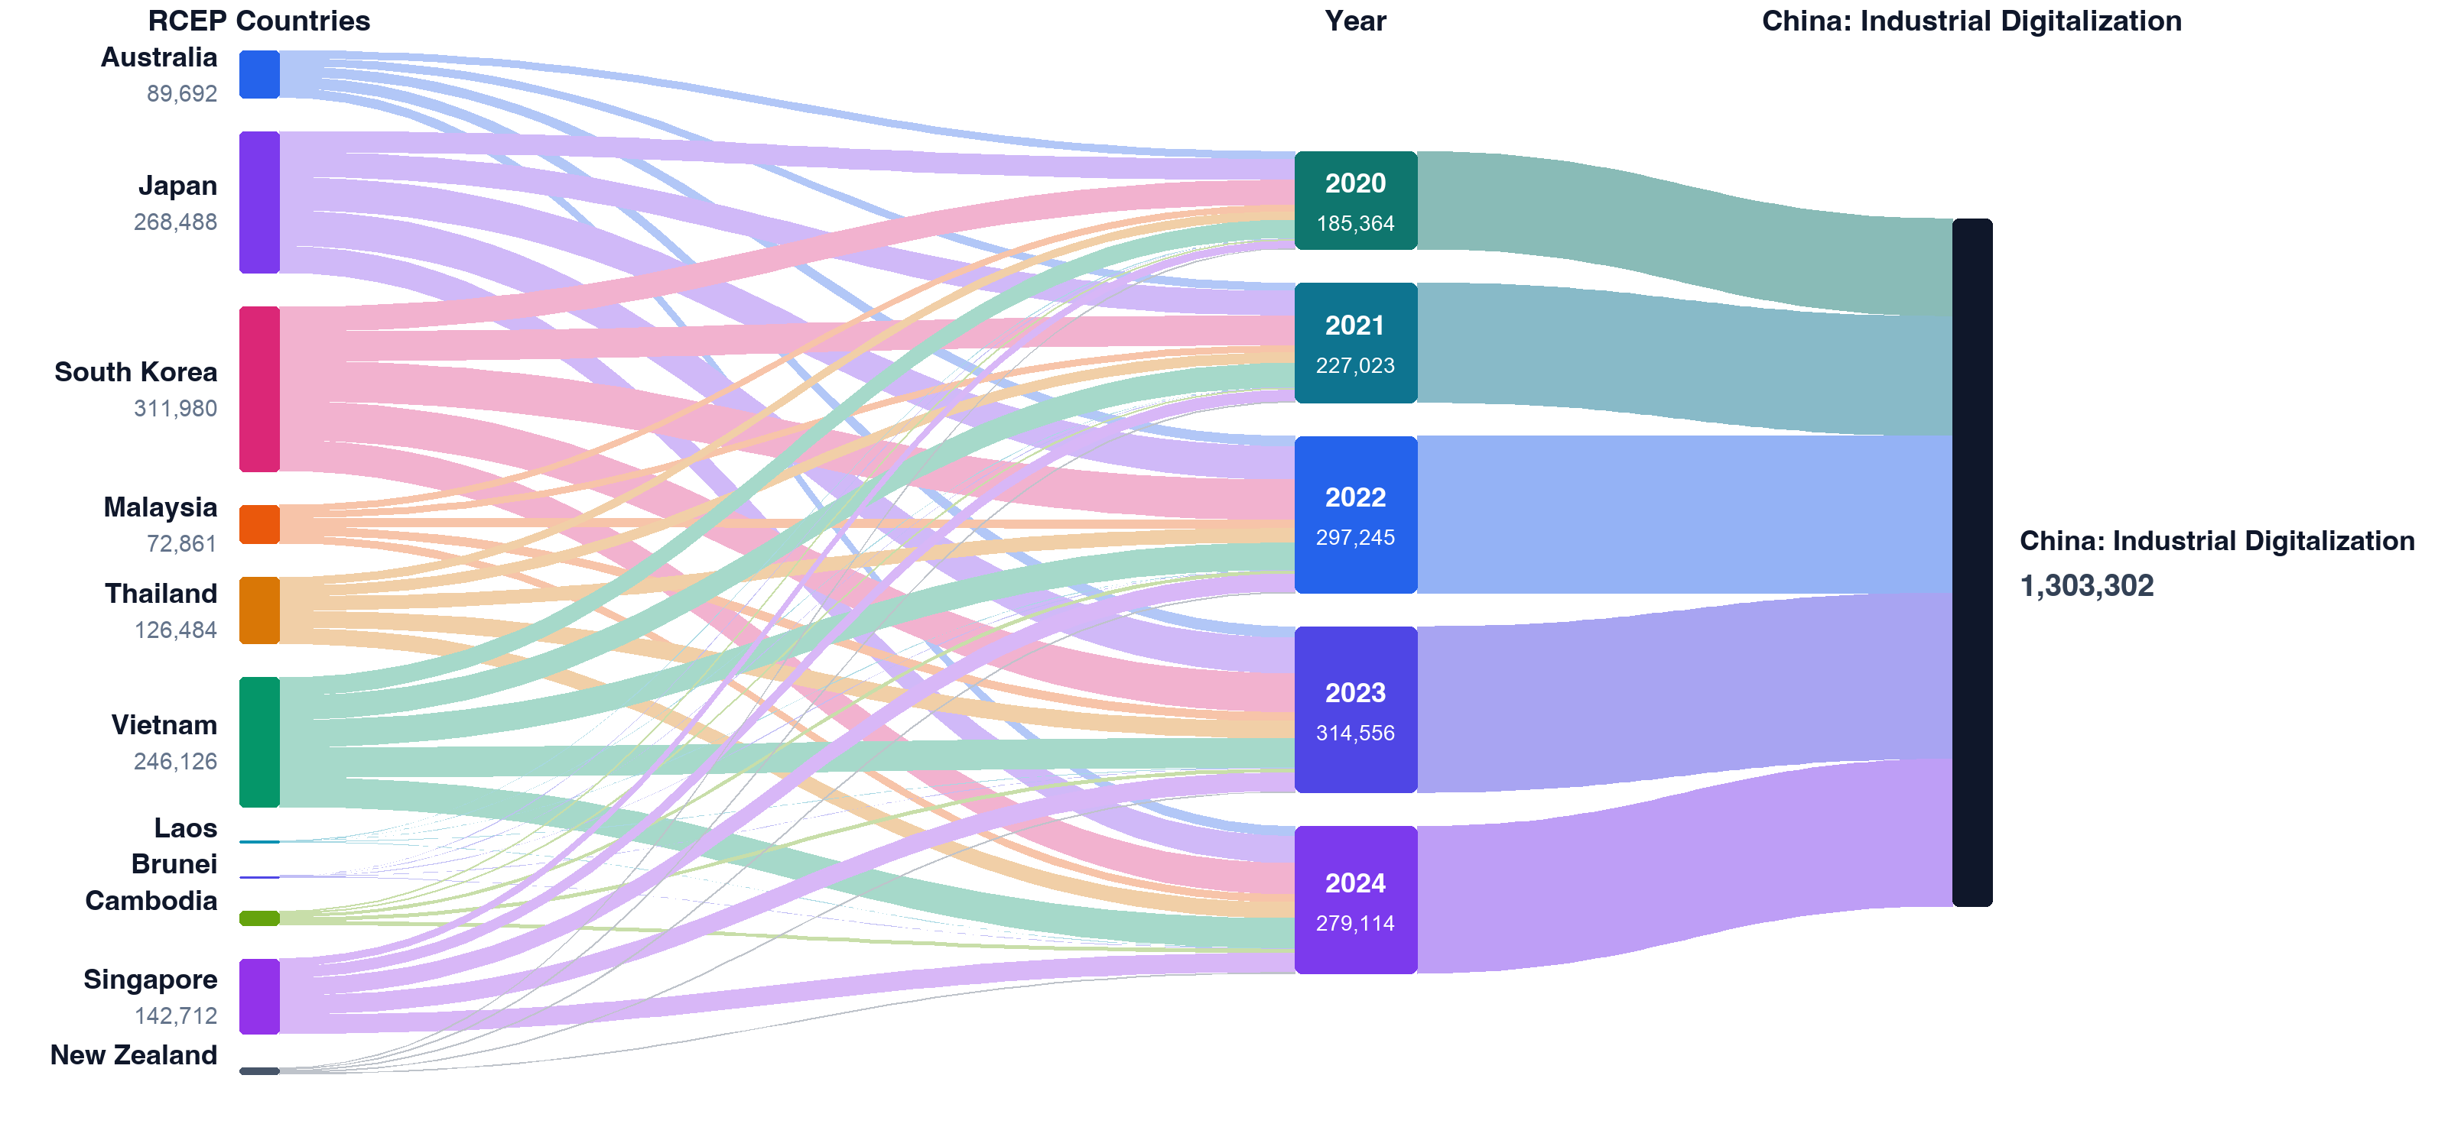
Fig.4 Changes in the Influence of Other RCEP Countries on China’s Industrial Digitalization
Notes:
Fig.4 shows the economic driving effect of RCEP countries’ economic development on China’s industrial digitalization sector. In other words, it reflects the value-added stimulus generated by other RCEP member countries for China’s industrial digitalization-related industries through trade, production division, and industrial chain linkages.
Overall, from 2020 to 2024, the driving effect of RCEP countries’ economies on China’s industrial digitalization sector showed a generally upward trend. In 2020, the total driving scale was approximately USD 185.364 billion, rising to about USD 279.114 billion in 2024, representing an increase of approximately 50.6%. The effect reached a temporary peak in 2023, at around USD 314.556 billion, indicating that after the RCEP came into effect, regional economic linkages and industrial chain cooperation were further strengthened, and the demand-driven effect of RCEP countries on China’s industrial digitalization sector expanded significantly. However, the decline in 2024 compared with 2023 suggests that this driving effect is also influenced by changes in international demand, industrial chain adjustments, and regional economic fluctuations.

Slide 22
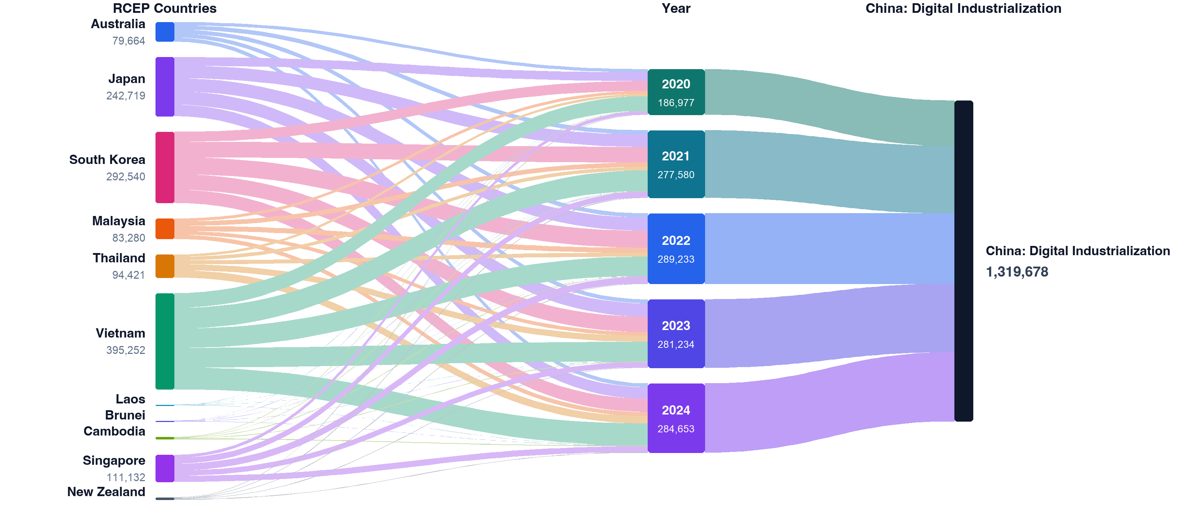
Fig.5 Changes in the Influence of Other RCEP Countries on China’s Digital Industrialization
Notes:
As shown in the Fig.5, from 2020 to 2024, the driving effect of RCEP countries’ economic activities on China’s digital industrialization sector generally expanded, indicating that China’s digital industrialization sector has become increasingly embedded in the RCEP regional production network. The overall scale increased from USD 186.977 billion in 2020 to USD 284.177 billion in 2024, representing an increase of approximately 52.0%. In particular, the effect grew rapidly in 2021 and 2022, reaching USD 289.233 billion in 2022. It then declined slightly in 2023 before rebounding in 2024. This trend suggests that the driving effect of RCEP countries on China’s digital industrialization sector did not follow a simple linear growth pattern. Instead, it showed phased fluctuations under the combined influence of regional industrial chain adjustments, changes in external demand, and fluctuations in trade in digital-related products.
From the perspective of country distribution, the driving effect of RCEP countries on China’s digital industrialization sector is highly concentrated. In 2024, Vietnam, South Korea, and Japan were the three major sources of influence, jointly generating approximately USD 191.832 billion, accounting for about 67.5% of the total driving effect from RCEP countries. This indicates that the external demand for China’s digital industrialization sector is mainly concentrated in countries with close linkages to China’s manufacturing and digital industrial chains. Among them, Vietnam had the most prominent driving effect, reaching USD 90.236 billion in 2024, surpassing South Korea and Japan to become the largest contributor among RCEP countries. This may be closely related to Vietnam’s rising position in electronic product assembly, processing manufacturing, and export-oriented industries in recent years. As Vietnam’s manufacturing sector continues to expand, its demand for China’s electronic information products, digital equipment, communication technologies, and related intermediate goods has also increased.

Slide 23
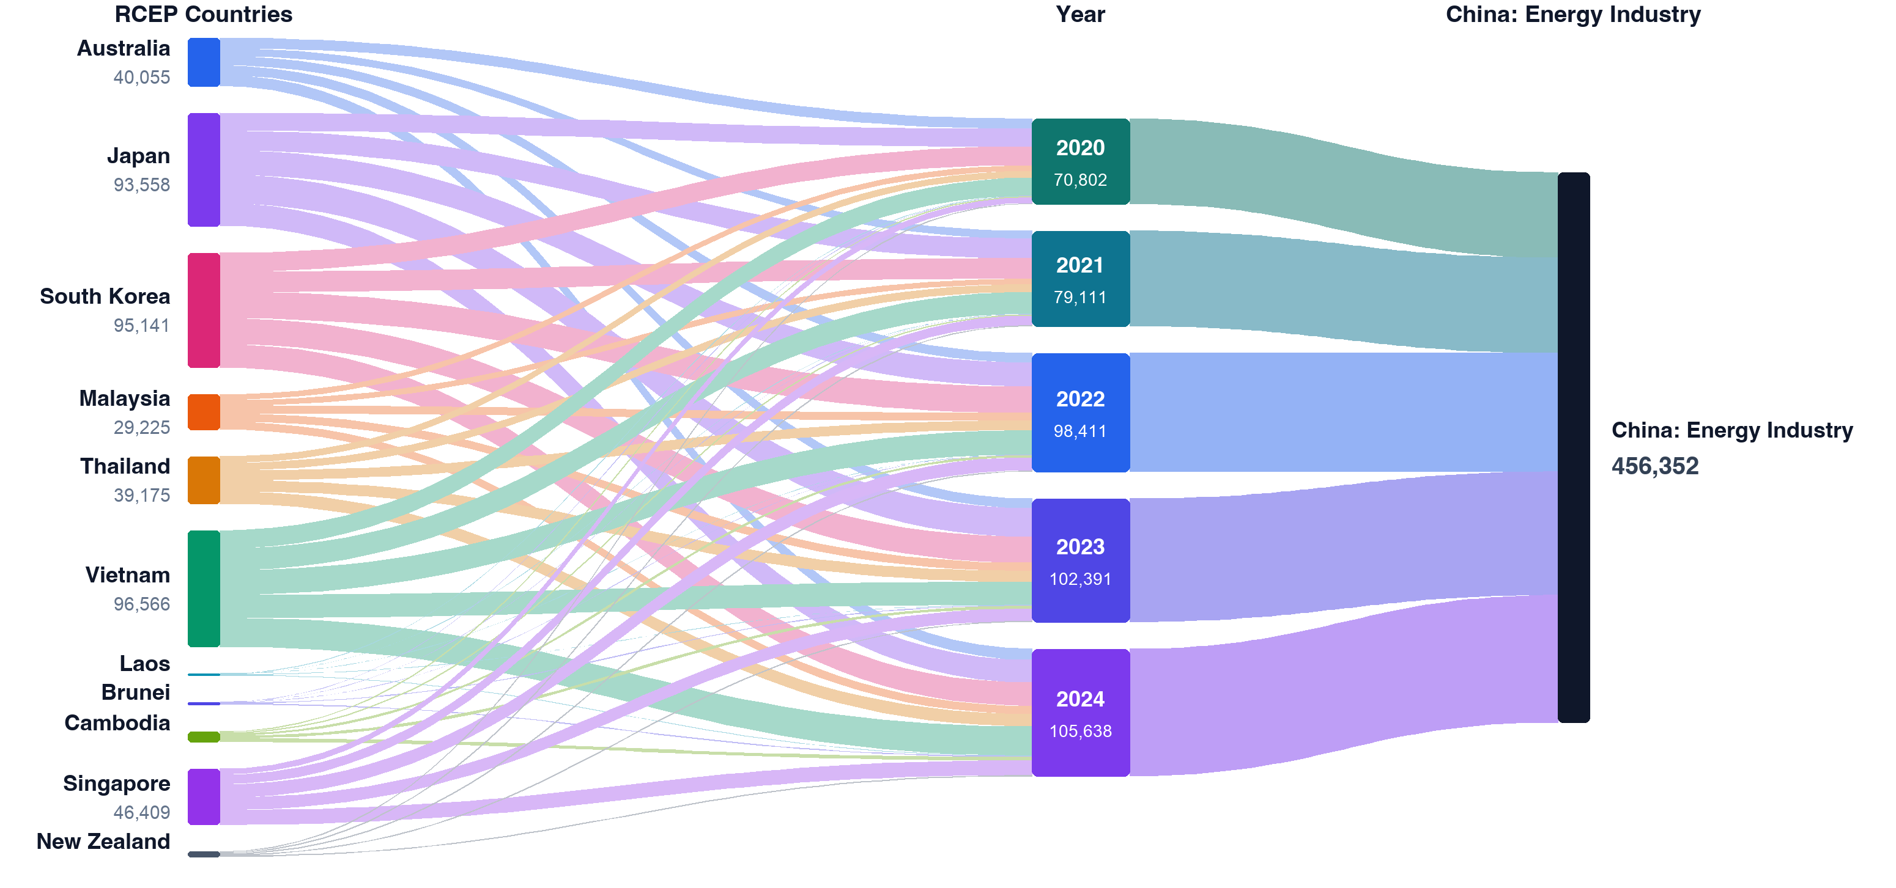
Fig.6 Changes in the Influence of Other RCEP Countries on China’s Energy Industry
Notes:
from 2020 to 2024, the driving effect of RCEP countries on China’s energy industry increased from approximately USD 70.802 billion to approximately USD 105.638 billion, showing an overall expanding trend. Especially after 2021, the driving scale remained at a relatively high level and reached its highest value during the observation period in 2024. This indicates that after the RCEP came into effect, industrial linkages and trade exchanges within the region were further strengthened, and the demand-supporting role of RCEP countries’ economic activities for China’s energy industry gradually increased. Compared with digital-economy-related industries, the driving effect on the energy industry has a stronger characteristic of “basic input demand”; that is, its growth is usually accompanied by the expansion of production scale, the strengthening of manufacturing activities, and the acceleration of cross-border supply chain operations.
this table reveals an important feature: China’s energy industry does not serve only domestic energy demand in isolation; rather, it has formed interactive linkages with neighboring economies through the RCEP regional production network. Economic expansion in RCEP countries can be transformed into a driving effect on China’s energy industry through manufacturing production, cross-border trade, logistics services, and intermediate input demand. Among them, Vietnam represents the rapidly rising demand from emerging manufacturing economies for China’s energy industry; South Korea and Japan represent the stable driving effect of mature manufacturing economies; while Singapore, Thailand, and Malaysia reflect the increasingly important connecting role of ASEAN countries in the regional value chain.

Slide 24
Part 5. Conclusion

Slide 25
China’s digital economy generates significant spillover effects on RCEP member countries.
Through manufacturing value chains, service networks, and intermediate goods trade, China’s industrial digitalization and digital industrialization have created substantial value-added effects in the manufacturing, service, and energy sectors of RCEP countries. Among these channels, manufacturing serves as the most important transmission mechanism.
RCEP member countries exert a reverse driving effect on China’s digital economy industries.
Countries such as Vietnam, Japan, South Korea, Singapore, and Thailand generate strong demand for China’s digital economy industries through regional industrial cooperation and market expansion. Among them, Vietnam demonstrates the most significant driving effect.
The energy industry provides fundamental support for digital economy development.
The operation of digital infrastructure, data centers, intelligent manufacturing systems, and cross-border logistics all requires substantial energy inputs. As a result, the energy industry has become a key foundational sector supporting the regional digital economy and industrial networks.

Slide 26
There exists a two-way coupling relationship between the digital economy and the energy industry.
On the one hand, digital technologies can improve energy efficiency and facilitate the intelligent and low-carbon transformation of the energy sector. On the other hand, a stable energy supply is essential for the sustainable development of the digital economy. Therefore, the two sectors are mutually dependent and mutually reinforcing.
The expansion of the energy industry may increase environmental pressure.
While energy industry growth supports the development of the digital economy and regional industrial chains, it may also lead to greater resource consumption, carbon emissions, and environmental burdens. Within the RCEP regional value chain, China provides energy and industrial support while simultaneously bearing a considerable share of the associated environmental costs.
RCEP has strengthened industrial linkages between China and its member countries.
Since the implementation of RCEP, industrial connections between China and other member countries have become increasingly integrated. Regional value chain cooperation has deepened, and the interaction between the digital economy and the energy industry has become more closely intertwined.

Slide 27
Thank you for listening
A study on the coordinated development of China's digital economy and energy structure before and after the entry into force of RCEP
SUN YUXUAN¹, ISHIRO TAKU², ZHU MINGJI¹
1: Yokohama National University Graduate School of International Social Sciences
2: Yokohama National University

