Slide 1
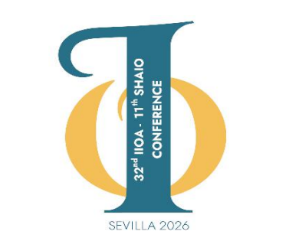
An Economic-Hydrological Approach to Brazil and Northeast Region of Brazil using the Input-Output Matrix
Ana Cristina G. Carneiro · Poema Isis A. de Souza · Isabel Cristina P. de Oliveira
Professors from the Department of Economics at UFRPE, Brazil

Slide 2
MOTIVATION
The use of natural resources and strong economic performance are fundamental to achieving sustainable development.
Water is a scarce resource, even for a country like Brazil, which holds about 12% of the planet’s available freshwater (ANA, 2022).
Water is distributed unequally throughout Brazil, with severe shortages in some regions; there is also the issue of water pollution, which limits the supply of potable water in many regions of Brazil, such as the Northeast (the country’s second most populous region).

Slide 3
MAIN OBJECTIVE
The objective is to conduct an economic and environmental analysis of Brazil’s water resources—and, more specifically, those of the Northeast Region—based on recent data from the water accounts and the Input-Output model.

Slide 4
The Environmental Economic Accounts for Water (CEAA) in Brazil and Regions
In Brazil, the CEAA is published by the Brazilian Institute of Geography and Statistics (IBGE), and the water-related information is compiled based on data from the National Water Agency (ANA), which, for the time being, aggregates information from all registered river basins in Brazil. In addition, since the 2017 publication, water balance data have been aggregated by major regions of Brazil.

Slide 5
The Environmental Economic Accounts for Water (CEAA) in Brazil and Regions
Table 1 - Structure of the Environmental Economic Accounts for Water (CEAA)
Economic Activities | Withdrawal of Environmental Resources | Discharge into the Environment
Agriculture, livestock, forestry, fishing, and aquaculture | Surface water | Surface water
Extractive industries | Groundwater | Groundwater
Manufacturing and construction industries | Soil water | Soil water
Electricity and gas | Rainwater harvesting | To the sea
Water and sewage | Seawater withdrawal
Other activities
Source: Adapted from CEAA (IBGE, 2018).

Slide 6
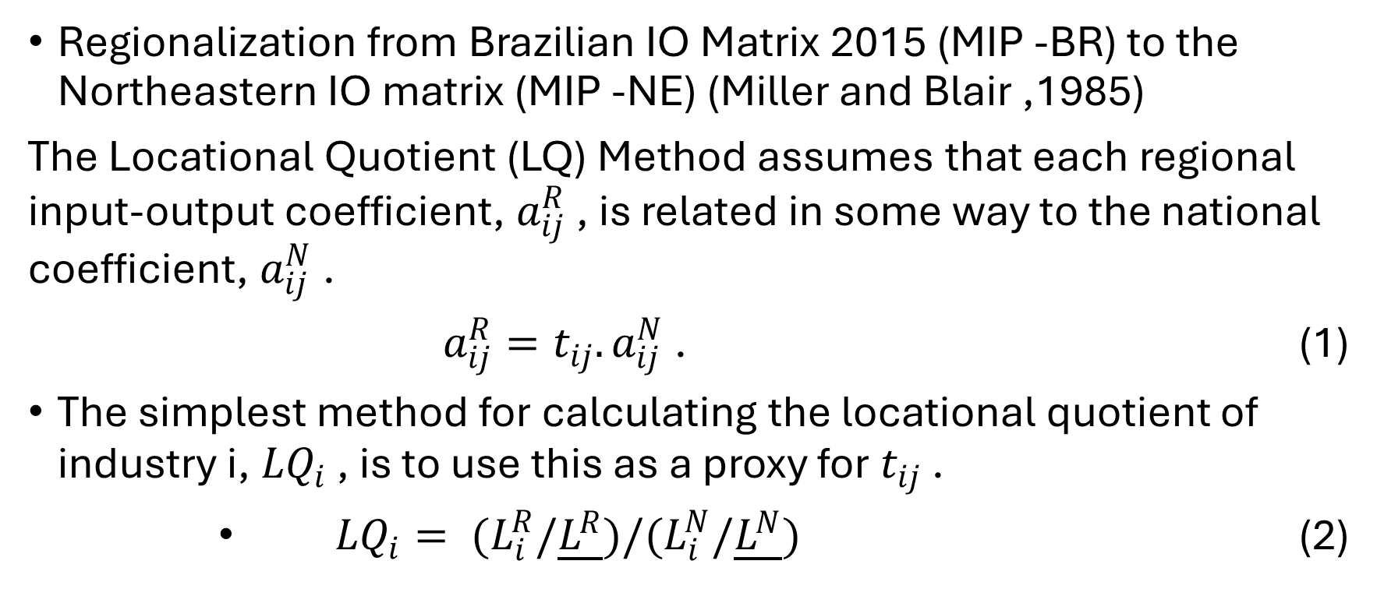
METHODOLOGY AND DATA
Regionalization from Brazilian IO Matrix 2015 (MIP -BR) to the Northeastern IO matrix (MIP -NE) (Miller and Blair ,1985)
The Locational Quotient (LQ) Method assumes that each regional input-output coefficient, $a_{ij}^{R}$ , is related in some way to the national coefficient, $a_{ij}^{N}$ .
$a_{ij}^{R}=t_{ij}.a_{ij}^{N}$ . (1)
The simplest method for calculating the locational quotient of industry i,${ LQ}_{i}$ , is to use this as a proxy for $t_{ij}$ .
${LQ}_{i}= (L_{i}^{R}/\underline{L^{R}})/(L_{i}^{N}/\underline{L^{N}})$ (2)

Slide 7
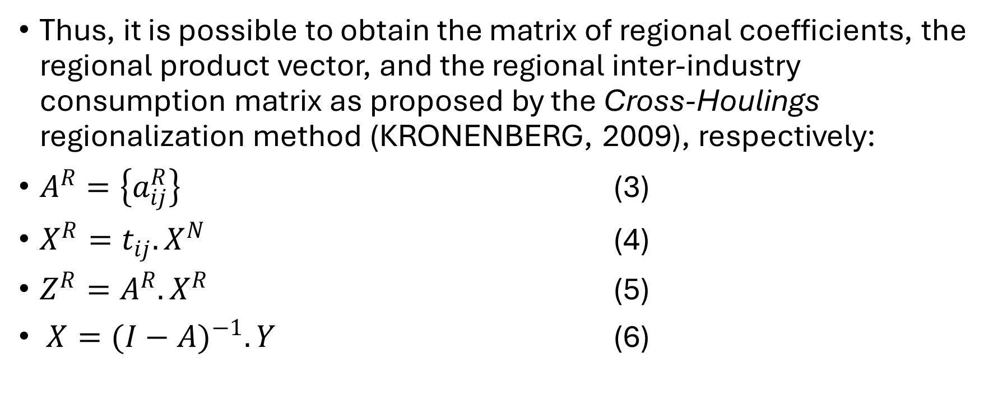
METHODOLOGY AND DATA
Thus, it is possible to obtain the matrix of regional coefficients, the regional product vector, and the regional inter-industry consumption matrix as proposed by the Cross-Houlings regionalization method (KRONENBERG, 2009), respectively:
$A^{R}=\left\{a_{ij}^{R}\right\}$ (3)
$X^{R}=t_{ij}.X^{N}$ (4)
$Z^{R}=A^{R}.X^{R}$ (5)
$X={(I−A)}^{−1}.Y$ (6)

Slide 8
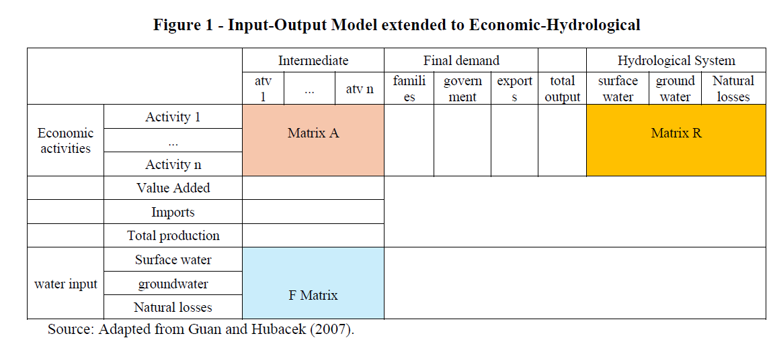
METHODOLOGY AND DATA
Figure 1 - Input-Output Model extended to Economic-Hydrological

Slide 9
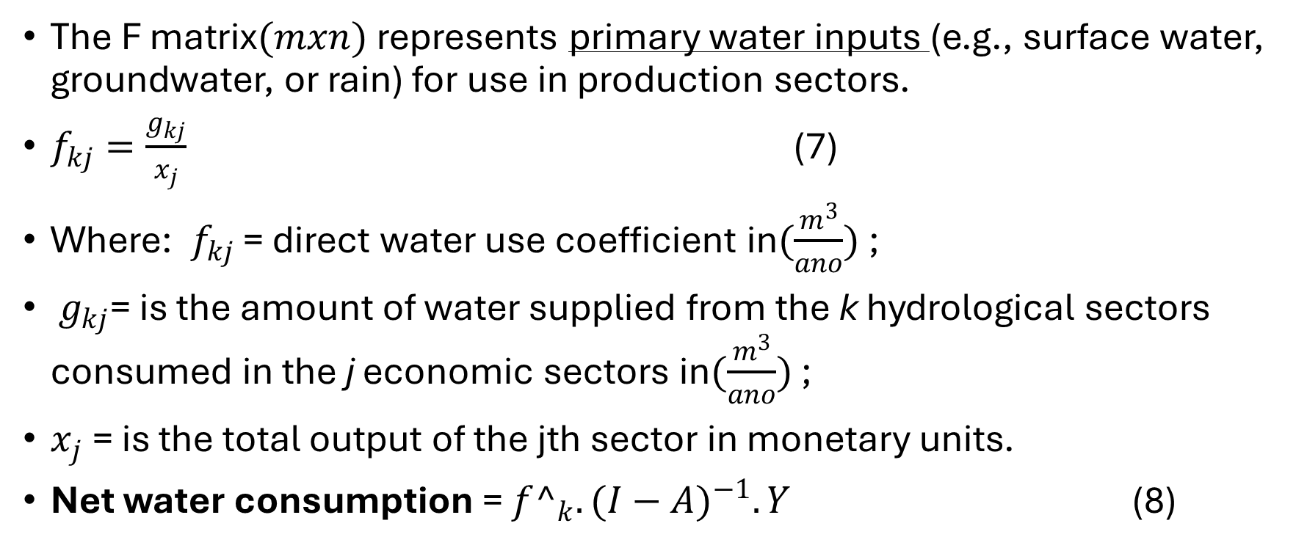
METHODOLOGY AND DATA
The F matrix$(mxn)$ represents primary water inputs (e.g., surface water, groundwater, or rain) for use in production sectors.
$f_{kj}=\frac{g_{kj}}{x_{j}}$ (7)
Where: $f_{kj}$ = direct water use coefficient in$(\frac{m^{3}}{ano})$ ;
$g_{kj}$= is the amount of water supplied from the k hydrological sectors consumed in the j economic sectors in$(\frac{m^{3}}{ano})$ ;
$x_{j}$ = is the total output of the jth sector in monetary units.
Net water consumption = ${f^}_{k}.{(I−A)}^{−1}.Y$ (8)

Slide 10
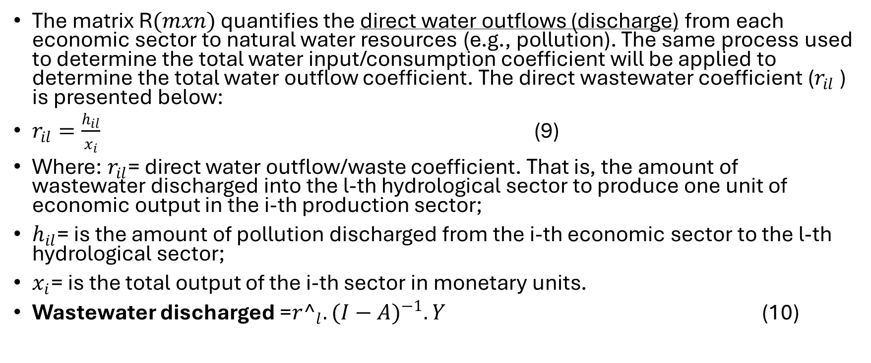
METHODOLOGY AND DATA
The matrix R$(mxn)$ quantifies the direct water outflows (discharge) from each economic sector to natural water resources (e.g., pollution). The same process used to determine the total water input/consumption coefficient will be applied to determine the total water outflow coefficient. The direct wastewater coefficient ($r_{il}$ ) is presented below:
$r_{il}=\frac{h_{il}}{x_{i}}$ (9)
Where: $r_{il}$= direct water outflow/waste coefficient. That is, the amount of wastewater discharged into the l-th hydrological sector to produce one unit of economic output in the i-th production sector;
$h_{il}$= is the amount of pollution discharged from the i-th economic sector to the l-th hydrological sector;
$x_{i}$= is the total output of the i-th sector in monetary units.
Wastewater discharged =${r^}_{l}.{(I−A)}^{−1}.Y$ (10)

Slide 11
METHODOLOGY AND DATA
The input-output matrix used for Brazil (MIP -BR) refers to the year 2015, prepared and published by IBGE (2020) and aggregated into 6 economic sectors (1. Agriculture, livestock, forestry, fishing, and aquaculture; 2. Extractive industries; 3. Manufacturing and construction; 4. Electricity and gas; 5. Water and sewage; 6. Other activities).
The water resource use matrix also refers to the year 2015 and includes 5 water withdrawal sources (surface water; groundwater; soil water; rainwater harvesting, and seawater abstraction), and 4 disposal destinations for these water resources (surface water; groundwater; soil water; and seawater).

Slide 12
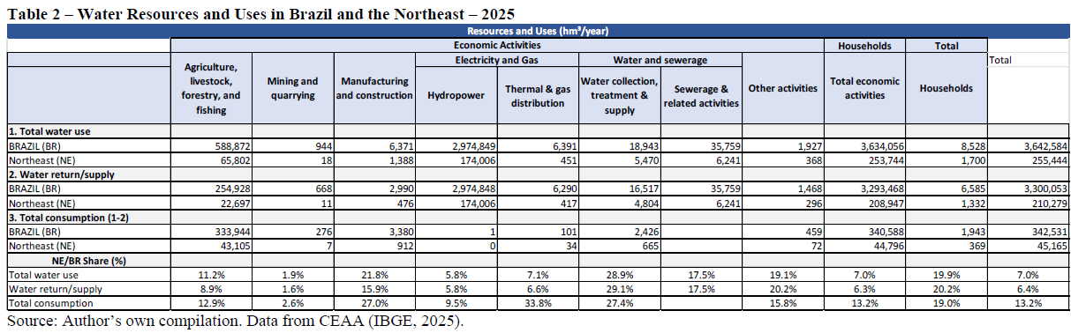
RESULTS

Slide 13
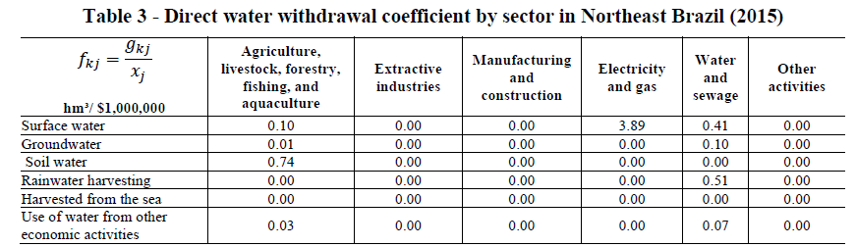
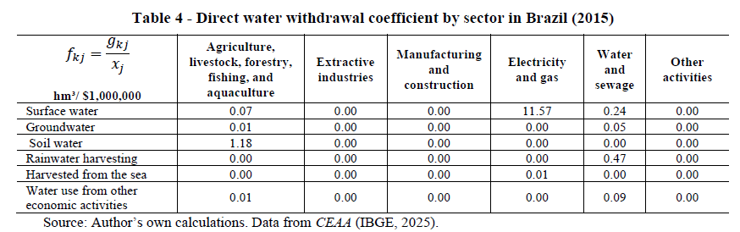
RESULTS

Slide 14
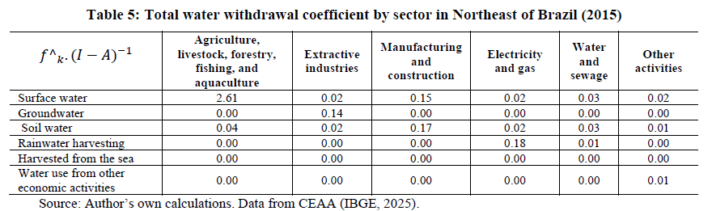
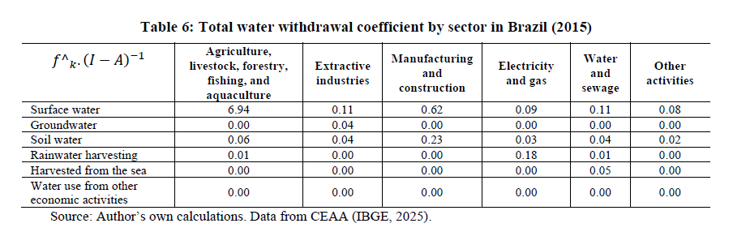
RESULTS

Slide 15
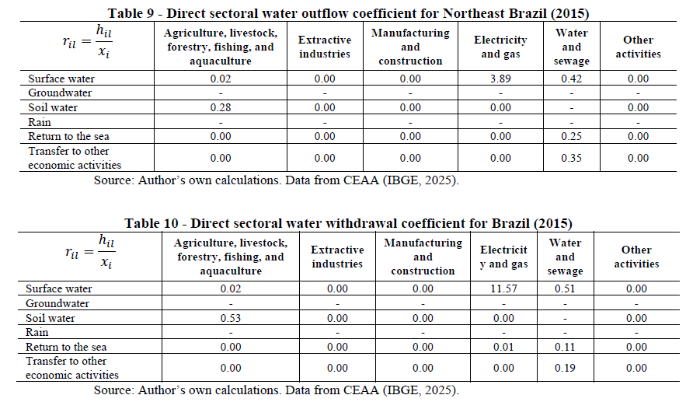
RESULTS

Slide 16
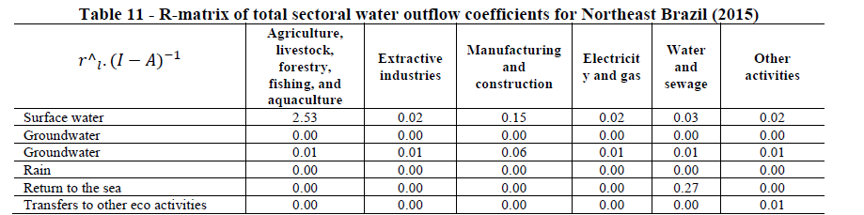
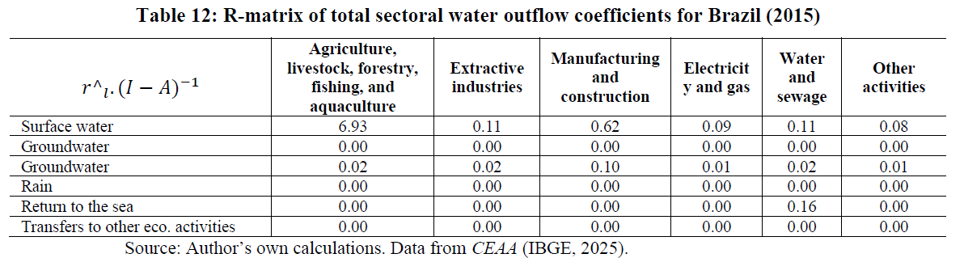
RESULTS

Slide 17
Concluding Remarks
The results indicate that the electricity and gas sector accounts for the largest share of water withdrawal and discharge.
In terms of total water use and discharge in the Northeast and in Brazil, the sector with the greatest direct and indirect impacts is agriculture and livestock, which has the greatest impact on the Brazilian economy.
The I-O extension reveals significant indirect water consumption embedded in manufacturing and energy sectors.
The Northeast has a water scarcity per unit of economic output compared to the national average.

Slide 18
Concluding Remarks
The high level of aggregation of economic activities in the environmental accounts, it is still necessary to include information on the quality of discharged water in the model.
Policy must prioritize the Northeast's water scarcity through infrastructure investment, efficient irrigation, and economic diversification.
Analyzing the impact of productive activities on water use (withdrawal and discharge) in Brazil would require a basin-by-basin analysis, using both regionalized IO and regionalized CEA-Water data by river basin; this is the main suggestion for future work.

Slide 19
THANK YOU VERY MUCH!
Contact: poema.isis@gmail.com

