Slide 1
REGIONAL CGE ANALYSIS · APULIA, ITALY
Soil Degradation and Regional Economic Impacts
A Computable General Equilibrium Assessment

Slide 2
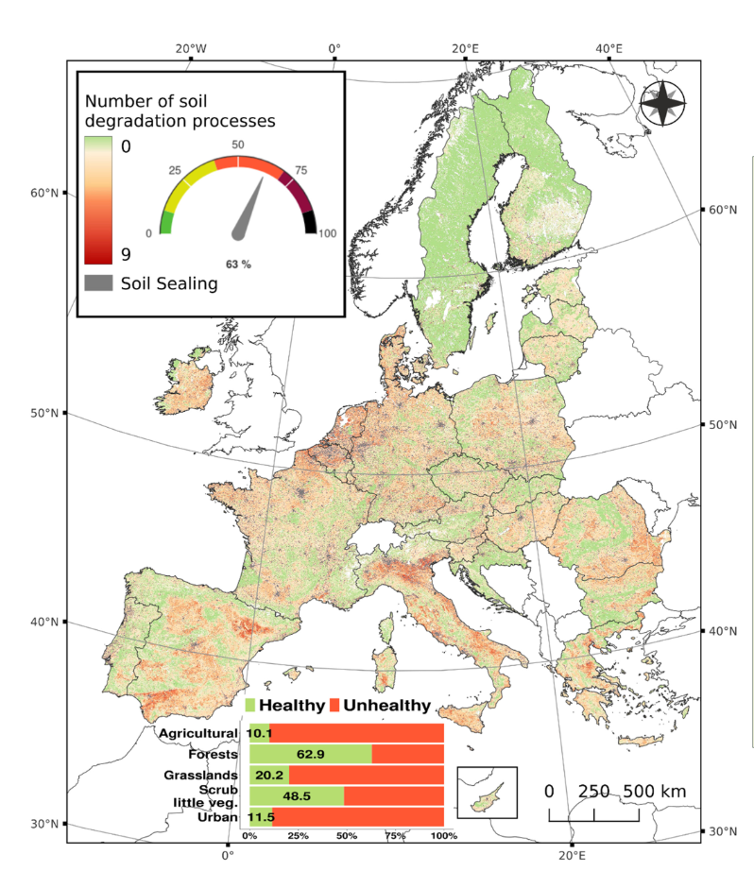

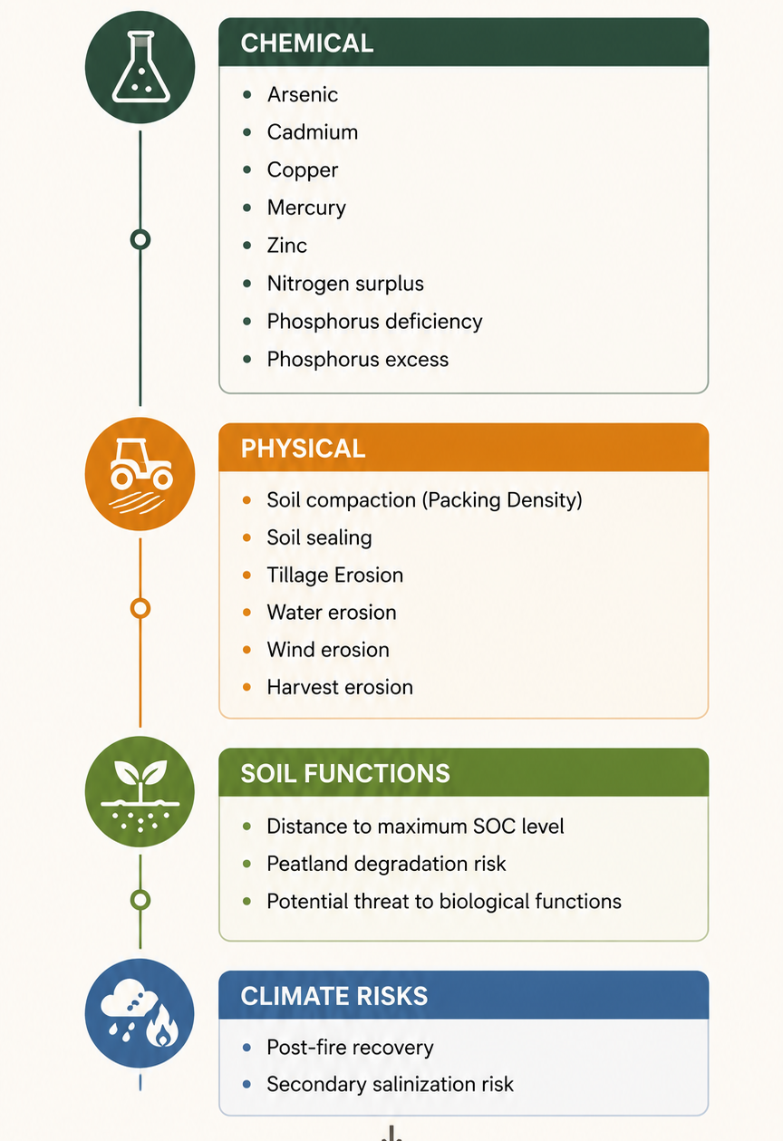

MOTIVATION
Why Soils Matters
  EU Soil Observatory (EUSO) monitors the state of soil health in the EU through Soil Health Dashboard
62% of soils in the EU are unhealthy
24% of EU soils are subject to one degradation process
16% to two, 10% to three and 5% to four processes
40.9–72.7 billion annual costs of soil degradation in Europe
.

Slide 3


Slide 4

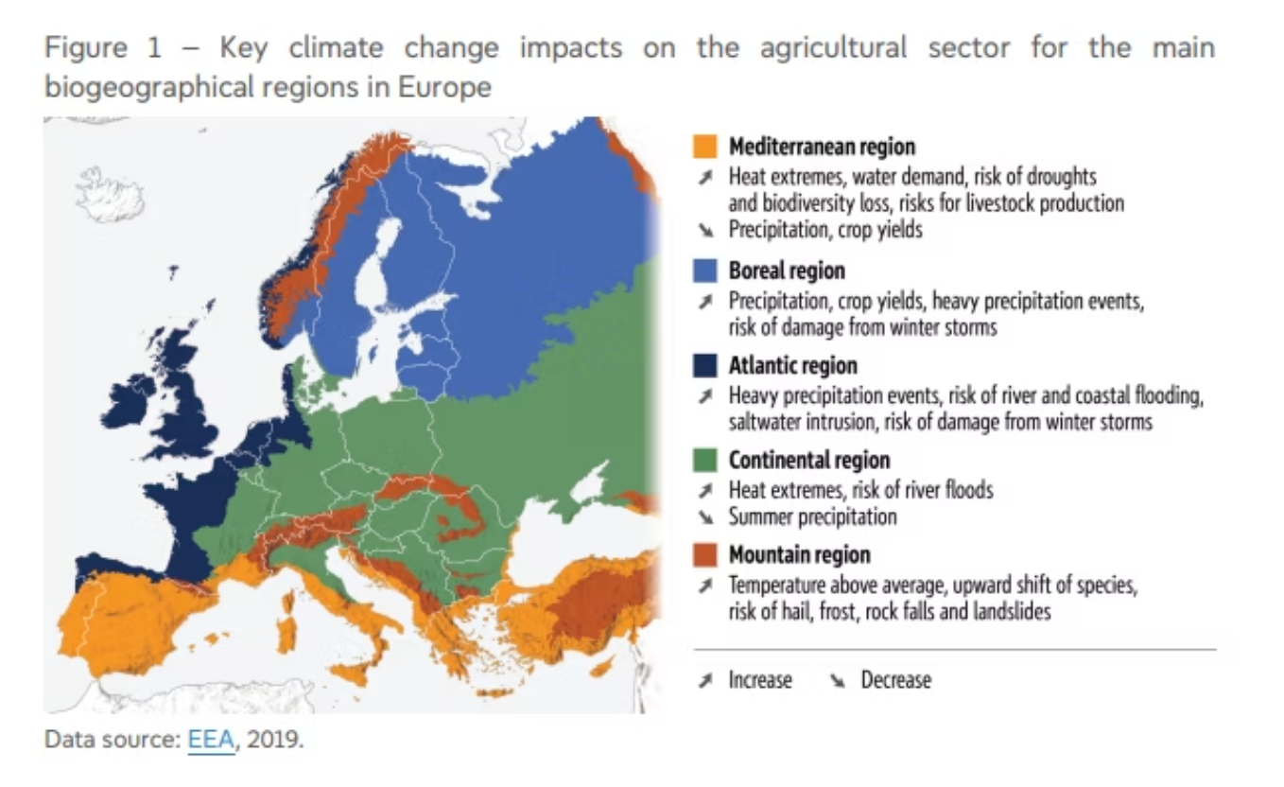
REGIONAL CONTEXT
REGIONAL CONTEXT
The Mediterranean as a Critical Zone
Environmental vulnerability and agricultural specialization interact within regional economies
Climate Stress
Land-Use Pressure
Apulia's Exposure
Increasing drought frequency and extreme precipitation intensify erosion rates across Southern Europe.
Urban expansion and agricultural intensification reduce soil organic matter and structural stability.
Italy's second-largest region by agricultural output faces severe erosion, salinization, and desertification risk.

Slide 5
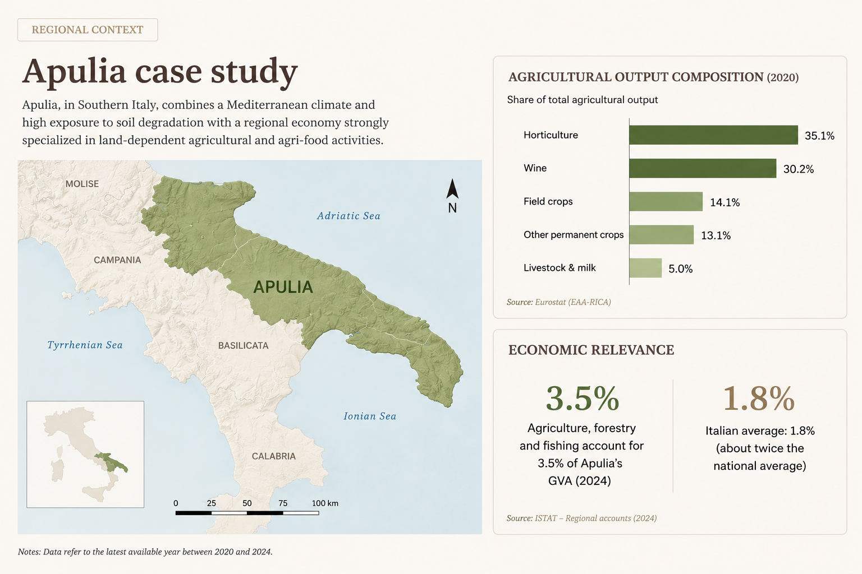

Slide 6
RESEARCH GAP
State of art
Existing research provides partial but fragmented evidence on the soil–land–economy nexus.
Biophysical studies quantify soil erosion and productivity losses.CGE models represent land heterogeneity and land-use allocation.These strands are rarely integrated in a single regional framework.
Research question
How can spatially explicit soil degradation be integrated into a regional CGE model to assess its economic, land-use and distributive impacts on Mediterranean agro-food systems?

Slide 7
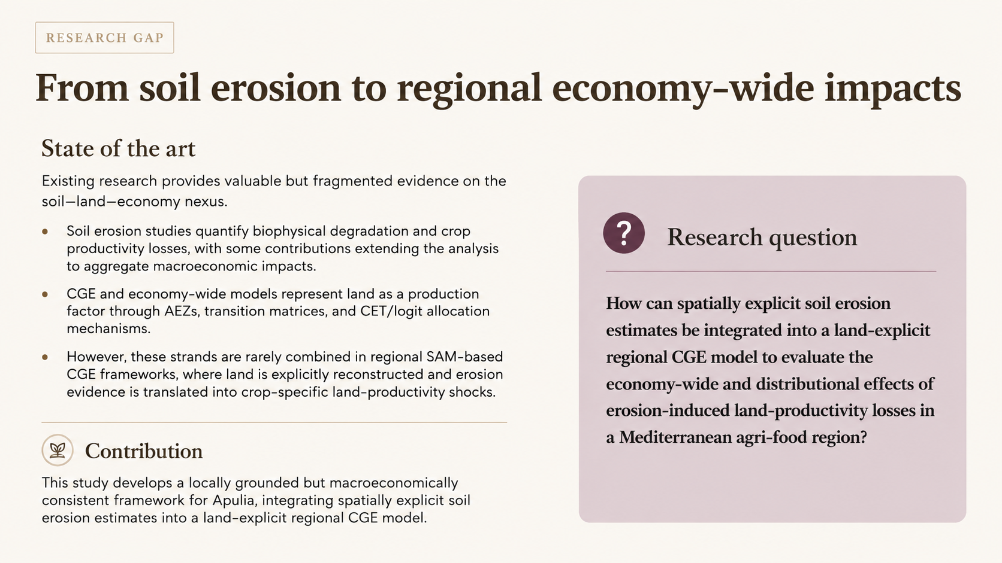

Slide 8
METHODOLOGY
The DEMETRA Framework
Social Accounting Matrix
FACTUSE
Elasticities
Sets&Maps
Production system
LES / LES-CES household demand
Government demand
Investment demand
Taxes and transfers
Nested production structure
Leontief / CES nests
Factors market
Demand system
Market clearing Factor returns and income distribution
Trade & Commodities
Armington import
CET export
Domestic market clearing
Walrasian equilibrium and closure rules
Markets clear through relative price and quantity adjustments.
Government, savings-investment and external balances are closed by macro assumptions..
Simulation output
Sectoral production • Factor income • Household welfare • Prices • Trade flows

Slide 9

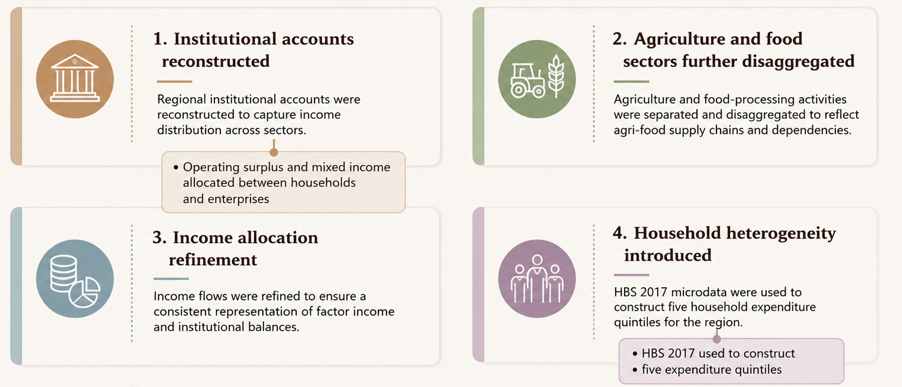
DATA
Regional Database Construction
Starting point: RHOMOLO NUTS2 SAM (2017):
European Commission’s spatial CGE model, for regional policy impact assessment.
It provides sectoral, regional and time-specific results through scenario analysis
SAM adaption to DEMETRA

Slide 10
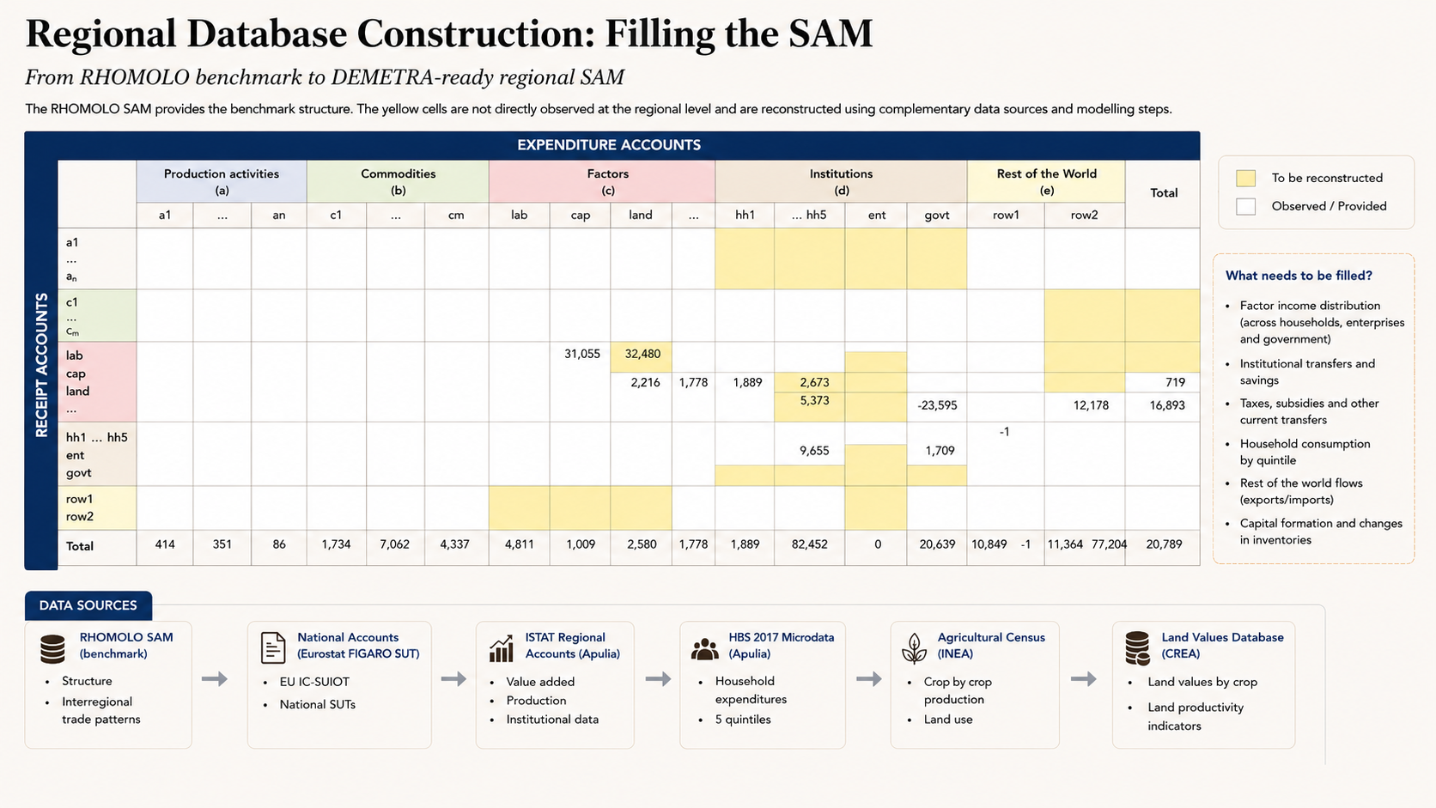
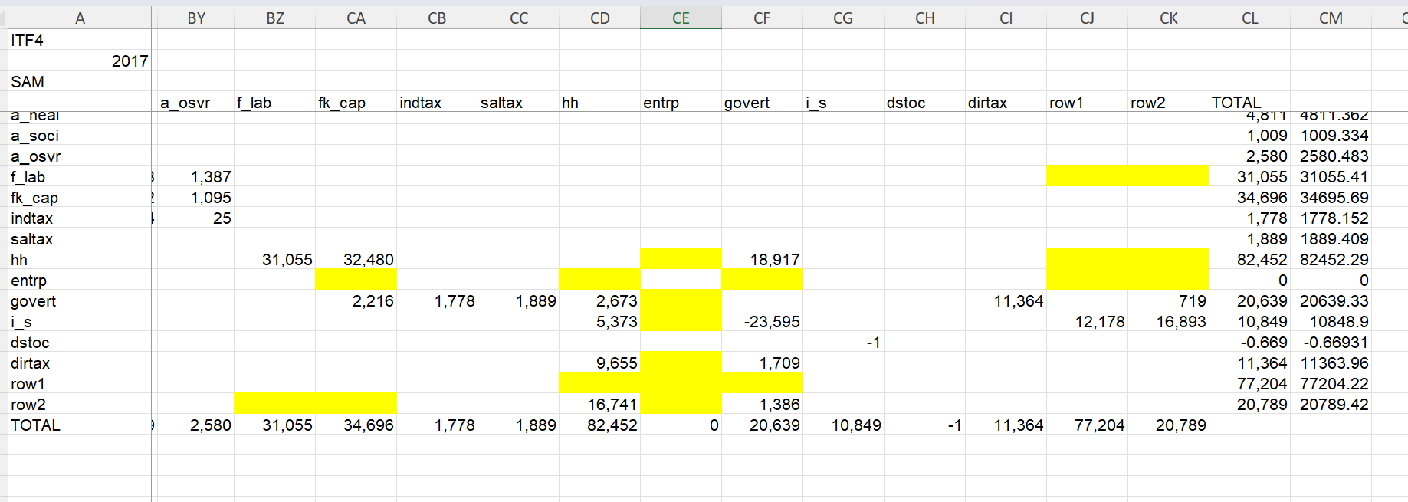

Slide 11
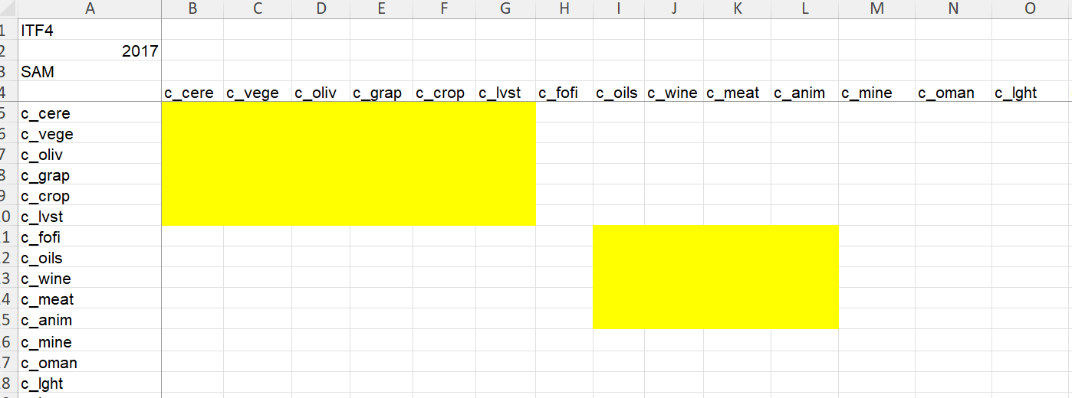

Slide 12
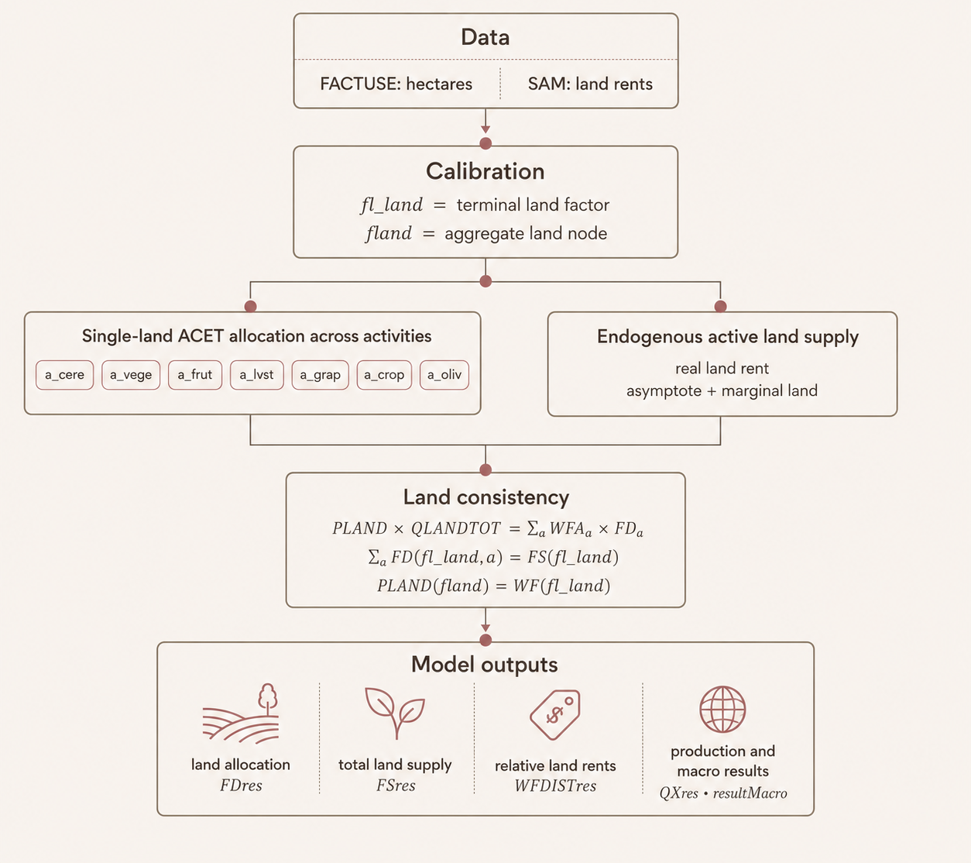
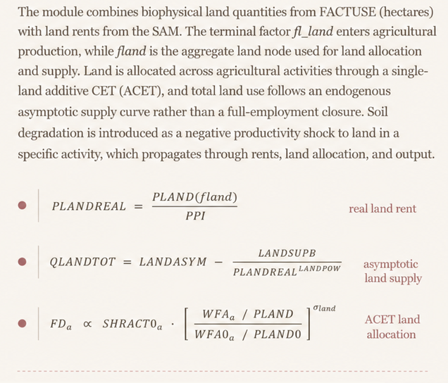
MODEL STRUCTURE
Land Productivity Module

Slide 13
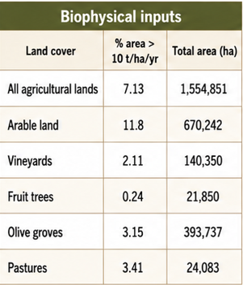
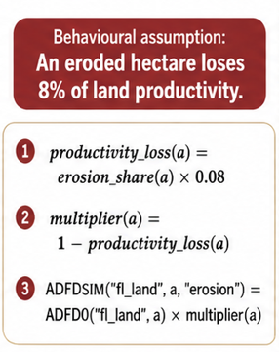
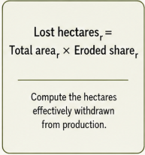
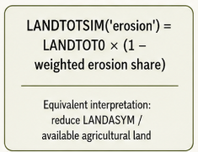
SHOCK DESIGN
RUSLE-Based Erosion Shock
The Revised Universal Soil Loss Equation (RUSLE) provides spatially explicit annual soil loss estimates (t·ha⁻¹·yr⁻¹). These are translated into productivity shocks on the land factor by sector and province.
productivity loss
effective land loss

Slide 14
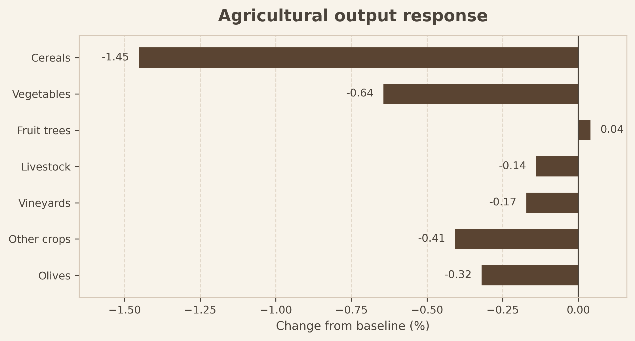
RESULTS · OUTPUT
Agricultural Output Response
Activity-level response to the soil-erosion productivity shock
Output changes are computed as QXres / QX0 × 100.
The largest contractions occur in cereals and vegetables, the activities most exposed to the arable-land shock.
Fruit shows a very small positive response, consistent with endogenous reallocation effects in general equilibrium.

Slide 15
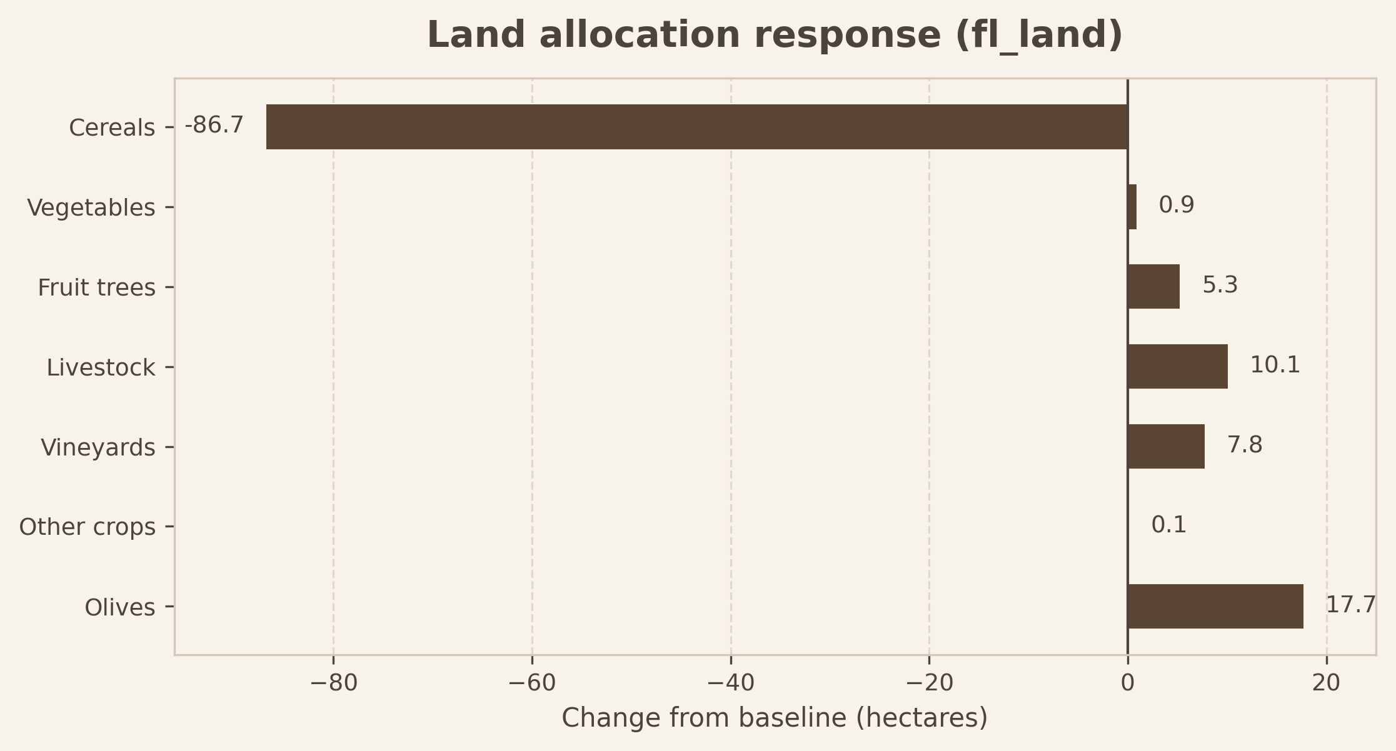
RESULTS · LAND
Land Allocation Response
The land response is reported in hectares using FDres(fl_land,a), not as a percentage.
Land is withdrawn from cereals and reallocated toward some less directly affected activities.
The land-market consistency check closes: ΔFS(fl_land) equals Σa ΔFD(fl_land,a) = −44.943 ha.

Slide 16
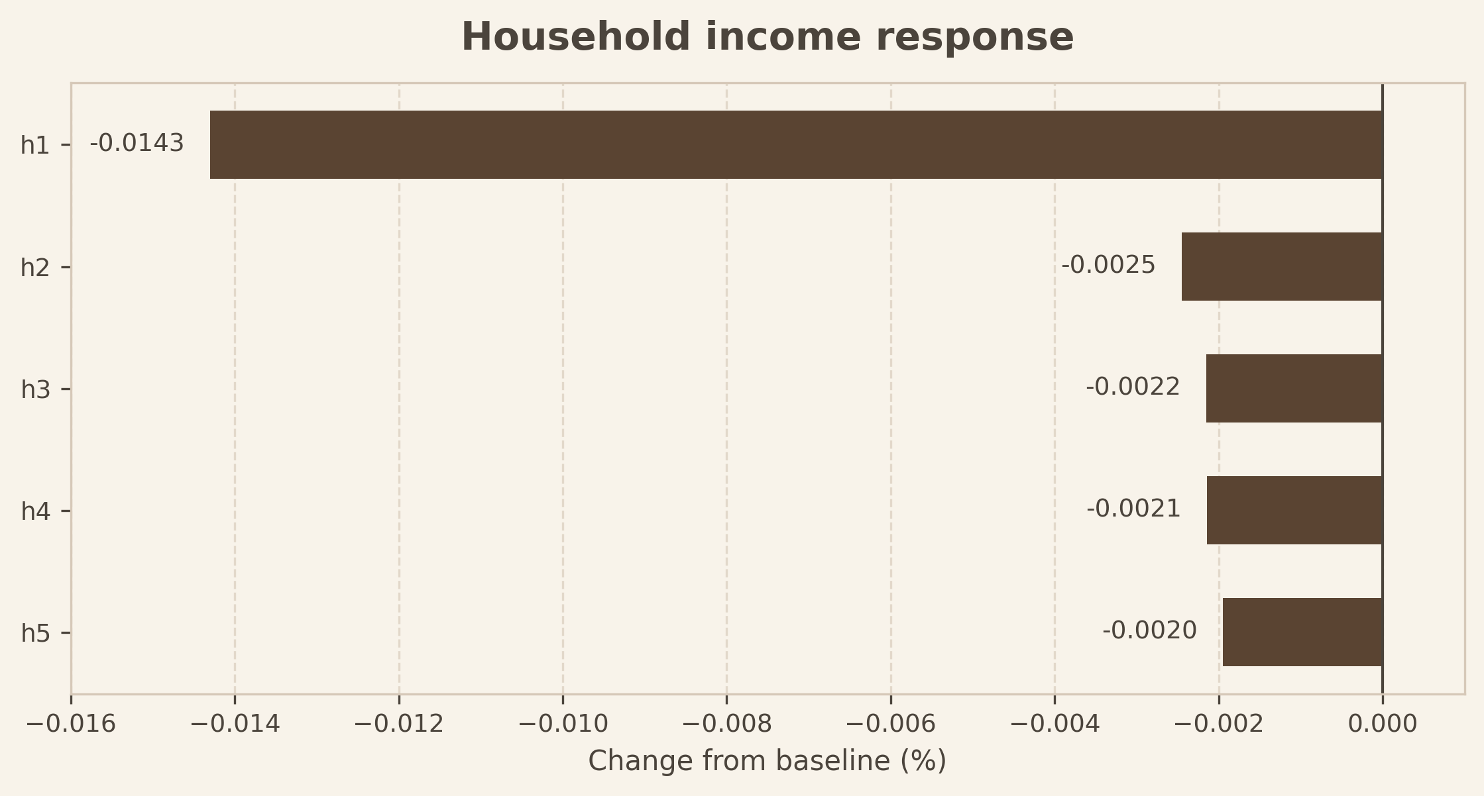
RESULTS · HOUSEHOLDS
Household Income Response
Household income changes are computed as YHres / YH0 × 100.
All household groups experience a negative income effect, although the magnitude is small.
In relative terms, h1 records the largest percentage loss; in absolute model units, h5 has the largest income loss.

Slide 17
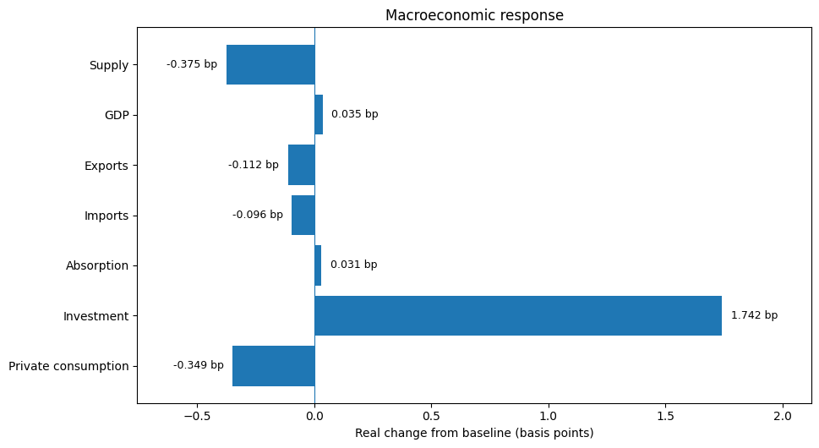
Macroeconomic Response

Slide 18
SHOCK DESIGN
Linking soil degration and the economy: some limitations
1
Phenomenon
Soil degradation is multidimensional; this study focuses on water-driven soil erosion as the measurable channel.
2
Scale
RUSLE-based erosion estimates are spatially sensitive: local results depend on rainfall erosivity, land cover, slope and topography.
3
Macro economic translation
Challenging in translate climate model in consistent macro effect in the economic wide system

