Slide 1
The Construction of Commodity-by-Commodity Input-Output Tables: A Theoretical and Empirical Review of Almon´s Algorithm
Wolfgang Koller
Institute for Industrial Research, Vienna
International Input-Output Association Conference 2026,
June 22nd-26th, Seville

Slide 2
Main Motivation
The procedure converges but it is not clear to what.
Rueda-Cantuche, J. M., The construction of input-output coefficients, In: Handbook of input-output Analysis, 2017, p. 160
This is, among others, one of the main criticism brought forward against Almon´s algorithm
Almon, C. (ESR, 2000): Product-to-product tables via product-technology with non-negative flows
In this research I strive to make it clear to what the algorithm converges:
  theoretically (both mathematically and economically)
  empirically

Slide 3
Overview
Further motivations:
  Review the economic interpretation of Almon´s algorithm
  Perform a comparison with alternative approaches (based on CTA)
Structure of the presentation:
  Introduction: The CTA and the ITA
  The negatives problem and Almon´s algorithm
  Schematic description with the help of an “accounting transfer matrix”
  An optimization model equivalent to Almon´s algorithm
  Alternative approaches: Bohlin/Widell (2005) and similar
  Empirical results (preliminary)
  Conclusion and further steps

Slide 4
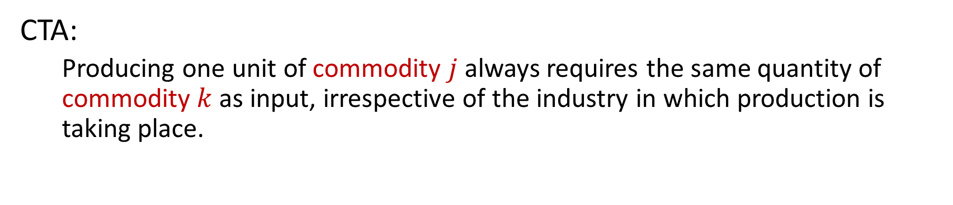
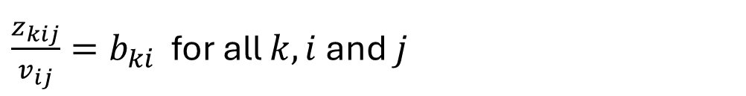
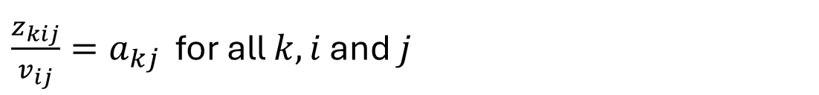
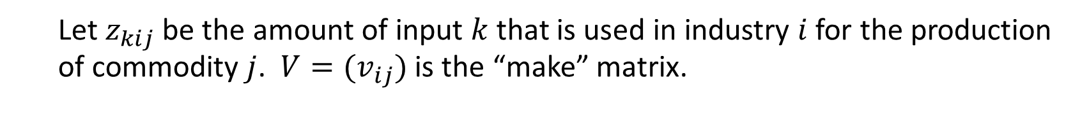
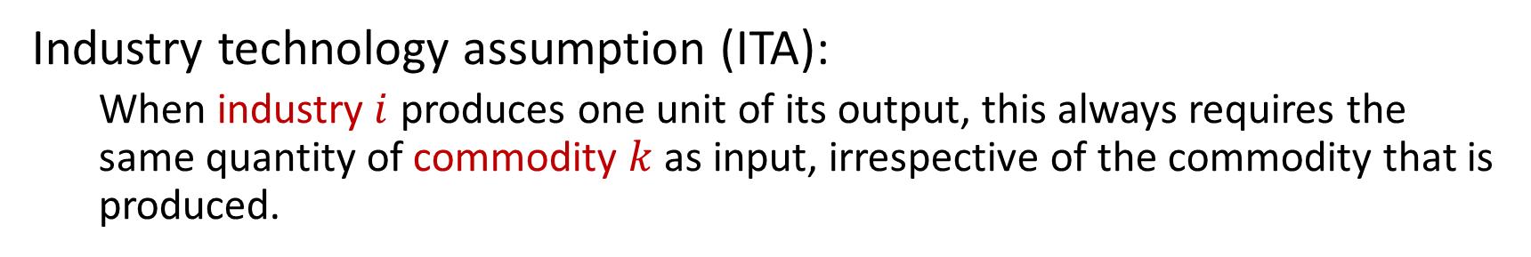
The commodity technology assumption (CTA)
  Let $z_{kij}$ be the amount of input $k$ that is used in industry $i$ for the production of commodity $j$. $V=(v_{ij})$ is the “make” matrix.
CTA:
  Producing one unit of commodity $j$ always requires the same quantity of commodity $k$ as input, irrespective of the industry in which production is taking place.
$\frac{z_{kij}}{v_{ij}}=a_{kj}$ for all $k, i$ and $j$
Industry technology assumption (ITA):
  When industry$i$ produces one unit of its output, this always requires the same quantity of commodity $k$ as input, irrespective of the commodity that is produced.
$\frac{z_{kij}}{v_{ij}}=b_{ki}$ for all $k, i$ and $j$

Slide 5
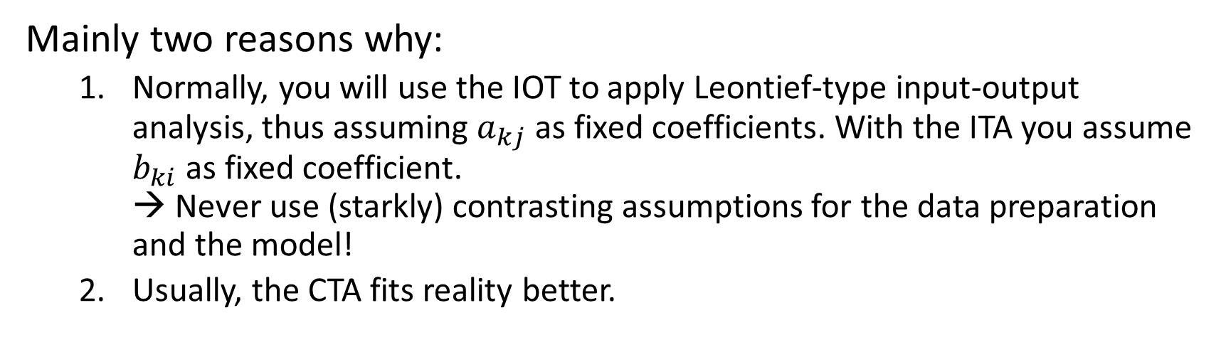
Why focus on the CTA?
  The CTA is the „normal“ starting point for the construction of input-output tables (IOT) in the commodity-by-commodity dimension, when data are available as make and use tables.
Mainly two reasons why:
  Normally, you will use the IOT to apply Leontief-type input-output analysis, thus assuming $a_{kj}$ as fixed coefficients. With the ITA you assume $b_{ki}$ as fixed coefficient.
  → Never use (starkly) contrasting assumptions for the data preparation and the model!
  Usually, the CTA fits reality better.
  This focus of mine is not meant as a license to ignore other older and recent research strands and potential methods to construct IOTs (e.g., mixing CTA, and ITA, byproduct-based approaches)

Slide 6
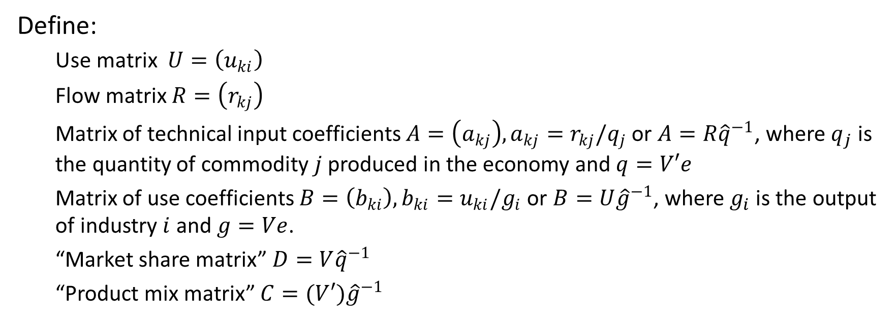
The problem with negatives (1)
  Unfortunately, an often occurring problem with application of the CTA is that the resulting IOT has (usually small) negative elements.
Define:
  Use matrix $U=\left(u_{ki}\right)$
  Flow matrix $R=\left(r_{kj}\right)$
  Matrix of technical input coefficients $A=\left(a_{kj}\right), a_{kj}=r_{kj}/q_{j}$ or $A=R{\hat{q}}^{−1}$, where $q_{j}$ is the quantity of commodity $j$ produced in the economy and $q=V′e$
  Matrix of use coefficients $B=\left(b_{ki}\right), b_{ki}=u_{ki}/g_{i}$ or $B=U{\hat{g}}^{−1}$, where $g_{i}$ is the output of industry $i$ and $g=Ve$.
  “Market share matrix” $D=V{\hat{q}}^{−1}$
  “Product mix matrix” $C=(V{′)\hat{g}}^{−1}$

Slide 7
The problem with negatives (2)
CTA: $A=BC^{−1}$ $A=U{\left(V^{′}\right)}^{−1}$ $R=U{\left(D^{′}\right)}^{−1}$
ITA: $A=BD$ $R=BV$ $R=UC′$
  → From a mathematical point of view the occurrence of negatives is not surprising.

Slide 8
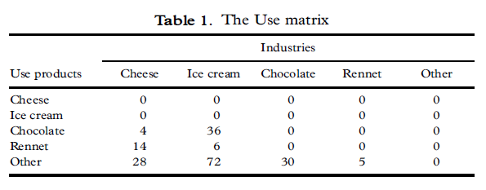
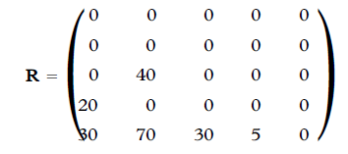
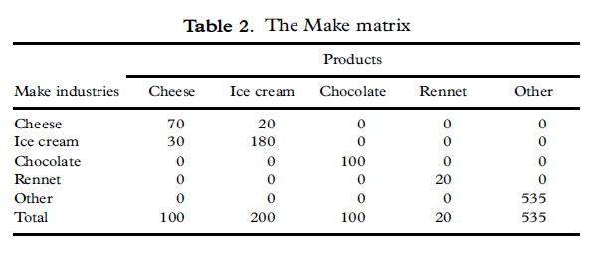
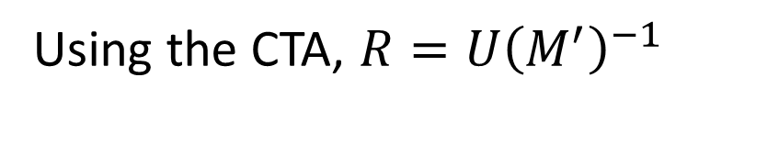
Why are there negatives? An example (1)
*
Using the CTA, $R=U{\left(M^{′}\right)}^{−1}$
This R is very neat. All rennet goes into cheese and all chocolate goes into ice cream.
Almon (2000, p. 30)
* Switching over to Almon‘s mathematical notation

Slide 9
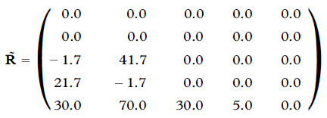

Why are there negatives? An example (2)
Introduce small changes in $U$
It is [..] very easy for the table makers to forget to put into the Cheese industry the chocolate necessary for the ice cream it produces, or to put in too little.
Almon (2000, p. 31)
3
37
15
5

Slide 10
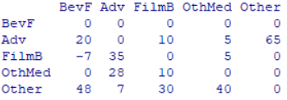

Why are there negatives? Another example
Different technologies are used for producing one and the same commodity.
$R$

Slide 11






Almon’s algorithm (1)
S$tart with U=AV^{′}=RM′$, transpose and select the column of input $k$
$$u=Mr$$
Finally, we got rid of $k$ and the input dimension, considering only one input from now on…
Iterative procedure:
$$r=\left(I−M\right)r+u$$
$$r^{\left(k+1\right)}=\left(I−M\right)r^{\left(k\right)}+u$$
The symbol $k$ is put to a new use and counts iterations.

Slide 12



Almon’s algorithm (2)
Introduce „stops“ to prevent negatives from occurring
and
Iterative procedure without negatives:

Slide 13


The accounting transfer matrix (1)
Case without negatives problem (or without caring)
$$Z=M\hat{r}, u=Ze, r=e´Z$$
$$z_{ij}=m_{ij}r_{j}$$
$$u$$
Note: Stahmer (1985) used this concept before („transformation matrix“)
$$r$$

Slide 14

The accounting transfer matrix (2)
Almon´s algorithm
$$Z=\hat{s}\check{M}\hat{r}+\hat{z}, u=Ze, r=e´Z$$
$$z_{ij}={s_{i}m}_{ij}r_{j}, i≠j$$
$$z_{ii}=u_{i}− \sum_{j}{s_{i}m_{ij}r_{j}}$$
$$u$$
$$r$$

Slide 15

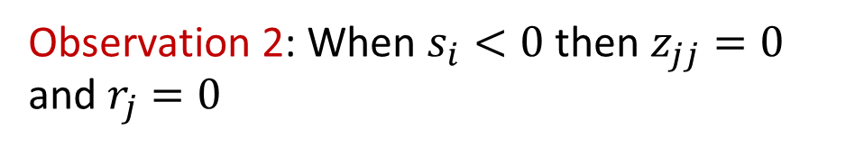
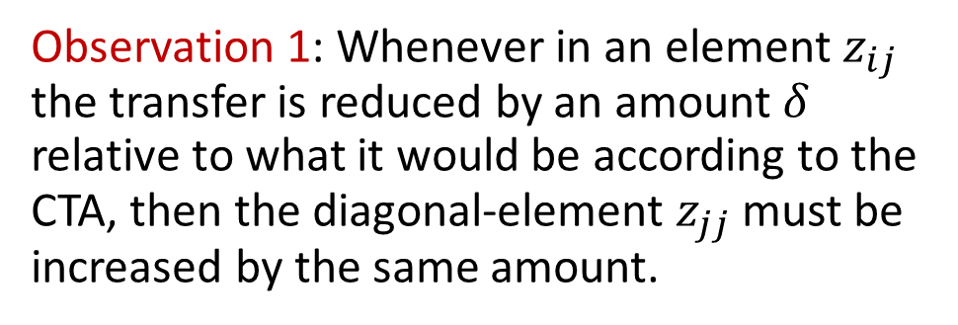
The accounting transfer matrix (3)
Consider the case, where just one industry, let’s say industry 4 needs a „stop“.
Observation 1: Whenever in an element $z_{ij}$ the transfer is reduced by an amount $δ$ relative to what it would be according to the CTA, then the diagonal-element $z_{jj}$ must be increased by the same amount.
$$s_{4}<1$$
Observation 2: When $s_{i}<0$ then $z_{jj}=0$ and $r_{j}=0$
→ Almon‘s algorithm „somehow“ favors characteristic production

Slide 16
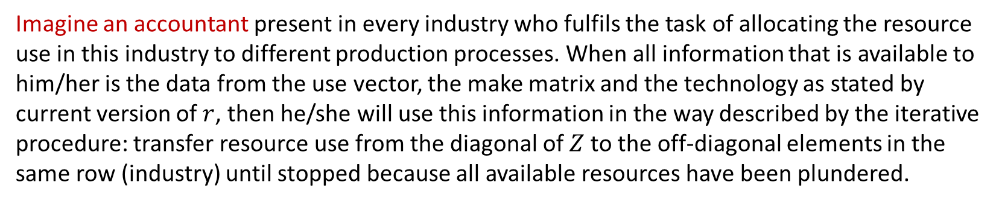
Economic Interpretation (of the iterative procedure)
Imagine an accountant present in every industry who fulfils the task of allocating the resource use in this industry to different production processes. When all information that is available to him/her is the data from the use vector, the make matrix and the technology as stated by current version of $r$, then he/she will use this information in the way described by the iterative procedure: transfer resource use from the diagonal of $Z$to the off-diagonal elements in the same row (industry) until stopped because all available resources have been plundered.
→ Similar line of argument as in an agent based economic model.
Some critics are not convinced (e.g. Rueda-Cantuche, 2017, p. 162).

Slide 17
An optimization model (1)
Is there an optimization model that replicates Almon‘s algorithm?
The constraints seem easy, but what is the objective function?

Slide 18
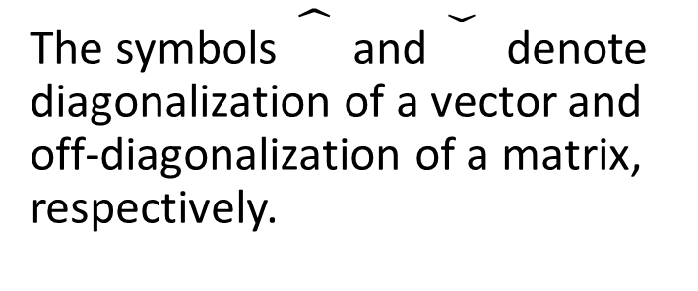


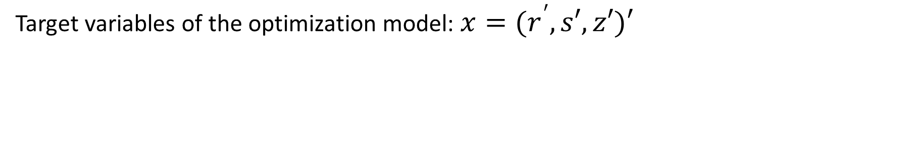


An optimization model (2)
Target variables of the optimization model: $x=(r^{′},s′,z′)′$
where $z=\left(z_{i}\right)=\left(z_{ii}\right)$ is the diagonal vector of $Z$
Model M1:
The symbols and denote diagonalization of a vector and off-diagonalization of a matrix, respectively.
$$\max_{r,s,z}{ s′Mr}$$
$$s.t. \hat{s}\check{M}r+z=u$$
$$s′\check{M}\hat{r}+z=r$$
$$r,z≥0, 0≤s≤1$$

Slide 19
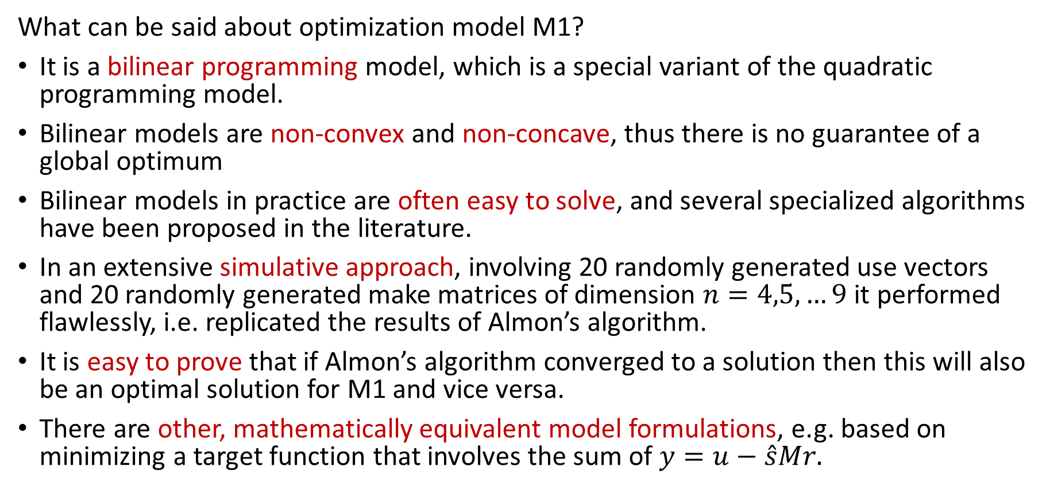
An optimization model (3)
What can be said about optimization model M1?
It is a bilinear programming model, which is a special variant of the quadratic programming model.
Bilinear models are non-convex and non-concave, thus there is no guarantee of a global optimum
Bilinear models in practice are often easy to solve, and several specialized algorithms have been proposed in the literature.
In an extensive simulative approach, involving 20 randomly generated use vectors and 20 randomly generated make matrices of dimension $n=4,5,…9$ it performed flawlessly, i.e. replicated the results of Almon’s algorithm.
It is easy to prove that if Almon’s algorithm converged to a solution then this will also be an optimal solution for M1 and vice versa.
There are other, mathematically equivalent model formulations, e.g. based on minimizing a target function that involves the sum of $y=u−\hat{s}Mr.$

Slide 20
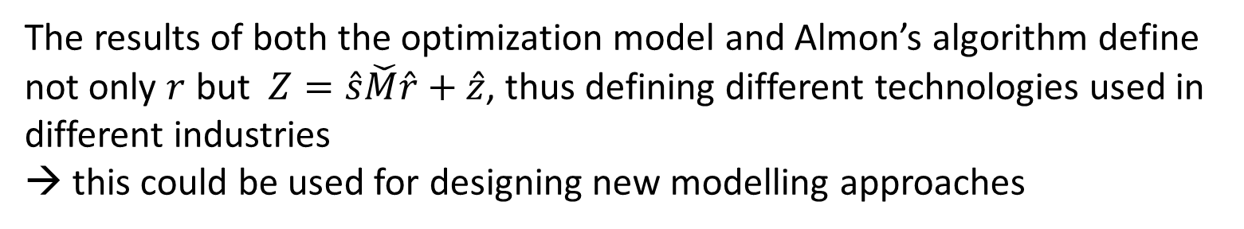
Economic Interpretation (of the optimization model)
Model M maximizes the sum of flows that are allocated according to the CTA.
$\frac{s^{′}Mr}{e^{′}r}$ A measure of the appropriateness of the CTA for the case at hand
The results of both the optimization model and Almon’s algorithm define not only $r$ but $Z=\hat{s}\check{M}\hat{r}+\hat{z}$, thus defining different technologies used in different industries
→ this could be used for designing new modelling approaches

Slide 21
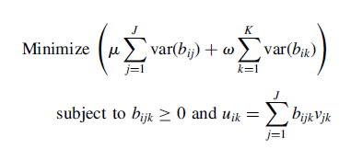
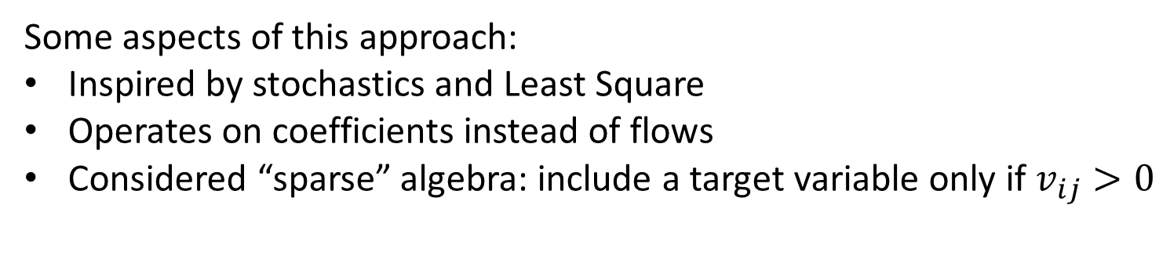
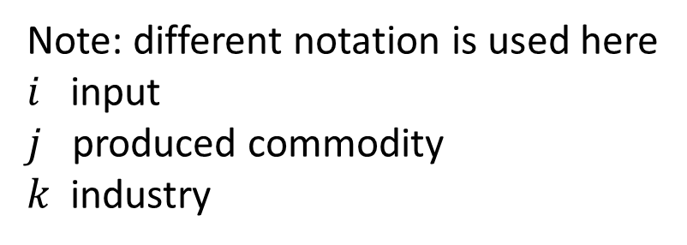
Alternative approaches (1)
Bohlin/Widell (ESR, 2006) developed an optimization model to mix the CTA and ITA in the construction of commodity-by-commodity tables:
CTA
ITA
Note: different notation is used here
$i$ input
$j$ produced commodity
$k$ industry
Some aspects of this approach:
Inspired by stochastics and Least Square
Operates on coefficients instead of flows
Considered “sparse” algebra: include a target variable only if $v_{ij}>0$

Slide 22

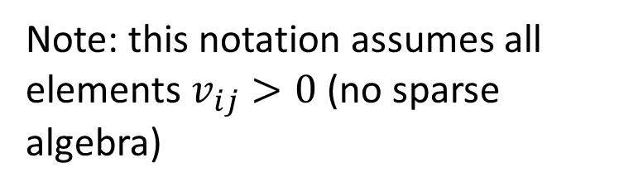
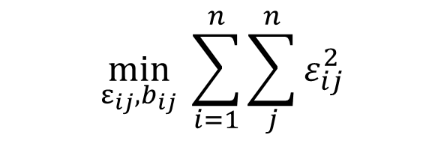
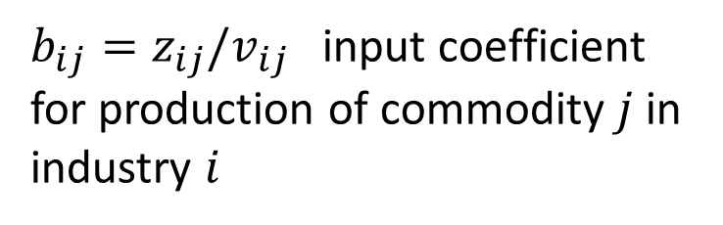

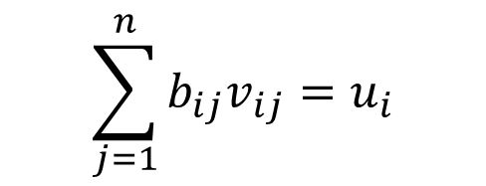
Alternative approaches (2)
A simplified version of this approach
Focussing only on the CTA and
Considering only one input at a time (e.g., one row of use matrix)
Adapting the notation
$$\min_{ε_{ij},b_{ij}}{ \sum_{i=1}^{n}{\sum_{j}^{n}{ε_{ij}^{2}}}}$$
Model M2:
$b_{ij}=z_{ij}/v_{ij}$ input coefficient for production of commodity $j$ in industry $i$
$$s.t. b_{ij}+ε_{ij}=\frac{1}{n}\sum_{i=1}^{n}{b_{ij}}$$
Note: this notation assumes all elements $v_{ij}>0$ (no sparse algebra)
$$\sum_{j=1}^{n}{b_{ij}v_{ij}=u_{i}}$$
$$b_{ij}≥0$$

Slide 23
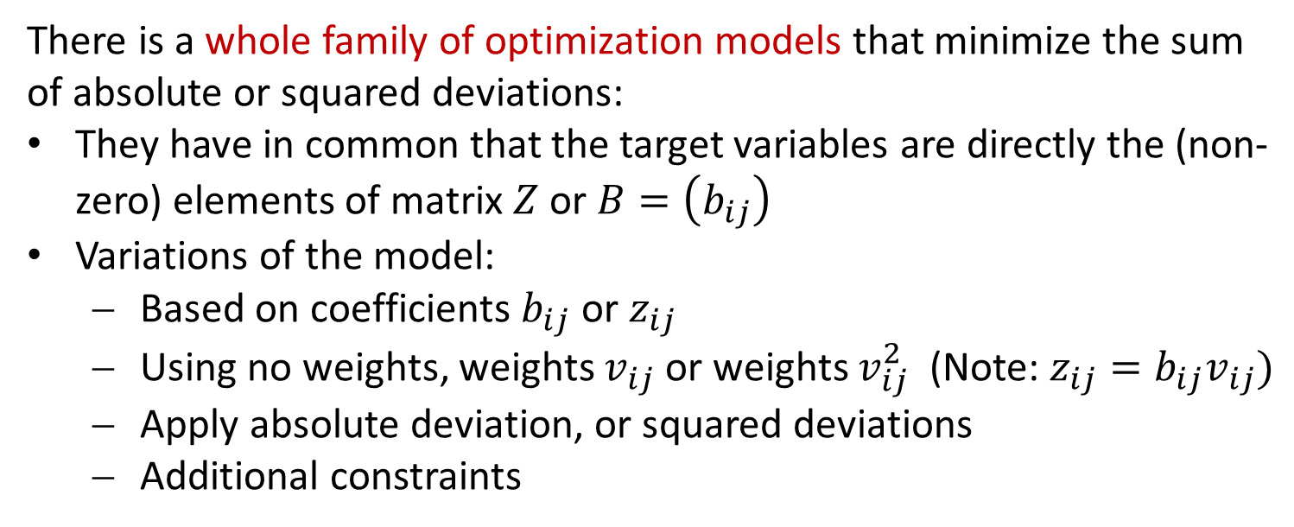
Alternative approaches (3)
There is a whole family of optimization models that minimize the sum of absolute or squared deviations:
They have in common that the target variables are directly the (non-zero) elements of matrix $Z$or $B=\left(b_{ij}\right)$
Variations of the model:
  Based on coefficients $b_{ij}$ or $z_{ij}$
  Using no weights, weights $v_{ij}$ or weights $v_{ij}^{2}$ (Note: $z_{ij}=b_{ij}v_{ij})$
  Apply absolute deviation, or squared deviations
  Additional constraints
(provisional) Model M1 is mathematically equivalent to one member of this family:
  Based on $z_{ij}$, absolute deviations, proportionality constraint

Slide 24
Empirical study
Aim: to show “to what” Almon’s algorithm converges to with the help of empirical data.
What is planned:
Selection of interesting input vectors, i.e. intermediate inputs, primary inputs, employment categories
Analyses:
  Analyse the performance of the methods given their own and each others performance measures
  Analyse the distance of the solutions to each other and to other reference points (official IOT, or ITA-solution) Note: there is no true solution.

Slide 25
Conclusions and further steps
The optimisation model M1 and its equivalent formulations show that Almon’s algorithm has a convergence point that can be clearly interpreted.
Our explorations, based on the “matrix of accounting transfers”, of the mechanisms behind both the iterative algorithm of Almon’s algorithm and the equivalent optimisation model M1 shed light on its meaning and its relation to other approaches.
The preliminary results of the empirical part so far show that all the methods presented deliver solutions for the chosen input vectors to be transformed from industry to commodity dimension that are close to each other, relative to solutions based on algorithms not inspired by the CTA.
As further steps we will work out the empirical part in detail and further work out the theoretical properties of the models M1 and the model family around M2.

Slide 26
Thank you for your attention!
  Contact:
  Wolfgang Koller
  Institute for Industrial Research, Vienna
  koller@science.iwi.ac.at

