Slide 1

Improving timeliness of FIGARO for measuring globalisation and sustainability in the EU
32nd IIOA & 11th SHAIO Conference
Alba Catalán, Pablo Piñero, José M. Rueda-Cantuche, Santacruz Banacloche – Joint Research Centre
Seville,
25th June 2026

Slide 2
What is FIGARO?
Full International and Global Accounts for Research in input-Output analysis
EU inter-country Supply, Use and Input-Output tables and applications (environment, economic globalisation)
Long-term cooperation between Eurostat and
the European Commission’s Joint Research Centre
Since 2021, FIGARO published annually as European statistics (last release July 2025)
Allow deep analyses of the socio-economic and environmental effects of globalisation
https://ec.europa.eu/eurostat/web/esa-supply-use-input-tables/database

Slide 3
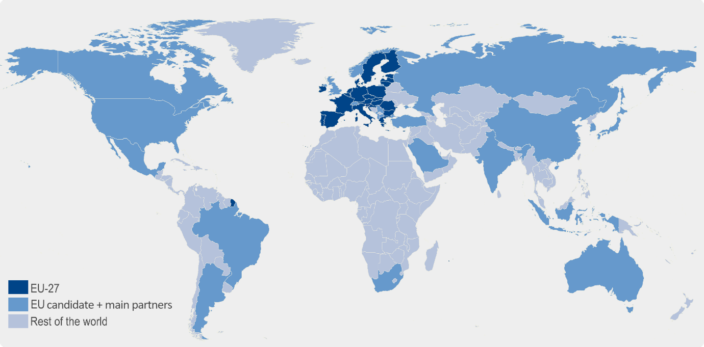
What are its main characteristics?
FIGARO 2010-2024 to be released early July 2026
EU-27 +
2 EFTA +
5 EU candidate
countries
15 main
trading
partners
+ RoW
+
=
Figaro
49 + RoW
Globally balanced view of National Accounts Main Aggregates, adjusted to latest national GDP main aggregates (99.1% population and 99.8% GDP)
Fully aligned with countries’ National Accounts official statistics
Build upon available data from National Accounts and balanced international trade statistics
  64 industry and product categories (NACE Rev.2: A*64 / CPA 2.1: P*64)
  Time series from 2010 to year T-2

Slide 4
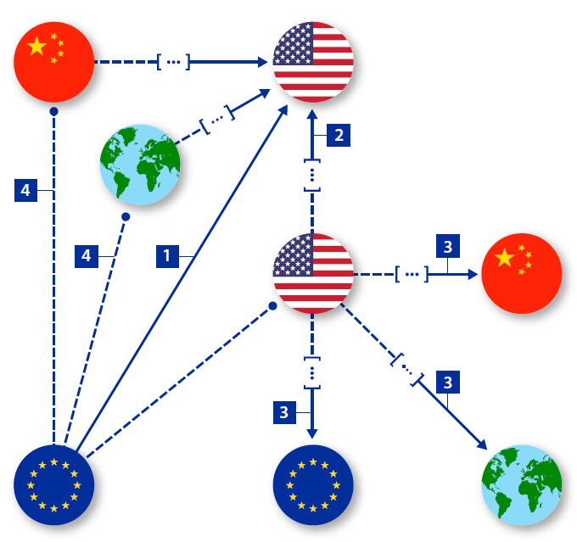
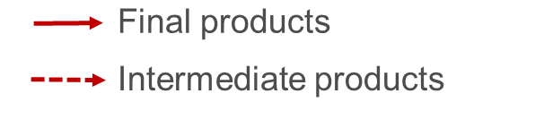
FIGARO MacroEconomic Globalisation indicators (MEG)
1 | Exports – the sum of intermediate and final exports.
2 | Imports – the sum of intermediate and final imports
3 | Domestic value added in exports – the exported value added produced anywhere in the economy
4 | Foreign value added in exports – the value added of intermediate imports embodied in domestic exports
5 | Domestic value added in foreign final use – the value added exported directly as final products, or indirectly via exports of intermediates that reach foreign final consumption through other countries
6 | Foreign value added in domestic final use – the value added imported directly as final products, or indirectly via imports of intermediates that reach domestic final consumption through other countries.
7 | Forward participation – domestic value added in exports which is exported again by trade partners as percentage of total exports
8 | Backward participation – foreign value added in exports which is exported again by trade partners as percentage of total exports
9 | GVC participation index – the sum of forward and backward participation
10 | Single exposure indicator - a combination of value added in trade and value added in final use e to cover all value added pathways in bilateral trade
11 | Domestic employment in exports – the employment supported by exporting industries and by those supplying inputs to them (spillover effects)
12 | Domestic employment in foreign final use – direct and indirect (spillover effects) employment supported by foreign final demand
Basic statistics
VA in Trade
VA in FU
Resilience/Semester
Other developments
Employment

Slide 5
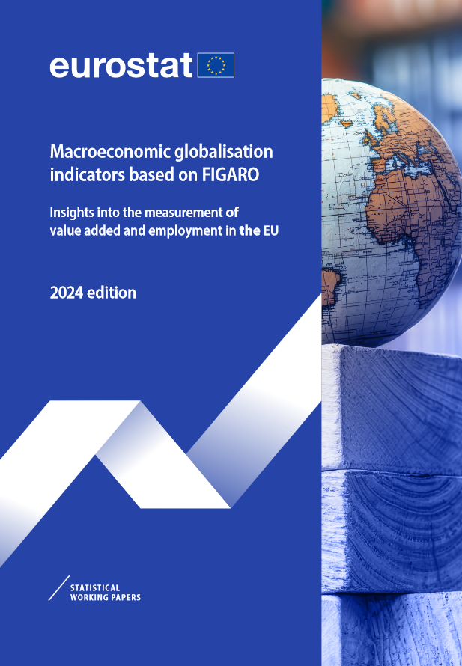
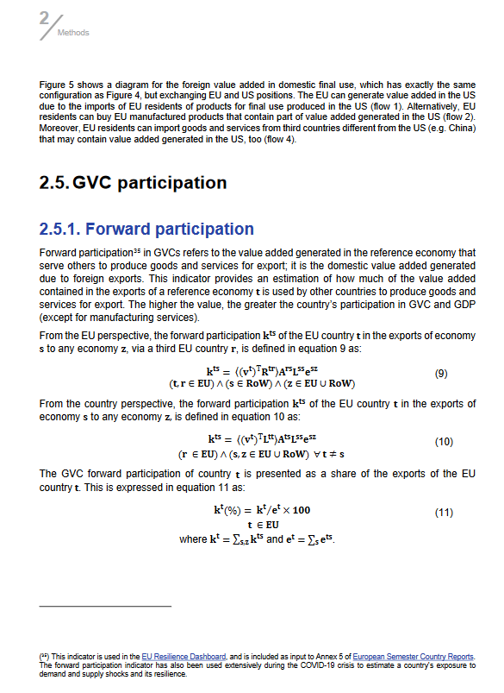
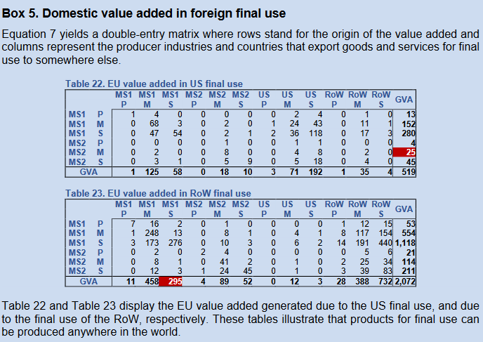
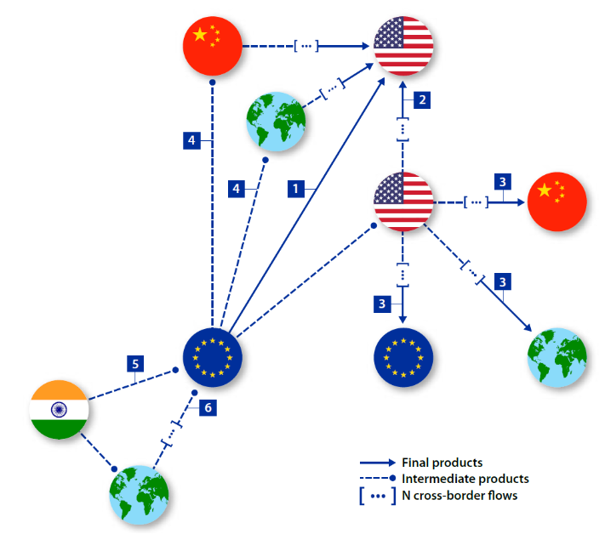
FIGARO MacroEconomic Globalisation indicators (MEG)
Methodological publication:
40 equations detailing indicators calculations, and quality assurance operations
Infographics
16 Example boxes

Slide 6
Improving timeliness of MEG indicators: Motivation
Extend the time series of FIGARO MEG indicators by one additional year
(new time series from 2010 to T-1)
Short-term forecasting of MEG indicators without complete annual database reconstruction
No need to compile FIGARO tables for the reference year T-1
Innovation to bridge the gap between data availability and policy relevance
Ensure that EU policymakers can access the most granular and timely data

Slide 7
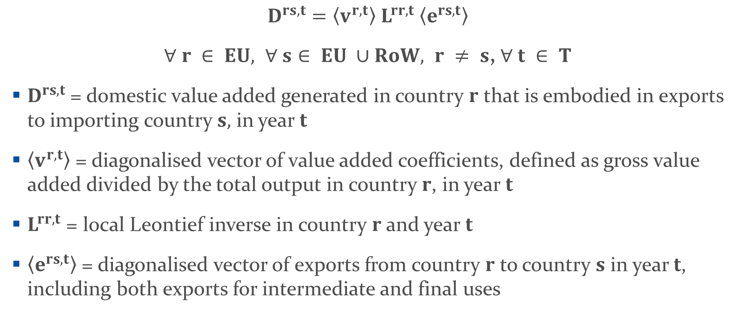
Methodology: Illustration with Domestic Value Added in exports
$$D^{rs, t}=〈v^{r,t}〉{ L}^{rr,t} 〈e^{rs,t}〉$$
$∀ r ∈ EU, ∀ s∈ EU ∪RoW, r ≠ s$, $∀ t ∈ T$
$D^{rs,t}$= domestic value added generated in country $r$ that is embodied in exports to importing country $s,$ in year $t$
$〈v^{r,t}〉$ = diagonalised vector of value added coefficients, defined as gross value added divided by the total output in country $r$, in year $t$
$L^{rr,t}$ = local Leontief inverse in country $r$ and year $t$
$〈e^{rs,t}〉$ = diagonalised vector of exports from country $r$ to country $s$ in year $t$, including both exports for intermediate and final uses

Slide 8
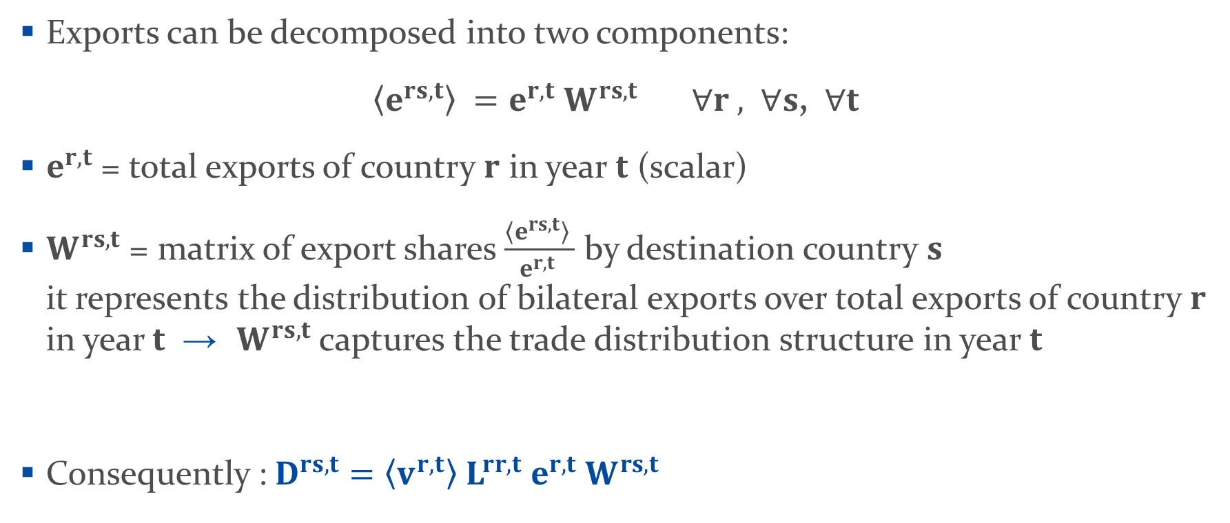
Methodology: Illustration with Domestic Value Added in exports
Exports can be decomposed into two components:
$〈e^{rs,t}〉 =e^{r,t}{ W}^{rs,t} ∀r , ∀s$, $∀t$
$e^{r,t}$ = total exports of country $r$ in year $t$ (scalar)
$W^{rs,t}$ = matrix of export shares $\frac{〈e^{rs,t}〉 }{e^{r,t} }$ by destination country $s$
it represents the distribution of bilateral exports over total exports of country $r$ in year $t$ → $W^{rs,t}$ captures the trade distribution structure in year $t$
Consequently :$D^{rs, t}=〈v^{r,t}〉{ L}^{rr,t}{ e}^{r,t}{ W}^{rs,t}$

Slide 9
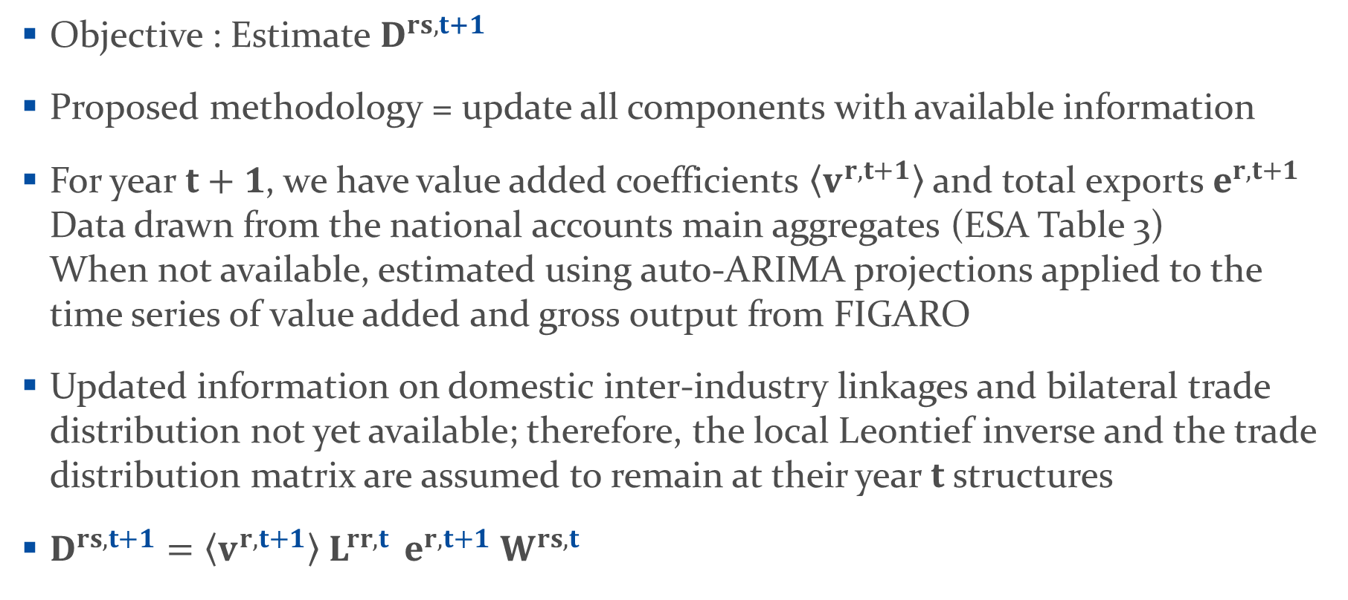
Methodology: Illustration with Domestic Value Added in exports
Objective : Estimate $D^{rs, t+1}$
Proposed methodology = update all components with available information
For year $t+1$, we have value added coefficients $〈v^{r,t+1}〉$ and total exports $e^{r,t+1}$ Data drawn from the national accounts main aggregates (ESA Table 3)
When not available, estimated using auto-ARIMA projections applied to the time series of value added and gross output from FIGARO
Updated information on domestic inter-industry linkages and bilateral trade distribution not yet available; therefore, the local Leontief inverse and the trade distribution matrix are assumed to remain at their year $t$ structures
$D^{rs, t+1}=〈v^{r,t+1}〉{ L}^{rr,t }{ e}^{r,t+1}{ W}^{rs,t}$

Slide 10
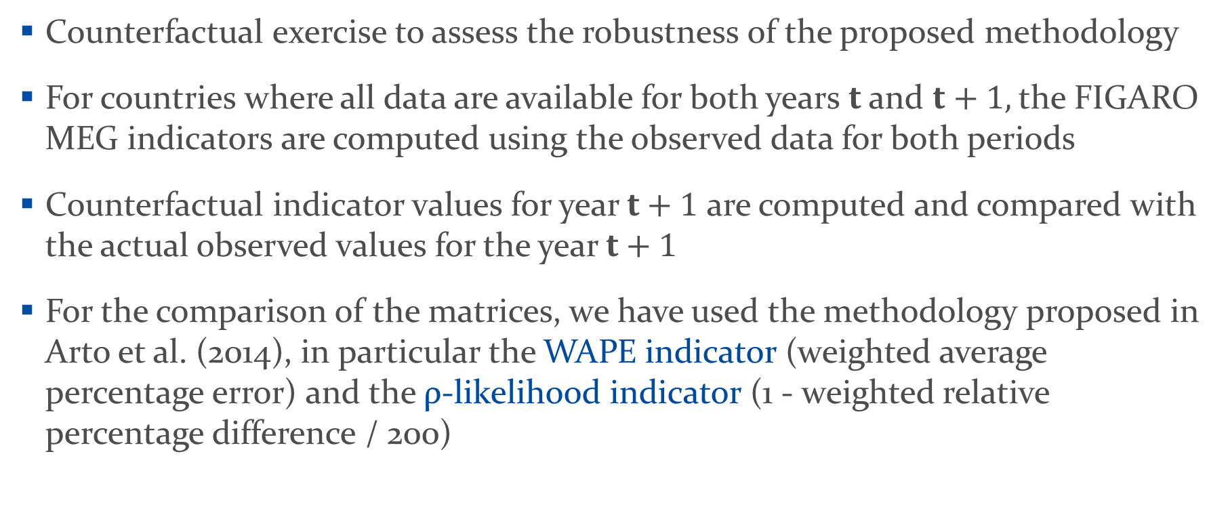
Robustness test
Counterfactual exercise to assess the robustness of the proposed methodology
For countries where all data are available for both years $t$ and $t+1,$the FIGARO MEG indicators are computed using the observed data for both periods
Counterfactual indicator values for year $t+1$ are computed and compared with the actual observed values for the year $t+1$
For the comparison of the matrices, we have used the methodology proposed in Arto et al. (2014), in particular the WAPE indicator (weighted average percentage error) and the ρ-likelihood indicator (1 - weighted relative percentage difference / 200)

Slide 11
Robustness test
1. WAPE indicator (weighted average percentage error)
where the subscripts T and E denote the true matrix and the estimated matrix, respectively

Slide 12
Results with WAPE indicator
Deviations level | Perspective | WAPE 2023 estimated | WAPE 2015 estimated | WAPE 2016 estimated
Deviations at total level | EU | 0.15% | 2.64% | 2.97%
 | Country | 0.04% | 1.66% | 0.24%
Deviations at country level | EU | 2.02% | 3.04% | 3.17%
 | Country | 1.09% | 1.98% | 0.68%
Deviations at country and industry levels | EU | 7.61% | 10.50% | 7.05%
 | Country | 6.03% | 9.91% | 5.58%
Deviations at country, industry, and trade partner levels | EU | 14.12% | 17.70% | 13.37%
 | Country | 13.33% | 16.89% | 12.65%

Slide 13
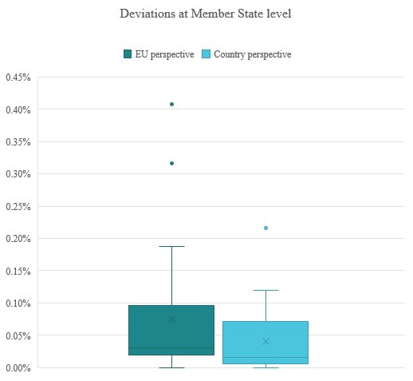
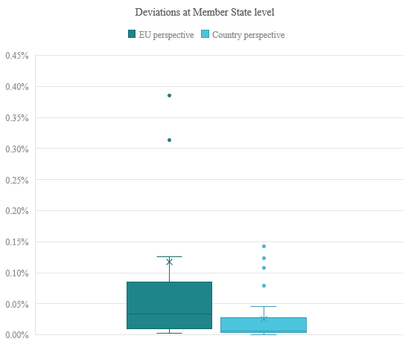
Results with WAPE indicator
Year 2023 estimated with year 2022 data
Year 2016 estimated with year 2015 data

Slide 14

Robustness test
2. ρ-likelihood indicator: with the WRPD (Weighted Relative Percentage Difference) and the RPD (Relative Percentage Difference) being computed as follows:
ρ-likelyhood $= 1− \frac{WRPD}{200}$

Slide 15
Results with ρ-likelihood indicator
Deviations level | Perspective | WAPE 2023 estimated | WAPE 2015 estimated | WAPE 2016 estimated
Deviations at total level | EU | 99.92% | 99.98% | 99.98%
 | Country | 99.98% | 99.99% | 99.99%
Deviations at country level | EU | 98.98% | 98.42% | 98.45%
 | Country | 99.45% | 98.98% | 99.66%
Deviations at country and industry levels | EU | 96.45% | 94.12% | 96.57%
 | Country | 97.05% | 94.41% | 97.21%
Deviations at country, industry, and trade partner levels | EU | 92.82% | 90.59% | 93.62%
 | Country | 93.20% | 91.01% | 93.66%

Slide 16
Conclusions and next steps
Short-term forecasting method for FIGARO MEG indicators, enhancing its timeliness and relevance for policy and decision-making
No need to fully construct the FIGARO tables for the latest year, extending time series by one year without compromising data integrity
Short-term changes in value added driven by:
  Updated value-added intensities and total exports
  Fixed production linkages and trade structures
Tests demonstrated the robustness of the approach: No significant deviations between 2023 forecast estimates and observed values, idem 2015, 2016 years
Further developments: Explore supplementary estimation techniques where NA main aggregates for t+1 are unavailable; Develop allocation techniques if full 64-industry breakdown is unavailable; Conduct comparative evaluation against alternative approaches (e.g. Bayesian methods)

Slide 17
References
Arto, I., Rueda-Cantuche, J.M. and Peters. G (2014). Comparting the GTAP-MRIO and WIOD databases for Carbon Footprint analysis, Economic Systems Research, 26:3, 327-353, DOI: 10.1080/09535314.2014.939949
Eurostat (2008). European Manual of Supply, Use and Input–Output Tables. Eurostat Methodologies and Working Papers. Available at: https://ec.europa.eu/eurostat/web/products-manuals-and-guidelines/-/KS-RA-07-013
Piñero, P., Banacloche, S., Rueda-Cantuche, J.M., Montaigne, F. (2024). Macroeconomic globalisation indicators based on FIGARO. Insights into the measurement of value added and employment in the EU. Eurostat Statistical Working Paper. Available at: https://ec.europa.eu/eurostat/web/products-statistical-working-papers/w/ks-01-24-017
Remond-Tiedrez, I., Rueda-Cantuche, J.M. (2019). EU inter-country supply, use and input-output tables — Full international and global accounts for research in input-output analysis (FIGARO). 2019 edition. Eurostat Statistical Working Paper. Available at: https://ec.europa.eu/eurostat/en/web/products-statistical-working-papers/-/ks-tc-19-002
Stehrer, R. (2012). Trade in Value Added and the Value Added in Trade. WIOD Working Paper 8, 1–19. Available at: https://www.rug.nl/ggdc/valuechain/wiod/papers/wiod8.pdf.

Slide 18

Thank you
© European Union 2020
Unless otherwise noted the reuse of this presentation is authorised under the CC BY 4.0 license. For any use or reproduction of elements that are not owned by the EU, permission may need to be sought directly from the respective right holders.
Notes:
Update/add/delete parts of the copy right notice where appropriate.
More information: https://myintracomm.ec.europa.eu/corp/intellectual-property/Documents/2019_Reuse-guidelines%28CC-BY%29.pdf

