Slide 1

Exploring the heterogenous implications of green transition in the European labor markets
Dr. Mehtap Akgüç
Senior researcher (ETUI) & research fellow (IZA@LISER)
32nd IIOA & 11th SHAIO conference
Seville, Spain
22-26 June 2026
Notes:
Good afternoon, everyone. Thank you for attending this session. Today, I am presenting my working paper titled 'Exploring the heterogeneous implications of the green transition in the European labour markets'. As the European Union rolls out its climate policies, public debate often prioritizes macroeconomic efficiency or environmental outcomes. However, the labor market implications are equally deep. This paper investigates how these structural shifts affect different groups of workers unequally, depending on their geographic location, industrial sector, gender, age, and wage bracket. This research is currently in progress at the ETUI, and I look forward to your valuable feedback."

Slide 2
Plan
Motivation
Contribution
Background
Empirical approach
  Methodology
  Policy simulations
  Data
Results
Reflections for future research and policy framework

Slide 3
Motivation
The green transition is widely presented as a central response to the accelerating climate crisis
  It refers to the systemic shift away from fossil-fuel based, carbon-intensive economic systems toward sustainable, low-carbon, resource-efficient economic models
It is often framed as a technical challenge with the following key elements:
  Scaling up renewable energy, modernizing grids, developing carbon storage technologies, decarbonization of energy-intensive industry, improving energy efficiency, increasing circular economy practices, and other climate adaptation and resilience measures
In fact, the green transition is a much deeper social transformation
It reshapes economies, labour markets, societies, regions, cities, land use, mobility systems, and even geopolitical relations
Its success depends not only on technology, but also on how it is managed
Taking action on climate change through appropriate green transition policies is integral to sustainable development goals (SGDs) and key to efforts to promote decent work and poverty reduction

Slide 4
European Green Deal
The European Green Deal (EGD) is the new growth strategy of the European Union (EU), launched in 2019, aimed at transforming the EU into a modern, competitive, and climate-neutral economy by 2050
It commits Europe to becoming the first carbon-neutral continent
Key objectives and components include:
  Climate neutrality by 2050: Drastically reduce greenhouse gas emissions;
  Green transition: Modernize industry, transport, energy, and agriculture;
  Sustainable economy: Decouple economic growth from resource use;
  "Fit for 55": The legislative package to reduce net emissions by 55% by 2030;
  Inclusivity: Ensure the transition is fair and equitable for all (just transition)
Socioeconomic realities: Sectoral restructuring requires massive changes in production, consumption, and infrastructure
The fundamental risk: Structural transformations do not automatically produce socially neutral outcomes. Without targeted policies, they risk exacerbating pre-existing inequalities and creating distributional imbalances.
Notes:
To ground this study, we must look at the institutional backdrop. The European Green Deal and the subsequent 'Fit for 55' package have locked in ambitious, binding climate targets. Achieving a 55% emissions cut by 2030 requires deep adjustments in high-impact sectors like energy, waste management, and construction. While these policies are essential for environmental sustainability, they trigger deep labor market adjustments. Workers are not perfectly mobile across industries; they face skills friction and geographic barriers. Therefore, the green transition risks compounding structural inequalities if complementary, targeted social measures are not introduced alongside it

Slide 5
Labor market implications of the green transition
Climate crisis and related green transition policies will have a major effect on the world of work
Millions of new jobs are expected to be created in the transition to a net-zero carbon economy, but a large number of jobs will also disappear
Most jobs will go through a fundamental transformation (task-based approaches)
This unprecedented wave of restructuring will have unequal effects on many fronts, including skills, gender, age, economic activity, sector and region
The impacts of green transition should be considered within a context where gender job segregation remains a significant feature of the EU labour market
Most job growth towards green transition is expected in the sectors dominated by men
  Energy, construction, transport or manufacturing

Slide 6
Research gaps and core contributions
Extensive margin vs. Intensive margin: Extensive research exists on macro-level net employment volumes (jobs created vs. destroyed). However, less is known about the intensive margin—the demographic and qualitative distribution of these jobs.
Heterogeneity: Existing literature often treats the workforce as a uniform block or limits analysis to descriptive statistics within single industries.
Paper’s main contributions:
  Blends macro-level Input-Output frameworks with micro-level demographic structures.
  Maps cross-border supply chain dependencies within a multi-regional cross-country environment (EU27).
  Traces labor market impacts across three simultaneous layers of diversity: gender, age group, and pay levels.
Notes:
Where does this paper sit in the literature? The existing research can broadly be split into macro-level studies quantifying net employment and micro-level studies mapping occupational skill requirements. Yet, a significant gap remains: we lack a clear view of the intensive margin—how policy-driven sectoral shifts filter down to diverse worker demographics. This paper targets that gap. It combines a multi-regional Input-Output framework with detailed labor force surveys across the EU27. By doing so, it captures the complex supply chain ripples across borders and links those macro shifts directly to gender compositions, age distributions, and wage structures

Slide 7
Two analytical strands
Strand 1: Macro-level & Input-output studies
  Direct Employment: Renewable energy technology creates substantial direct jobs, but they are often highly concentrated in specific regions or countries (e.g., Germany, Spain).
  Indirect/Ripple Effects: Supply chains matter deeply. For instance, Allan and Ross (2019) show that 1 direct power sector job supports 7 indirect jobs across the wider economy. Markandya et al. (2016) find that one-third of net energy-sector jobs are generated via cross-border trade effects.
Strand 2: Meso/Micro-level & skill frameworks
  Focuses on defining "green vs. non-green" jobs.
  Highlights a rising demand for transversal, analytical, digital, and technical skills alongside a drop in standard equipment maintenance jobs (Cedefop 2021; Borgonovi et al. 2023).
Notes:
Let's zoom into the two main strands of literature. The macro-economic strand emphasizes that green investments yield net positive employment, but underscores two vital caveats: regional concentration and supply chain linkages. For example, studies confirm that energy transition jobs are highly localized, and input-output linkages prove that a single green utility job can generate multiple indirect jobs elsewhere in the economy. The micro-economic strand, meanwhile, deals with job definitions and skills forecasting, showing an accelerating demand for technical, analytical, and creative thinking skills. This paper builds on these insights by using multi-regional input-output tables to look at how these supply chain links affect labor markets.

Slide 8
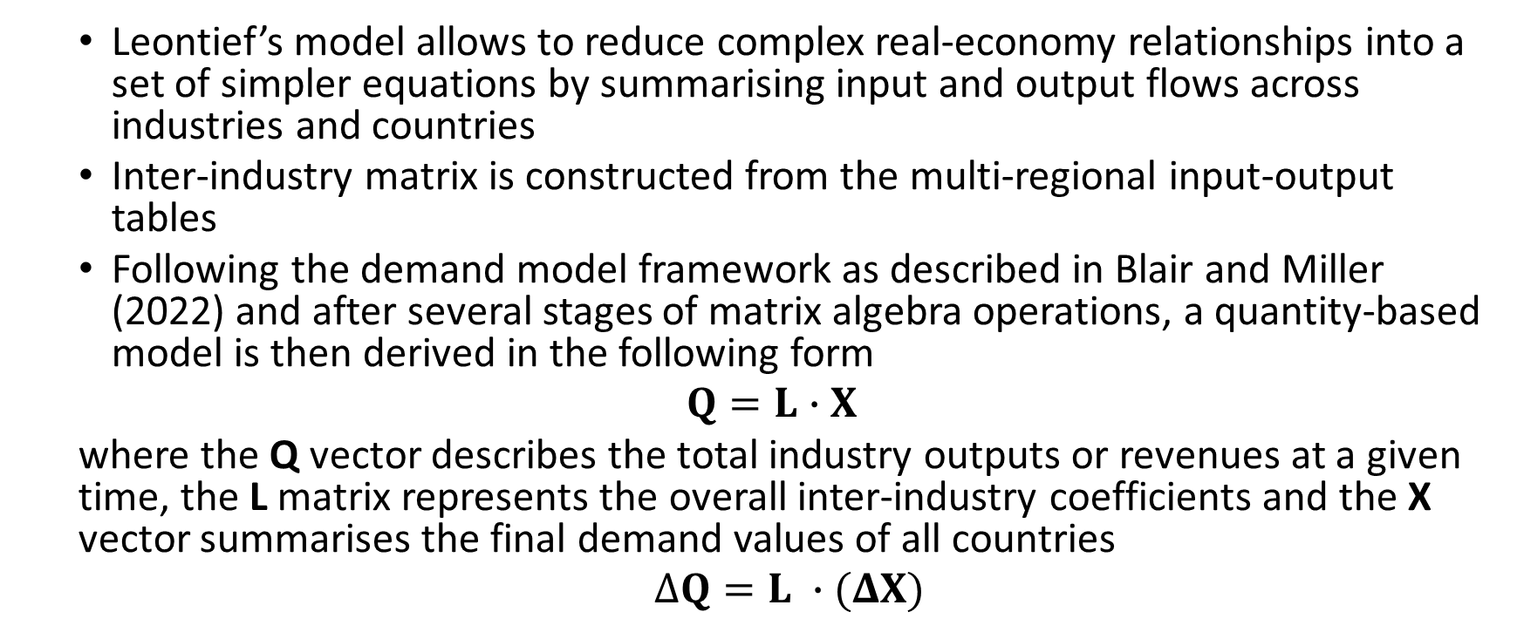
Leontief framework – demand model
  Leontief’s model allows to reduce complex real-economy relationships into a set of simpler equations by summarising input and output flows across industries and countries
  Inter-industry matrix is constructed from the multi-regional input-output tables
  Following the demand model framework as described in Blair and Miller (2022) and after several stages of matrix algebra operations, a quantity-based model is then derived in the following form
  $Q=L∙X$
  where the Q vector describes the total industry outputs or revenues at a given time, the L matrix represents the overall inter-industry coefficients and the X vector summarises the final demand values of all countries
  $ΔQ=L ∙(ΔX)$
Notes:
To model these interactions, I rely on the foundational input-output framework of Leontief. The mathematical intuition is straightforward but powerful: it treats the economy as an integrated system where total output matches total input. By computing the Leontief Inverse Matrix, denoted as L, we can model how a specific shock in final demand shifts total output across all sectors and borders. To extend this to the labor market, I scale these output shifts by sector-specific employment intensities, derived from integrated satellite accounts. This allows me to calculate changes in overall employment that account for direct, indirect, and cross-border trade ripples."
the Leontief Output Model, allows to compute changes in total outputs as a result of change in final demands by the first derivatives of the relation above
Since the main goal is to assess the heterogeneity of impacts in the labour markets in this model, the effect of the green transition policy needs to be mapped to employment levels through the former’s impacts in the total output. This is done by computing the employment intensity for each sector and each country by using satellite accounts complementing the core input-output tables

Slide 9
Policy simulation in the EU context
  In view of the 2035 and 2050 net-zero transition targets of the EU as part of the EGD and binding climate law, significant spending/investment – public and private – is needed to accelerate the green transition
    Revised Renewable Energy Directive from 2023, the binding target for the share of renewable energy is set to a minimum of 42.5% in the overall energy mix by 2030
    Renovation Wave aims to double the annual rate of energy-related renovations, to reach 35 million buildings by 2030
  A synchronized +25% increase in government spending introduced across all 27 EU member states, targeting three sectors critical for the green transition:
    Electricity, Gas, and Steam Supply (NACE Code D)
    Water Supply, Sewerage, and Waste Management (NACE Code E)
    Construction (NACE Code F)
Notes:
How do we operationalize this empirical exercise? We inject a synchronized 25% increase in government infrastructure spending across all 27 EU member states. This shock is strictly channeled into three core sectors driving the Green Deal: utilities, waste management, and construction.

Slide 10
Data sources
Macroeconomic linkages:
  Eurostat's FIGARO Tables (2023 Edition), tracking 21 industries across the EU27 and key global trading partners.
Demographic structures:
  EU Labor Force Survey (EU-LFS 2023), providing breakdowns by gender and age groups.
Wage structures:
  Structure of Earnings Survey (SES 2022), offering sector-level mean earnings and gender pay ratios.
Combination of data sources makes it possible to analyse both aggregate and sectoral employment dynamics as well as the heterogenous labour market effects, with implications for potential unequal and distributional effects, among workers
Notes:
To calibrate this shock, I rely on a unique combination of datasets. The structural linkages are derived from Eurostat’s 2023 FIGARO tables, which map intermediate transactions across 21 industries. I then merge this macro data with micro-demographic details from the 2023 EU Labor Force Survey and wage data from the 2022 Structure of Earnings Survey to analyze worker characteristics

Slide 11
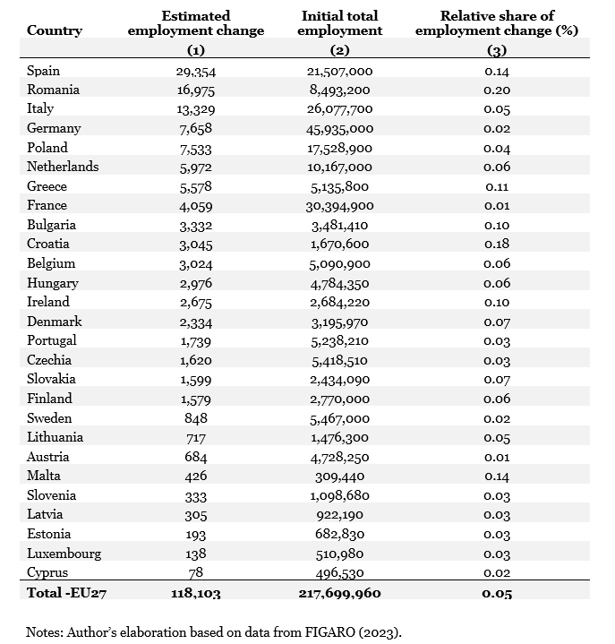
  Results by country
  +118,103 net additional jobs across the EU27 (a +0.05% relative expansion)
  Top gainers by abs. volume:
    Spain: +29,354 jobs (+0.14% relative change)
    Romania: +16,975 jobs (+0.20% relative change)
    Italy: +13,329 jobs (+0.05% relative change)
  Lowest gainers by abs. volume: Estonia (+193), Luxembourg (+138), Cyprus (+78)
  Even with identical percentage spending increases, employment outcomes differ sharply across countries due to unique national labor markets, industrial structures, and baseline employment intensities
Notes:
Let's dive into the empirical results, starting with the aggregate country impacts shown in Table 1 of the paper. Across the EU, the model predicts a net expansion of roughly 118,000 jobs. What stands out immediately is the sharp geographical variation. Nearly half of all new jobs are concentrated in just three member states: Spain, Romania, and Italy. In relative terms, Romania sees the highest growth at 0.20%, while manufacturing centers like France or Germany experience much smaller relative employment changes. This demonstrates that an identical policy mandate filters through national economies in very different ways, heavily shaped by pre-existing industrial structures and labor market capacities

Slide 12
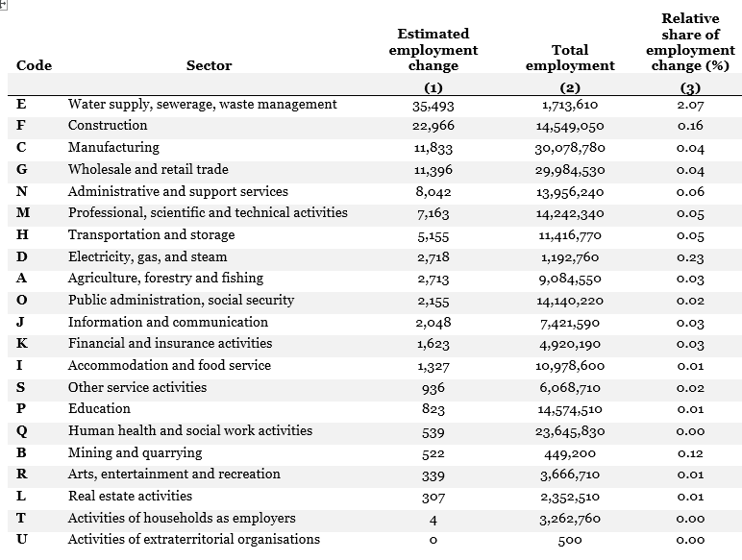
Results by sector
Empl. effects in directly impacted sectors:
  Water Supply & Waste Management (E): +35,493 jobs (+2.07% growth) — most sensitive to the shock
  Construction (F): +22,966 jobs (+0.16% growth)
  Electricity, Gas, and Steam (D): +2,718 jobs (+0.23% growth)
Empl. effects in indirect sectors (supply chain transmission):
  Manufacturing (C): +11,833 jobs (+0.04% growth)
  Wholesale & Retail Trade (G): +11,396 jobs (+0.04% growth)
  Business Services (M & N): +15,205 combined jobs (Professional, Technical & Admin)
Non-Responsive Sectors: Human health (0.00%) and Education (0.01%) show negligible shifts
Notes:
Table 2 details these impacts by sector, illustrating the clear distinction between direct and indirect employment generation. Unsurprisingly, the largest relative growth occurs directly within the targeted utility and construction sectors; water and waste management, for instance, expands by over 2%. However, the Leontief framework reveals its true strength when we observe the indirect spillovers. Over 23,000 jobs are generated in manufacturing and retail trade, driven by the demand for equipment and distribution networks. Another 15,000 jobs appear in professional, scientific, and administrative services to support planning and project management. This highlights that green infrastructure spending acts as a broad economic driver across the entire supply chain

Slide 13
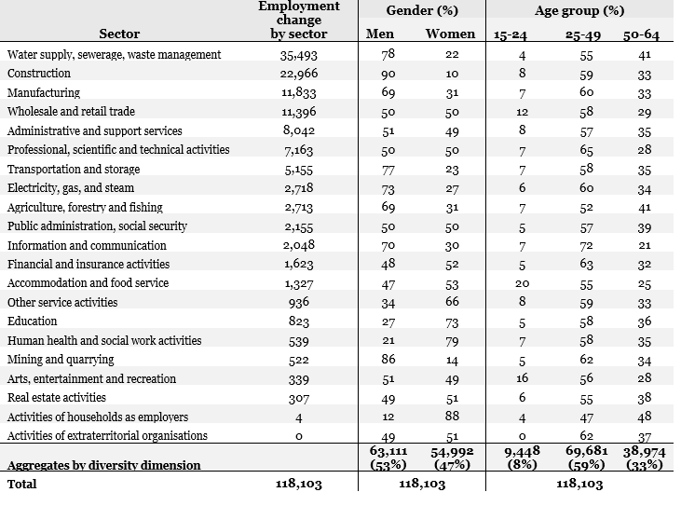
Intensive margin: demographic disparities
Demographic imbalance: Total employment shifts lean heavily toward men (53%) over women (47%).
Gender segmentation in key sectors:
  Construction: 90% of job growth goes to Men; only 10% to Women.
  Mining & Quarrying: 86% Men vs. 14% Women.
  Water Supply & Waste Management: 78% Men vs. 22% Women.
  Electricity, Gas & Steam: 73% Men vs. 27% Women.
Where do women benefit (if at all)?
Majority gains for women occur only in minor spillover sectors like Human Health (79%) or Education (73%), where overall job creation from this shock is lowest.
Notes:
Now let's examine the intensive margin by intersecting these sectoral numbers with demographic data from Table 3. This is a central finding of the paper: green infrastructure spending triggers deep demographic imbalances. Out of the 118,000 jobs created, 53% are captured by men. This inequality becomes starker when we look at the sectors receiving the direct investments. In construction, 90% of new jobs go to men; in water supply, it's 78%; and in electricity, it's 73%. Women only achieve majority gains in sectors like health, education, or household employment—industries that are already highly gender-segregated and see almost no job growth from these green policies. Without specific interventions, green spending risks reinforcing structural gender segregation

Slide 14
Age group
  Aggregate Cohort Capture:
    Ages 15–24 (Youth): Captures only 8% of net job growth (9,448 jobs).
    Ages 25–49 (Prime-Age): Captures 59% of net job growth (69,681 jobs).
    Ages 50–64 (Older Workers): Captures 33% of net job growth (38,974 jobs).
  Sector-Level Realities:
    Water Supply (E): Youth capture just 4%, while older workers (50–64) secure 41%.
    The Sole Youth Exception: Wholesale & Retail Trade (G), where young workers capture a double-digit share (12%) of the employment growth.
Notes:
The demographic disparities extend directly into age distributions, as shown in the right-hand columns of Table 3. The simulated green transition strongly favors prime-age and career-established workers, while leaving younger cohorts behind. Young workers aged 15 to 24 capture a mere 8% of the total employment expansion. In the high-growth water and waste management sector, youth capture only 4% of the new jobs, while older workers secure 41%. The only sector where young workers see a double-digit share of job growth is wholesale and retail trade. This reveals a clear barrier to entry for the younger generation in core or enabling green industries, likely due to pre-existing experience requirements and structural hiring patterns

Slide 15
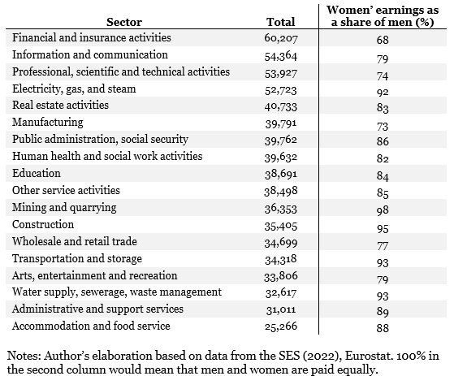
Compounding wage inequalities
Sectoral pay disparities:
  High-Paying Targeted Sector: Electricity, Gas & Steam (€52,723 mean annual earnings).
  Low-Paying Targeted Sectors: Construction (€35,405) and Water/Waste Management (€32,617) sit near the bottom of industrial averages.
The double disadvantage?
  In every single sector analyzed, men hold a definitive pay advantage over women (e.g., Financial Services ratios sit at 68%).
  Green policies channel massive funding into sectors where men already dominate the workforce and maintain structural wage advantages
Notes:
To round out the distributional analysis, Table 4 incorporates data from the Structure of Earnings Survey to look at pay levels by sector. The economic returns of this transition are unevenly distributed by both job volume and wage gaps. While the electricity and gas sector is high-paying, the other two targeted sectors—construction and waste management—sit near the bottom of the average wage distribution. Crucially, the data confirms that men maintain a structural wage advantage over women across all 18 sectors. Therefore, we see a compounding inequality: green spending channels public funds into sectors where men are already the vast majority and hold a distinct wage advantage over their female counterparts.

Slide 16
Discussion/reflections for a just transition
Methodological caveats: fixed production technologies and short-run horizons omit immediate substitution effects and skill-group adaptations
The just transition challenge:
  Environmental policy cannot look past labor market realities
  Green transitions do not automatically create inclusive or equitable outcomes
Three essential policy pillars:
  Targeted inclusivity frameworks: Actively break down barriers to entry for women and young workers in green sectors through specialized recruitment and training initiatives
  Active Labor Market Policies (ALMPs): Funded up-skilling, re-skilling, and vocational education programs to reduce friction and ease transitions into green jobs (Cedefop 2021)
  Social protection & dialogue: Strengthen social dialogue and collective bargaining to protect job quality, improve baseline wages, and ensure no vulnerable group is left behind during major transitions
Notes:
What are the broader takeaways from these findings?
While this model has limitations—such as assuming fixed production technologies in the short run—the core lesson for a 'Just Transition' is clear.
Climate policies do not automatically generate inclusive social outcomes. If left unmanaged, green investments can reinforce old labor market segmentations.
To address this, we must integrate social and labor considerations directly into climate policy design. This means combining green infrastructure funds with targeted training programs to help women and young workers break into these sectors, alongside strong active labor market policies and social dialogue to protect job quality across the supply chain."

Slide 17
Further research
  Synchronized green spending yields positive net employment, but creates distinct geographic, sectoral, gender, and age imbalances.
  Extension of the simulation exercise
  Incorporate occupational structures, potential regional migration dynamics, and specific skill-group adjustments into the IOM framework
Notes:
To conclude, this paper demonstrates that while the green transition is macroeconomically positive, its benefits are distributed unevenly across borders and demographics. Future iterations of this work will incorporate deeper skill-group classifications as data becomes available. Thank you very much for your time, and I am now very happy to open the floor to your questions and comments

Slide 18
Thank you for your attention!
Contact: makguc@etui.org

