Slide 1
Assessing the environmental impact of CE policies
A case study of Electric and Electronic Equipment in Flanders
IIOA Conference 2026
Dani Sangers & Pieter Fonteyn

Slide 2
Agenda
Methodology
Material Flow Analysis
Dynamic Stock-Flow Model (SF)
Scenario modelling
Extending EEMRIO with Flanders
Creating prospective tables
Linking SF to EEMRIO

Slide 3
Methodology
Case study: Electronic and Electrical Equipment (EEE) in Flanders
1.
Material Flow Analysis
2.
Dynamic Stock-Flow Model
3.
Policy scenarios
4.
Extended EEMRIO model
5.
Environmental impact assessment

Slide 4
Methodology
Case study: Electronic and Electrical Equipment (EEE) in Flanders
1.
Material Flow Analysis
Map current EEE flows and identify key stocks and flows.
2.
Dynamic Stock-Flow Model
Model future material stocks and flows until 2050.
3.
Policy scenarios
Model CE policy interventions through what-if scenarios.
4.
Extended EEMRIO model
Extend the FIGARO-e3 input-output model with the Flemish region.
5.
Environmental impact assessment
Translate the material flow changes into monetary effects and estimate the carbon footprint of EEE consumption.

Slide 5
Material Flow Analysis

Slide 6
Material Flow Analysis
Creating a conceptual material flow diagram
Mapped EEE system from put on market to end-of-life
Captured key stocks and flows
  In-use stock, repair, reuse, waste collection, recycling, energy recovery and disposal
Integrated multiple data sources to quantify flows and identify data gaps:
  WEEE Calculation Tool (POM, lifetimes, waste generation)
  Eurostat (EU-6 waste management statistics)
  Recupel
  BeWeee
  PV Cycle Belgium
Identified possible CE intervention points

Slide 7
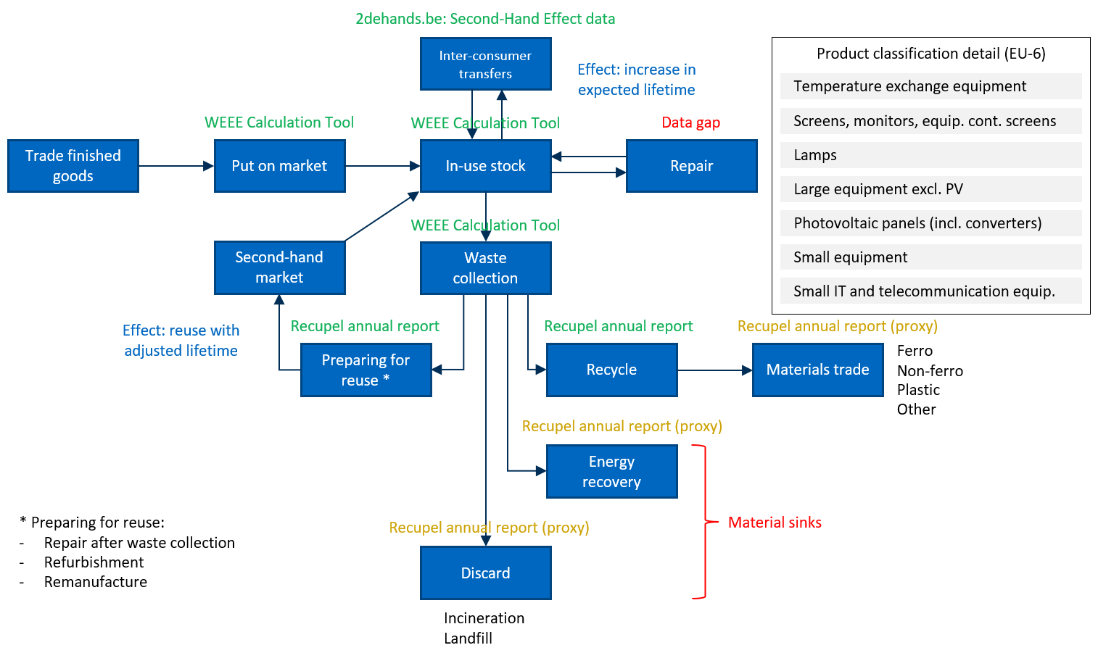
Mapping material flows

Slide 8
Dynamic stock-flow model

Slide 9
Development of stock model
Based on WEEE Calculation Tool Belgium
  At UNU Key level (54 product categories)
  Historic POM data (1980-2022)
  Weibull parameters
  Result: estimate of waste generated
  Expanded to include stock estimate, modeling in units and tonnes (based on avg unit weights)
Derive household stock, create projections (logistic trend) for 2023-2050
  Multiply by estimates of number of households in Flanders → projected total stock Flanders
Dynamic stock model: recursively estimate POM quantities
  Based on projected stock evolution, estimate of waste generated, and estimate of reused products

Slide 10
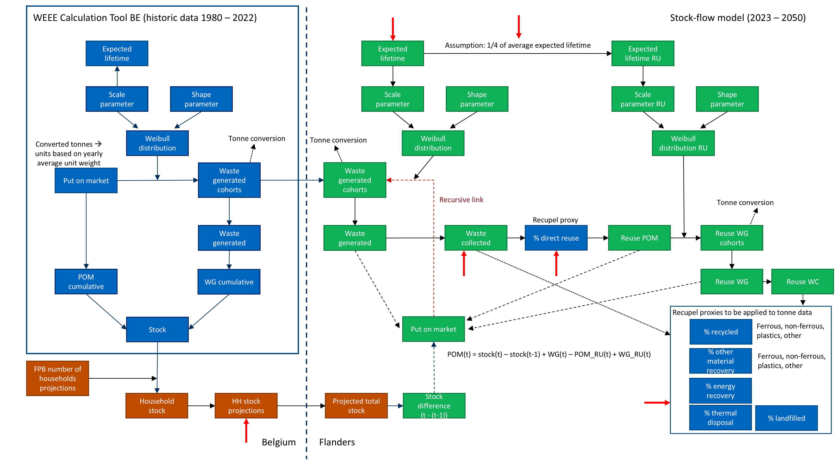

Slide 11
Policy scenarios

Slide 12
Policy scenarios
Possible circular policy interventions
8 policy scenarios
Reduce dormant products
Extended active use
Improved collection
Increase reuse
Increased lifetime during reuse
Refuse
Combined scenario 1-5
Combined scenario 1-6
Put on market phase: enabling circularity from the outset
  Ecodesign and durability requirement, repairability and upgradability requirements, …
Use phase: extending and intensifying product lifetimes
  Repair and maintenance incentives, support for local repair ecosystems, …
Post-use phase: preparing products for further use
  Reuse targets, quality standards, public procurement for refurbished, …
End-of-life phase: closing material loops and managing residual waste
  High-quality recycling requirements, improved collection systems, …

Slide 13
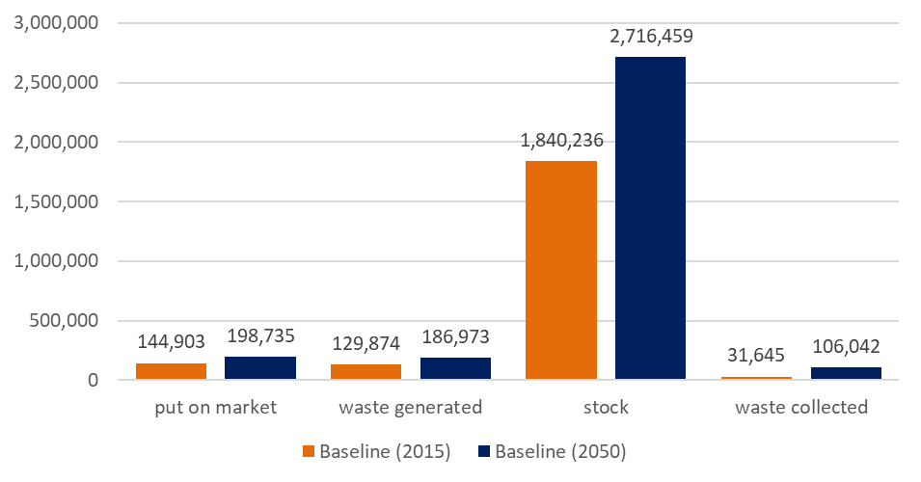
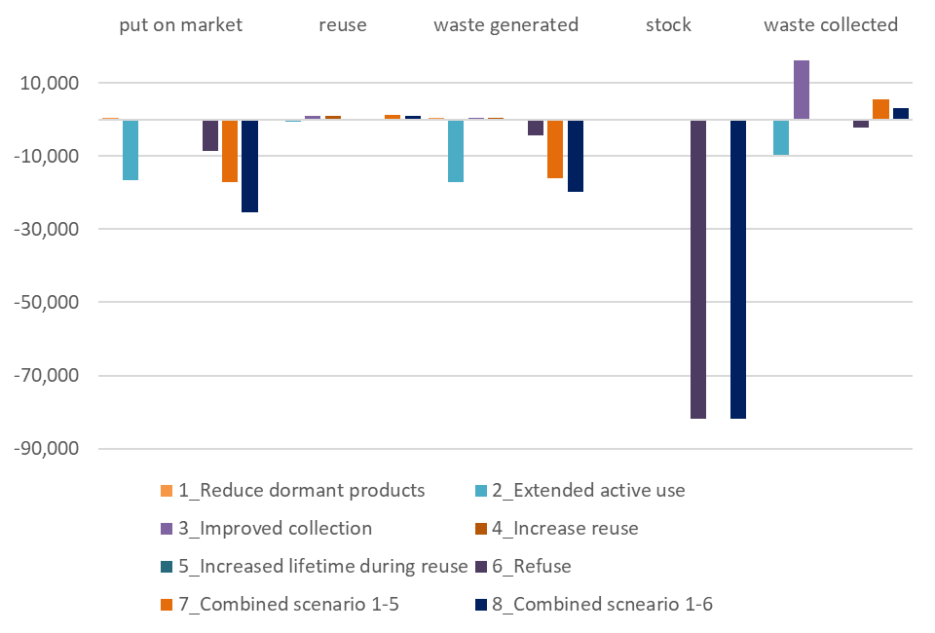
Results stock-flow model
Baseline, 2015 vs. 2050, in tonnes
Intervention results, 2050, in tonnes
Intervention | 2030 | 2050
1. Reduce inactive life (selected products only) | -5% | -15%
2. Extend active life | +5% | +15%
3. Improve collection | +5% | +15%
4. Increase reuse | +5% | +15%
5. Extend reuse life | +5% | +15%
6. Reduce consumption | No change | -3%

Slide 14
Extending the EEMRIO model with the Flemish region

Slide 15
Extending FIGARO-e3 with the Flemish region
FIGARO-e3
Flemish IO Model
Extending FIGAROe3
Global multiregional input-output model: 45 regions + rest-of-world, 213 products, 176 industries
Built from inter-country supply & use tables (CPA 2.1 / NACE 2.1)
Extended with GHG emissions (CO₂, CH₄, N₂O, F-gases) and an EXIOBASE-based material footprint
Based on 2015 Belgian interregional supply & use tables: 145 industries, 147 products
Multi-regional: Flanders, Wallonia, Brussels-Capital, extra-regional
Same environmental extensions as FIGAROe3: climate change impact (kg CO₂-eq) and material footprint
Belgian region in FIGARO-e3 split into Flanders + rest-of-Belgium
Flemish classifications (SUT 2008 / SUTTAK-2008) converted to FIGAROe3's CPA 2.1 / NACE 2.1
Disaggregation uses Belgium's shares in FIGARO-e3 as allocation weights (incl. Flemish trade flows)

Slide 16
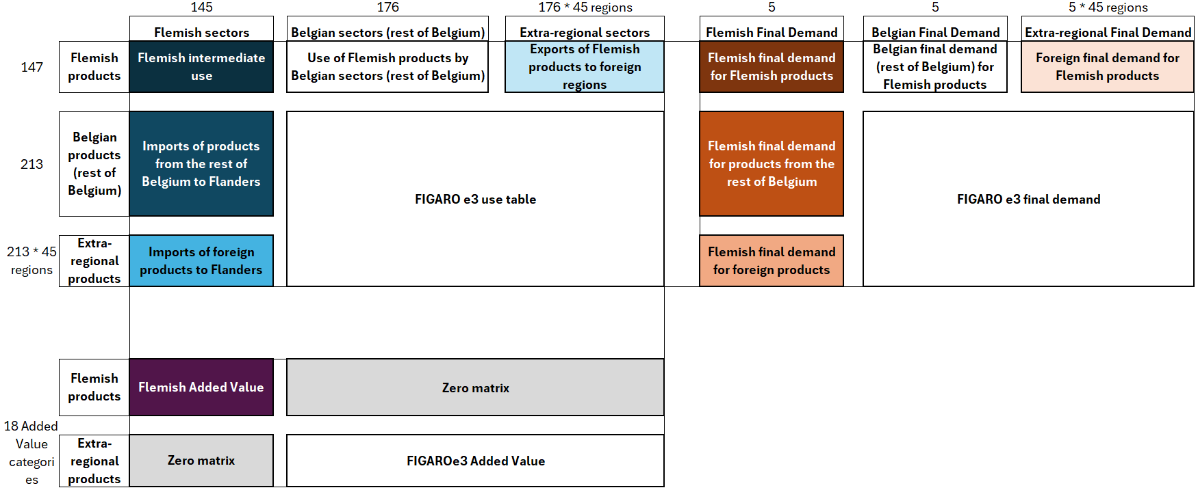
Extending FIGARO-e3 with the Flemish region
Schematic overview of the extended FIGAROe3 use table integrating the Flemish use table

Slide 17
Creating prospective SUTs

Slide 18
Creating prospective SUTs: Two pathways to 2050
Projecting the Flemish-FIGARO-e3 tables to compare CE policies against two future baselines
Pathway 1: Business-as-usual
Pathway 2: NDC-LTS
Projected to 2050
Market forces + currently legislated climate policy
Exogenous GDP & population growth
Builds on Pathway 1, adding 2030/2035 NDC targets
Plus long-term net-zero strategies beyond the NDC year
Extended Flemish-FIGAROe3 SUTs, using GDP/population projections from the EC's Global Energy and Climate Outlook 2025
Both pathways serve as separate baselines: CE policy interventions are tested against each, comparing effectiveness under business-as-usual vs. a climate-ambitious future

Slide 19
Linking SF to EEMRIO

Slide 20
Translating CE Scenarios into the Prospective SUTs
Material flow changes from the scenario analysis were translated into three types of adjustments to the use table:
1. Recycled materials: intermediate use (matrix Z)
Additional recycled ferrous/non-ferrous metals, plastics and other materials substitute primary inputs in the largest-using Flemish industries; converted to monetary values using Eurostat waste collection & treatment prices (CPA 381/382).
2. Put on market: final demand (matrix Y)
Reductions in EEE products put on market are modelled as a one-on-one decrease in Flemish household final demand, after mapping UNU product codes to CPA 2.1; valued using Eurostat Belgian import data.
3. In-use stock: repair & maintenance demand (matrix Y)
Percentage change in physical EEE stock vs. baseline is applied to Flemish household demand for repair & maintenance services (SUT code 95A); not applied for Scenario 1 (dormant products) or Scenario 3 (collection).
The adjusted SUTs are then rebalanced (model D, Eurostat 2019), new input coefficients and Leontief inverses are derived, and combined with the environmental extensions to estimate the carbon and material footprint for each scenario.

Slide 21
Results

Slide 22
Results: Overall
Baseline vs. combined policy interventions, by pathway

Slide 23
Results: Carbon footprint
Carbon footprint reduction of CE interventions in the Flemish EEE sector, occurring globally, compared to the baseline scenario (in kt CO₂-eq.).

Slide 24
Results: Material footprint
Material footprint reduction of CE interventions in the Flemish EEE sector, occurring globally, compared to the baseline scenario (in kt).

Slide 25
Discussion & conclusion

Slide 26
Discussion
Upstream interventions (extending lifetimes, reducing demand)
  Largest carbon & material footprint reductions, in both pathways
Downstream interventions (collection, reuse)
  Limited benefits; most EEE impact sits upstream
  85% of avoided emissions/material use occur outside the EU27 → Flanders' import-dependence
CE policy still delivers ~75% of its climate benefit even under a decarbonised (NDC-LTS) future
  CE and climate policy are complementary

Slide 27
Conclusion & limitations
Conclusion
Stock-flow + EEMRIO modelling enables consumption-based, globally-traced CE policy assessment
Largest benefits = reduce/rethink/repair/reuse interventions, realised mostly outside Flanders/EU27
Limitations
Consumption-based view = partial picture; pair with economic, social, and territorial analysis
Aggregated EEMRIO structure limits product-level detail; recycling/repair sectors poorly captured
Static model: no technological change, price dynamics, or rebound effects

Slide 28
Future research
More EEMRIO detail for R-strategy-relevant sectors
Add economic & social indicators
Explore a dynamic EEMRIO framework

Slide 29
Appendix

Slide 30
Dynamic stock-flow model
Approach
Purpose
  Projecting the evolution of EEE stocks and flows up to 2050
Conceptual approach
  POM → In-use stock → Waste generated (WG)
    Timing is determined by product lifetime distributions
  Links market dynamics, consumer stock, waste generation and treatment
  Allows the calculation of historic trends and future projections
Data sources
  WEEE Calculation tool (POM, Weibull parameters & waste generated)
  Federal Planning Bureau of Belgium (Population and household forecasts)
  Recupel (Downstream waste treatment and material composition)

Slide 31
Dynamic stock-flow model
Modelling & lifetime assumptions
Main elements of the dynamic system
  Inflows: new products placed on the market (POM) and second-hand products re-entering the in-use stock through direct reuse (POM_RU) after waste collection.
  Stock: the in-use stock of EEE in households and businesses.
  Outflows: waste generated (WG), which is subsequently collected, reused, or treated.
  Treatment pathways: direct reuse, material recycling, other material recovery, energy recovery, incineration, and landfill
Estimation of the volume of EEE products put on market
  Based on stock changes, waste generation and direct reuse flows.
  Direct reuse and waste collection rates are calibrated using Recupel and Eurostat data

Slide 32
Stakeholder workshop
Representation by OVAM, Recupel, PV Cycle Belgium, BeWeee, Agoria, Adevinta, Repair & Share, Herwin, Nelectra
Validate baseline assumptions for exogenous parameters in stock model
  Household stock projections*
  Expected service life (new* & reused products**)
  % waste collected***
  % direct reuse***
  % recycled***
Try to quantify impact of CE policy measures for EEE
  Proved difficult
  Modelled potential changes to exogenous parameters if CE policy measures would be successfully implemented
* Derived from WEEE Calculation Tool data
** Assumption 25% of new products
*** Based on Recupel, PV Cycle, BeWeee data

Slide 33
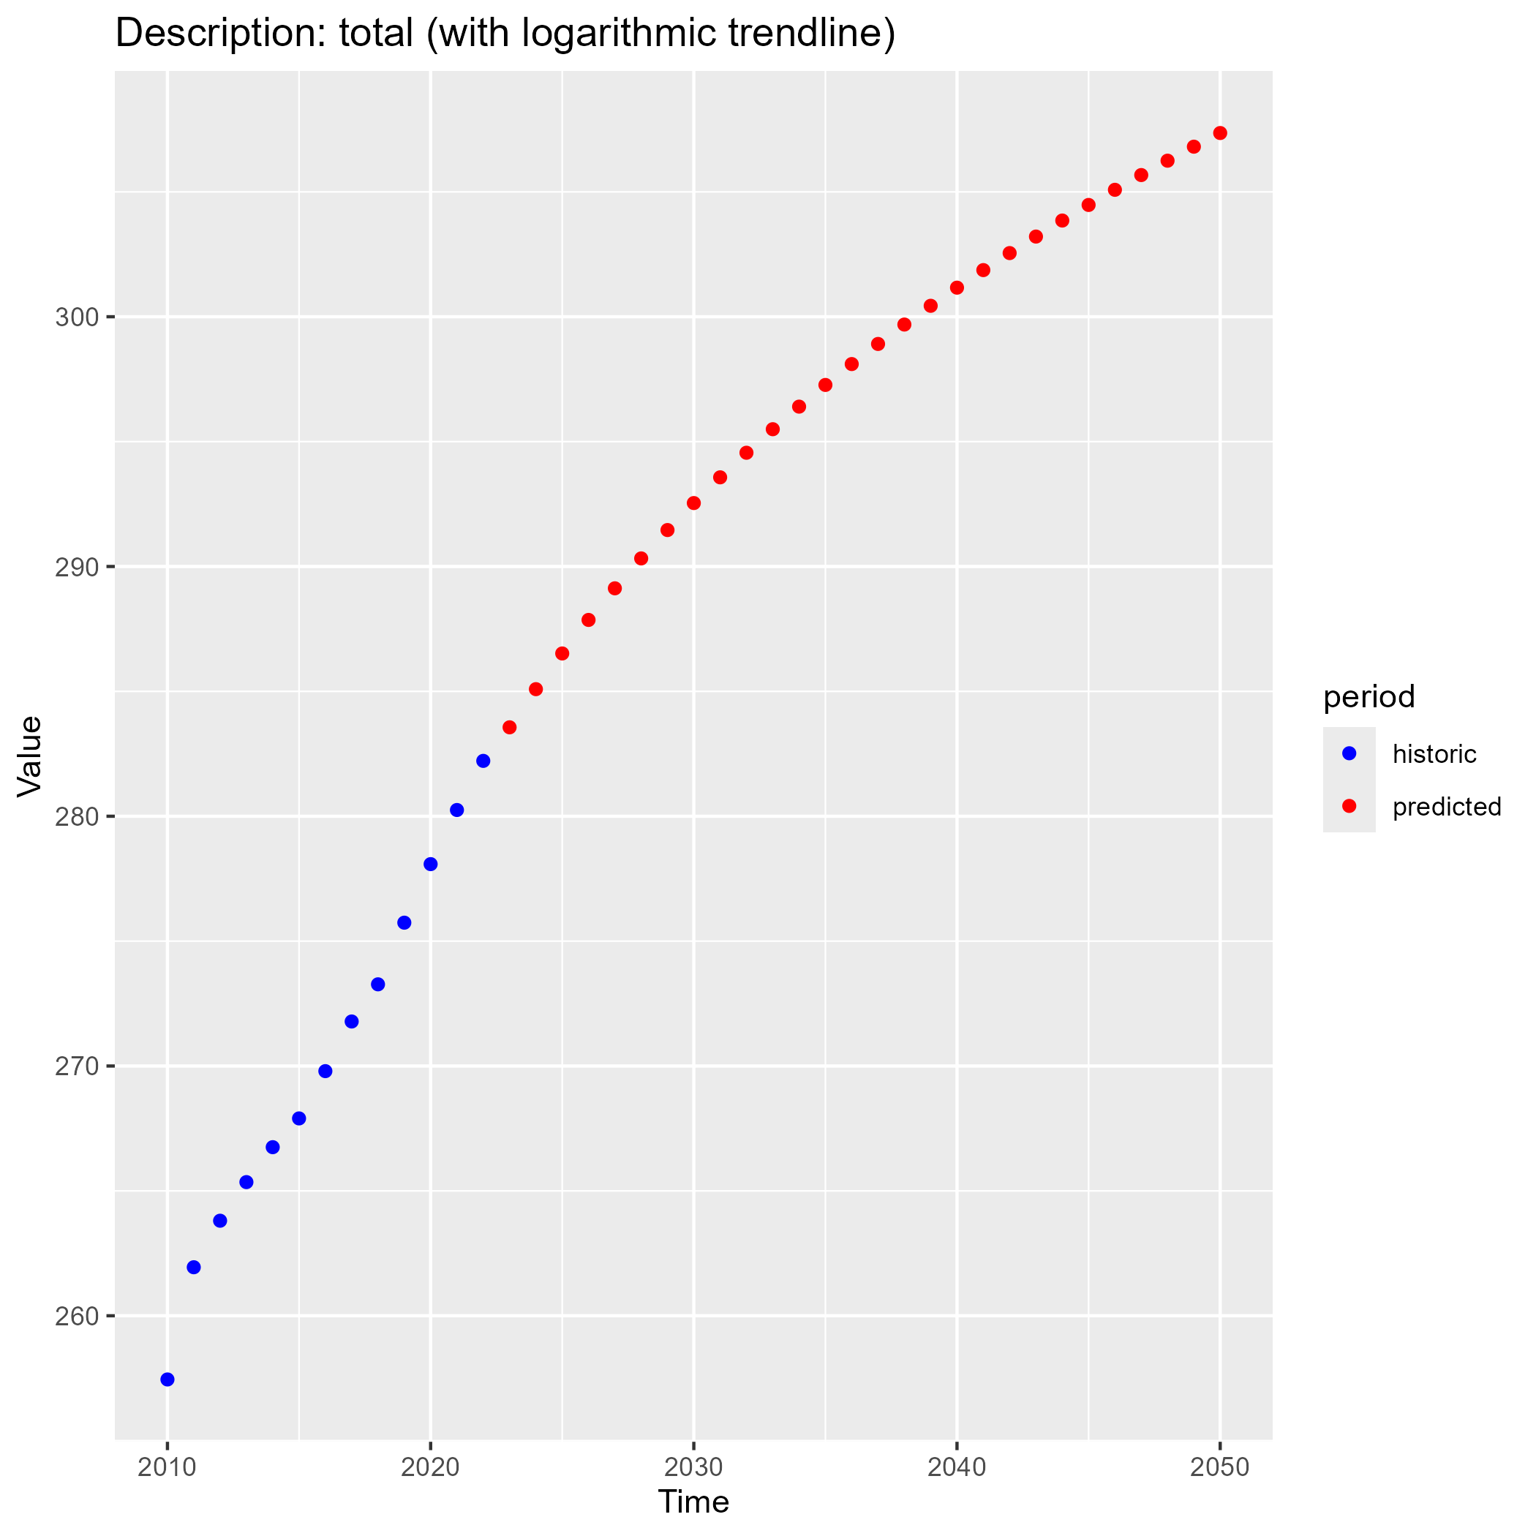
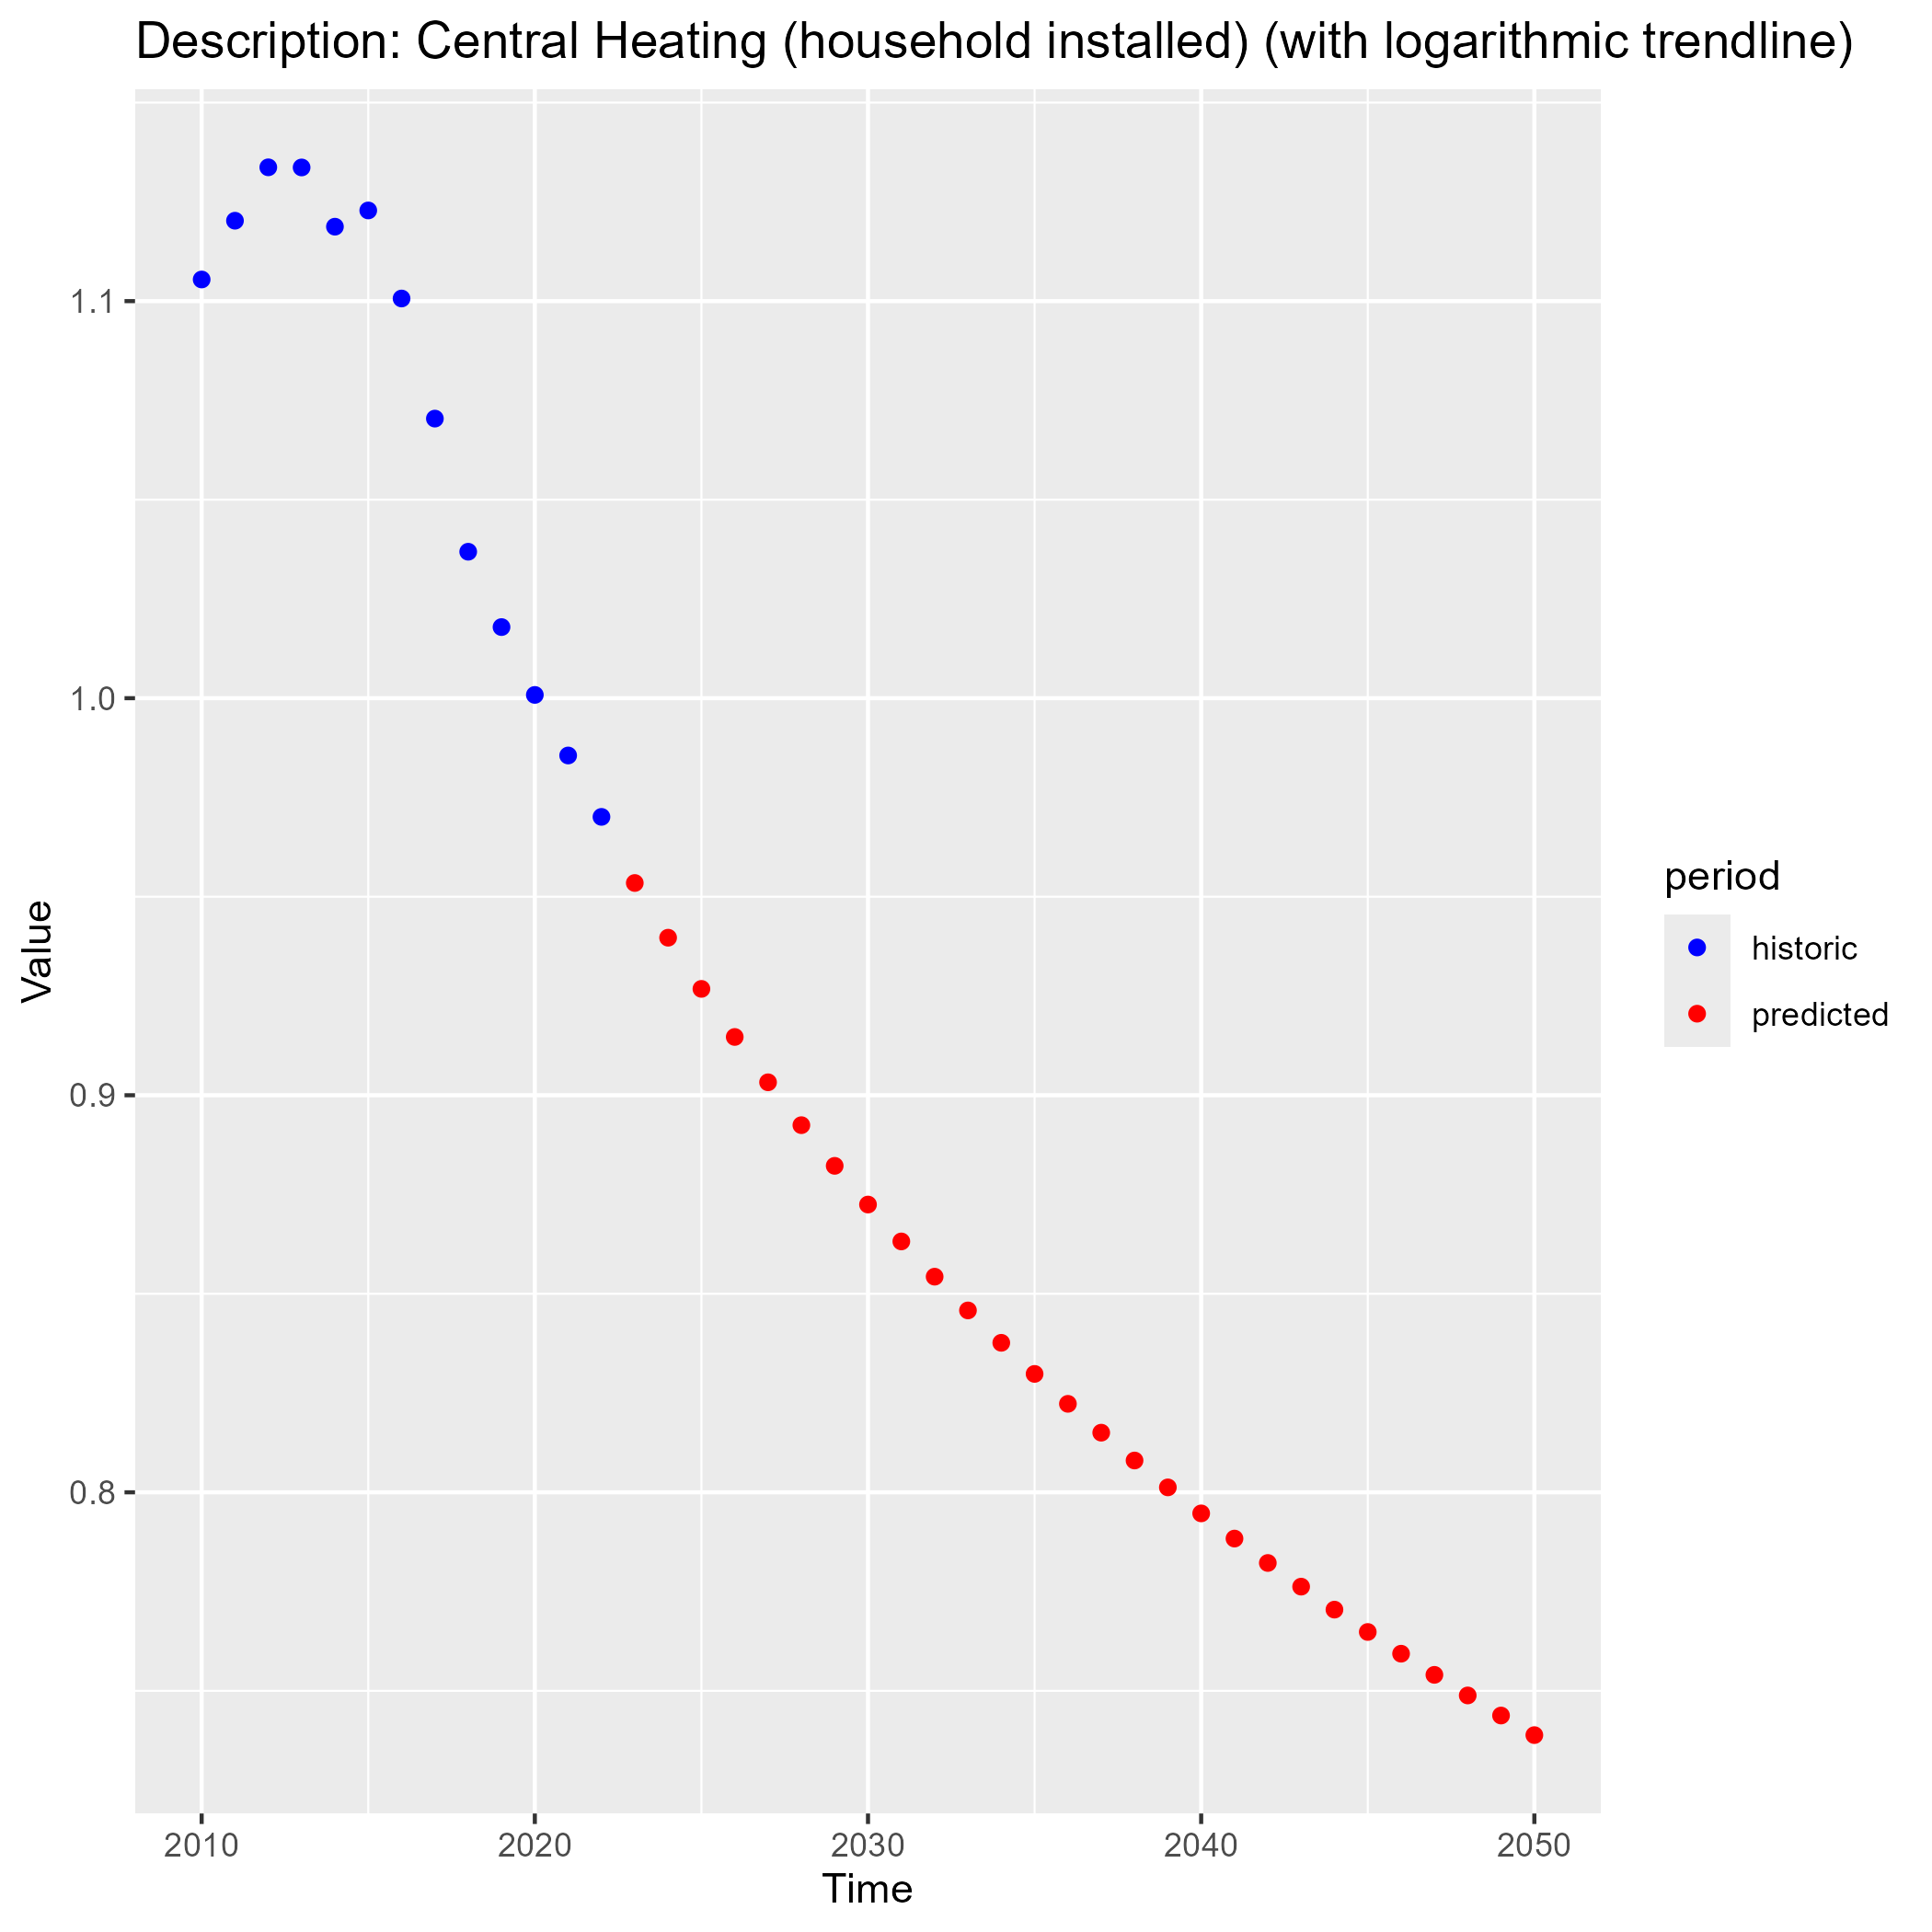

Slide 34
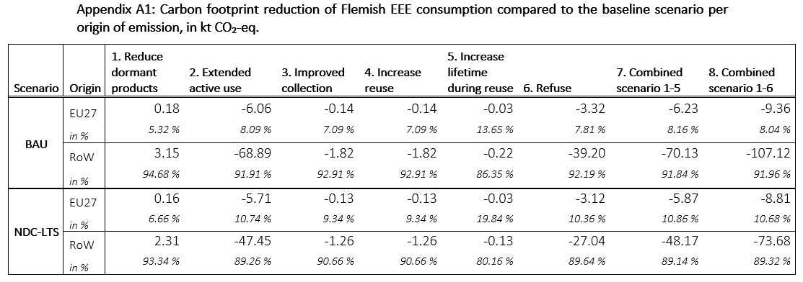

Slide 35
