Slide 1
Incremental Input-Output Analysis and Empirical Study of Structural Change in China
Song Hui¹, Wang Chunli¹, Song Ruijie², Chen Zhuowen³
(Affiliations: 1. Hebei University, China; 2. Nagoya University, Japan;
3. University of Chinese Academy of Sciences, China)
Presenter: Song Hui, Professor at Hebei University, China.

Slide 2



0
Abstract
1
Introduction
2
Incremental Input and Allocation Coefficients:
Concepts, Types, and Analytical Methods
3
Empirical Analysis
4
Conclusions and Future Research

Slide 3

0、Abstract

Slide 4
0、Abstract
The input-output method pioneered by Leontief has achieved notable success in economic and environmental analysis, as well as in policy simulations. However, it is limited in analyzing economic structural changes and their driving factors. This paper proposes an incremental input-output analysis method. Using a compiled incremental input-output table for China from 2010 to 2020 as an empirical example, the study shows that during this period, China’s economic structure underwent transformation and upgrading, with increases in total output, GDP, and economic benefits. This analytical system can reveal dynamic industrial interrelationships and change characteristics, representing an important development of input-output theory.

Slide 5
1. Introduction

Slide 6
1. Introduction
Analyzing economic structural changes and their driving factors using dynamic indicators is a key issue that current input-output analysis needs to address. Incremental input-output analysis is an analytical method that examines the quantitative dependency between input increments and output increments across various sectors of a national economy. In 1967, Tilanus first proposed the concept of marginal (incremental) input coefficients.

Slide 7
1. Introduction
In 1995, Chinese scholar Li Guozhang proposed a method for compiling incremental input-output tables. However, progress has been slow due to the difficulty in interpreting the positive and negative values of incremental coefficients and the unresolved issue of the invertibility of the incremental Leontief inverse matrix.

Slide 8
1. Introduction
In 2025, Song Hui et al. proposed the assumptions of the incremental model, preliminarily proved the invertibility of the incremental Leontief inverse, and provided the concepts and manifestations of incremental input and allocation coefficients. Nevertheless, the nature and types of pure income incremental coefficients and incremental allocation coefficients were not addressed. To address the above issues, this paper proposes a refined analytical method for incremental coefficients and provides empirical evidence, thereby offering a reference for conducting incremental input-output analysis.

Slide 9
2、Incremental Input and Allocation Coefficients: Concepts, Types, and Analytical Methods

Slide 10
2. Incremental Input and Allocation Coefficients: Concepts, Types, and Analytical Methods
Subtracting the base-year table at constant prices from the reporting-year table at constant prices yields the incremental input-output table, as shown in Table 1.
The incremental input-output table has the same balancing relationships as a standard input-output table, with the only difference being the addition of incremental components (omitted).

Slide 11
Table 1 Incremental input-output table
 |  | Intermediate use increments |  |  |  |  | Final use increments | Total output increments
 |  | Sector 1 | Sector 2 | … | Sector n | Total
Intermediate input increments | Sector 1 | ∆x₁₁ | ∆x₁₂ | … | ∆x_{1n} | ∆Z₁ | ∆Y₁ | ∆X₁
 | Sector 2 | ∆x₂₁ | ∆x₂₂ | … | ∆x_{2n} | ∆Z₂ | ∆Y₂ | ∆X₂
 | … | … | … | … | … | … | … | …
 | Sector n | ∆x_{n1} | ∆x_{n1} | … | ∆x_{nn} | ∆Z_{n} | ∆Y_{n} | ∆X_{n}
 | Total | ∆U₁ | ∆U₂ | … | ∆U_{n} | ∆Z | ∆Y | ∆X
Initial input increments | Depreciation of fixed assets | ∆D₁ | ∆D₂ | … | ∆D_{n} | ∆D
 | Compensation of employees | ∆V₁ | ∆V₂ | … | ∆V_{n} | ∆V
 | Pure income | ∆M₁ | ∆M₂ | … | ∆M_{n} | ∆M
 | Total | ∆N₁ | ∆N₂ | … | ∆N_{n} | ∆N
Total input increments |  | ∆X₁ | ∆X₂ | … | ∆X_{n} | ∆X
Note: In the table, pure income increments include net taxes on production and operating surplus increments; final use increments include consumption, gross capital formation, and net export increments.

Slide 12
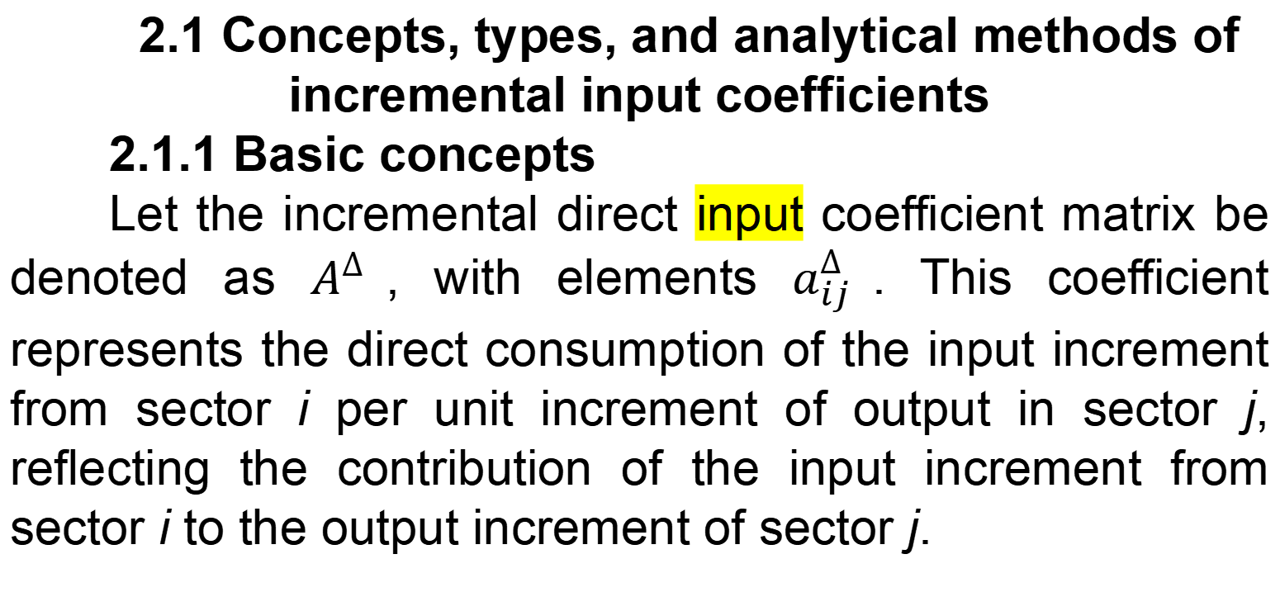
2. Incremental Input and Allocation Coefficients: Concepts, Types, and Analytical Methods
2.1 Concepts, types, and analytical methods of incremental input coefficients
2.1.1 Basic concepts
Let the incremental direct input coefficient matrix be denoted as $A^{∆}$, with elements $a_{ij}^{∆}$. This coefficient represents the direct consumption of the input increment from sector i per unit increment of output in sector j, reflecting the contribution of the input increment from sector i to the output increment of sector j.

Slide 13
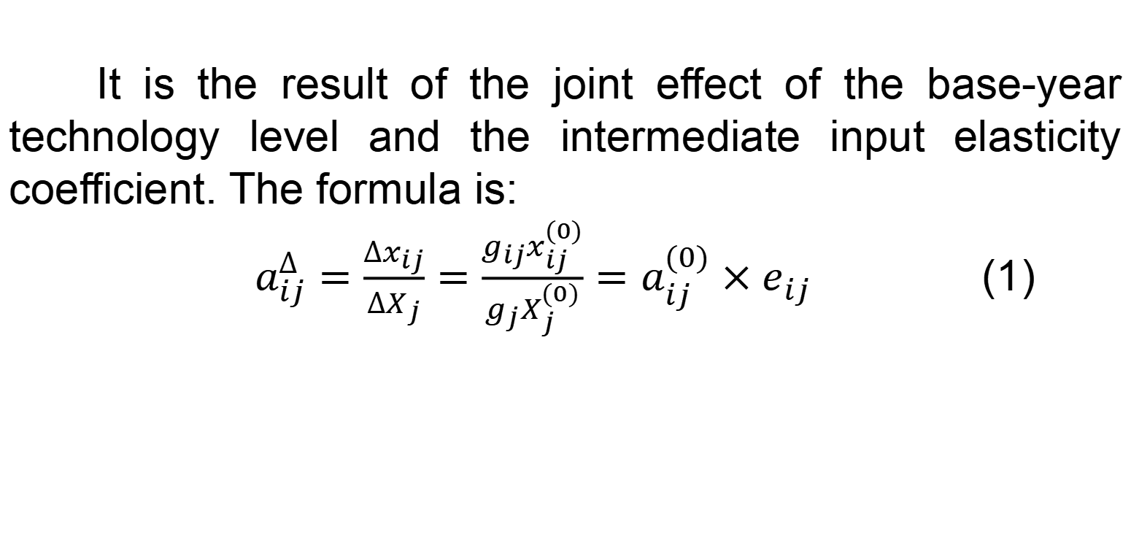
2. Incremental Input and Allocation Coefficients: Concepts, Types, and Analytical Methods
It is the result of the joint effect of the base-year technology level and the intermediate input elasticity coefficient. The formula is:
$a_{ij}^{∆}=\frac{∆x_{ij}}{∆X_{j}}=\frac{g_{ij}x_{ij}^{(0)}}{g_{j}X_{j}^{(0)}}=a_{ij}^{(0)}×e_{ij}$ (1)

Slide 14
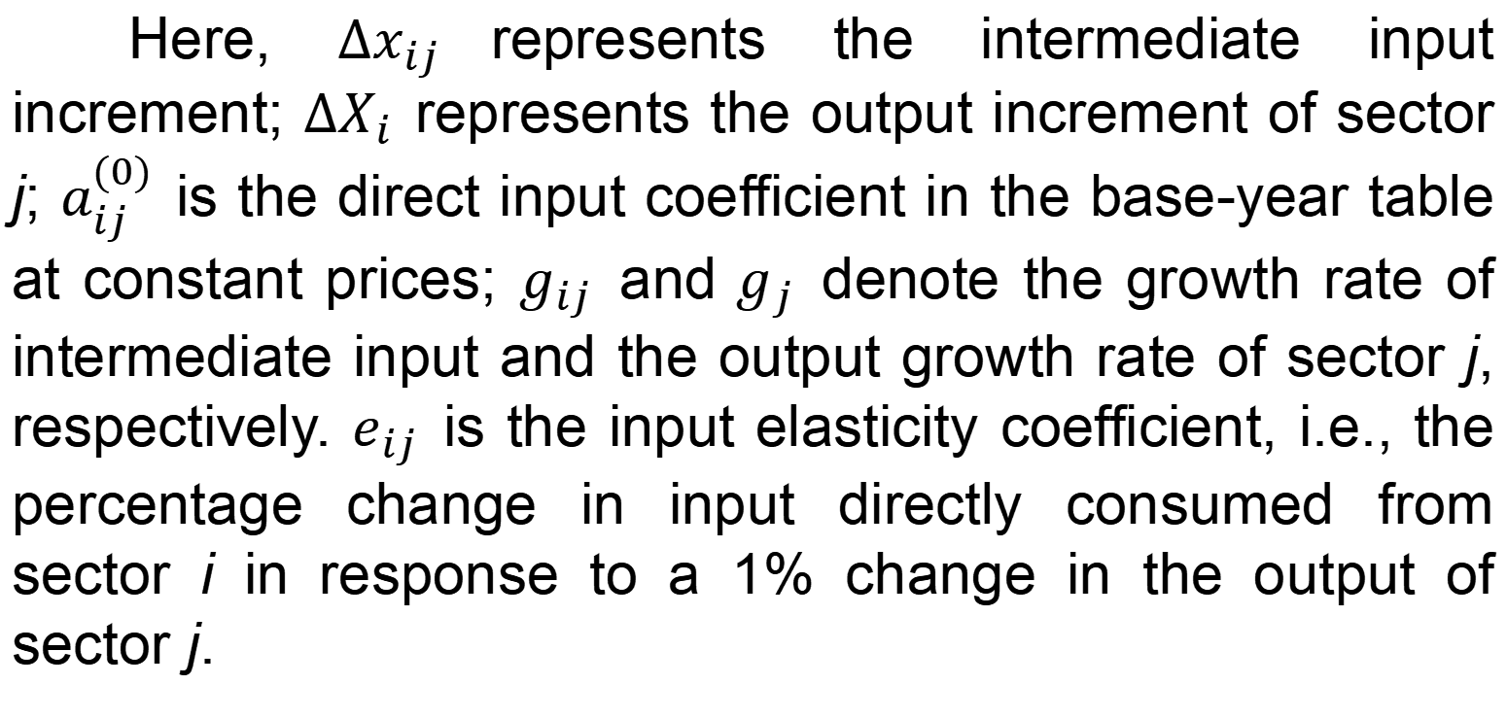
2. Incremental Input and Allocation Coefficients: Concepts, Types, and Analytical Methods
Here, $∆x_{ij}$represents the intermediate input increment; $∆X_{i}$ represents the output increment of sector j; $a_{ij}^{(0)}$ is the direct input coefficient in the base-year table at constant prices; $g_{ij}$ and${ g}_{j}$ denote the growth rate of intermediate input and the output growth rate of sector j, respectively. $e_{ij}$ is the input elasticity coefficient, i.e., the percentage change in input directly consumed from sector i in response to a 1% change in the output of sector j.

Slide 15
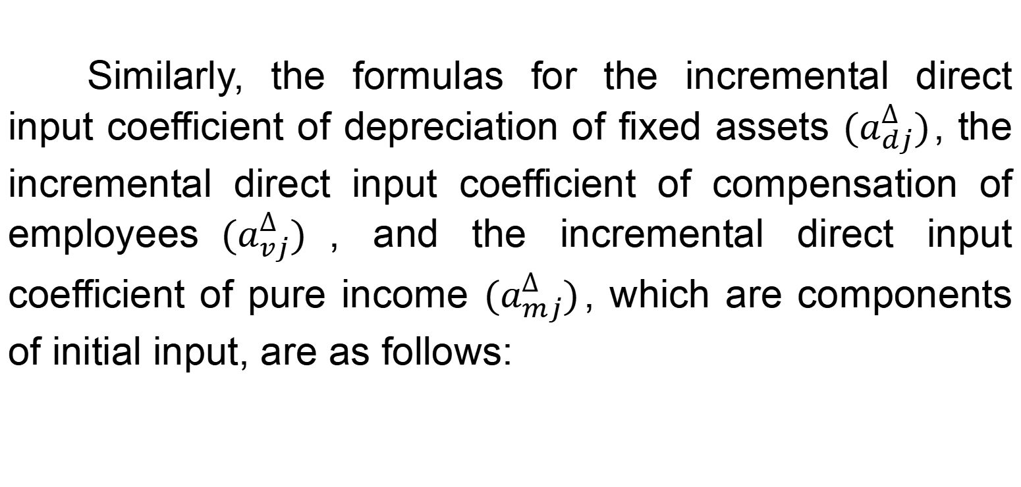
2. Incremental Input and Allocation Coefficients: Concepts, Types, and Analytical Methods
Similarly, the formulas for the incremental direct input coefficient of depreciation of fixed assets $(a_{dj}^{∆})$, the incremental direct input coefficient of compensation of employees$(a_{vj}^{∆})$, and the incremental direct input coefficient of pure income $(a_{mj}^{∆})$, which are components of initial input, are as follows:

Slide 16
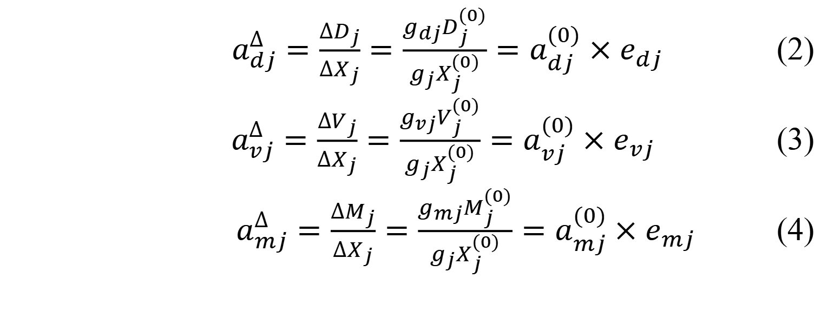
2. Incremental Input and Allocation Coefficients: Concepts, Types, and Analytical Methods
$a_{dj}^{∆}=\frac{∆D_{j}}{∆X_{j}}=\frac{g_{dj}D_{j}^{(0)}}{g_{j}X_{j}^{(0)}}=a_{dj}^{(0)}×e_{dj}$ (2)
$a_{vj}^{∆}=\frac{∆V_{j}}{∆X_{j}}=\frac{g_{vj}V_{j}^{(0)}}{g_{j}X_{j}^{(0)}}=a_{vj}^{(0)}×e_{vj}$ (3)
$a_{mj}^{∆}=\frac{∆M_{j}}{∆X_{j}}=\frac{g_{mj}M_{j}^{(0)}}{g_{j}X_{j}^{(0)}}=a_{mj}^{(0)}×e_{mj}$ (4)

Slide 17
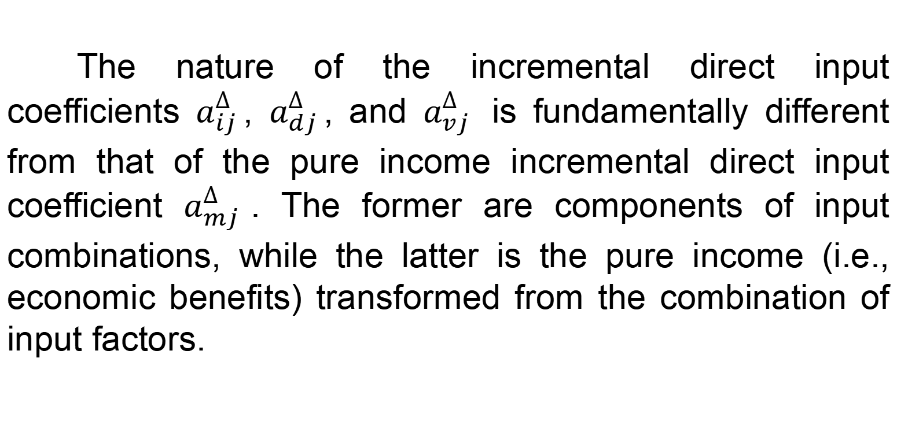
2. Incremental Input and Allocation Coefficients: Concepts, Types, and Analytical Methods
The nature of the incremental direct input coefficients $a_{ij}^{∆}$, $a_{dj}^{∆}$, and $a_{vj}^{∆}$ is fundamentally different from that of the pure income incremental direct input coefficient $a_{mj}^{∆}$. The former are components of input combinations, while the latter is the pure income (i.e., economic benefits) transformed from the combination of input factors.

Slide 18
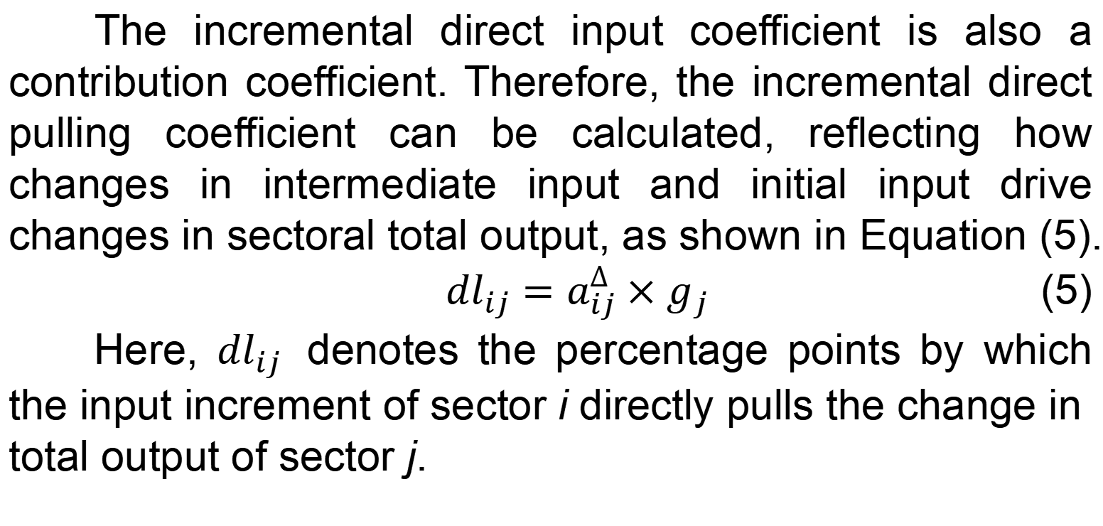
2. Incremental Input and Allocation Coefficients: Concepts, Types, and Analytical Methods
The incremental direct input coefficient is also a contribution coefficient. Therefore, the incremental direct pulling coefficient can be calculated, reflecting how changes in intermediate input and initial input drive changes in sectoral total output, as shown in Equation (5).
${dl}_{ij}=a_{ij}^{∆}×g_{j}$ (5)
Here, ${dl}_{ij}$ denotes the percentage points by which the input increment of sector i directly pulls the change in total output of sector j.

Slide 19
2. Incremental Input and Allocation Coefficients: Concepts, Types, and Analytical Methods
2.1.2 Types and analytical methods
The incremental direct input coefficients presented in Table 2 can be used to determine the degree of positive or negative pulling contribution of a sector’s incremental direct input coefficients to its output. The characteristics of a sector’s changes can be identified through the signs (positive or negative) of the output growth rate of sector j and the input growth rate of sector i (or value added component).

Slide 20
Table 2 Types and economic interpretations of incremental direct input coefficients
Type | Incremental direct input coefficient | Output growth rate of sector j | Input growth rate of sector i (or value added component) | Economic interpretation
(1) | Positive value | Positive value | Positive value | The increase in direct consumption of inputs from sector i (or value added component) when sector j increases output by one unit, reflecting the positive contribution of increased input from sector i (or value added component) to the output increase of sector j. Generally corresponds to scale-expansion growth (except for the pure income incremental direct input coefficient).
(2) | Positive value | Negative value | Negative value | The increase in direct consumption of inputs from sector i (or value added component) when sector j increases output by one unit, reflecting the positive contribution of increased input from sector i (or value added component) to the output increase of sector j. Generally corresponds to scale-expansion growth (except for the pure income incremental direct input coefficient).
(3) | Negative value | Positive value | Negative value | The decrease in direct consumption of inputs from sector i (or value added component) when sector j increases output by one unit, reflecting the negative contribution of reduced input from sector i (or value added component) to the output increase of sector j. Generally corresponds to technology substitution or efficiency-improving growth (ideal structural upgrading), except for the pure income incremental direct input coefficient.
(4) | Negative value | Negative value | Positive value | The increase in direct consumption of inputs from sector i (or value added component) when sector j decreases output by one unit, reflecting the negative contribution of increased input from sector i (or value added component) to the output decrease of sector j. Generally corresponds to a “rigid demand” trap during a recessionary period (cost disease or passive inventory accumulation), except for the pure income incremental direct input coefficient.
Note: Value added components consist of compensation of employees, depreciation of fixed assets, and pure income; This table is applicable for interpreting $a_{ij}^{∆}$, $a_{dj}^{∆}$ ,$a_{vj}^{∆}$and $a_{mj}^{∆}$.

Slide 21
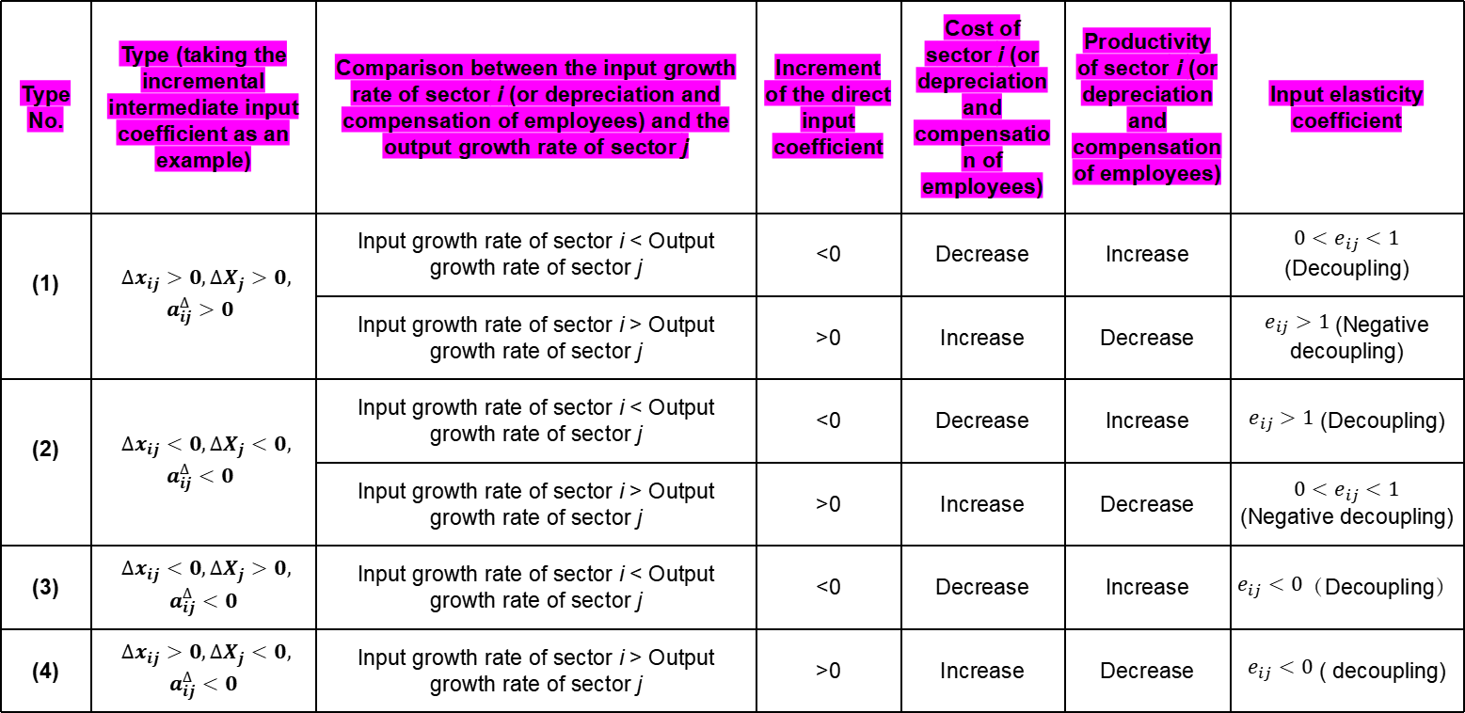
Table 3 The characteristics of factor productivity changes exhibited by the incremental direct input coefficient
Type No. | Type (taking the incremental intermediate input coefficient as an example) | Comparison between the input growth rate of sector i (or depreciation and compensation of employees) and the output growth rate of sector j | Increment of the direct input coefficient | Cost of sector i (or depreciation and compensation of employees) | Productivity of sector i (or depreciation and compensation of employees) | Input elasticity coefficient
(1) | $∆x_{ij}>0,∆X_{j}>0,$ $a_{ij}^{∆}>0$ | Input growth rate of sector i < Output growth rate of sector j | <0 | Decrease | Increase | $0<e_{ij}<1$ (Decoupling)
 |  | Input growth rate of sector i > Output growth rate of sector j | >0 | Increase | Decrease | $e_{ij}>1$(Negative decoupling)
(2) | $∆x_{ij}<0,∆X_{j}<0,$ $a_{ij}^{∆}<0$ | Input growth rate of sector i < Output growth rate of sector j | <0 | Decrease | Increase | $e_{ij}>1$ (Decoupling)
 |  | Input growth rate of sector i > Output growth rate of sector j | >0 | Increase | Decrease | $$0<e_{ij}<1$$ (Negative decoupling)
(3) | $∆x_{ij}<0,∆X_{j}>0,$ $$a_{ij}^{∆}<0$$ | Input growth rate of sector i < Output growth rate of sector j | <0 | Decrease | Increase | $e_{ij}<0$（Decoupling）
(4) | $∆x_{ij}>0,∆X_{j}<0,$ $$a_{ij}^{∆}<0$$ | Input growth rate of sector i > Output growth rate of sector j | >0 | Increase | Decrease | $e_{ij}<0$ ( decoupling)
Note: The intermediate input from sector i, depreciation of fixed assets, and compensation of employees are each single-factor inputs, corresponding to the interpretation of $a_{ij}^{∆}$, $a_{dj}^{∆}$, and $a_{vj}^{∆}$.

Slide 22
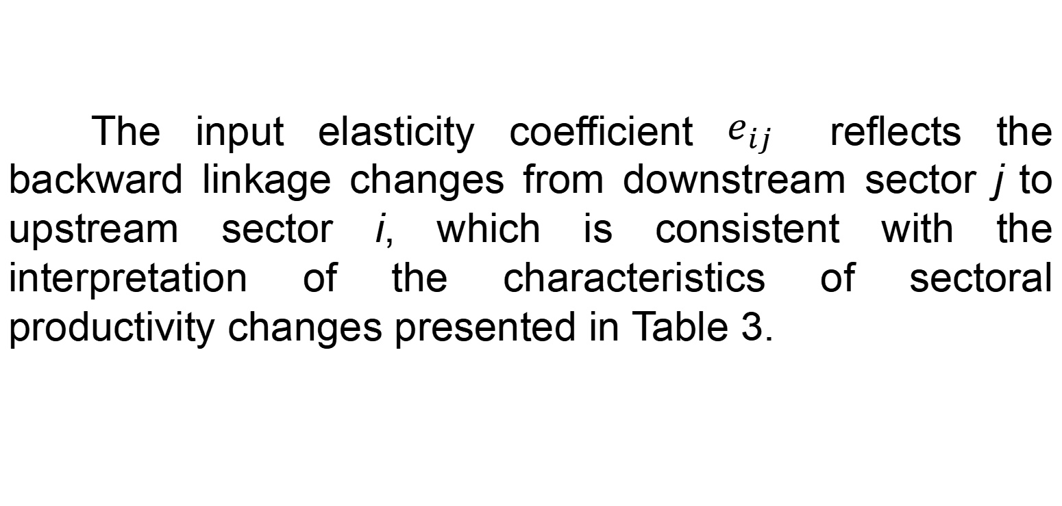
2. Incremental Input and Allocation Coefficients: Concepts, Types, and Analytical Methods
The input elasticity coefficient $e_{ij}$ reflects the backward linkage changes from downstream sector j to upstream sector i, which is consistent with the interpretation of the characteristics of sectoral productivity changes presented in Table 3.

Slide 23
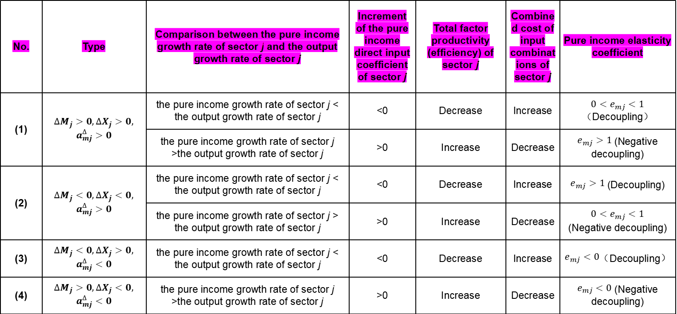
Table 4 The characteristics of combined cost and factor productivity changes exhibited by the pure income incremental direct input coefficient
No. | Type | Comparison between the pure income growth rate of sector j and the output growth rate of sector j | Increment of the pure income direct input coefficient of sector j | Total factor productivity (efficiency) of sector j | Combined cost of input combinations of sector j | Pure income elasticity coefficient
(1) | $$∆M_{j}>0,∆X_{j}>0,$$ $$a_{mj}^{∆}>0$$ | the pure income growth rate of sector j < the output growth rate of sector j | <0 | Decrease | Increase | $0<e_{mj}<1$（Decoupling）
 |  | the pure income growth rate of sector j >the output growth rate of sector j | >0 | Increase | Decrease | $e_{mj}>1$(Negative decoupling)
(2) | $$∆M_{j}<0,∆X_{j}<0,$$ $$a_{mj}^{∆}>0$$ | the pure income growth rate of sector j < the output growth rate of sector j | <0 | Decrease | Increase | $e_{mj}>1$(Decoupling)
 |  | the pure income growth rate of sector j > the output growth rate of sector j | >0 | Increase | Decrease | $0<e_{mj}<1$ (Negative decoupling)
(3) | $$∆M_{j}<0,∆X_{j}>0,$$ $$a_{mj}^{∆}<0$$ | the pure income growth rate of sector j < the output growth rate of sector j | <0 | Decrease | Increase | $e_{mj}<0$（Decoupling）
(4) | $$∆M_{j}>0,∆X_{j}<0,$$ $$a_{mj}^{∆}<0$$ | the pure income growth rate of sector j >the output growth rate of sector j | >0 | Increase | Decrease | $e_{mj}<0$ (Negative decoupling)
Note: In the table, the single-factor inputs are intermediate input, depreciation of fixed assets, and compensation of employees, and their input combination constitutes total factor input; Pure income reflects the effect of the input combination, corresponding to the interpretation of $a_{mj}^{∆}$; When the pure income in the base year is negative, the judgment should be based on the increment of the pure income direct input coefficient.

Slide 24
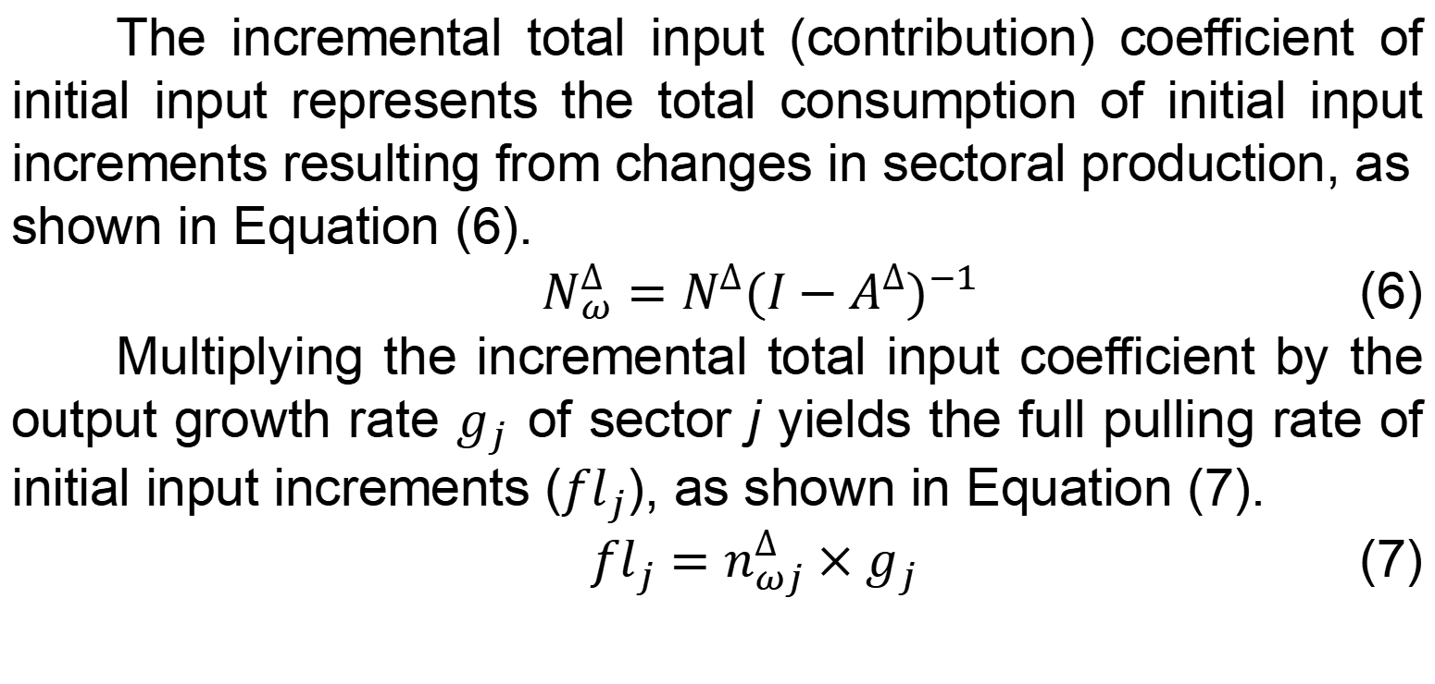
2. Incremental Input and Allocation Coefficients: Concepts, Types, and Analytical Methods
The incremental total input (contribution) coefficient of initial input represents the total consumption of initial input increments resulting from changes in sectoral production, as shown in Equation (6).
$N_{ω}^{∆}=N^{∆}{(I−A^{∆})}^{−1}$ (6)
Multiplying the incremental total input coefficient by the output growth rate $g_{j}$ of sector j yields the full pulling rate of initial input increments (${fl}_{j}$), as shown in Equation (7).
${fl}_{j}=n_{ωj}^{∆}×g_{j}$ (7)

Slide 25
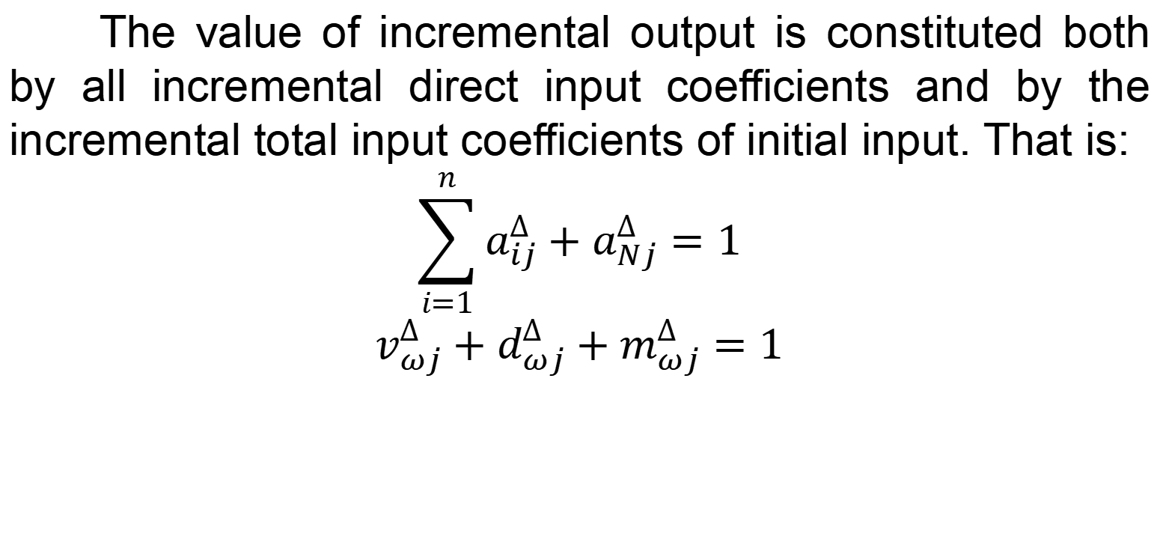
2. Incremental Input and Allocation Coefficients: Concepts, Types, and Analytical Methods
The value of incremental output is constituted both by all incremental direct input coefficients and by the incremental total input coefficients of initial input. That is:
$$\sum_{i=1}^{n}{a_{ij}^{∆}+a_{Nj}^{∆}=1}$$
$$v_{ωj}^{∆}+d_{ωj}^{∆}+m_{ωj}^{∆}=1$$

Slide 26
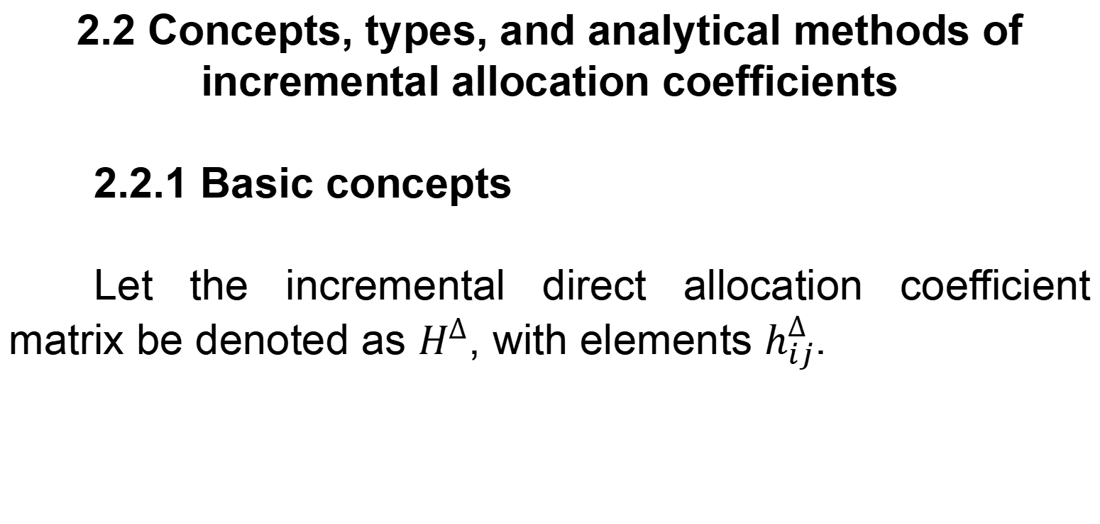
2. Incremental Input and Allocation Coefficients: Concepts, Types, and Analytical Methods
2.2 Concepts, types, and analytical methods of incremental allocation coefficients
2.2.1 Basic concepts
Let the incremental direct allocation coefficient matrix be denoted as $H^{∆}$, with elements $h_{ij}^{∆}$.

Slide 27
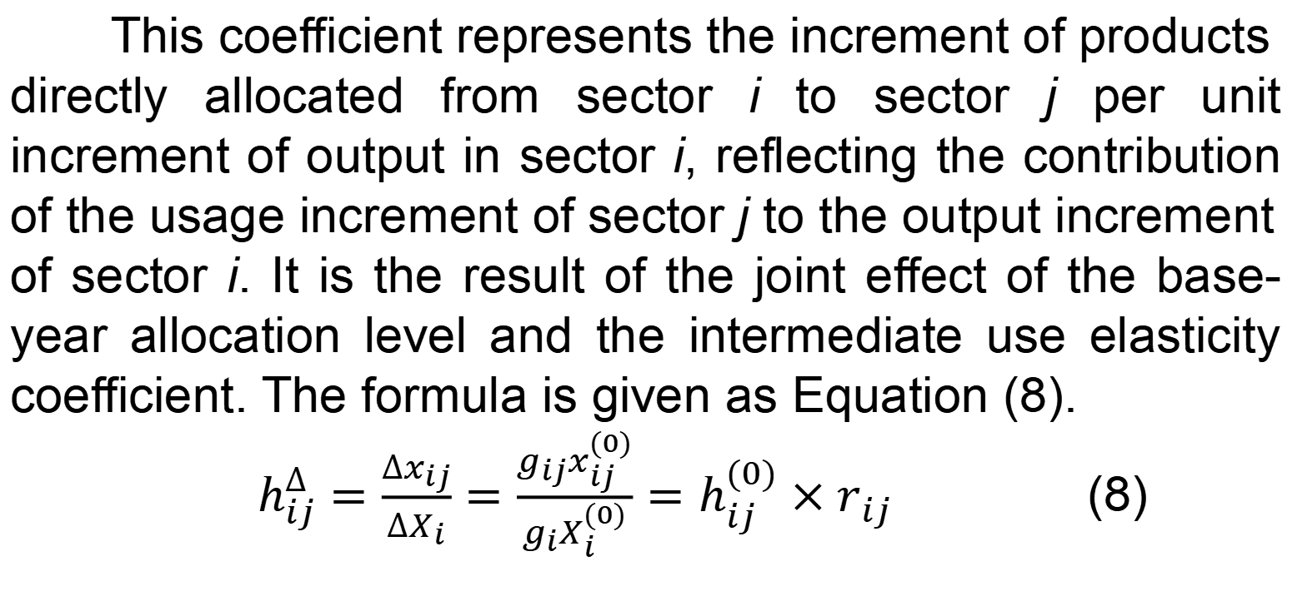
2. Incremental Input and Allocation Coefficients: Concepts, Types, and Analytical Methods
This coefficient represents the increment of products directly allocated from sector i to sector j per unit increment of output in sector i, reflecting the contribution of the usage increment of sector j to the output increment of sector i. It is the result of the joint effect of the base-year allocation level and the intermediate use elasticity coefficient. The formula is given as Equation (8).
$h_{ij}^{∆}=\frac{∆x_{ij}}{∆X_{i}}=\frac{g_{ij}x_{ij}^{(0)}}{g_{i}X_{i}^{(0)}}=h_{ij}^{(0)}×r_{ij}$ (8)

Slide 28
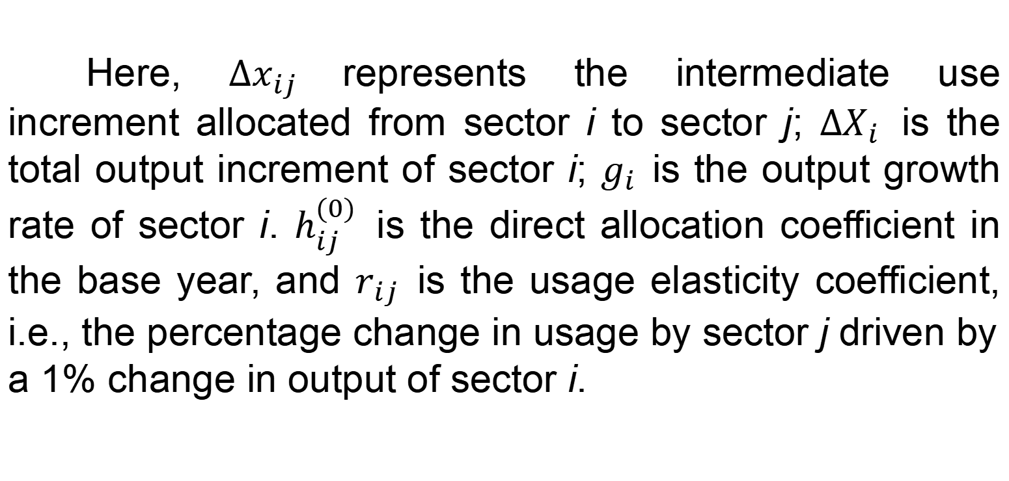
2. Incremental Input and Allocation Coefficients: Concepts, Types, and Analytical Methods
Here, $∆x_{ij}$represents the intermediate use increment allocated from sector i to sector j; $∆X_{i}$ is the total output increment of sector i; $g_{i}$ is the output growth rate of sector i. $h_{ij}^{(0)}$ is the direct allocation coefficient in the base year, and $r_{ij}$ is the usage elasticity coefficient, i.e., the percentage change in usage by sector j driven by a 1% change in output of sector i.

Slide 29
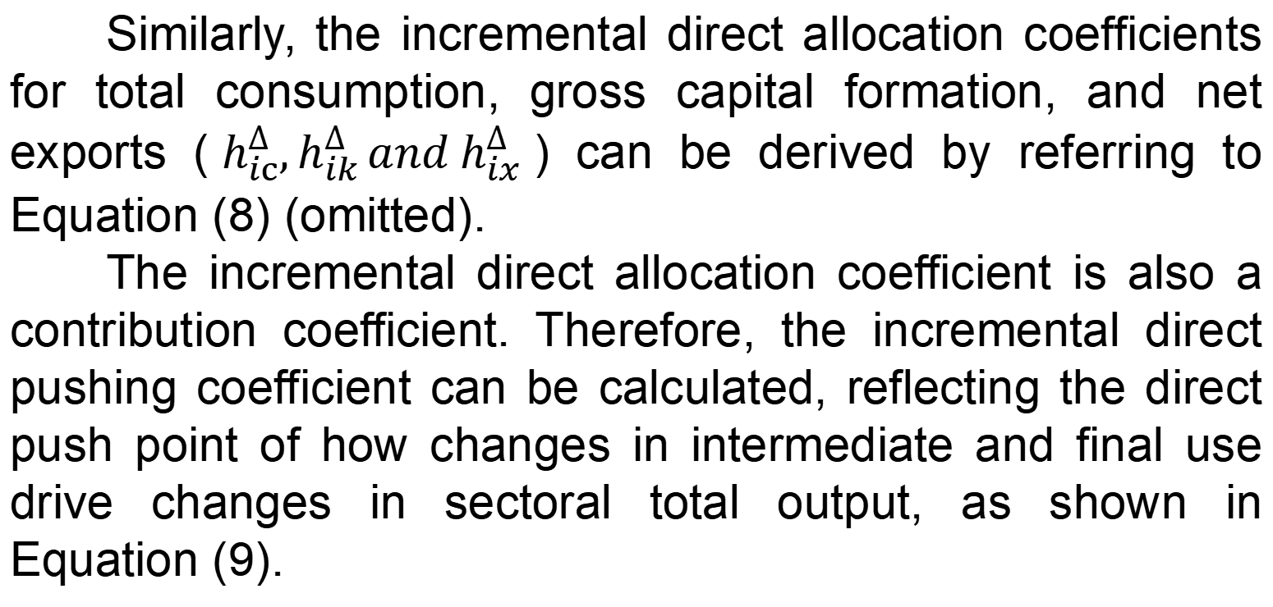
2. Incremental Input and Allocation Coefficients: Concepts, Types, and Analytical Methods
Similarly, the incremental direct allocation coefficients for total consumption, gross capital formation, and net exports ($h_{ic}^{∆},h_{ik }^{∆}and{ h}_{ix}^{∆}$) can be derived by referring to Equation (8) (omitted).
The incremental direct allocation coefficient is also a contribution coefficient. Therefore, the incremental direct pushing coefficient can be calculated, reflecting the direct push point of how changes in intermediate and final use drive changes in sectoral total output, as shown in Equation (9).

Slide 30
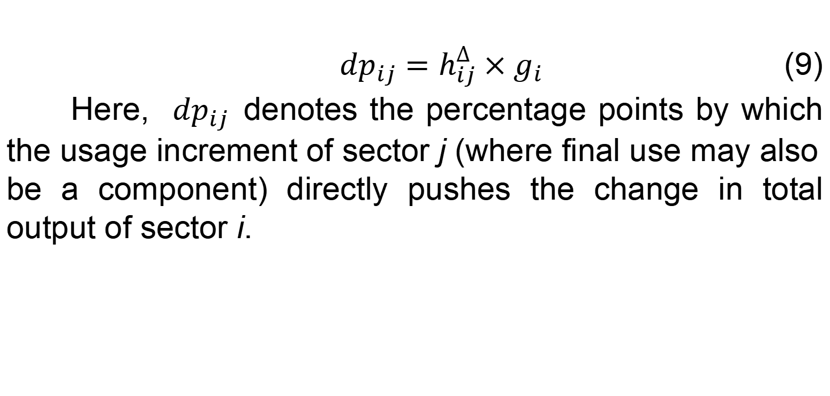
2. Incremental Input and Allocation Coefficients: Concepts, Types, and Analytical Methods
${dp}_{ij}=h_{ij}^{∆}×g_{i}$ (9)
Here, ${dp}_{ij}$ denotes the percentage points by which the usage increment of sector j (where final use may also be a component) directly pushes the change in total output of sector i.

Slide 31
2. Incremental Input and Allocation Coefficients: Concepts, Types, and Analytical Methods
2.2.2 Types and analytical methods
The types and interpretations of the incremental direct allocation coefficients are presented in Tables 5, 6, and 7.

Slide 32
Table 5 Types and economic implications of incremental direct allocation coefficients
Type | Incremental direct allocation coefficient | Output growth rate of sector i | Usage growth rate of sector j (or final use component) | Economic interpretation
(1) | Positive value | Positive value | Positive value | The increase directly allocated to sector j (or final use component) when sector i increases output by one unit, reflecting the positive contribution of increased usage by sector j (or final use component) to the output growth of sector i. Corresponds to the normal marginal allocation structure during an expansionary period.
(2) | Positive value | Negative value | Negative value | The decrease directly allocated to sector j (or final use component) when sector i decreases output by one unit, reflecting the positive contribution of reduced usage by sector j (or final use component) to the output decrease of sector i. Corresponds to the symmetric marginal allocation structure during a contractionary period.
(3) | Negative value | Positive value | Negative value | The decrease directly allocated to sector j (or final use component) when sector i increases output by one unit, reflecting the negative contribution of reduced usage by sector j (or final use component) to the output growth of sector i. Abnormal allocation (inventory release, structural adjustment, import substitution effect).
(4) | Negative value | Negative value | Positive value | The increase directly allocated to sector j (or final use component) when sector i decreases output by one unit, reflecting the negative contribution of increased usage by sector j (or final use component) to the output decrease of sector i. Efficiency improvement or structural optimization (technological progress, final demand structure adjustment, self-production substitution by sector j).
Note: Final use components consist of consumption, gross capital formation, and net exports.

Slide 33
2. Incremental Input and Allocation Coefficients: Concepts, Types, and Analytical Methods
The incremental direct allocation coefficients presented in Table 5 can be used to determine the degree of positive or negative pushing contribution of a sector’s incremental direct allocation coefficients to its output. The characteristics of a sector’s changes can be identified through the positive or negative growth signs of the output growth rate of sector i and the usage growth rate of sector j (or final use component).

Slide 34
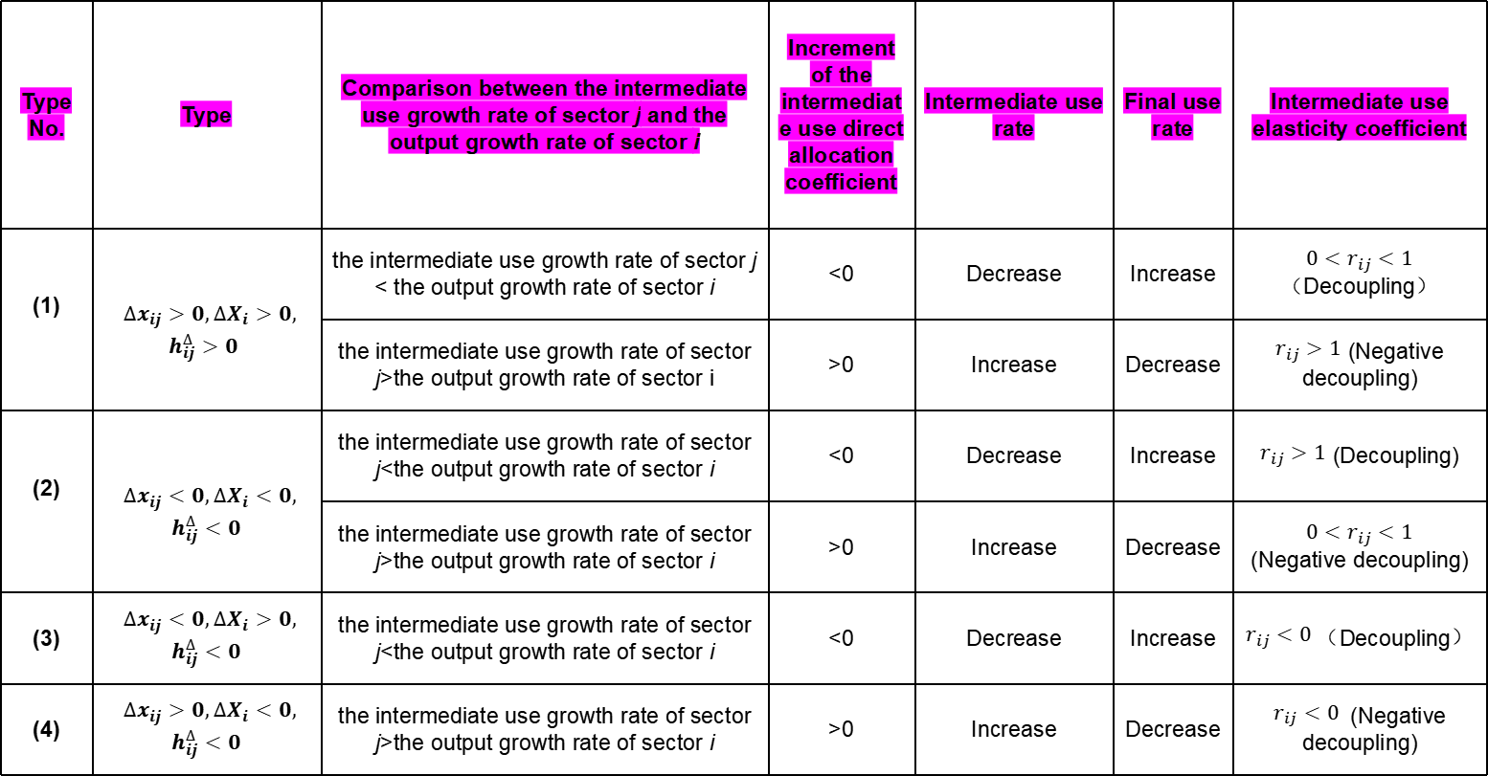
Table 6 The characteristics of structural efficiency changes exhibited by the intermediate use incremental direct allocation coefficient
Type No. | Type | Comparison between the intermediate use growth rate of sector j and the output growth rate of sector i | Increment of the intermediate use direct allocation coefficient | Intermediate use rate | Final use rate | Intermediate use elasticity coefficient
(1) | $∆x_{ij}>0,∆X_{i}>0,$ $h_{ij}^{∆}>0$ | the intermediate use growth rate of sector j < the output growth rate of sector i | <0 | Decrease | Increase | $0<r_{ij}<1$（Decoupling）
 |  | the intermediate use growth rate of sector j>the output growth rate of sector i | >0 | Increase | Decrease | $r_{ij}>1$ (Negative decoupling)
(2) | $∆x_{ij}<0,∆X_{i}<0,$ $$h_{ij}^{∆}<0$$ | the intermediate use growth rate of sector j<the output growth rate of sector i | <0 | Decrease | Increase | $r_{ij}>1$ (Decoupling)
 |  | the intermediate use growth rate of sector j>the output growth rate of sector i | >0 | Increase | Decrease | $$0<r_{ij}<1$$ (Negative decoupling)
(3) | $∆x_{ij}<0,∆X_{i}>0,$ $$h_{ij}^{∆}<0$$ | the intermediate use growth rate of sector j<the output growth rate of sector i | <0 | Decrease | Increase | $r_{ij}<0$（Decoupling）
(4) | $∆x_{ij}>0,∆X_{i}<0,$ $$h_{ij}^{∆}<0$$ | the intermediate use growth rate of sector j>the output growth rate of sector i | >0 | Increase | Decrease | $r_{ij}<0$ (Negative decoupling)

Slide 35
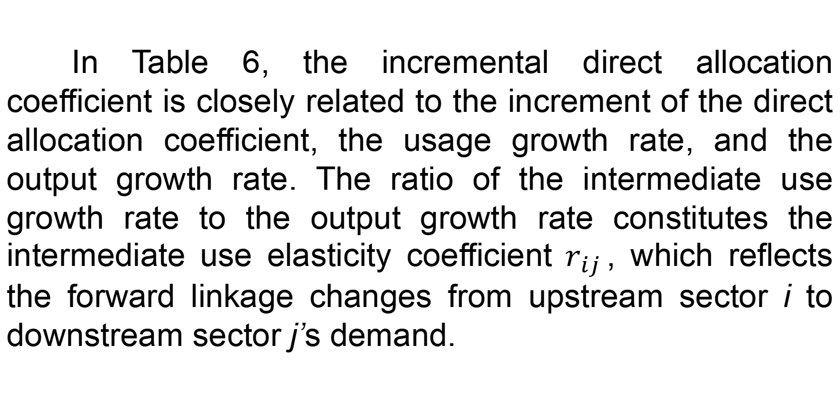
2. Incremental Input and Allocation Coefficients: Concepts, Types, and Analytical Methods
In Table 6, the incremental direct allocation coefficient is closely related to the increment of the direct allocation coefficient, the usage growth rate, and the output growth rate. The ratio of the intermediate use growth rate to the output growth rate constitutes the intermediate use elasticity coefficient${ r}_{ij}$, which reflects the forward linkage changes from upstream sector i to downstream sector j’s demand.

Slide 36
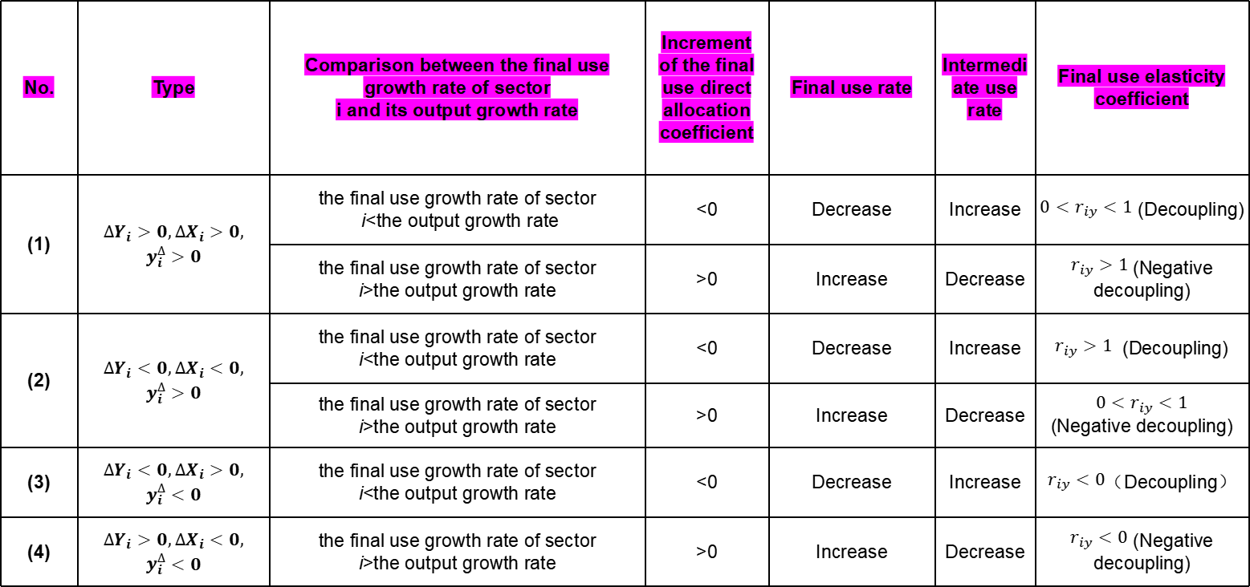
Table 7 The characteristics of structural efficiency changes exhibited by the final use incremental direct allocation coefficient
No. | Type | Comparison between the final use growth rate of sector i and its output growth rate | Increment of the final use direct allocation coefficient | Final use rate | Intermediate use rate | Final use elasticity coefficient
(1) | $$∆Y_{i}>0,∆X_{i}>0,$$ $$y_{i}^{∆}>0$$ | the final use growth rate of sector i<the output growth rate | <0 | Decrease | Increase | $0<r_{iy}<1$ (Decoupling)
 |  | the final use growth rate of sector i>the output growth rate | >0 | Increase | Decrease | $r_{iy}>1$(Negative decoupling)
(2) | $$∆Y_{i}<0,∆X_{i}<0,$$ $$y_{i}^{∆}>0$$ | the final use growth rate of sector i<the output growth rate | <0 | Decrease | Increase | $r_{iy}>1$ (Decoupling)
 |  | the final use growth rate of sector i>the output growth rate | >0 | Increase | Decrease | $$0<r_{iy}<1$$ (Negative decoupling)
(3) | $$∆Y_{i}<0,∆X_{i}>0,$$ $$y_{i}^{∆}<0$$ | the final use growth rate of sector i<the output growth rate | <0 | Decrease | Increase | $r_{iy}<0$（Decoupling）
(4) | $$∆Y_{i}>0,∆X_{i}<0,$$ $$y_{i}^{∆}<0$$ | the final use growth rate of sector i>the output growth rate | >0 | Increase | Decrease | $r_{iy}<0$ (Negative decoupling)
Note: Table 7 presents the judgment basis based on the comparison between the final use growth rate of sector i and its output growth rate; When net exports in the base year are negative, the judgment should be based on the increment of the final use direct allocation coefficient.

Slide 37
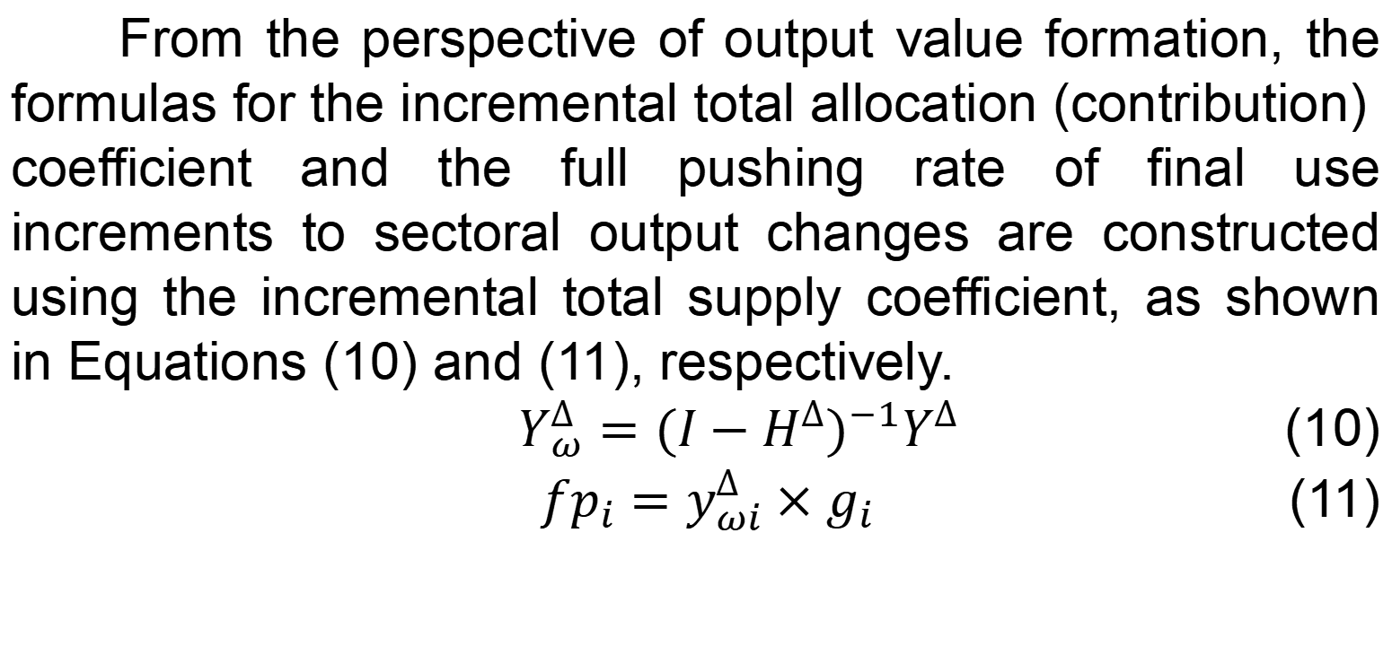
2. Incremental Input and Allocation Coefficients: Concepts, Types, and Analytical Methods
From the perspective of output value formation, the formulas for the incremental total allocation (contribution) coefficient and the full pushing rate of final use increments to sectoral output changes are constructed using the incremental total supply coefficient, as shown in Equations (10) and (11), respectively.
$Y_{ω}^{∆}={(I−H^{∆})}^{−1}Y^{∆}$ (10)
${fp}_{i}=y_{ωi}^{∆}×g_{i}$ (11)

Slide 38
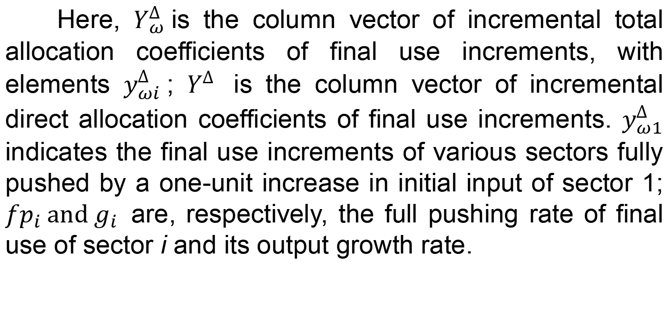
2. Incremental Input and Allocation Coefficients: Concepts, Types, and Analytical Methods
Here, $Y_{ω}^{∆}$is the column vector of incremental total allocation coefficients of final use increments, with elements $y_{ωi}^{∆}$; $Y^{∆}$ is the column vector of incremental direct allocation coefficients of final use increments. $y_{ω1}^{∆}$ indicates the final use increments of various sectors fully pushed by a one-unit increase in initial input of sector 1; ${fp}_{i} and g_{i}$ are, respectively, the full pushing rate of final use of sector i and its output growth rate.

Slide 39
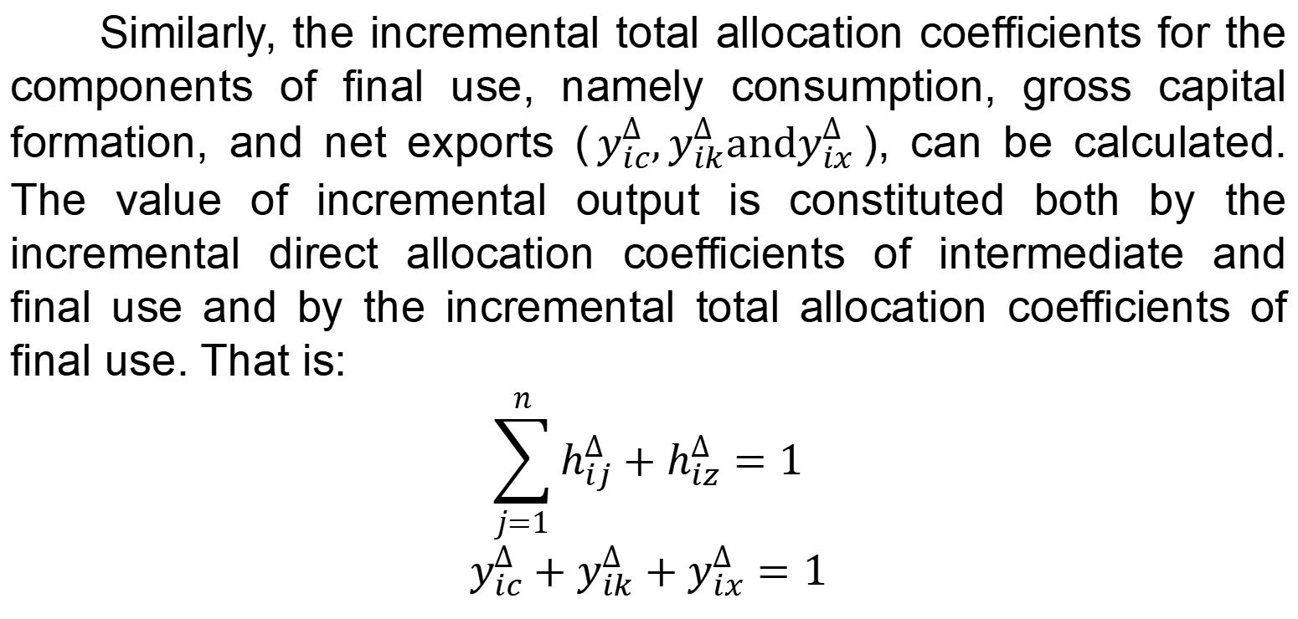
2. Incremental Input and Allocation Coefficients: Concepts, Types, and Analytical Methods
Similarly, the incremental total allocation coefficients for the components of final use, namely consumption, gross capital formation, and net exports ($y_{ic}^{∆},y_{ik}^{∆}andy_{ix}^{∆}$), can be calculated. The value of incremental output is constituted both by the incremental direct allocation coefficients of intermediate and final use and by the incremental total allocation coefficients of final use. That is:
$$\sum_{j=1}^{n}{h_{ij}^{∆}+h_{iz}^{∆}=1}$$
$$y_{ic}^{∆}+y_{ik}^{∆}+y_{ix}^{∆}=1$$

Slide 40
3. Empirical Analysis

Slide 41
3. Empirical Analysis
3.1 Analysis of the Four-Sector Incremental Input-Output Table for China
This paper conducts an empirical analysis using the compiled four-sector incremental input-output tables for China for the period 2010–2020, including both continuous annual tables and a ten-year interval table (with 2015 as the base year), as shown in Table 8.

Slide 42
Table 8 Four-sector incremental input-output table for China, 2010–2020 (100 million yuan)
 |  | Intermediate use increments |  |  |  |  | Final use increments |  |  |  | Total output increments
 |  | Agriculture | Industry | Construction | Services | Total intermediate use | Total consumption expenditure | Gross capital formation | Net exports | Total final use
Intermediate input increments | Agriculture | -454 | 1200 | 949 | 1848 | 3543 | 10998 | 853 | 460 | 12311 | 15854
 | Industry | -4857 | -186465 | 19792 | 22406 | -149125 | 21115 | -41768 | 3920 | -16733 | -165858
 | Construction | 31 | 87 | 6282 | -17 | 6383 | -3758 | 65517 | -1010 | 60749 | 67132
 | Services | 1515 | 15065 | 25379 | 151057 | 193018 | 87849 | 20004 | -1418 | 106435 | 299453
 | Total intermediate input | -3765 | -170114 | 52402 | 175294 | 53818 | 116204 | 44606 | 1952 | 162762 | 216580
Value added increments | Compensation of employees | 23744 | -2931 | 13091 | 87078 | 120982
 | Depreciation of fixed assets | -738 | 6297 | -143 | 22350 | 27766
 | Pure income | -3388 | 890 | 1781 | 14730 | 14014
 | Total value added | 19618 | 4256 | 14729 | 124158 | 162762
Total input increments |  | 15854 | -165858 | 67132 | 299453 | 216580

Slide 43
3. Empirical Analysis
As shown in Table 8, China’s total output, GDP, and pure income increased by 21,658 billion yuan, 16,276.2 billion yuan, and 1,401.4 billion yuan, respectively. Affected by the COVID-19 pandemic in 2020, China’s economy exhibited structural transformation characteristics featuring a relative contraction in industry, expansion in services and construction, consumption-led growth, and a rising share of compensation of employees. The structural shares of the three industries in China’s value added changed from 8.03:46.65:45.32 in 2010 to 8.88:39.22:51.90 in 2020, with the share of the tertiary industry increasing by 6.58 percentage points. The trajectory of this change is shown in Figure 1.

Slide 44
Figure 1 Share of value added of the three industries in GDP (%), 2010–2020

Slide 45
3. Empirical Analysis
3.2 Structural analysis of input and use increments
Based on the compiled continuous annual incremental input-output table for China for the period 2010–2020, the structural analysis of input increments is shown in Table 9.

Slide 46
Table 9 Structural analysis of input increments, 2010–2020 (100 million yuan)
Period / Sector | Intermediate input | Compensation of employees | Depreciation of fixed assets | Pure income | Input combination | Value added | Total input | Contribution rate of input combination (%)
2010-2011 | 73852.36 | 30265.16 | 5126.24 | 13229.55 | 109243.76 | 48620.96 | 122473.32 | 89.20
2011-2012 | 6131.71 | 14460.47 | 548.66 | 510.53 | 21140.84 | 15519.66 | 21651.37 | 97.64
2012-2013 | 51782.13 | 14005.21 | 442.76 | 309.76 | 66230.10 | 14757.74 | 66539.87 | 99.53
2013-2014 | 31705.30 | 10108.69 | -595.31 | -2212.13 | 41218.68 | 7301.25 | 39006.55 | 105.67
2014-2015 | 10917.70 | 6932.66 | -1579.00 | -6075.46 | 16271.35 | -721.81 | 10195.89 | 159.59
2015-2016 | -82859.27 | 5921.33 | 3034.76 | 512.24 | -73903.18 | 9468.33 | -73390.94 | 100.70
2016-2017 | -57776.60 | 14158.93 | 5651.54 | 9639.84 | -37966.13 | 29450.31 | -28326.29 | 134.03
2017-2018 | 34832.64 | 13539.42 | 11232.73 | 195.04 | 59604.78 | 24967.18 | 59799.82 | 99.67
2018-2019 | 246.63 | 6762.11 | 2406.55 | 246.39 | 9415.28 | 9415.05 | 9661.68 | 97.45
2019-2020 | -15014.32 | 4828.52 | 1496.73 | -2342.13 | -8689.07 | 3983.12 | -11031.20 | 78.77
Sum of successive increments | 53818.27 | 120982.48 | 27765.66 | 14013.64 | 202566.41 | 162761.78 | 216580.05 | 93.53
Cumulative increment | 53818.27 | 120982.48 | 27765.66 | 14013.64 | 202566.41 | 162761.78 | 216580.05 | 93.53
Note: The sum of successive increments refers to the sum of the indicator data in the incremental tables obtained by subtracting the preceding year from the subsequent year over the period 2010–2020; the cumulative increment refers to the indicator data in the incremental table for the ten-year interval from 2010 to 2020, with 2010 as the base year and 2020 as the reporting year; the input combination increment refers to the sum of the increments of intermediate input, depreciation of fixed assets, and compensation of employees.

Slide 47
Table 10 Structural analysis of use increments, 2010–2020 (100 million yuan)
Period / Sector | Intermediate use | Consumption | Gross capital formation | Net exports | Final use | Total output
2010-2011 | 73852.36 | 28495.41 | 18608.09 | 1517.45 | 48620.96 | 122473.32
2011-2012 | 6131.71 | 12083.20 | 2649.92 | 786.54 | 15519.66 | 21651.37
2012-2013 | 51782.13 | 7877.90 | 4915.17 | 1964.67 | 14757.74 | 66539.87
2013-2014 | 31705.30 | 5301.66 | 388.38 | 1611.21 | 7301.25 | 39006.55
2014-2015 | 10917.70 | 8458.25 | -10537.81 | 1357.76 | -721.81 | 10195.89
2015-2016 | -82859.27 | 14638.23 | 2296.89 | -7466.79 | 9468.33 | -73390.94
2016-2017 | -57776.60 | 16982.43 | 15808.51 | -3340.63 | 29450.31 | -28326.29
2017-2018 | 34832.64 | 14326.80 | 17968.69 | -7328.30 | 24967.18 | 59799.82
2018-2019 | 246.63 | 11517.71 | -4862.37 | 2759.70 | 9415.05 | 9661.68
2019-2020 | -15014.32 | -3478.09 | -2629.03 | 10090.23 | 3983.12 | -11031.20
Sum of successive increments | 53818.27 | 116203.50 | 44606.44 | 1951.84 | 162761.78 | 216580.05
Cumulative increment | 53818.27 | 116203.50 | 44606.44 | 1951.84 | 162761.78 | 216580.05

Slide 48
3. Empirical Analysis
During the period 2010–2020, the increase in total output primarily relied on the rise in final use, with increases in consumption and gross capital formation being important factors driving the increase in final use, and consumption became the main growth point driving domestic demand. This reflects a structural transformation characterized by an increasing final use rate and a decreasing intermediate use rate, indicating that China’s economy has exhibited a development trend of structural upgrading and demand-driven growth.

Slide 49
3. Empirical Analysis
3.3 Analysis of value added and growth rates
This paper combines growth rates with growth amounts. According to the formula “Absolute value of a one-percentage-point increase in growth rate = Base period development level × 1%”, the results are shown in Table 11.

Slide 50
Table 11 Value added and growth in China, 2010–2020
Year | Symbol | Value added (100 million yuan) | Cumulative growth (100 million yuan) | Fixed-base growth rate (%) | Chain growth rate (%) | Fixed-base growth speed (%) | Chain growth speed (%) | Absolute value of a one-percentage-point increase in growth rate (100 million yuan)
2010 | a0 | 603380.40 | — | — | — | — | — | —
2011 | a1 | 652001.35 | 48620.96 | 108.06 | 108.06 | 8.06 | 8.06 | 6033.80
2012 | a2 | 667521.01 | 64140.62 | 110.63 | 102.38 | 10.63 | 2.38 | 6520.01
2013 | a3 | 682278.75 | 78898.36 | 113.08 | 102.21 | 13.08 | 2.21 | 6675.21
2014 | a4 | 689580.01 | 86199.61 | 114.29 | 101.07 | 14.29 | 1.07 | 6822.79
2015 | a5 | 688858.20 | 85477.80 | 114.17 | 99.90 | 14.17 | -0.10 | 6895.80
2016 | a6 | 698326.53 | 94946.13 | 115.74 | 101.37 | 15.74 | 1.37 | 6888.58
2017 | a7 | 727776.84 | 124396.44 | 120.62 | 104.22 | 20.62 | 4.22 | 6983.27
2018 | a8 | 752744.02 | 149363.62 | 124.75 | 103.43 | 24.75 | 3.43 | 7277.77
2019 | a9 | 762159.06 | 158778.67 | 126.31 | 101.25 | 26.31 | 1.25 | 7527.44
2020 | a10 | 766142.18 | 162761.78 | 126.97 | 100.52 | 26.97 | 0.52 | 7621.59

Slide 51
3. Empirical Analysis
It can be seen that in 2020, China’s fixed-base and chain growth rates of value added were 126.97% and 100.52%, respectively, while the fixed-base and chain growth speeds were 26.97% and 0.52%, respectively.
The absolute value of a one-percentage-point increase in the chain growth rate of value added continued to rise from 2011 to 2020, indicating that China’s economic development has strong “resilience.”

Slide 52
3. Empirical Analysis
3.4 Analysis of incremental direct input coefficients
Based on Equations (1)–(4), Table 12 is obtained.
To reveal the characteristics of input-output efficiency changes, the structural analysis of China’s input calculated based on Equations (1)–(7) is presented in the following table.

Slide 53
Table 12 Incremental direct input coefficients for four sectors in China, 2010–2020
Input sector | Agriculture | Industry | Construction | Services | Total intermediate use
Agriculture | -0.0287 | -0.0072 | 0.0141 | 0.0062 | 0.0164
Industry | -0.3064 | 1.1242 | 0.2948 | 0.0748 | -0.6885
Construction | 0.0020 | -0.0005 | 0.0936 | -0.0001 | 0.0295
Services | 0.0956 | -0.0908 | 0.3781 | 0.5044 | 0.8912
Total intermediate input | -0.2375 | 1.0257 | 0.7806 | 0.5854 | 0.2485
Compensation of employees | 1.4977 | 0.0177 | 0.1950 | 0.2908 | 0.5586
Depreciation of fixed assets | -0.0465 | -0.0380 | -0.0021 | 0.0746 | 0.1282
Pure income | -0.2137 | -0.0054 | 0.0265 | 0.0492 | 0.0647
Total value added | 1.2375 | -0.0257 | 0.2194 | 0.4146 | 0.7515
(Input combination) | 1.2137 | 1.0054 | 0.9735 | 0.9508 | 0.9353
Total | 1.0000 | 1.0000 | 1.0000 | 1.0000 | 1.0000
Output growth rate (%) | 17.83 | -14.88 | 44.07 | 63.10 | 11.83

Slide 54
Table 13 Structural analysis table of China’s input structure, 2010–2020
Input sector | (1) Incremental direct input coefficient | (2) Direct input coefficient in the base year | (3) Direct input coefficient in the reporting year | (4) Increment of the direct input coefficient | (5) Input growth rate (%) | (6) Output growth rate (%) | (7) Input elasticity coefficient | (8) Direct pulling rate (%)
 | (1) | (2) | (3) | (4)=(3)-(2) | (5) | (6) | (7)=(5)/(6) | (8)=(1)×(6)
Agriculture | 0.0164 | 0.0383 | 0.0360 | -0.0023 | 5.06 | 11.83 | 0.4273 | 0.19
Industry | -0.6885 | 0.5010 | 0.3752 | -0.1259 | -16.26 | 11.83 | -1.3743 | -8.15
Construction | 0.0295 | 0.0028 | 0.0056 | 0.0028 | 124.45 | 11.83 | 10.5166 | 0.35
Services | 0.8912 | 0.1282 | 0.2089 | 0.0807 | 82.26 | 11.83 | 6.9516 | 10.55
Total intermediate input | 0.2485 | 0.6703 | 0.6257 | -0.0446 | 4.39 | 11.83 | 0.3707 | 2.94
Compensation of employees | 0.5586 | 0.1533 | 0.1962 | 0.0429 | 43.11 | 11.83 | 3.6428 | 6.61
Depreciation of fixed assets | 0.1282 | 0.0459 | 0.0546 | 0.0087 | 33.02 | 11.83 | 2.7904 | 1.52
Pure income | 0.0647 | 0.1304 | 0.1234 | -0.0070 | 5.87 | 11.83 | 0.4962 | 0.77
Total value added | 0.7515 | 0.3297 | 0.3743 | 0.0446 | 26.97 | 11.83 | 2.2795 | 8.89
(Input combination) | 0.9353 | 0.8696 | 0.8766 | 0.0070 | 12.73 | 11.83 | 1.0755 | 11.07
Total | 1.0000 | 1.0000 | 1.0000 | 0.0000 | / | / | 1.0000 | 11.83

Slide 55
3. Empirical Analysis
The quantitative relationship among the incremental direct input coefficient, the direct input coefficient in the base year, and the input elasticity coefficient presented in Table 13 is shown in Figure 2.

Slide 56
Figure 2 Comparison of key indicators of China’s input structure, 2010–2020

Slide 57
3. Empirical Analysis
(1) Analysis of incremental input and pulling. The increase in services input and the decrease in industrial input are the main positive and negative contributing factors to the increase in total output. Within the 11.83% output growth, inputs from agriculture, construction, services, compensation of employees, depreciation of fixed assets, and pure income each pulled total output growth, while industrial input pulled total output down.

Slide 58
3. Empirical Analysis
(2) Input-output efficiency analysis. The increases in total output, intermediate input, and value added reflect the transformation of China’s economic structure toward higher value added. The growth rate of pure income input is lower than the output growth rate, indicating that the profitability of China’s economy has declined to some extent.

Slide 59
3. Empirical Analysis
(3) Input elasticity coefficient analysis. The incremental direct input coefficient is proportional to the input elasticity coefficient. Among the sectors, the construction sector has a relatively high elasticity, followed by the services sector. The input structure exhibits pronounced characteristics of differentiated adjustment, transformation, and upgrading.

Slide 60
3. Empirical Analysis
3.5 Analysis of incremental direct allocation coefficients
Based on Equation (8), Table 14 is obtained.
To reveal the characteristics of supply-push effect changes, it is necessary to apply the analytical methods based on the types and manifestations of incremental direct allocation coefficients. Based on Equations (8)–(11) and the analysis in Table 14, the structural analysis of China’s use structure for the period 2010–2020 is calculated and presented in Table 15.

Slide 61
Table 14 Incremental direct allocation coefficients for four sectors in China, 2010–2020
Using sector | Agriculture | Industry | Construction | Services | Total intermediate input
Agriculture | -0.0287 | 0.0293 | 0.0005 | 0.0051 | -0.0174
Industry | 0.0757 | 1.1242 | 0.0013 | 0.0503 | -0.7855
Construction | 0.0599 | -0.1193 | 0.0936 | 0.0848 | 0.2420
Services | 0.1166 | -0.1351 | -0.0003 | 0.5044 | 0.8094
Total intermediate use | 0.2235 | 0.8991 | 0.0951 | 0.6446 | 0.2485
Consumption | 0.6937 | -0.1273 | -0.0560 | 0.2934 | 0.5365
Gross capital formation | 0.0538 | 0.2518 | 0.9759 | 0.0668 | 0.2060
Net exports | 0.0290 | -0.0236 | -0.0150 | -0.0047 | 0.0090
Final use | 0.7765 | 0.1009 | 0.9049 | 0.3554 | 0.7515
Total | 1.0000 | 1.0000 | 1.0000 | 1.0000 | 1.0000

Slide 62
Table 15 Structural analysis table of China’s use structure, 2010–2020
Using sector | (1) Incremental direct allocation coefficient | (2) Direct allocation coefficient in the base year | (3) Direct allocation coefficient in the reporting year | (4) Increment of the direct allocation coefficient | (5) Usage growth rate (%) | (6) Output growth rate (%) | (7) Usage elasticity coefficient | (8) Direct pushing rate (%)
 | (1) | (2) | (3) | (4)=(3)-(2) | (5) | (6) | (7)=(5)/(6) | (8)=(1)×(6)
Agriculture | -0.0174 | 0.0221 | 0.0179 | -0.0042 | -9.30 | 11.83 | -0.7860 | -0.21
Industry | -0.7855 | 0.4781 | 0.3444 | -0.1337 | -19.44 | 11.83 | -1.6428 | -9.29
Construction | 0.2420 | 0.0602 | 0.0794 | 0.0192 | 47.56 | 11.83 | 4.0190 | 2.86
Services | 0.8094 | 0.1099 | 0.1839 | 0.0740 | 87.16 | 11.83 | 7.3656 | 9.58
Total intermediate use | 0.2485 | 0.6703 | 0.6257 | -0.0446 | 4.39 | 11.83 | 0.3707 | 2.94
Consumption | 0.5365 | 0.1644 | 0.2038 | 0.0394 | 38.61 | 11.83 | 3.2631 | 6.35
Gross capital formation | 0.2060 | 0.1563 | 0.1616 | 0.0053 | 15.59 | 11.83 | 1.3176 | 2.44
Net exports | 0.0090 | 0.0089 | 0.0090 | 0.0000 | 11.92 | 11.83 | 1.0072 | 0.11
Final use | 0.7515 | 0.3297 | 0.3743 | 0.0446 | 26.97 | 11.83 | 2.2795 | 8.89
Total | 1.0000 | 1.0000 | 1.0000 | 0.0000 | / | / | 1.0000 | 11.83
Note: The comparison between the output growth rate of sector i and the growth rate of final use components differs from the judgment criteria for intermediate use sectors.

Slide 63
3. Empirical Analysis
The quantitative relationship among the incremental direct allocation coefficient, the direct allocation coefficient in the base year, and the usage elasticity coefficient presented in Table 15 is shown in Figure 3. This indicates that the usage elasticity coefficient exhibits a trend consistent with that of the input elasticity coefficient, though with a slower and more lagged fluctuation, with the services sector showing a relatively high elasticity.

Slide 64
Figure 3 Comparison of key indicators of China’s use structure, 2010–2020

Slide 65
3. Empirical Analysis
(1) Analysis of incremental direct allocation and pushing coefficients. This reflects that the increase in services use and the decrease in industrial use are the main positive and negative contributing factors to China’s output growth.
(2) Use structure efficiency analysis. Intermediate use and final use increased by 4.39% and 26.97%, respectively, with the growth rate of final use far exceeding that of intermediate use, indicating an improvement in use structure efficiency.
(3) Use elasticity coefficient analysis. During the expansionary period when output grew by 11.83%, the economic structure exhibited pronounced characteristics of differentiated adjustment.

Slide 66
4. Conclusions and Future Research

Slide 67
4. Conclusions and Future Research
4.1 Conclusions
1.The proposed systematic analytical method for incremental coefficients provides a basis for revealing the drivers of economic structural change. This represents an extension and significant development of input-output theory, deepening the analysis from reflecting economic operation to capturing the process of economic change.

Slide 68
4. Conclusions and Future Research
2.Empirical evidence shows that during the period 2010–2020, despite shocks such as the COVID-19 pandemic, China’s total output, GDP, and pure income (economic benefits) all increased,with notable achievements in economic structural transformation.
3.The study finds that the savings in input combinations per unit of output in each sector are entirely transformed into pure income per unit of output, revealing the quantitative transformation relationship between the improvement in input combination quality and the contributed pure income.

Slide 69
4. Conclusions and Future Research
4.2 Future Research
The fluctuations in the growth rates of various sectors within the economic system originate from both demand-side pulling, primarily transmitted through the intermediate input elasticity coefficient, and supply-side pushing, primarily transmitted through the intermediate use elasticity coefficient, resulting from the joint action of both.

Slide 70
4. Conclusions and Future Research
Research on incremental input-output analysis remains in its early stages. Further research is needed on issues such as incremental non-competitive tables, incremental interregional tables, incremental CGE models, and incremental digital economy supply and use tables.

Slide 71
References
[1]Leontief W. Air pollution and the economic structure: Empirical results of input-output comparisons[J]. Input-Output Economics Second Edition, 1972:273-293.
[2]Tilanus C B.Marginal versus average input coefficients in input-output forecasting[J].The Quarterly Journal of Economics,1967, 81(1): 140-145.
[3]Li Guozhang. Contribution analysis of soft input in output increment [J]. Journal of Quantitative & Technological Economics, 1995, (04): 54-61.
[4]Li Guozhang, Chen Nanxu. Research on the compilation method of incremental input-output table [J]. Statistics & Decision, 2016, (20): 4-8.
[5]Song Hui, Zhang Shuo, Bian Shaoqing. Theoretical Analysis of Basic Coefficients and Models ofIncremental Input-Output Table [J]. China Journal of Econometrics, 2025, 5 (02): 556-583.
[6]Song Hui. Characteristics and functions of incremental input-output table [J]. Statistics and Consultation 2025, (05): 31-33.
[7]Song Hui, Wang Chunli. Calculation and analysis method of incremental input coefficient [J]. Statistics and Consultation, 2025, (06): 22-25.
[8]Song Hui, Wang Chunli. The Relationship among Statistical Indicators between Incremental Input-Output Tables[J]. Statistics and Consultation, 2026, (1): 22-25.
[9]Song Hui, Wang Chunli. Calculation and Analysis Methods of Incremental Allocation Coefficients[J]. Statistics and Consultation, 2026, (2): 22-25.

Slide 72


Thanks for your attention!
Song Hui
Mobile:+86 180 3116 7376
Email:sh5649@163.com
宋辉
电话：18031167376；
邮箱：sh5649@163.com

