Slide 1

Economic potential of the energy transition: A regionalized input-output analysis of wind power in Lower Saxony
June 2026
IIOA Sevilla
Tobias Mueller, Dilan Türk, Etti Winter, Ulrike Grote

Slide 2

Outline
Motivation & Background
Methods & Data
Results
  Regional input-output table
  Regional vs. national data
  Economic and environmental impact
Summary & Conclusion

Slide 3
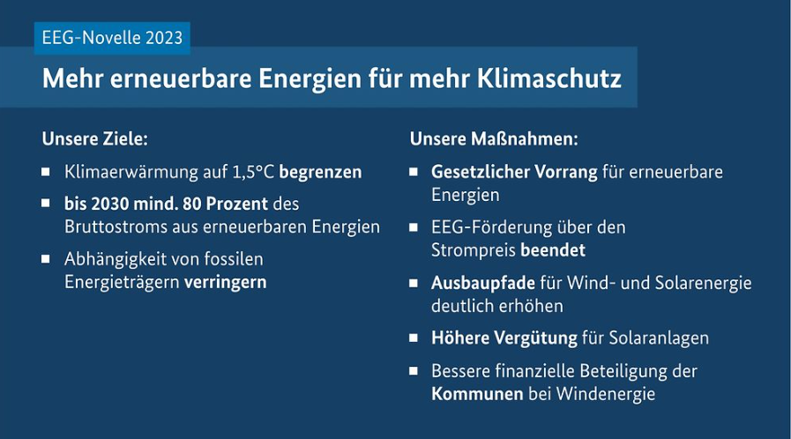
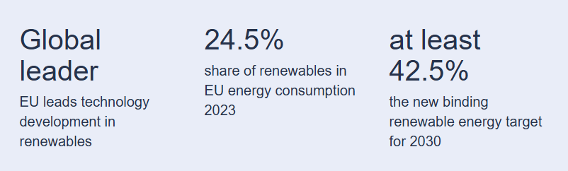
Motivation
Energy transition is one of the key pillars in achieving climate goals
Erneuerbaren-Energien Gesetz (EEG), Germany
EU Renewable Energy Directive, revised in 2023
European Commission (2024)
Bundesregierung (2023)
The energy transition is one of the key drivers for mitigating climate change, especially the expansion of renewable energy like wind and solar (Caldés et al., 2009; Corona et al., 2016; Stamopoulos et al., 2021)
The transition triggers macroeconomic shifts by creating new industries, reshaping value chains, and fostering opportunities for economic growth (Lehr et al., 2012; Garrett-Peltier, 2017; Gelo et al., 2021)
Different regions have varying conditions and outcomes for renewable energy adoption ​(Lutz et al., 2017; Sievers et al., 2019)​

Slide 4
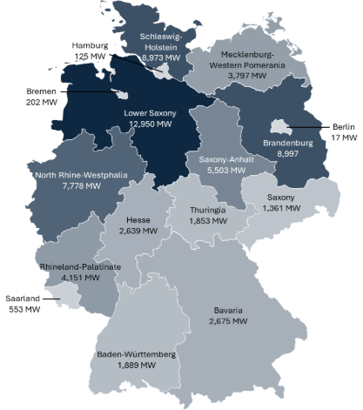

Background
Lower Saxony is one of the pioneers in the wind energy production
Second-largest federal state by land area located in northern Germany, featuring vast flat landscapes and direct access to the North Sea coast (State of Lower Saxony, n.d., Kosmos, 2022)
Goal to reach climate-neutrality by 2040 (Niedersächsischer Landtag, 2023)
Lower Saxony produced more renewable energy than it consumed in 2023 (Niedersächsisches Ministerium für Umwelt, Energie und Klimaschutz, 2024)​
with approximately 20% of the nationally installed wind energy capacity is located in Lower Saxony and its objective is to further expand this capacity to 20 GW by 2035​ (Niedersächsisches Ministerium für Umwelt, Energie und Klimaschutz, 2024)​
Installed onshore wind power capacity in Germany in 2024
(Quentin, 2025)

Slide 5
Background
Regional analyses of energy transition impacts are missing
State of research:
  Broad literature on economic potential and impacts of renewable energy and other clean technologies on national level ​(Allan et al., 2020; Nasirov et al., 2021, Gupta et al., 2023)
  Few regional studies: Hessen, Schleswig-Holstein, Saxony-Anhalt (Hirschl et al., 2010; Bröcker et al., 2014)
Research gaps:
  Few analyses of clean technologies on regional level; most are outdated ​(Raupach-Sumiya et al., 2015)
  Little to no research on Lower Saxony and lack of recent regional datasets ​(DIW, Econ, 2014; Stöver, 2018)
Research Questions
  To what extent is the economic footprint of wind power influenced by the underlying data sources?
  How do economic multipliers of wind power differ by technology, lifetime phase, and effect type?
  What are the economic and environmental impacts of regional wind power expansion?
Notes:
However, due to time constraints, I would like to shed light on the question how important the integration of regional data is

Slide 6

Methodology
Construction of a RIOT
Non-survey approach using given data from the Statistical Office of Lower Saxony (LSN) and the established regionalization method CHARM by Kronenberg (2009)
Aggregation level of 72 industries,
according to the national IOT
for the year 2019
Schematic Overview of the RIOT Framework with Calculation Steps (Own illustration)

Slide 7
Methodology
Construction of a RIOT
Non-survey approach using given data from the Statistical Office of Lower Saxony (LSN) and the established regionalization method CHARM by Kronenberg (2009)
I: Production Value
  Adjusting LSN data from WZ* to CPA** using national assumptions
Schematic Overview of the RIOT Framework with Calculation Steps (Own illustration)
*WZ = Wirtschaftszweige
**CPA = Classfication of Products by Activity

Slide 8
Methodology
Construction of a RIOT
Non-survey approach using given data from the Statistical Office of Lower Saxony (LSN) and the established regionalization method CHARM by Kronenberg (2009)
I: Production Value
  Adjusting LSN data from WZ to CPA using national assumptions
II: Value-added
  Converting LSN data from WZ to CPA with optimization
Schematic Overview of the RIOT Framework with Calculation Steps (Own illustration)

Slide 9
Methodology
Construction of a RIOT
Non-survey approach using given data from the Statistical Office of Lower Saxony (LSN) and the established regionalization method CHARM by Kronenberg (2009)
I: Production Value
  Adjusting LSN data from WZ to CPA using national assumptions
II: Value-added
  Converting LSN data from WZ to CPA with optimization
III: Intermediate Demand
  Derived from I-II + national assumptions
Schematic Overview of the RIOT Framework with Calculation Steps (Own illustration)

Slide 10
Methodology
Construction of a RIOT
Non-survey approach using given data from the Statistical Office of Lower Saxony (LSN) and the established regionalization method CHARM by Kronenberg (2009)
I: Production Value
  Adjusting LSN data from WZ to CPA using national
  assumptions
II: Value-added
  Converting LSN data from WZ to CPA with optimization
III: Intermediate Demand
  Derived from I-II + national assumptions
IV: Public Consumption
  Total values available + national distribution assumptions
Schematic Overview of the RIOT Framework with Calculation Steps (Own illustration)

Slide 11
Methodology
Construction of a RIOT
Non-survey approach using given data from the Statistical Office of Lower Saxony (LSN) and the established regionalization method CHARM by Kronenberg (2009)
I: Production Value
  Adjusting LSN data from WZ to CPA using national
  assumptions
II: Value-added
  Converting LSN data from WZ to CPA with optimization
III: Intermediate Demand
  Derived from I-II + national assumptions
IV: Public Consumption
  Total values available + national distribution assumptions
V: Private Consumption
  Based on Household Budget Survey according to Stöver
  (2018) and Optimization
Schematic Overview of the RIOT Framework with Calculation Steps (Own illustration)

Slide 12
Methodology
Construction of a RIOT
Non-survey approach using given data from the Statistical Office of Lower Saxony (LSN) and the established regionalization method CHARM by Kronenberg (2009)
I: Production Value
  Adjusting LSN data from WZ to CPA using national assumptions
II: Value-added
  Converting LSN data from WZ to CPA with optimization
III: Intermediate Demand
  Derived from I-II + national assumptions
IV: Public Consumption
  Total values available + national distribution assumptions
V: Private Consumption
  Based on Household Budget Survey according to Stöver (2018) and Optimization
VI: Taxes
  Calculated from total LSN value + residuum
Schematic Overview of the RIOT Framework with Calculation Steps (Own illustration)

Slide 13
Methodology
Construction of a RIOT
Non-survey approach using given data from the Statistical Office of Lower Saxony (LSN) and the established regionalization method CHARM by Kronenberg (2009)
I: Production Value
  Adjusting LSN data from WZ to CPA using national assumptions
II: Value-added
  Converting LSN data from WZ to CPA with optimization
III: Intermediate Demand
  Derived from I-II + national assumptions
IV: Public Consumption
  Total values available + national distribution assumptions
V: Private Consumption
  Based on Household Budget Survey according to Stöver (2018) and Optimization
VI: Taxes
  Calculated from total LSN value + residuum
VII: Exports & Imports
  CHARM by Kronenberg (2009)
Schematic Overview of the RIOT Framework with Calculation Steps (Own illustration)

Slide 14
Methodology
Construction of a RIOT
Non-survey approach using given data from the Statistical Office of Lower Saxony (LSN) and the established regionalization method CHARM by Kronenberg (2009)
I: Production Value
  Adjusting LSN data from WZ to CPA using national assumptions
II: Value-added
  Converting LSN data from WZ to CPA with optimization
III: Intermediate Demand
  Derived from I-II + national assumptions
IV: Public Consumption
  Total values available + national distribution assumptions
V: Private Consumption
  Based on Household Budget Survey according to Stöver (2018) and Optimization
VI: Taxes
  Calculated from total LSN value + residuum
VII: Exports & Imports
  CHARM by Kronenberg (2009)
VIII: Total Final Demand
  Aggregation of all demand accounts
Schematic Overview of the RIOT Framework with Calculation Steps (Own illustration)

Slide 15

Results
Lower Saxony‘s economy 2019
A key challenge to wind energy modelling within an IO framework is the absence as a distinct industry in economic statistics
​(Garrett-Peltier 2017)​
GDP (at basic prices): 280 billion euros
Manufacturing and services make up 52% and 40% of the total prouction value
*in 1,000 EUR₂₀₁₉

Slide 16
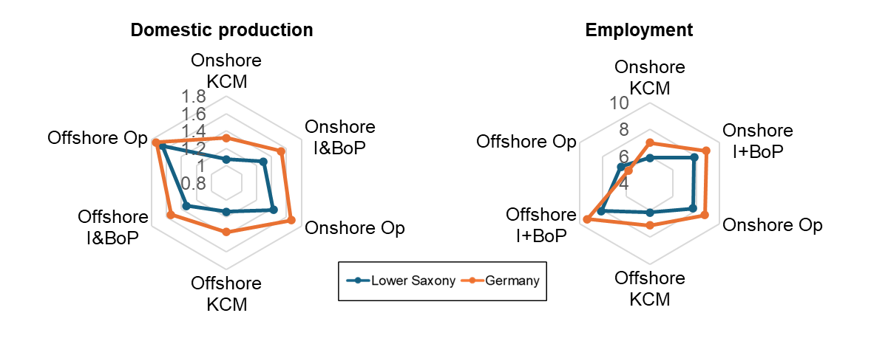
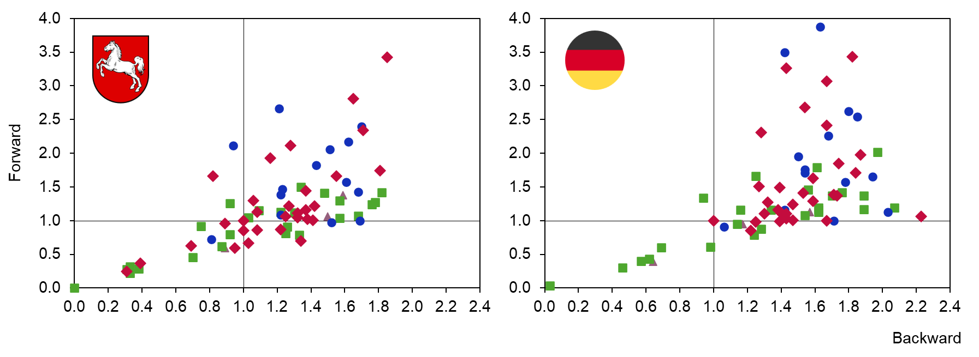
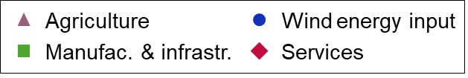
Results
The economic potential of wind power is higher on national level
Comparison of regional and national level (synthetic-industry-based)
Most multipliers higher on national level
  Exception: Employment in Offshore Operation, may be due to Lower Saxony’s coastal access which is not the case for most federal states in Germany
Germany with stronger backward linkages for wind power activities
Highlighting the relevance of regionalized datasets (national average not sufficient)
Type I multipliers for domestic production and employment
Notes:
Kommentar Etti:
- Kritische Reflexion zum ersten Punkt?
Letzten Punkt plausible erklären
Consequently, these findings should not lead to the conclusion that Lower Saxony cannot benefit from wind power. Instead, the comparison underlines that national datasets are insufficient for regional analyses on RES, as they would lead to a massive overestimation of wind power multipliers [2].

Slide 17
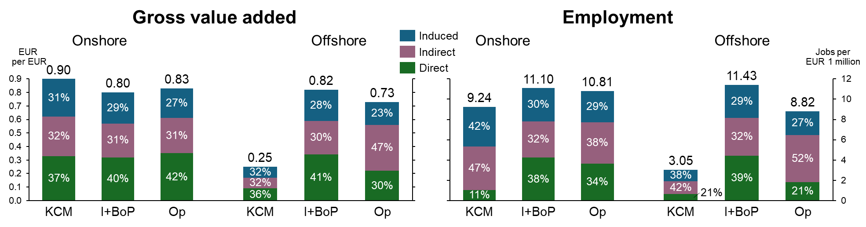
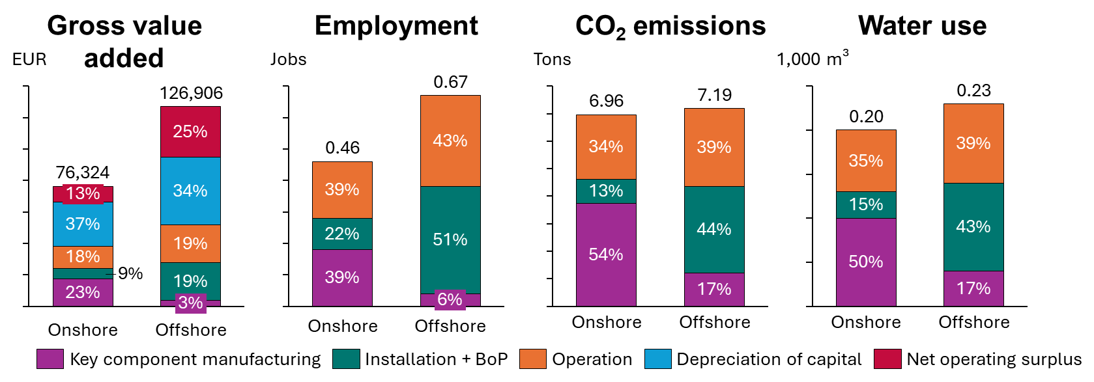
Results
Disaggregation shows differences across phases and technologies
Regional economic and environmental impacts with technological and lifetime phase differentiation (full inclusion)
Strongest GVA for onshore KCM; strongest employment effect for offshore installation & BoP
Relevance of income-induced effects (23-42%)
Ecological indicators only cover effect within Lower Saxony, not along entire supply chain
Direct, indirect and induced multipliers for GVA and employment for wind power demand stimulus
Type II effects per GWh electricity generated from wind power
KCM = Key component manufacturing I+BoP = Installation + Balance of Plant
Op = Operation

Slide 18



Conclusion
The two datasets enable future research on Lower Saxony‘s economy
Policy implication:
Promote the collection and availability of regional data for economic analyses
Critical assessment of national studies when deriving regional policies, as regional characteristics may be overlooked
Limitations:
Confined to a single region
  quantitative results are strongly context-specific and depend on regional characteristics
Highly dependent on available input data
Future research:
Comparative analyses across federal states
Extending the analysis on further (new) industries
Database can be used in further models e.g. analyzing different policy measures

Slide 19

Thank you for your attention!
Contact:
Dilan Türk
tuerk@iuw.uni-hannover.de

Slide 20
Sources
Allan, Grant; Comerford, David; Connolly, Kevin; McGregor, Peter; Ross, Andrew G. (2020): The economic and environmental impacts of UK offshore wind
development: The importance of local content. In Energy 199, p. 117436. DOI: 10.1016/j.energy.2020.117436.
Bundesregierung (2023). Amendment to the EEG Act 2023. Retrieved on [22.03.2025], from https://www.bundesregierung.de/breg-de/aktuelles/novelle-eeg-gesetz-2023-2023972
DIW Econ (2014): Die ökonomische Bedeutung der Windenergie. Windenergie an Land in den Bundesländern Bremen und Niedersachsen.
Bröcker, Johannes; Burmeister, Johannes; Preißler-Jebe, Jan Hendrik; Alberty, Franka (2014): Wertschöpfungs- und Beschäftigungseffekte als Folge des Ausbaus Erneuerbarer Energien in Schleswig-Holstein.
Caldés, N.; Varela, M.; Santamaría, M.; Sáez, R. (2009): Economic impact of solar thermal electricity deployment in Spain. In Energy Policy 37 (5), pp. 1628–1636. DOI: 10.1016/j.enpol.2008.12.022.
Corona, Blanca; La Rúa, Cristina de; San Miguel, Guillermo (2016): Socio-economic and environmental effects of concentrated solar power in Spain: A multiregional input output analysis. In Solar Energy Materials and Solar Cells 156, pp. 112–121. DOI: 10.1016/j.solmat.2016.03.014.
Dettmer, Bianka; Sauer, Thomas (2014): Regionalökonomische Auswirkungen eines geplanten Pumpspeicherkraftwerks: Eine Input-Output-Analyse für den Freistaat Thüringen. In Z Energiewirtsch 38 (4), pp. 255–268. DOI: 10.1007/s12398-014-0138-8.
European Commission (2024). Renewable Energy Directive – Targets and Rules. Retrieved on [22.03.2025], from https://energy.ec.europa.eu/topics/renewable-energy/renewable-energy-directive-targets-and-rules/renewable-energy-directive_en
Garrett-Peltier, Heidi (2017): Green versus brown: Comparing the employment impacts of energy efficiency, renewable energy, and fossil fuels using an input-output model. In Economic Modelling 61, pp. 439–447. DOI: 10.1016/j.econmod.2016.11.012.
Gelo, Tomislav; Šimurina, Nika; Šimurina, Jurica (2021): The Economic Impact of Investment in Renewables in Croatia by 2030. In Energies 14 (24), p. 8215. DOI: 10.3390/en14248215.
Gronau, Steven; Hoelzen, Julian; Mueller, Tobias; Hanke-Rauschenbach, Richard (2023): Hydrogen-powered aviation in Germany: A macroeconomic perspective and methodological approach of fuel supply chain integration into an economy-wide dataset. In International Journal of Hydrogen Energy 48 (14), pp. 5347–5376. DOI: 10.1016/j.ijhydene.2022.10.168.
Gupta, Ruchi; Guibentif, Thomas M.M.; Friedl, Markus; Parra, David; Patel, Martin Kumar (2023): Macroeconomic analysis of a new green hydrogen industry using Input-Output analysis: The case of Switzerland. In Energy Policy 183, p. 113768. DOI: 10.1016/j.enpol.2023.113768.
Hirschl, Bernd; Heinbach, Katharina; Prahl, Andreas; Salecki, Steven; Schröder, André; Aretz, Astrid; Weiß, Julika (2010): Wertschöpfung durch Erneuerbare Energien. Ermittlung der Effekte auf Länder- und Bundesebene. Berlin: Institut für ökologische Wirtschaftsforschung (IÖW) (Schriftenreihe des IÖW, 210).
Kosmos (2022). Der neue Kosmos Welt-Almanach und –Atlas 2023. Daten. Fakten. Karten. Stuttgart, Deutschland. KOSMOS.
Kost, C., Schlegl, T. (2018) Stromgestehungskosten erneuerbare Energien (März 2018). Fraunhofer ISE; Fraunhofer ISE: Studie:

Slide 21
Sources
Kronenberg, Tobias (2009): Construction of Regional Input-Output Tables Using Nonsurvey Methods.
In International Regional Science Review 32 (1), pp. 40–64. DOI: 10.1177/0160017608322555.
Lehr, Ulrike; Lutz, Christian; Edler, Dietmar (2012): Green jobs? Economic impacts of renewable energy in Germany.
In Energy Policy 47, pp. 358–364. DOI: 10.1016/j.enpol.2012.04.076.
Leontief, Wassily W. (1936): Quantitative Input and Output Relations in the Economic Systems of the United States. In The Review of Economics and Statistics 18 (3), pp. 105–125. Available online at http://www.jstor.org/stable/1927837.
Leontief, Wassily W. (1951): Input-Output Economics. In Scientific American 185 (4). Available online at https://www.jstor.org/stable/10.2307/24945285.
Lutz, Lotte Marie; Fischer, Lisa-Britt; Newig, Jens; Lang, Daniel Johannes (2017): Driving factors for the regional implementation of renewable energy ‐ A multiple case study on the German energy transition. In Energy Policy 105, pp. 136–147. DOI: 10.1016/j.enpol.2017.02.019.
Mueller, Tobias; Winter, Etti; Grote, Ulrike (2024): Economic impacts of power-to-liquid fuels in aviation: A general equilibrium analysis of production and utilization in Germany. In Energy Conversion and Management: X 23, p. 100632. DOI: 10.1016/j.ecmx.2024.100632.
Niedersächsischer Landtag, of 6/13/2023, case number 19/1598.
Niedersächsisches Ministerium für Umwelt, Energie und Klimaschutz (2024): Energiewendebericht 2023. Hannover, Germany.
Nasirov, Shahriyar; Girard, Aymeric; Peña, Cristobal; Salazar, Felipe; Simon, François (2021): Expansion of renewable energy in Chile: Analysis of the effects on employment. In Energy 226, p. 120410. DOI: 10.1016/j.energy.2021.120410.
Raupach-Sumiya, Jörg; Matsubara, Hironao; Prahl, Andreas; Aretz, Astrid; Salecki, Steven (2015): Regional economic effects of renewable energies - comparing Germany and Japan. In Energ Sustain Soc 5 (1). DOI: 10.1186/s13705-015-0036-x.
Sievers, Luisa; Breitschopf, Barbara; Pfaff, Matthias; Schaffer, Axel (2019): Macroeconomic impact of the German energy transition and its distribution by sectors and regions. In Ecological Economics 160, pp. 191–204. DOI: 10.1016/j.ecolecon.2019.02.017.
Stamopoulos, Dimitrios; Dimas, Petros; Sebos, Ioannis; Tsakaniskas, Aggelos (2021): Does Investing in Renewable Energy Sources Contribute to Growth? A Preliminary Study on Greece's National Energy and Climate Plan. In Energies 2021 (14), Article 8537. Available online at https://doi.org/10.3390/en14248537.
State of Lower Saxony (n.d.). Knowledge for Children. Retrieved on [22.03.2025], from https://www.niedersachsen.de/kinder/sachwissen/
Stöver, Britta (2018): The local impact and multiplier effect of universities in Lower Saxony on the labour market. In Hannover Economic Papers (646).

Slide 22
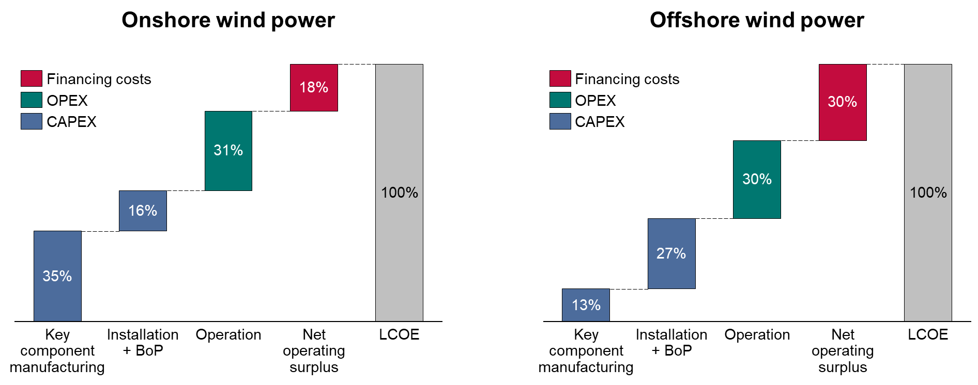
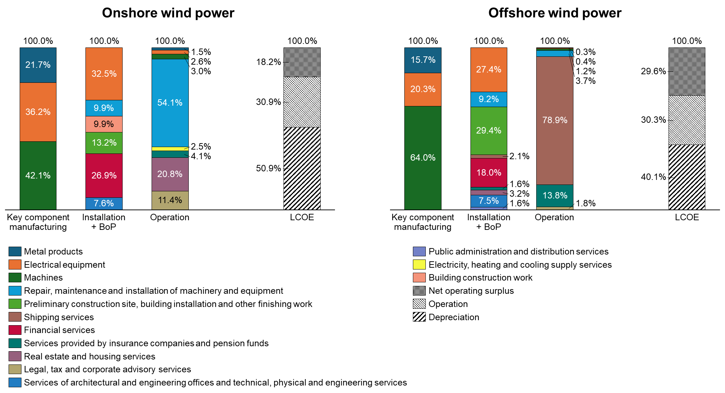
Methods & Data
We integrated wind power as novel sectors into the initial rIOT
Integration process
Definition of wind power sector(s)
  Onshore/offshore separation
  Transformation of CAPEX and OPEX
  into three lifetime phases
  Additional sector for electricity generation
Construction of synthetic industries
for wind power sectors
  Supply chain analysis on cost components
  of wind power sectors
  Mapping of cost components to rIOT sectors
  and derivation of production input structure
Cost breakdown in the phase-differentiated approach (data from Kost et al. (2018); Stehly et al. (2020))

Slide 23

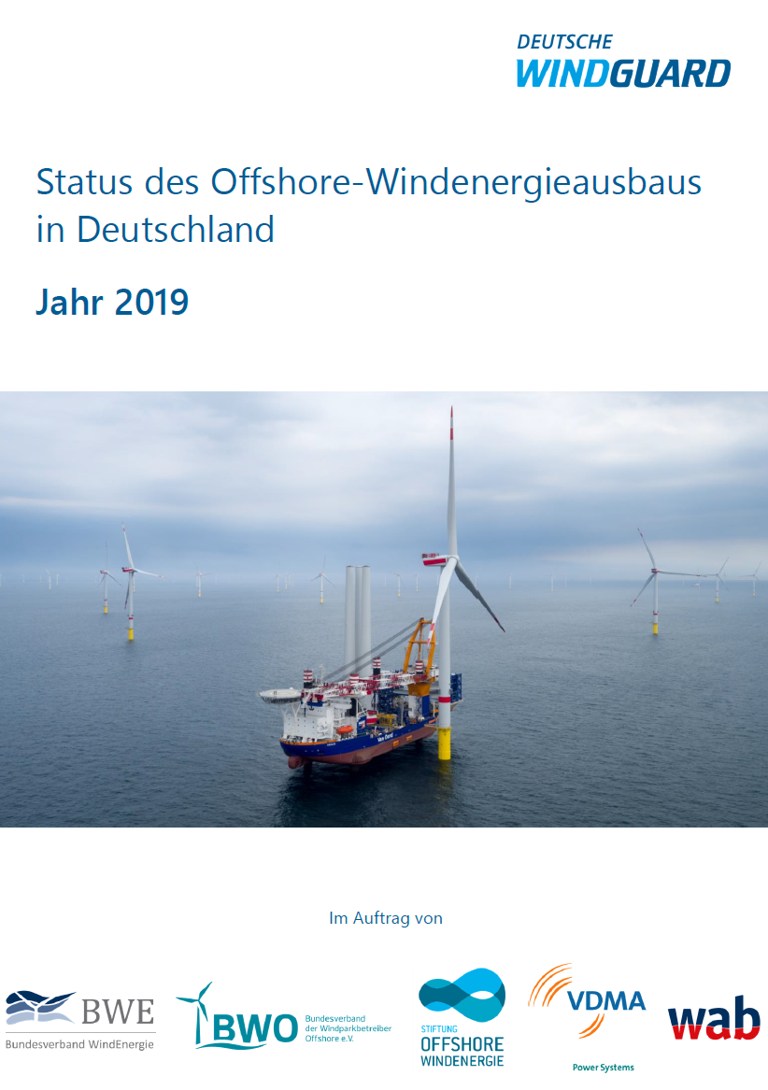







Methods & Data
We integrated wind power as novel sectors into the initial rIOT
Integration process
Full inclusion and rebalancing
of the rIOT
  Extraction of wind energy based on
  publicly available data (focus on
  key component manufacturing)
  Rebalancing with GRAS method
Annual report

Slide 24
Results
The economic potential of wind power is higher on national level
Comparison of regional and national level (synthetic-industry-based)
Most multipliers higher on national level
  Exception: Employment in Offshore Operation, may be due to Lower Saxony’s coastal access which is not the case for most federal states in Germany
Germany with stronger backward linkages for wind power activities
Relevance of regionalized datasets (national average not sufficient)
Type I multipliers for domestic production and employment
Notes:
Kommentar Etti:
- Kritische Reflexion zum ersten Punkt?
Letzten Punkt plausible erklären
Consequently, these findings should not lead to the conclusion that Lower Saxony cannot benefit from wind power. Instead, the comparison underlines that national datasets are insufficient for regional analyses on RES, as they would lead to a massive overestimation of wind power multipliers [2].

Slide 25
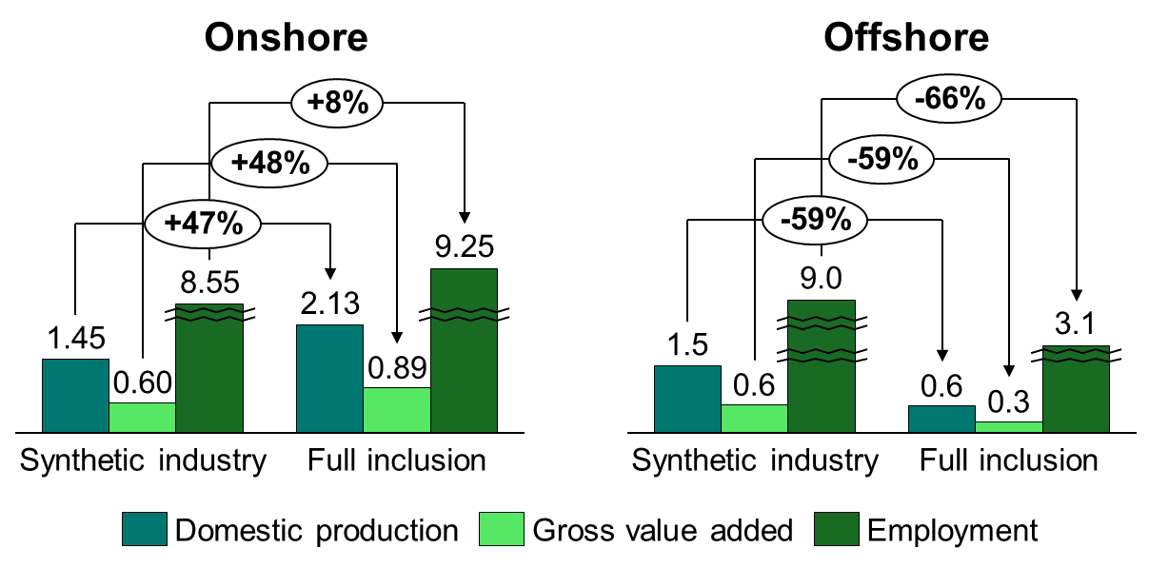
Results
IO results vary with modelling approach – especially in specialized industries
Comparison between synthetic-industry-based and full inclusion multipliers
Strong differences between multipliers
Onshore wind power with more domestic production
Relevance of including sectoral data of highly specialized industries (wind turbine manufacturing)
Type II multipliers of key component manufacturing phase for onshore and offshore wind power

