Slide 1

Combining agent-based and input–output modelling in economics
The Multi-Agent Input–Output
(MAIO) Framework
Marco Raberto¹ Marcello Nieddu² Andrea Teglio²
¹ DIME, University of Genoa, Italy
² Department of Economics, Ca' Foscari University of Venice, Italy
32nd IIOA Conference & 11th SHAIO Conference
Parallel Session 9 — Input–Output Theory & Methodology
Seville, Spain · 26 June 2026

Slide 2

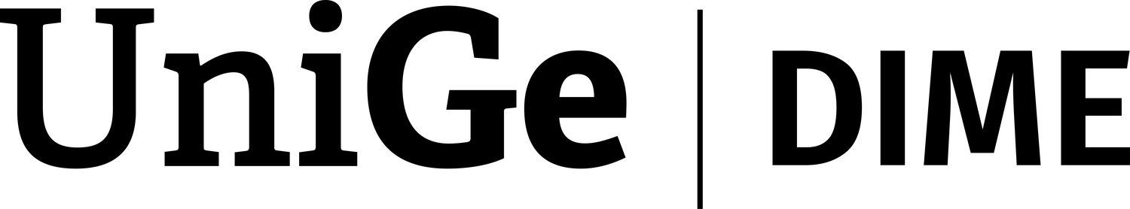
Outline
1
Motivation
From input–output accounting to a multi-agent economy
2
The MAIO framework
MAIO1, its analytical benchmark, and MAIO2
3
Application: Italy's energy transition
Calibrating MAIO to Italy and the PNIEC experiment
4
Results
Macro, sectoral and distributional effects
2 / 37

Slide 3
1
Motivation
From two modelling traditions to one integrated framework
3 / 37

Slide 4
Two modelling traditions — and the gap
Input–output accounting and agent-based behaviour — why neither alone suffices
Input–Output analysis
Rigorous inter-sectoral accounting; multipliers along supply chains. But final demand is exogenous and behaviour is sector-average.
Agent-Based models
Heterogeneous, boundedly-rational agents; out-of-equilibrium dynamics. But often without stock-flow-consistent sectoral accounting.
The gap
No framework couples inter-sectoral IO accounting with heterogeneous households, endogenous demand and SFC consistency.
MAIO
Embeds an agent-based architecture inside a fully calibrated IO accounting structure — anchored to harmonised IO tables (EXIOBASE, Eurostat SUTs).
4 / 37

Slide 5
The sequence: properties and design dimensions
The framework as a research programme: each term relaxes one restriction at a time, in a controlled way
Four properties of the programme
Three dimensions of model design
(1)
Heterogeneity preserved
A
Agent configurations
Agents, sectors, networks are explicit; complex factors are not neutralised by construction.
A1 — single household · A2 — one KAU per sector · A3 — one KAU per firm
(2)
Tractable benchmark
Relaxing A introduces multiplicity and heterogeneity.
At least one term admits a closed-form steady-state characterisation under explicit restrictions.
B
Behavioural restrictions
B1 fixed prices · B2 naive expectations · B3 no inventory targets · B4 no supplier switching
(3)
Aggregation conditions
Relaxing B activates dynamic mechanisms.
Explicit criteria identify when macro coincides with micro — and when it does not.
C
Dynamic regimes
(4)
Nested extensions
C1 no input shortage · C2 no demand rationing · C3 no money constraint
Each later term relaxes one restriction at a time → comparability across models in the sequence.
C-conditions classify regimes; rationing breaks linearity.
MAIO1 sits at A1·A2·A3 / B1–B4 / C1·C2·C3 — the most restricted starting point: linear, autonomous, fully tractable.
It also answers Sims’s “wilderness of bounded rationality” critique (1980): the sequence makes each non-equilibrium choice comparable, not arbitrary.
5 / 37

Slide 6
The MAIO sequence: MAIO1 → MAIO2 → MAIO3
One programme, three nested models — each relaxing one restriction at a time
01
02
03
MAIO1 · tractable benchmark
MAIO2 · institutional economy
MAIO3 · coupled transitions
Linear input–output economy with explicit ownership and purchasing networks; admits a closed-form steady state (Perron–Frobenius). The reference point of the sequence.
Adds Government, Bank and Rest of World, and enriches firms with labour, capital and credit — still anchored by a closed-form benchmark under explicit restrictions.
Couples the energy strand (MAIO-EN) with the AI strand (MAIO-AI): the twin AI–energy transition — the next term of the sequence.
Each term relaxes one restriction at a time, so micro–macro gaps stay auditable rather than arbitrary.
MAIO2 is the model we put to work on Italy’s energy transition —
an application, not the purpose of the programme.
6 / 37

Slide 7
2
The MAIO framework
MAIO1, its analytical benchmark, and the extension to MAIO2
7 / 37

Slide 8
MAIO1: two networks — ownership and purchasing
Ownership routes income · purchasing routes goods · together they make MAIO1 a heterogeneous IO economy
Ownership network — income flow
Purchasing network — buyer→seller
Example: N_{H} = 2, N_{F} = 3, N_{K} = 6, N_{A} = 3
Distinct from the ownership network. Endogenous: it reconfigures under rationing.
HHs
Firms
KAUs
k1
Households (final demand)
αᵢ,ₕ : share of household h's budget on commodity i, Σᵢ αᵢ,ₕ = 1
Each h has a preferred KAU per commodity; rationed demand cascades down a price-ordered list
f1
h1
1.0
k2
0.5
KAUs (intermediate demand)
k3
Cⱼ,ᵢ : technical coefficient (units of input j per unit of output i) — same form as standard IO
Matrix shape Nₐ × Nₖ : multiple KAUs per sector are allowed
Same protocol as households: preferred supplier per commodity, rationing redirects to alternatives
f2
0.2
k4
h2
0.5
f3
k5
0.8
Endogenous network. Repeated rationing triggers supplier switching; the buyer-seller graph evolves with the dynamics.
k6
Agric.
Mining
Processing
Y = S · Ω · π
8 / 37

Slide 9
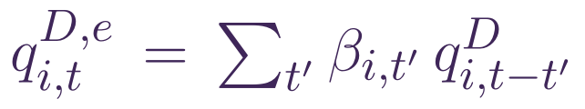
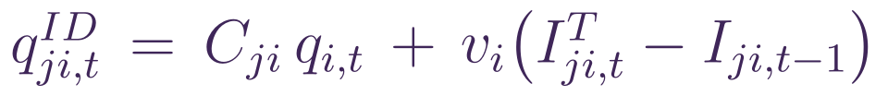
Production with Leontief technology and inventories
Three-step planning per period: expectations → output planning → input demand. Inventories are the buffer that allows out-of-equilibrium dynamics
1
Form expectations
2
Plan production
3
Plan input purchases
Each KAU forecasts demand from past data. β-coefficients allow naive expectations, moving averages, or regression. In the baseline (B2): naive — βᵢ,₁=1, all others 0.
Production plan = expected demand + own-stock restocking, scaled by 1 minus the share of own output used internally as input. vᵢ is the speed of inventory adjustment toward target Iᵀ.
For each input j the demand has two components: current usage (Leontief) plus the gap between target and current stock, closed at speed vᵢ.
Why inventories matter. They are the structural device that allows MAIO1 to operate out of equilibrium: without inventories, planning and realisation would have to coincide period by period — and the model would collapse to a Walrasian closure.
9 / 37

Slide 10
The decentralised market protocol
Preferred supplier · rationing · switching → endogenous bilateral network
1
Preferred supplier
Each buyer holds an ordered list of suppliers; demand goes first to the preferred one.
Why this matters
Decentralised exchange is the one complex factor that survives all the B-restrictions.
Under rationing, sales depend on the order of access, and the network reshapes accordingly.
Two switching mechanisms co-exist:
rationing-driven
price-driven (opportunistic)
2
Rationing
If supply falls short, the unmet portion cascades down the list, ordered by price.
3
Switching
When rationed beyond a threshold, a buyer replaces its preferred supplier with the next available one. With small probability, buyers also switch on price.
4
Network reconfiguration
The buyer–seller network evolves endogenously over time.
10 / 37

Slide 11
Behavioural restrictions of the first term
What B1–B4 disable — and why this restricted version is informative
Code
Restriction
What it does
B1
Fixed prices
Prices exogenous, no pricing rule, no markup dynamics.
B2
Naive expectations
Expected demand at t equals realised demand at t−1.
B3
No inventory targets
Stock-adjustment speed v = 0; inputs replenish current consumption.
B4
No supplier switching
Buyers stay with their preferred supplier unless rationed.
Under B1–B4 the model is partially analytically tractable, while heterogeneity and decentralised interaction remain explicit.
11 / 37

Slide 12
The model space — agent configurations × dynamic regimes
A 4×3 grid that organises the entire analysis · we start in the gold cell and relax conditions one at a time
Baseline
(A1·A2·A3)
Multi-HH
(¬A1)
Multi-KAU
(¬A2)
Unconstrained
(C1·C2·C3)
Linear stable
dynamics
Closed-form Y*
Linear stable
dynamics
Linear stable
dynamics
Exp. 1
Exp. 2
Input shortage
(¬C1)
Scaled steady
state Y*·a
Scaled steady
state
Scaled steady
state
Demand rationing
(¬C2)
Adaptation /
Collapse
Distributional
effects
Path
dependency
Money shortage
(¬C3)
Adaptation /
Collapse
Distributional
effects
Path
dependency
We start in the gold cell (A1·A2·A3 + C1·C2·C3 + B1–B4): linear autonomous dynamics, Perron-Frobenius stability, closed-form Y*. Then we relax — A1 first (multiple HH), then A2 (multiple KAUs).
12 / 37

Slide 13
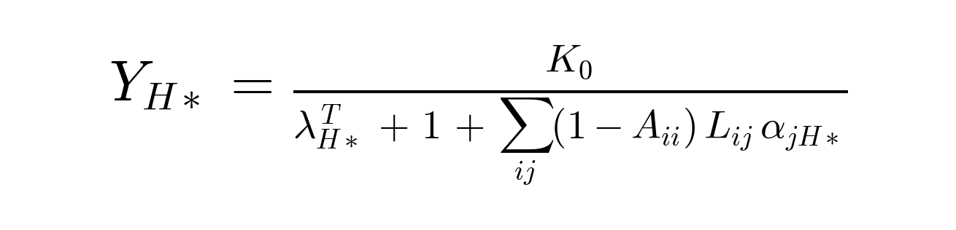
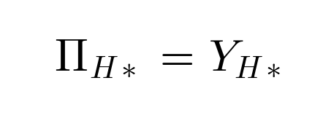
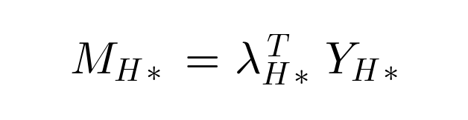
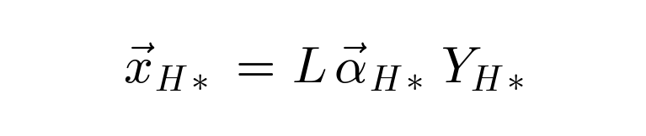
Closed-form steady state
Multi-household submodel: macroscopic parameters at the steady state (λᵀ_H*, α_H*) determine Y_H* — defined as income-share-weighted averages
Income alignment
Wealth target
Production
aggregate consumption equals aggregate income
aggregate wealth at macroscopic target
Leontief identity in macro form
Same Perron–Frobenius argument applies on the enlarged state space: at the steady state, the macroscopic parameters λᵀ_H* and α_H* are constant, so Y_H* admits this closed form even under household heterogeneity.
13 / 37

Slide 14
Two artifact agents
Compressing N households into one — and when this is allowed
Macro propensities are weighted averages of microscopic ones — the choice of weights defines the artifact agent.
Representative Household
RH
Equivalent Household
EH
Definition
Definition
An agent whose parameters are the
arithmetic mean of individual ones.
An agent whose parameters are weighted
by steady-state income shares.
Weights: w_{h} = 1/N_{H} (uniform)
Weights: w_{h} = s_{h*} (income shares)
Steady-state error
Accuracy
ε_{R} ∝ σ_{λ} · σ_{s} · ρ
exact only when ρ = 0 — i.e. parameters uncorrelated
with ownership shares.
Coincides with multi-HH at the steady state by construction.
Reproduces the dynamics only under Strong
Relational Indistinguishability (P3).
→ Exp. 1: vary the correlation ρ
→ Exp. 2: traverse Het. → W.R.I. → S.R.I.
The next slide formalises when each compression is exact (P1, P2, P3); Experiments 1 and 2 then test what happens outside.
14 / 37

Slide 15
When does macro = micro?
Three formal criteria identifying when complex factors can — and cannot — be ignored
P1
P2
P3
Individual
Weak relational
Strong relational
indistinguishability
indistinguishability
indistinguishability
All individual parameters are identical across agents of the same type.
Relational parameters identical (e.g. equal ownership shares Sh = s̄ for every household).
P2 holds, plus the parameters not automatically averaged out by ownership symmetry (e.g. α_h) are also identical across households.
Strongest. Aggregate dynamics independent of network and distribution.
Aggregate parameters become macro-invariant.
Aggregate dynamics decouple from distributional dynamics.
Outside P1–P3, aggregation introduces systematic errors that grow with heterogeneity and correlation — so the distributional effects of a shock like the PNIEC cannot be read off a representative agent.
15 / 37

Slide 16
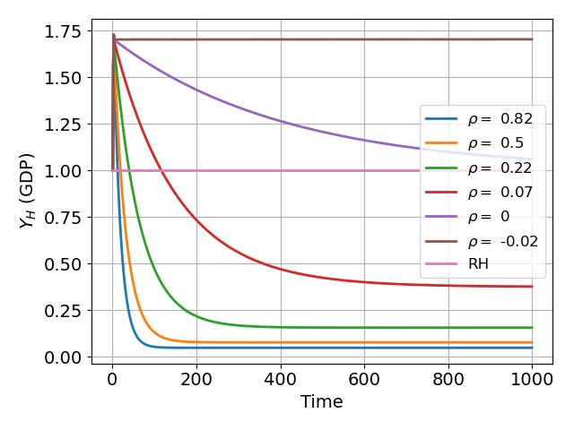
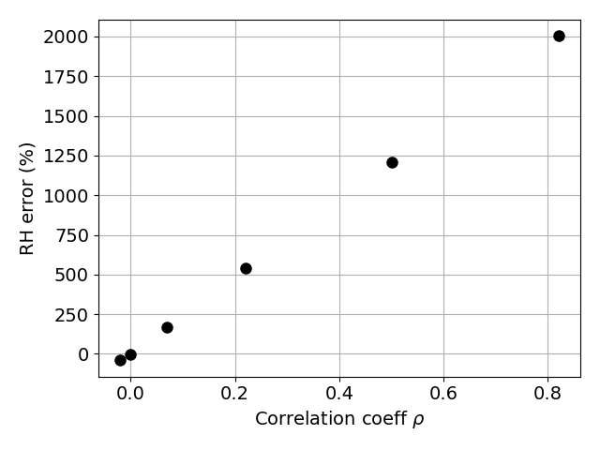
Experiment 1 — Representative-household error
[¬A1 · C1·C2·C3] · 2 sectors · 100 households · 6 models share the same RH by construction · vary correlation ρ between (λ, ξ) and ownership shares
(a) GDP convergence by ρ
(b) Steady-state RH error vs ρ
→
Take-away. Different ρ → distinct steady-state Y* and convergence times. The RH-error grows monotonically with ρ (up to ~2000 %) — confirms the analytical decomposition.
A model where households share the same RH by construction can still produce wildly different macro behaviours: representative-agent reduction is exact only at perfect uncorrelation (ρ = 0). (Figures from MAIO1 paper.)
16 / 37

Slide 17
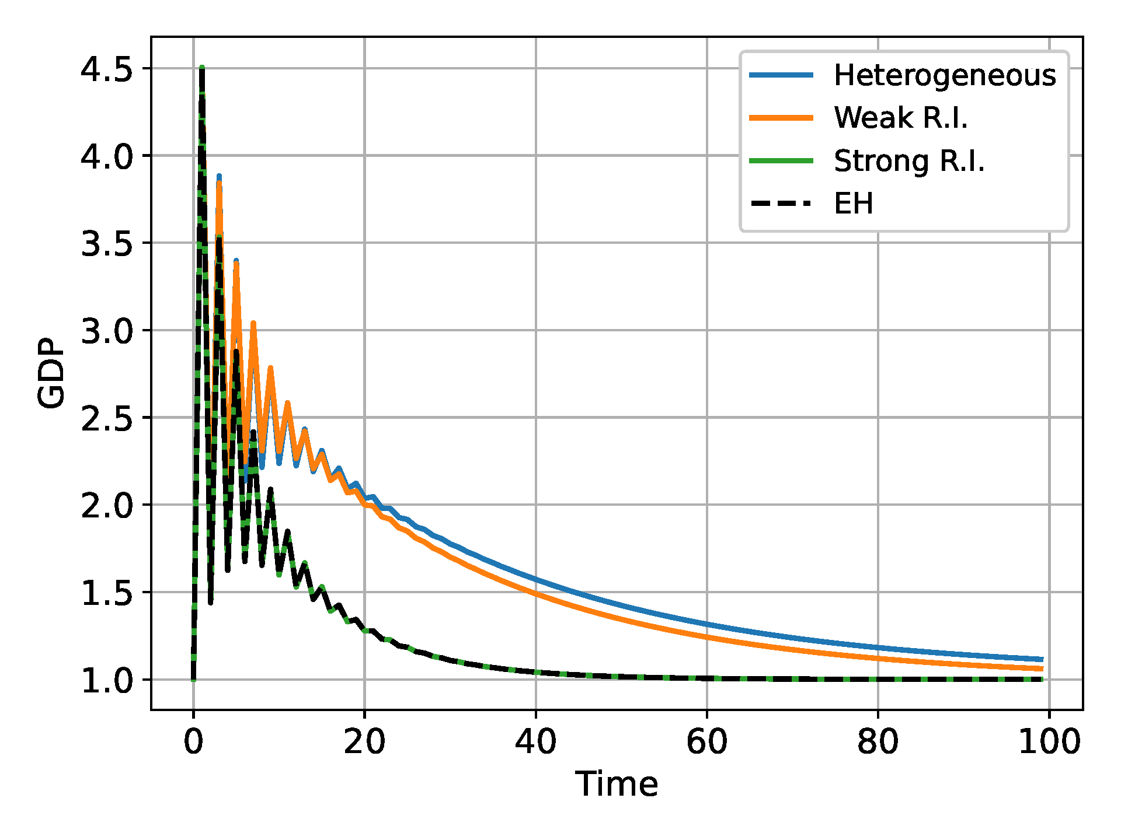
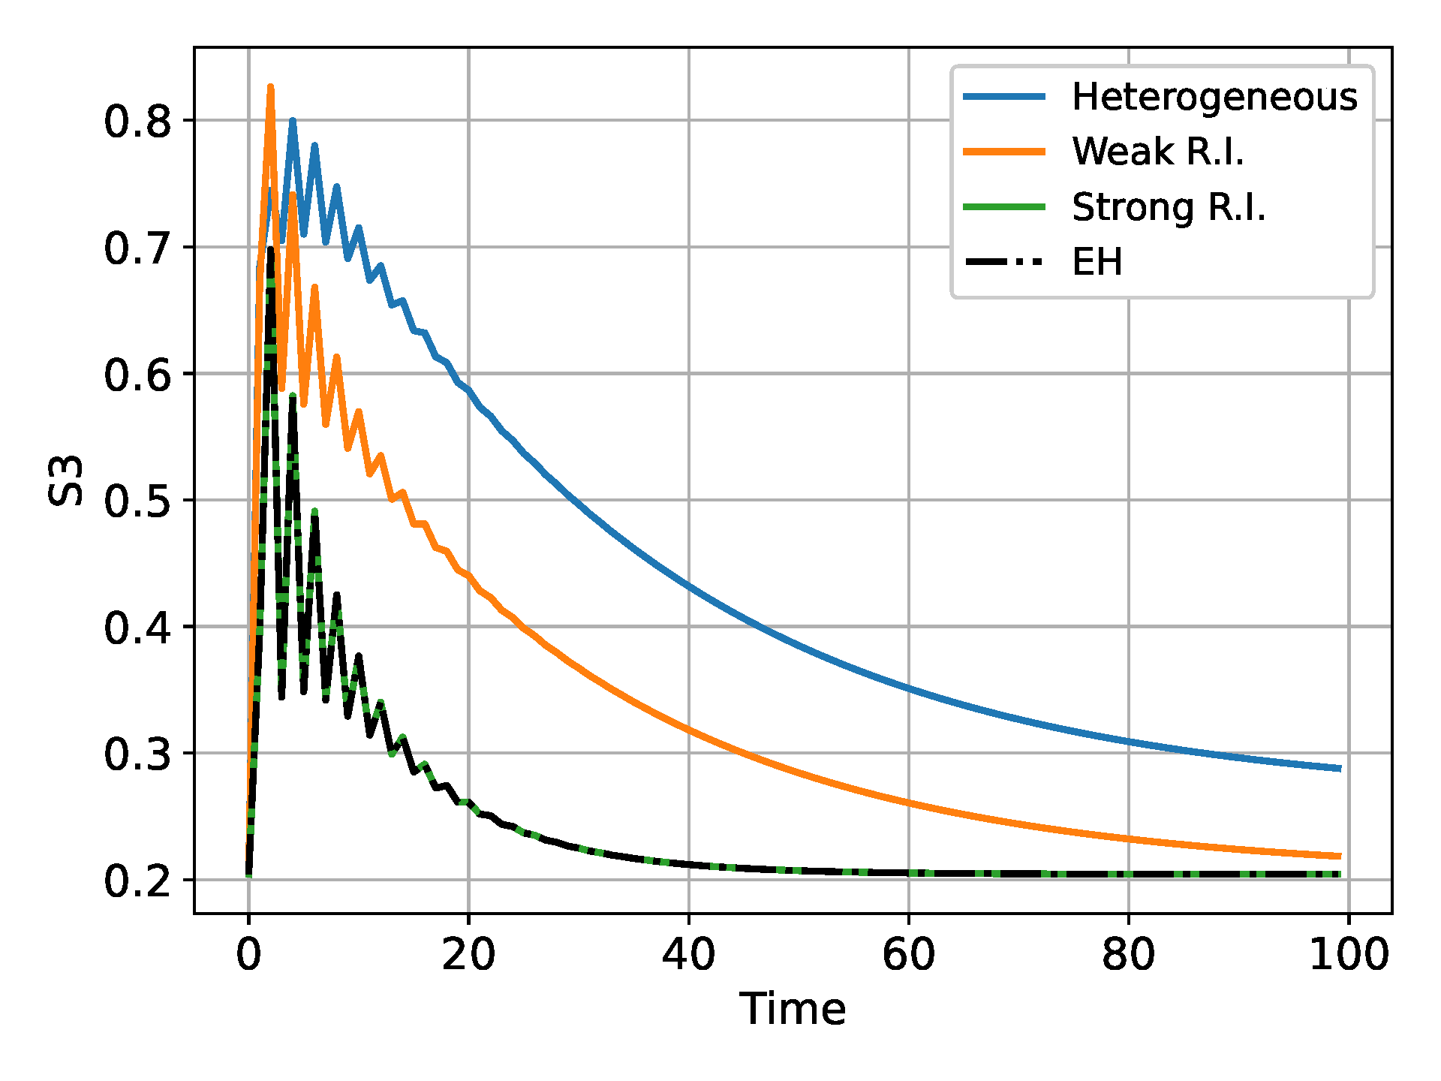
Experiment 2 — Equivalent-household error
[¬A1 · C1·C2·C3] · 3 sectors · 3 households · three models — Heterogeneous, Weak R.I., Strong R.I. — all share the same Equivalent Household
(a) GDP dynamics across the three models
(b) Sector-3 real production
→
Take-away. Equivalent agent (EH, dashed black) reproduces multi-agent dynamics only under Strong Relational Indist. (green): the green and dashed black curves coincide. Otherwise the EH systematically misrepresents both GDP and sectoral aggregates.
The Equivalent Household captures steady-state aggregates exactly, but its dynamic accuracy is confined to the Strong Relational Indistinguishability case. Heterogeneity in households’ ξ and α breaks dynamic equivalence even when the steady states agree.
17 / 37

Slide 18
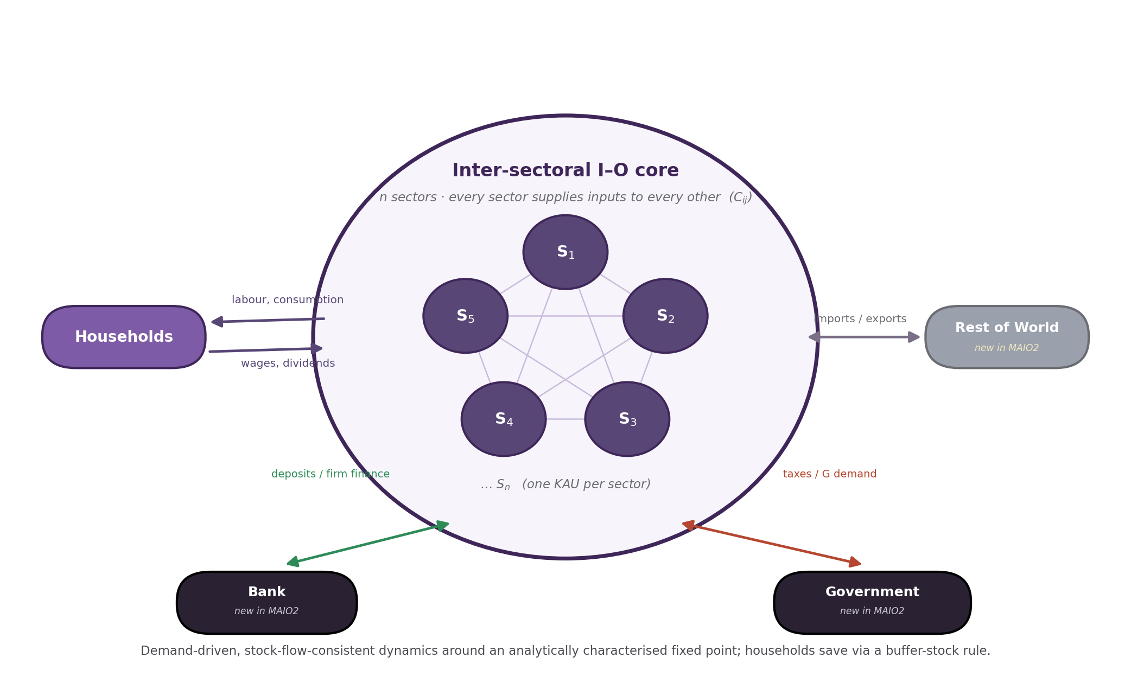
MAIO2: the sectoral core and its new agents
Three new agents — Government, Bank and Rest of World — close the SFC accounting around the inter-sectoral core; firms gain labour, capital and credit
18 / 37

Slide 19
Endogenous demand in the IO network
The key methodological departure from standard input–output analysis
Standard IO
Final demand is exogenous; the Leontief inverse maps a fixed demand vector to output. The multiplier is mechanical.
MAIO — demand feeds back
Incomes generated along supply chains — wages, profits, dividends, transfers — flow back into household consumption, re-activating demand through the same technical coefficients C.
A genuine income–expenditure multiplier
It operates within the IO production network — a channel that traditional IO captures only by assuming exogenous spending profiles.
What it unlocks
Firms adjust plans, inventories and investment to observed demand → endogenous business cycles, rationing episodes, and distributional outcomes.
19 / 37

Slide 20
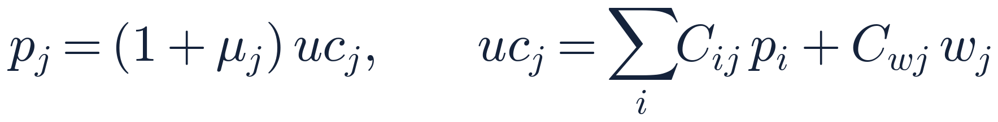
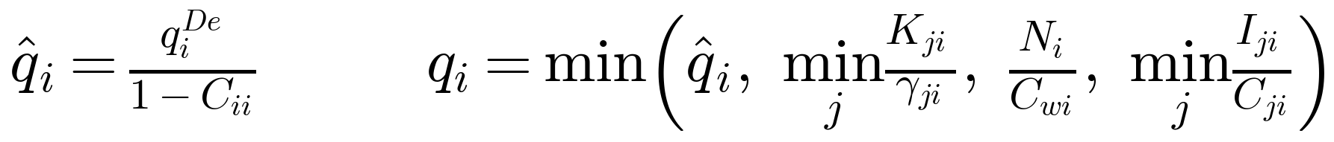
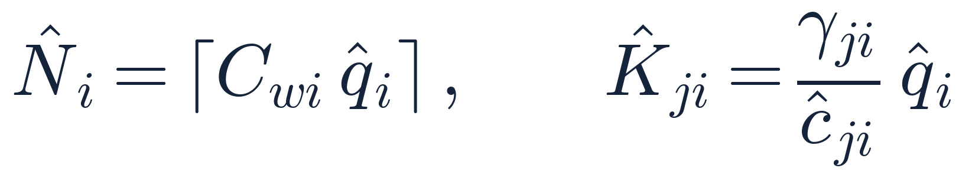
Key behavioural equations — agents’ decision rules
Household consumption — buffer-stock rule
B: consumption budget · Y: disposable income · M: money/wealth
ξ: buffer-stock speed · λ^{T}: target wealth/income · c^{y}, c^{w}: propensities
Pricing — markup over unit cost
p: posted price · μ: markup · uc: unit cost
C: technical coeff. · C_{w}: labour coeff. · w: wage
Planned production — Leontief with three bottlenecks
q̂: planned output · q^{De}: expected demand · C_{ii}: own input · q: realised output
K: capital · γ: capital intensity · N: workers · C_{w}: labour coeff. · I: input inventory
Factor demands — labour and capital
N̂: workers demanded · K̂: target capital
γ: capital intensity · ĉ: target capital utilisation
20 / 37

Slide 21
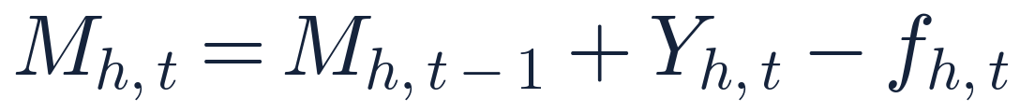
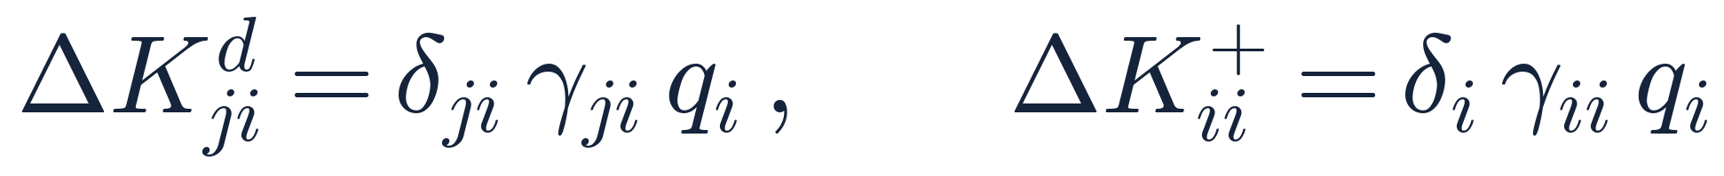
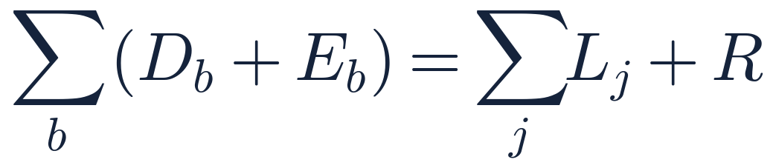
Key balance-sheet and accounting identities
Household money — law of motion
M: household money/deposits · Y: income inflow · f: realised expenditure
Capital — depreciation & own-account formation (production-proportional)
ΔK^{d}: depreciation flow · ΔK⁺: own-account formation
δ: depreciation rate · γ: capital intensity · q: output
Functional income — labour and disposable shares
y_{w}: labour share · d: disposable share · m: output multiplier
θ_{w}, θ_{π}, θ_{F}: tax rates · f_{TU}, t_{c}: transfer / corporate
Stock-flow consistency — bank balance sheet
D: deposits (HH+firms) · E_{b}: bank equity · L: loans · R: reserves
21 / 37

Slide 22
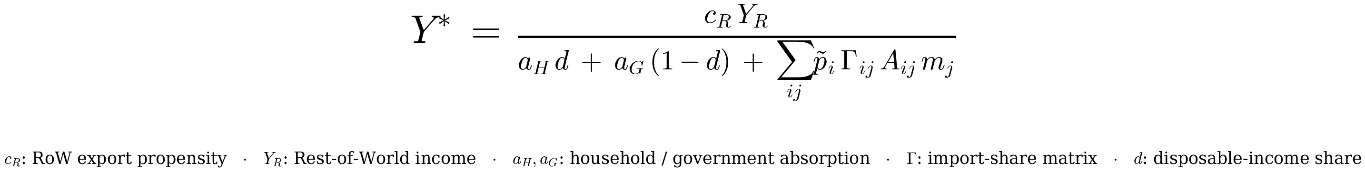
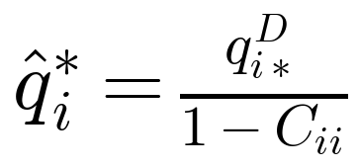
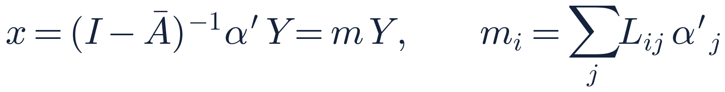
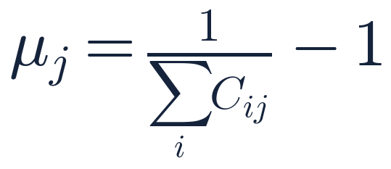
Steady state — benchmark and analytical solution
Benchmark assumptions
• one KAU per sector · identical households · fixed prices (s_{i} = 0)
• naïve expectations · zero target-adjustment speeds · no input shortage / no rationing
• stationary foreign & fiscal sectors · credit-active regime
Aggregate income at the steady state
Gross output at SS
Input–output fixed point
Steady-state markup
q̂*: SS gross output · q^{D}: final demand
C_{ii}: own-commodity loop
x: gross-output vector · Ā: effective coeff. matrix
L=(I−Ā)⁻¹: Leontief inverse · m: multipliers · α′: demand shares
μ_{j}: SS markup
C_{ij}: technical coefficients
22 / 37

Slide 23
3
Application: Italy's energy transition
Calibrating MAIO to Italy and the PNIEC investment experiment
23 / 37

Slide 24
Why the energy transition? A testbed for MAIO2
Italy’s PNIEC investment plan — a shock that is sectoral and distributional at once
01
02
03
The plan
The propagation
The distribution
Italy's NECP (PNIEC) accelerates wind and solar capacity to 2030; the targets translate into a large, multi-year stream of capital-goods investment.
That investment is a demand shock that propagates along inter-sectoral linkages: output, value added and employment respond across all 15 sectors, not only in electricity.
Households differ in income, wealth and ownership, so the same shock reshapes consumption and inequality — aggregate and distributional effects must be read together.
We use this application to test how MAIO2 carries a large investment impulse — across all 15 sectors and across households.
An application, not a goal. A demonstration of the framework on a concrete policy question.
24 / 37

Slide 25
Calibrating MAIO to the Italian economy
Three data sources pin down technology, distribution and sector structure
01
02
03
Inter-industry matrix
Household distribution
Sector aggregation
Technical coefficients from EXIOBASE 3.6 (2020) for Italy: the Leontief structure across the 15 aggregated sectors.
Income and net-wealth distribution by quintile from the Bank of Italy Survey on Household Income and Wealth (2020): five household groups.
200 EXIOBASE sectors aggregated to 15, keeping wind, solar and their capital-goods suppliers distinct.
Pre-shock calibration: the model is set to a steady state reproducing the pre-shock Italian economy.
Benchmark: the closed-form Y* of the restricted regime anchors the calibration.
Scope: a preliminary, qualitative assessment under the model's restrictions — not a precise forecast.
25 / 37

Slide 26
Aggregating Italy to 15 sectors
200 EXIOBASE sectors → 15, keeping the energy transition observable
Capital-goods suppliers (9)
Electricity sectors (3)
P1 Machinery & equipment n.e.c.
P2 Electrical machinery & apparatus n.e.c.
P5 Construction work
P10 Computer & related services
P6 Financial intermediation services
P7 Insurance & pension funding services
P8 Services auxiliary to financial intermediation
P9 Real estate services
P11 Other business services
P3 Electricity by wind
P4 Electricity by solar PV
P12 Other electricity (aggregate)
Rest of the economy (3)
P13 Non-electric energy (aggregate)
P14 Energy-intensive sectors (aggregate)
P15 Low energy-intensity sectors (aggregate)
Aggregation criterion. Wind, solar and their key capital-goods suppliers stay separate so the transition is observable; all other sectors are grouped by energy intensity to keep the model tractable.
26 / 37

Slide 27
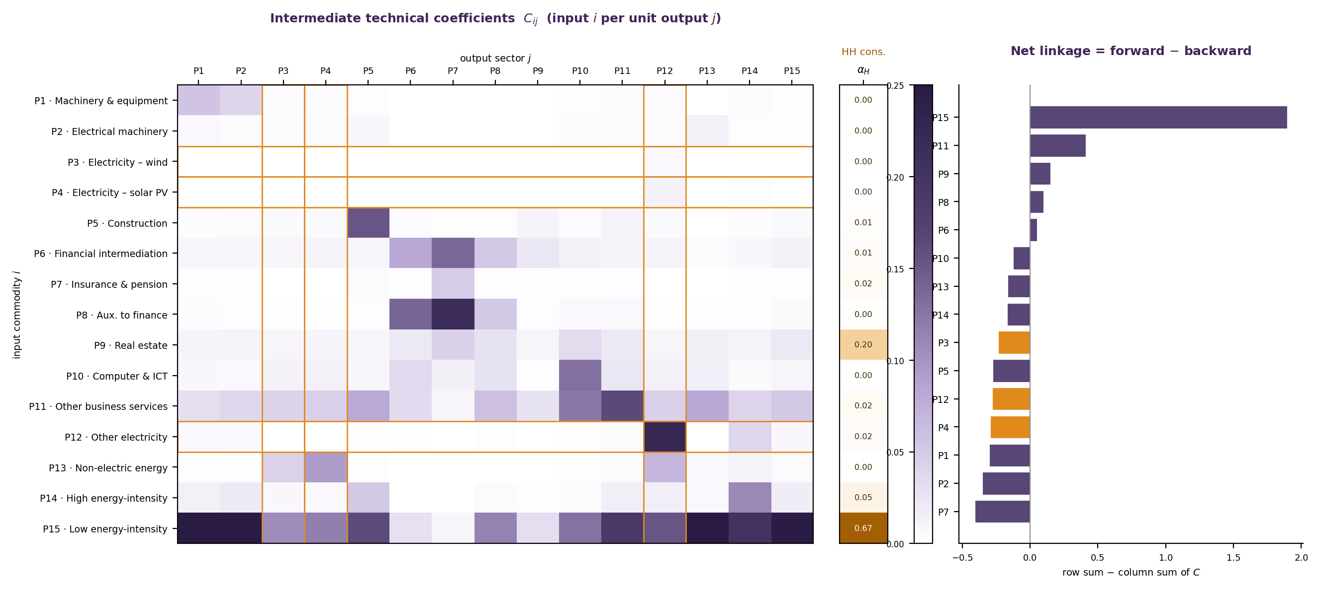
Technical coefficients and sectoral linkages
Intermediate coefficients C_ij, household consumption (α_H) and the net forward−backward linkage (Italy, EXIOBASE 3.6, 2020)
C_ij = input i per unit output j; α_H = household consumption share (EXIOBASE 3.6, Italy 2020). Net linkage = forward − backward; electricity sectors (wind/solar/other) highlighted in orange.
27 / 37

Slide 28
PNIEC 2030 targets → investment shock
Renewable capacity gaps to 2030, translated into capital-goods investment
+13,050 MW
Multi-year investment by supplier sector
EXIOBASE 3.6 sector | Investment (mln €)
Machinery & equipment n.e.c. | 25,437
Electrical machinery & apparatus n.e.c. | 5,755
Construction work | 8,412
Financial intermediation services | 1,705
Insurance & pension funding services | 1,040
Services auxiliary to fin. intermediation | 1,705
Real estate services | 1,040
Computer & related services | 2,535
Other business services | 1,705
Total | 49,334
Wind capacity gap, 2024→2030
+42,171 MW
Solar-PV capacity gap, 2024→2030
≈ €49.3 bn
Total capital-goods investment
Figures corrected against the official PNIEC (June 2024, Table 11): wind +13,050 MW and solar +42,171 MW.
Correction: earlier work inverted the excluded sub-items (offshore wind, concentrated solar); we use the corrected gaps.
Allocation: overnight costs (IEA 2020) split to nine supplier sectors via CAPEX shares (Černý et al. 2021).
28 / 37

Slide 29
Experimental design and restrictions
Two mechanisms over 60 months — a capital-goods shock and a green-priority reallocation — under explicit restrictions
Dimension
Assumption
Implication
Prices
Price-takers, constant prices
The shock works through quantities, not price changes.
Finance
No credit or financial market
Investment is neither crowded out nor amplified by finance.
Trade
Exogenous, constant foreign demand
Exports fixed; the import content of demand is fixed.
Agents
One firm per sector; five household groups
A representative producer per sector; household heterogeneity preserved.
What we measure: sectoral output and the electricity mix, GDP and employment, the trade balance, and consumption and inequality (income and wealth Gini).
Green priority: each month, electricity demand shifts from ‘other electricity’ toward wind and solar — the demand-side rule behind the mix transition.
29 / 37

Slide 30
4
Results
Macro, sectoral and distributional effects of the PNIEC shock
30 / 37

Slide 31
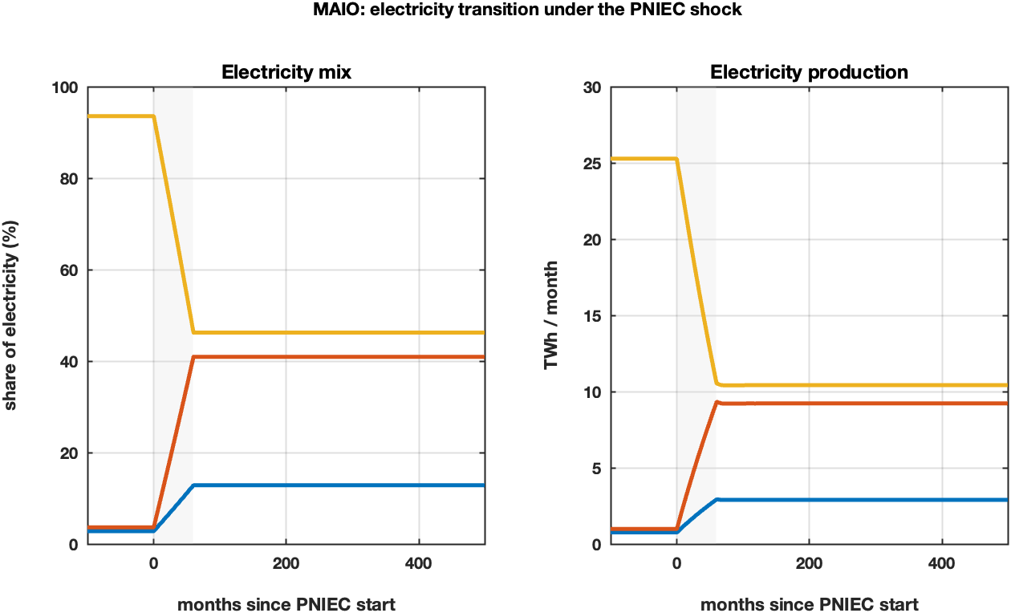
The electricity transition
Renewables displace conventional generation, across the mix and in total output
■ wind (P3) ■ solar (P4) ■ other electricity (P12)
Wind and solar rise from ~6% to ~54% of the electricity mix (wind 13%, solar 41%); ‘other electricity’ falls to 46%. Total generation declines as the carbon-intensive base is displaced.
31 / 37

Slide 32
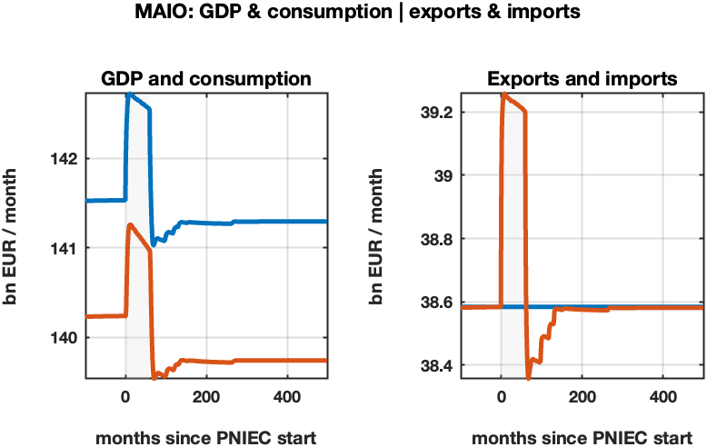
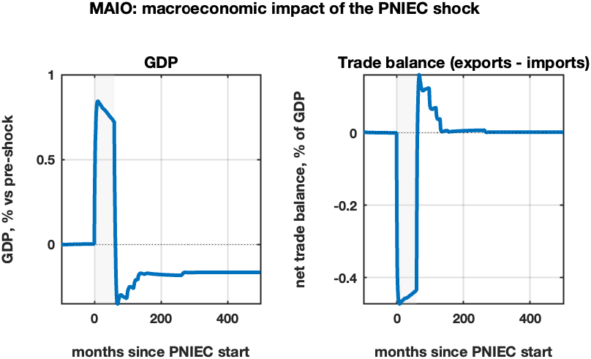
Macroeconomic impact
Demand components (left) and the two-phase aggregate response (right)
■ GDP
■ consumption (C+G)
■ exports
■ imports
Investment-led boom during the 60-month shock (GDP +0.84%), then a slightly lower steady state (−0.17%); the import surge opens a temporary trade deficit (−0.47% of GDP) that reverses as new capacity comes online.
32 / 37

Slide 33
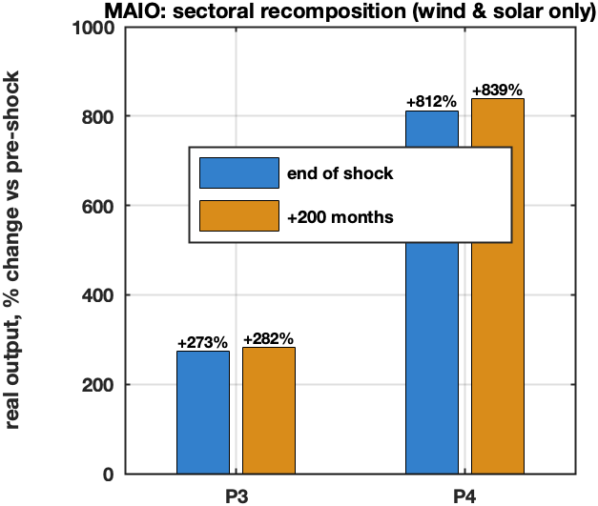
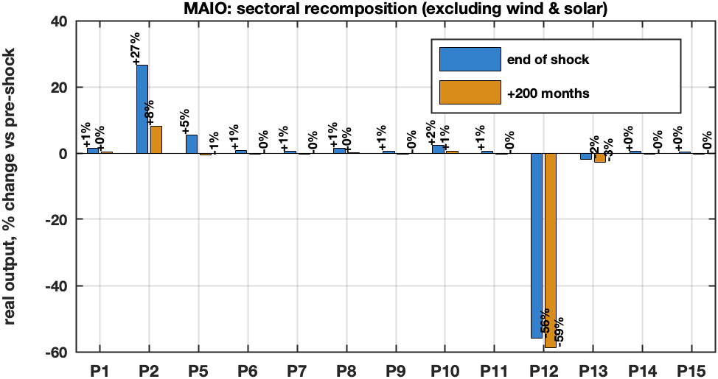
Sectoral recomposition
Renewables shown separately — their output multiplies while the rest barely moves
Solar +839% and wind +282% at the new steady state (left). Among all other sectors (right) only electrical machinery (+8%, the renewables’ supplier) and ‘other electricity’ (−59%, displaced) move materially — a recomposition, not an expansion.
33 / 37

Slide 34
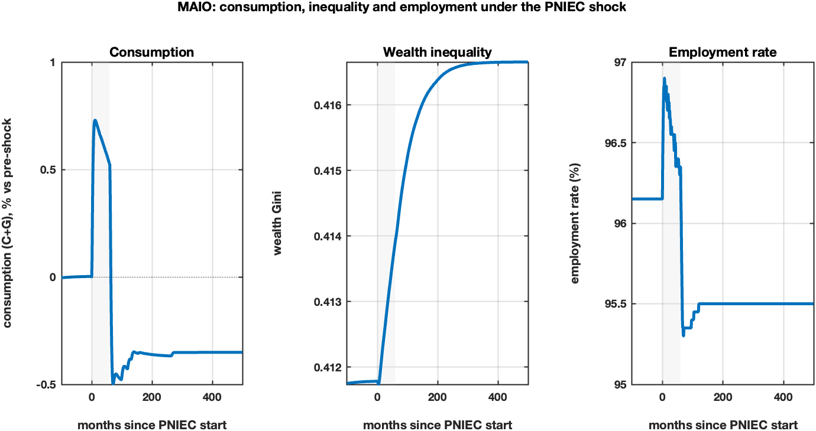
Consumption, inequality and employment
The household side: consumption, inequality and jobs
Consumption tracks the two-phase path — a +0.73% boom, then −0.35% at the new steady state. Wealth inequality rises modestly (Gini 0.412→0.417), and employment peaks during the build-out before settling slightly below baseline (96.2%→95.5%): the greener steady state is marginally less labour-intensive.
34 / 37

Slide 35
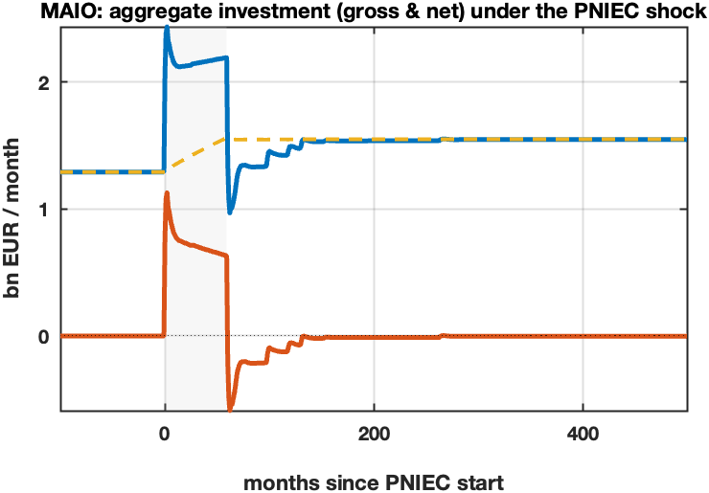
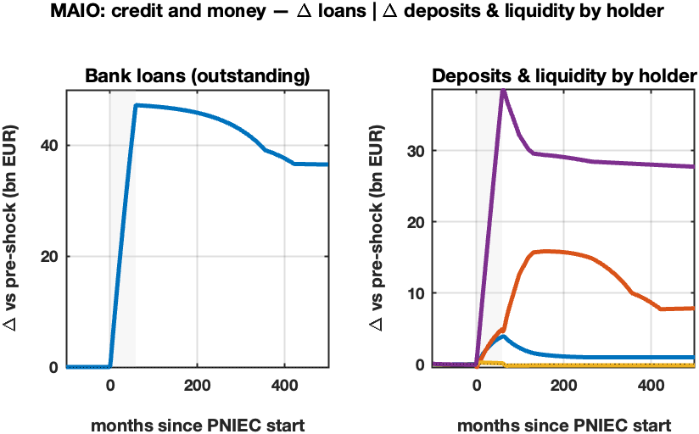
Investment and its financing
The capital build-out (left) and the credit and money it sets in motion (right)
■ gross investment
■ net investment
■ depreciation
■ household deposits
■ firm deposits
■ government liquidity
■ Rest of World liquidity
Gross investment jumps from €1.3 to ~€2.2 bn/month during the build-out, then settles higher as the larger capital stock raises replacement. Bank loans rise ~€47 bn; the matching deposits accrue mostly to firms and to the Rest of World (the import counterpart).
35 / 37

Slide 36
Take-aways
What the programme delivers — and what the PNIEC application shows
A method, not just a model. MAIO is a sequence of nested, comparable models with a closed-form benchmark — controlled complexity rather than a single opaque simulation. T₁ MAIO1 (baseline IO) → T₂ MAIO2 (capital, labour, credit, fiscal, foreign) → T₃, T₄ (richer behavioural and institutional layers).
A closed-form benchmark
The transition is a recomposition
Both MAIO1 and MAIO2 admit a closed-form steady state Y* under explicit restrictions — MAIO1 via Perron–Frobenius, MAIO2 via the augmented Leontief inverse.
It anchors the calibration and gives a transparent reference for the full agent-based simulation.
Under the PNIEC shock the economy recomposes rather than expands: renewables’ output multiplies and ‘other electricity’ is displaced (−59%), while most sectors barely move.
GDP follows a two-phase path — an investment-led boom (+0.84%), then a slightly lower steady state (−0.17%) with a permanently greener mix.
On the horizon — T₃: endogenous pricing (set_price/update_prices currently no-op), bank credit-granting beyond gating, innovation in the IO matrix C, and coupling with the AI strand toward MAIO3 (the twin AI–energy transition).
36 / 37

Slide 37

Thank you
A sequence of nested models
A closed-form steady-state benchmark
Transition as recomposition, not expansion
Marco Raberto · Marcello Nieddu · Andrea Teglio
marco.raberto@unige.it
37 / 37
32nd IIOA Conference · Seville, Spain · 26 June 2026

