Slide 1
Global MRIO databases in practice: A comparative assessment of EXIOBASE, WIOD, and Eora databases
Joan Shilpa Kiran & Tejal Kanitkar
National Institute of Advanced Studies, Bengaluru, India

Slide 2
Introduction
MRIO databases → Monetary flows of goods and services in an economy and across different regional economies.
Used in environmental and climate change studies
  Economic role of abatement sectors, embodied energy, employment benefits of energy efficiency mechanisms, carbon footprint of nations/regions, environmental impacts of production processes, consumption-based accounting etc. (IPCC, 2014).
Constructed using different sources of data, classification systems, data, assumptions, structure, and method of analysis
Considerable difference in their analytical outcomes.
Investigating the underlying reasons and highlighting limitation important due to the wide usage of these databases
  Eg: Used in working group III’s contribution to the sixth assessment report of the IPCC for calculating consumption based GHG emissions for countries (IPCC, 2022)

Slide 3
MRIO tables reviewed in this study
Database | Type | Time-period covered in the latest version
World Input-Output Database (WIOD) | Industry X Industry | 2000-2014
EORA global supply chain database | Supply-use tables; Product X product; Industry X industry | 1990-2024
EXIOBASE | Supply-use tables; Product X product; Industry X industry | 1995-2020; Projections till 2022

Slide 4
Methods of construction
WIOD
SNA version: SNA 1993 ; (SNA 2008 in 2016 release)
EORA
EXIOBASE
SNA version: SNA 2008/ ESA 2010 frameworks
Time series: Year-by-year bi-proportional scaling (RAS) updating algorithm.
Time series: Continuous, stepwise sequential iterative back-casting and forward-forecasting
Data source: National SUTs, Eurostat statistics, UN Comtrade, and physical energy/material data.
Data source: Official National SUTs UN National Accounts, and UN Comtrade.
Base year: 2000
Harmonization: Heterogeneous national IO tables, SUTs, and macro accounts. Skips intermediate SUT stages; dumps all national and trade data into a single global matrix
Base year: Country-specific, uneven benchmark years (e.g., 1997, 2002, 2007).
Harmonization: Official national SUTs into a uniform 35-sector framework. Maps bilateral trade data using 6-digit HS product codes categorized into intermediate, final, or investment end-uses
SNA version: SNA 1993
Data source: Heterogeneous country tables, UN Comtrade, and UN/IMF macroeconomic aggregates.
Time series: Forward-projecting matrix slices by mathematically imposing temporal developments.
Base year: 2020
Harmonization: All country tables into a uniform European NACE rectangular template (163 industries). Combines industrial sectors by putting local data into a detailed global trade matrix

Slide 5
Limitations
Structural
Methodological
Constraints due to level of sector detail and country coverage
Gaps in construction, projections and data use

Slide 6
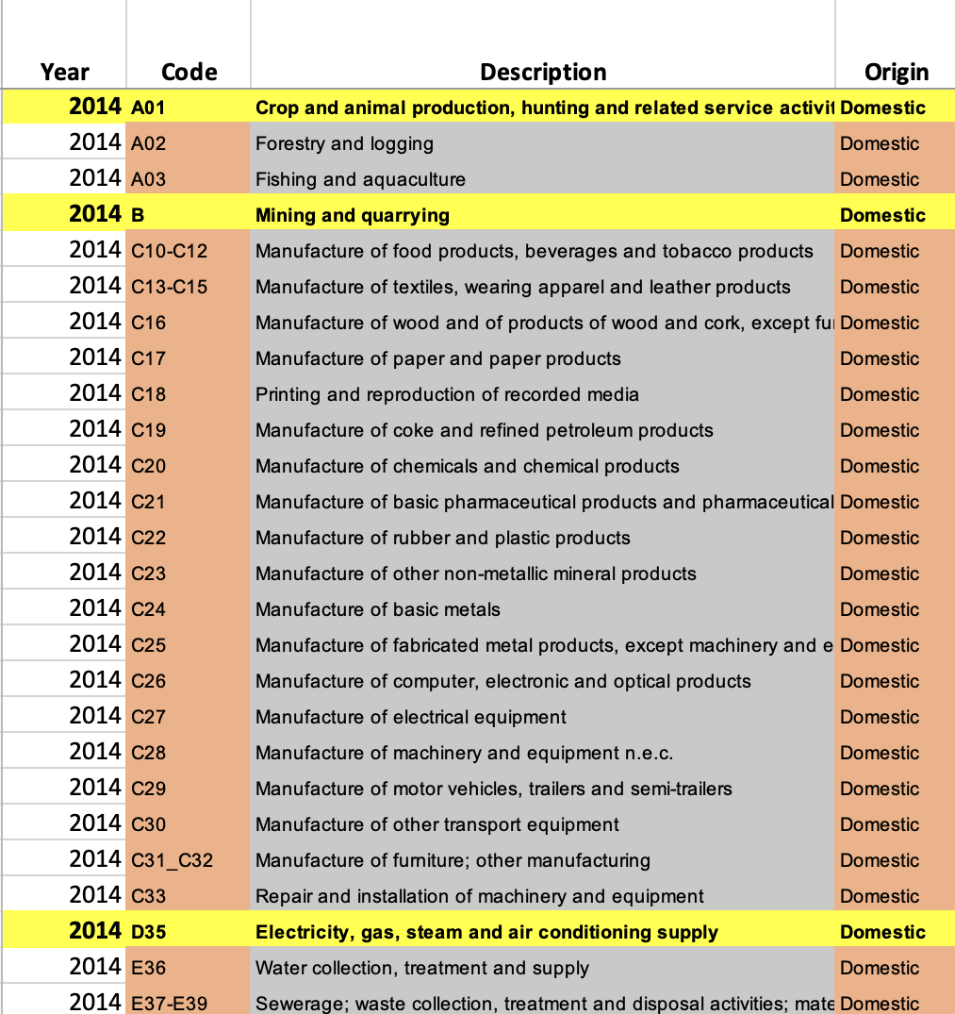
Structural limitations: WIOD
Only 43 countries (primarily EU-28 and 15 other major economies) & a "Rest of the World" region.
Latest available data for the year 2014. Not continually updated.
High levels of sector aggregation
  Production of different crops is aggregated into the agricultural sector.
  Aggregated electricity sectors and energy production sectors
Overview of versions
Release year | Types of tables | No. of countries | No. of sectors | Years covered
2013 | National, Regional and World IO tables | 40 | 35 | 1995-2011
2016 | National, and World IO tables | 43 | 56 | 2000-2014
2022 | World IO tables | 25 | 23 | 1965-2000
Figure1. Example of sector aggregation in the WIOD from the National IO tables for India by the WIOD for the year 2014.

Slide 7
Structural limitations: Eora Global Supply chain Database
Overview of versions
Release year | Types of tables | No. of countries | No. of sectors | Years covered | Base year
2013 | Individual country tables Global MRIOS | 190 | National IO: 38-429 Global MRIO: 26 | 1990-2022 | 2000
2025 | Individual country tables Global MRIOS | 121 | National IO: 21- 402 Global MRIO: 25 | 1990-2024 | 2015
Based on UN System of National Accounts 1993.
National sector counts range from 21 to over 400 across countries. Converting national tables into the broad "Eora26" classification destroys fine-grained detail.
Small economies are sometimes grouped together, hiding specific country-to-country trade flows.
Distinct products (like electronics and heavy machinery) are frequently forced into single broad categories.
Missing data for smaller or developing nations is filled using proxy algorithms.

Slide 8
Structural limitations: EXIOBASE
Overview of versions
Release year | Types of tables | No. of countries | No. of sectors | Years covered | Base year
2013 | Global MRIO | 43 countries 1 RoW | 200 products 163 industries | 2000 | 2000
2015 | Global MRIO | 43 countries 5 RoW | 200 products 163 industries | 2007 | 2007
2018 | Global MRIO | 44 countries 5 RoW | 200 products 163 industries | 1995-2022 | 2020
Maps 28 EU member states but only a handful of other major global economies (e.g., US, Japan, China, India).
No tables for emerging economies and Least Developed Countries (LDC). Grouped into just five geographic "Rest of the World" (RoW) blocs.
High sectoral resolution but low precision

Slide 9
Methodological limitations
Time series construction
  Highly reliant on several data assumptions
  Benchmarks a base year to forecast and back cast future and historical tables.
However, IO assumes constant returns to scale.
  Long-term projections
  Economies of scale may change due to technological change and efficiencies of production.
  Unprecedented supply disruptions such as the COVID-19.

Slide 10
Methodological limitations
Harmonization of data to transform and integrate them to MRIOs and for the ease of comparison.
  Real data sources are adjusted to fit an overarching uniform framework
  WIOD: National SUTs were harmonized using international trade statistics (Timmer et. al, 2015).
  EXIOBASE: Top-down approach where the technological data and national level data were harmonized to global economic statistics (Staedler et. al, 2018).
  EORA: Compiles all country-level inputs directly into a single and large global matrix for simultaneous mathematical balancing (Lenzen et. al, 2013)
Congruency with macroeconomic data. Absolute compliance with national SUTs were not prioritized.
  Eora: Prioritizes global trade and macro balancing over country tables. Allows algorithms to alter national SUT cells to clear global conflicts. Generates missing national matrices by scaling a US-Japan-Australia baseline average to local macro indicators.
  EXIOBASE: National SUTs were used only mathematically adjust the initial MRIO tables. Data retention and omission left to modeller’s discretion. Rely on other databases such as FAO statistical database, IEA’s energy balances etc and proxy values in case of unavailability.
  WIOD: Resolves import-export discrepancies via a bi-proportional RAS modifier applied to trade shares.

Slide 11
Implication of the limitations
Impact the data quality and translates into an inaccuracy of the reported data.
Significant deviation from the actual numbers given in the national account statistics which impacts the validity of results
Adoption of assumptions due to data shortage results in discrepancies of the numbers reported.
  EXIOBASE: Labour employed in the coal sector in India in 2011 is 5.7 million workers, whereas, the labour employed in the coal sector in China is 13 workers.
.

Slide 12
What has the limitations resulted in?
An example from the EXIOBASE for the year 2019
Comparison of GDP (in T USD): Real vs IO
Countries | EXIOBASE (2019) | World Bank (2019) | Change | In %
IN | 2.80 | 2.69 | 0.11 | 4%
US | 20.58 | 20.16 | 0.42 | 2%
CN | 13.64 | 14.58 | -0.94 | -6%
DE | 3.93 | 3.67 | 0.26 | 7%
Comparison of total employment (in millions) : Real vs IO
Countries | EXIOBASE (2019) | World bank (2019) | Change | In %
IN | 497 | 531 | -34.60 | -7%
US | 166 | 169 | -2.47 | -1%
CN | 749 | 776 | -27.09 | -3%
DE | 43 | 44 | -1.35 | -3%

Slide 13
Analysis using EXIOBASE to highlight discrepancies in numbers
Impact analysis to estimate the economic and labour impacts of coal and gas phase down.
Compare results for four countries: India, China, US and Germany.
Uses the EXIOBASE 2019 for analysis. While the latest available table is for the year 2020, we use the 2019 tables.
  This is because 2020 was affected by the COVID-19 pandemic that caused signification supply disruptions across world and hence may not accurately reflect normal economic conditions.

Slide 14
Analysis
IO 2019
Scenario-1
Impact analysis
Reduction: 100 TWh from coal-based electricity.
$\left[∆f\right]={\left[L_{diag}\right]}^{−1} × \left\lceil ∆x\right\rceil$
[∆𝒇]=[𝑳_𝒅𝒊𝒂𝒈 ]^(−𝟏) × ⌈∆𝒙⌉
New IO
New output (x), final demand (f) and inter-industry use (Z) calculated.
(Miller & Blair, 2009)
India
USA
Germany
China
Addition: 100 TWh (50 TWh each) from wind and solar power
Energy data from BP statistical review
Conversion to monetary terms using price coefficients.
Employment values from EXIOBASE

Slide 21
Discrepancies in underlying data
Sector wise values (in M USD) of Labour and Capital for India for 2019 from the EXIOBASE
 | Labour | Capital
Coal | 0 | 13939
Oil | 4044 | 13896
Gas | 786 | 1490
Electricity-Coal | 8 | 5
Electricity-Gas | 158 | 94
Electricity- Solar | 750 | 506
Electricity-Wind | 0 | 253

Slide 22
Discrepancies in underlying data
Sector wise values (in M USD) of Labour and Capital for India for 2019 from the EXIOBASE
 | Labour | Capital
Coal | 0 | 13939
Oil | 4044 | 13896
Gas | 786 | 1490
Electricity-Coal | 8 | 5
Electricity-Gas | 158 | 94
Electricity- Solar | 750 | 506
Electricity-Wind | 0 | 253

Slide 23
Discrepancies in underlying data
Sector wise values (in M USD) of Labour and Capital for India for 2019 from the EXIOBASE
 | Labour | Capital
Coal | 0 | 13939
Oil | 4044 | 13896
Gas | 786 | 1490
Electricity-Coal | 8 | 5
Electricity-Gas | 158 | 94
Electricity- Solar | 750 | 506
Electricity-Wind | 0 | 253

Slide 24
Discrepancies in underlying data
Sector wise values (in M USD) of Labour and Capital for India for 2019 from the EXIOBASE
 | Labour | Capital
Coal | 0 | 13939
Oil | 4044 | 13896
Gas | 786 | 1490
Electricity-Coal | 8 | 5
Electricity-Gas | 158 | 94
Electricity- Solar | 750 | 506
Electricity-Wind | 0 | 253

Slide 25
Conclusion
Reveals acute data shortages, methodological assumptions and issues due to sectoral classification and geographical representation
The MRIO tables are expected to provide a realistic picture and function as a snapshot of the global economy
Inherent data issues lead to counterfactual results obtained from these studies.
    Ordonez et. al (2023): EXIOBASE
    Pollin & Chakraborty (2015): WIOD
    Azad & Chakraborty (2019): EXIOBASE
    IPCC (2022): EXIOBASE & Eora
Tampers the qualitative interpretation and understanding of the results and in turn the reality itself impacting the global mitigation.
Most of the MRIO databases are published by researcher and consultation groups based in the global North.
  Inclusivity and representation LDCs and low-income countries is inadequate
  Data availability for these regions are limited and data concerns more rampant
Construction of better tables derived from national account statistics or tables that are nationally constructed required for robust analysis.

Slide 26
References
Geschke, A., Wood, R., Kanemoto, K., Lenzen, M., & Moran, D. (2014). Investigating alternative approaches to harmonise multi-regional input–output data. Economic Systems Research, 26 (3), 354–385. https://doi.org/10.1080/09535314.2014.937069
Huo, J., Chen, P., Hubacek, K., Zheng, H., Meng. J., & Guan, D. (2022). Full-scale, near real-time multi-regional input–output table for the global emerging economies (EMERGING). Journal of Industrial Ecology, 26 (4), 1218-1232. https://doi.org/10.1111/jiec.13264
Intergovernmental Panel for Climate Change [IPCC]. (2014). Annex II: Metrics & Methodology. In: Climate Change 2014: Mitigation of Climate Change. Contribution of Working Group III to the Fifth Assessment Report of the Intergovernmental Panel on Climate Change. https://www.ipcc.ch/site/assets/uploads/2018/02/ipcc_wg3_ar5_annex-ii.pdf
IPCC. (2022). Emissions Trends and Drivers. In IPCC, 2022: Climate Change 2022: Mitigation of Climate Change. Contribution of Working Group III to the Sixth Assessment Report of the Intergovernmental Panel on Climate Change. https://www.ipcc.ch/report/ar6/wg3/downloads/report/IPCC_AR6_WGIII_Chapter02.pdf
Jones, L., Wang, Z., Degain, C., & Li, X. (2014). The Similarities and differences among three major inter-country Input–Output Databases and their implications for trade in value-added estimates. https://www.usitc.gov/publications/332/ec201412b.pdf
Lenzen M, Kanemoto K; Moran D, and Geschke A (2012) Mapping the structure of the world economy. Environmental Science & Technology, 46(15), 8374-8381. http://dx.doi.org/10.1021/es300171x
Lenzen, M., Moran, D., Kanemoto, K., & Geschke, A. (2013). Building EORA: A global multi-region input-output database at high country and sector resolution. Economic Systems Research, 25(1), 20-49. https://doi.org/10.1080/09535314.2013.769938
Miller, R. E., & Blair, P. D. (2009). Input–Output Analysis: Foundations and Extensions, Second Edition. 784.
Moran, D., & Wood, R. (2014). Convergence between the Eora, WIOD, EXIOBASE, and OPENEU’s consumption-based carbon accounts. Economic Systems Research, 26 (3), 245–261. https://doi.org/10.1080/09535314.2014.935298
Staedler, K., Wood, R., Bulavskya, T., Sodersten, C., Simas, M., Schmidt, S., Usubiaga, A. Acost-Fernandez, J., Kuenen, J., Bruckner, M., Giljum, S., Lutter, S., Merciai, S., Schmidt, J. H., therurl, M.C., Plutzar, C., Kastner, T., Eisenmenger, N., Erb, K.,…Tukker, A. (2018). Developing a time series of detailed environmentally extended multi-regional input-output tables. Journal of Industrial Ecology, 22(3), 502-515. https://doi.org/10.1111/jiec.12715
Steen-Olsen, K., Owen, A., Hertwich, E. G., & Lenzen, M. (2014). Effects of sector aggregation on CO2 multipliers in multiregional input–output analyses. Economic Systems Research, 26 (3), 284–302. https://doi.org/10.1080/09535314.2014.934325
Timmer, M. P., Dietzenbacher, E., Los, B., Stehrer, R., & de Vries, G, J. (2015). An illustrated user guide to the world input-output database: The case of global automotive production. Review of International Economics, 23(3), 575-605. https://doi.org/10.1111/roie.12178
Timmer, M. P., Los, B., Stehrer, R. and de Vries, G. J. (2016). An anatomy of the global trade slowdown based on the WIOD 2016 release. https://www.rug.nl/ggdc/html_publications/memorandum/gd162.pdf
World Bank. (2021). Labour force, total. https://data.worldbank.org/indicator/SL.TLF.TOTL.IN?locations=IN

Slide 27
Thank you

