Slide 1
Simulating Pure Capitalism:
Experimental Evidence with Human Agents
32nd IIOA & 11th SHAIO Conference
Manuel Muiños, Pablo R. Liboreiro, Esther Mañe Borras,
Lucía Andrés Algaba, Ivan Aparicio Cabeza, Ashad Ayub Parween,
Fatima Boumahdi, Elitsa Dianova Kostadinova, Mikael Faria Guerra,
Berta Fernández Martínez, Doae Iallachen Ahmittach, Laia Lafuente Navarro,
Rebecca Levy Sanchez, Alba Lozano Jurado, Miriam Martínez Rosales,
Blanca Masalles Ráfales, Jacqueline Moral Pérez, Aleix Pagès Moya,
Erik Pérez García, Andrea Rubio Auge, Alejandro Trasierra Rabanal,
Mariami Tskhovrebadze Abramishvili, Aniol Vancells Rovira,
Carlos Vidal Montesinos, Esther Zamora Onate.
https://sites.google.com/view/manuelmuinhospaneng

Slide 2
Acknowledgments
Our first thanks go to Professor Alfons Barceló, who served as our original inspiration and supported us with the simulations.
We also extend our special thanks to the organizers of the 32nd International Input-Output Association Conference and, in particular, to the Chair of the Scientific Committee, Professor Alfredo José Mainar Causapé, for his great generosity and understanding.
We also thank the organizers of the X Jornadas de Análisis Input-Output and, especially, the Chair of the Scientific Committee, Professor Esteban Fernández Vázquez, for his support in the organization and presentation of the paper.
We would also like to express our gratitude to the Department of Applied Economics at the Autonomous University of Barcelona, and in particular to its two successive directors, Professors Emilio Padilla and Javier Asensio, for creating the conditions that allowed us to carry out this research.
Finally, although only some are listed as co-authors, this research could not have been carried out without the active participation of all 210 students involved in the project.

Slide 3
Participants in the simulation
We listed the names of the active participants in the research.
First semester, September to December 2023
  Mohamad, Alba, Mario, Marc, Júlia, Lucía, Helena, Naiara, Carla, Bruno, Helena, Victor, Valeria, Jordi, Joel, Martina, Bruna, Claudia, Maria, Aitana, Miriam, Laura, Sara, Aroa, Núria, Alba, Gonzalo, Alessia, Marta, Milena, Itziar, Mohamed, Diana, Marc, Marina, Xinrou, Lucía, Carla, Pol, Clàudia, Lucía, Aitana, Cristina, Melany, Alexia, Maria, Roger, Maria, Aina, Olenka, Ashmeet, Karyna, Jan, Adrian, Laia, Julen, Aniol, Sergio, Joan, Zhe.
Second semester, February to May 2024
  Natàlia, Laia, Albert, Maryam, Pau, Antonio, Ariadna, Ona, María, Laura, Rocio, Huishan, Sara, Irene, Salima, Malak, Pol, Biel, Raúl, Biel, Emma, Pol, Maria Jesús, Cèlia, Alex, Noa, Manuel, Pol, Gonzalo, Laia, Adriana, Rim, Romaisa, Abel, Héctor, Joan, Lucía, Natàlia, Miriam, Yess, Roser, Mireia, Mar, Júlia, Mariia, Javier, Mar, Aran, Edna, Bernat, Martí, Elisenda, Samuel, Melanie, David, Júlia, Esther, Eric, Ainara, Àlex, Bernat, Erika, Aina, Carlota, Marina, Gemma.
Third semester, February to May 2025
  Lucía, Ivan, Rut, Ariadna, Mar, Ashad, Denisa, Fatima, Marta, Eva, Daniel Zhengyong, Mariona, Sofia, Miquel, Paula, Elitsa, Suleimane, Martina, Mikael, Meriam, Júlia, Berta, Mar, Lucia, Andrea, Doae, Hector, Laia, Wasim, Izan, Rebeca Noa, Judit, Cristina, Nicolas, Alba, Aina, Victor, Éric, Ingrid, Miriam, Irene, Daniela, Miriam, Blanca, Aina, Jacqueline, Pau, Josep, Martina, Judith, Aleix, Evelyn Nicole, Erik, Nirld Manel, Celia, Daina Sainan, Nora, Andrea, Emil Anton, Jovanpreet, Guillem, Nerea, Joel, Carla, Alejandro, Mariami, Laia, Ramon, Carlos, Andrea, Maria Felisa, Esther.

Slide 4
Theory

Slide 5
Input-output analysis

Slide 6
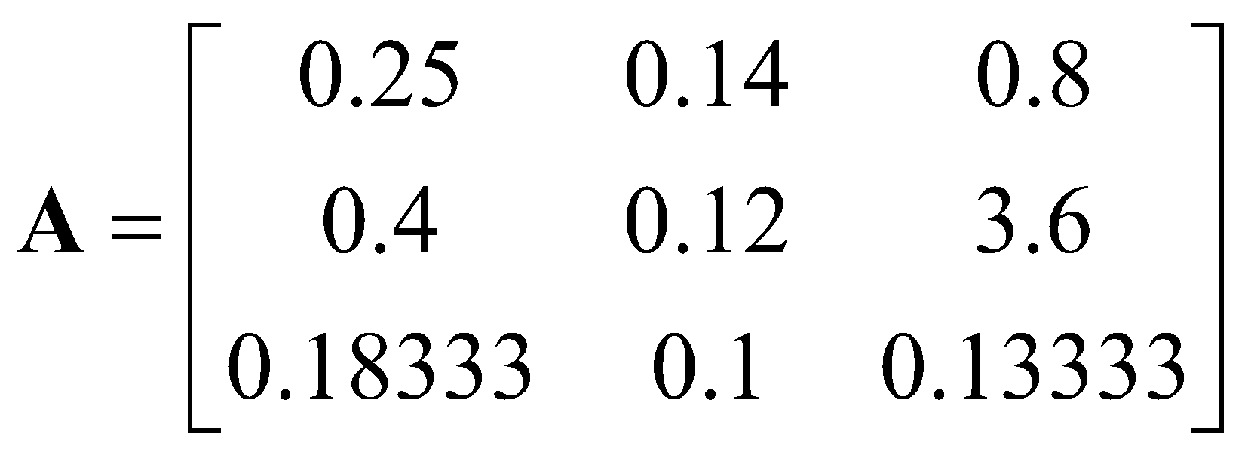
Input-output analysis. Matrices
The Agriculture sector consumes 0.25 bushels of wheat, 0.14 yards of cloth and 0.8 man-years of labor to produce 1 bushel of wheat.
The Industrial sector consumes 0.4 bushels of wheat, 0.12 yards of cloth and 3.6 man-years of labor to produce 1 yard of cloth.
The Households sector consumes 0.18333 bushels of wheat, 0.1 yards of cloth and 0.13333 man-years of labor to produce 1 man-year of labor.
From these flows between sectors we can construct an input matrix A (we write the sectors or processes in rows, horizontally, and not like Leontief who writes them in columns).

Slide 7
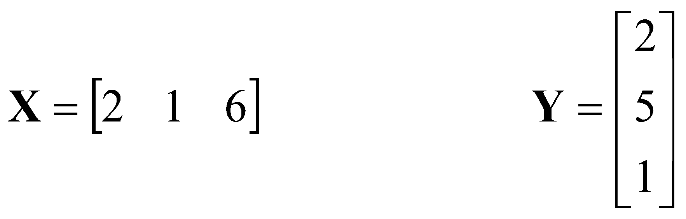
Input-output analysis.
Solution of the equations
The equations of the closed Leontief model, written in matrices, are
X A = X
A Y = Y
X represents the process intensities, the number of times they operate, and Y represents the prices of the materials. The first expression states that for each material, consumption, X A, is equal to production, X. The second expression states that for each process, costs, A Y, are equal to revenue , Y.
In our example the solutions are
The first process operates twice as often as the second, and the third six times. A bushel of wheat is worth two man-years of labor, and a yard of cloth is worth five man-years of labor.

Slide 8
Von Neumann model (VN)

Slide 9
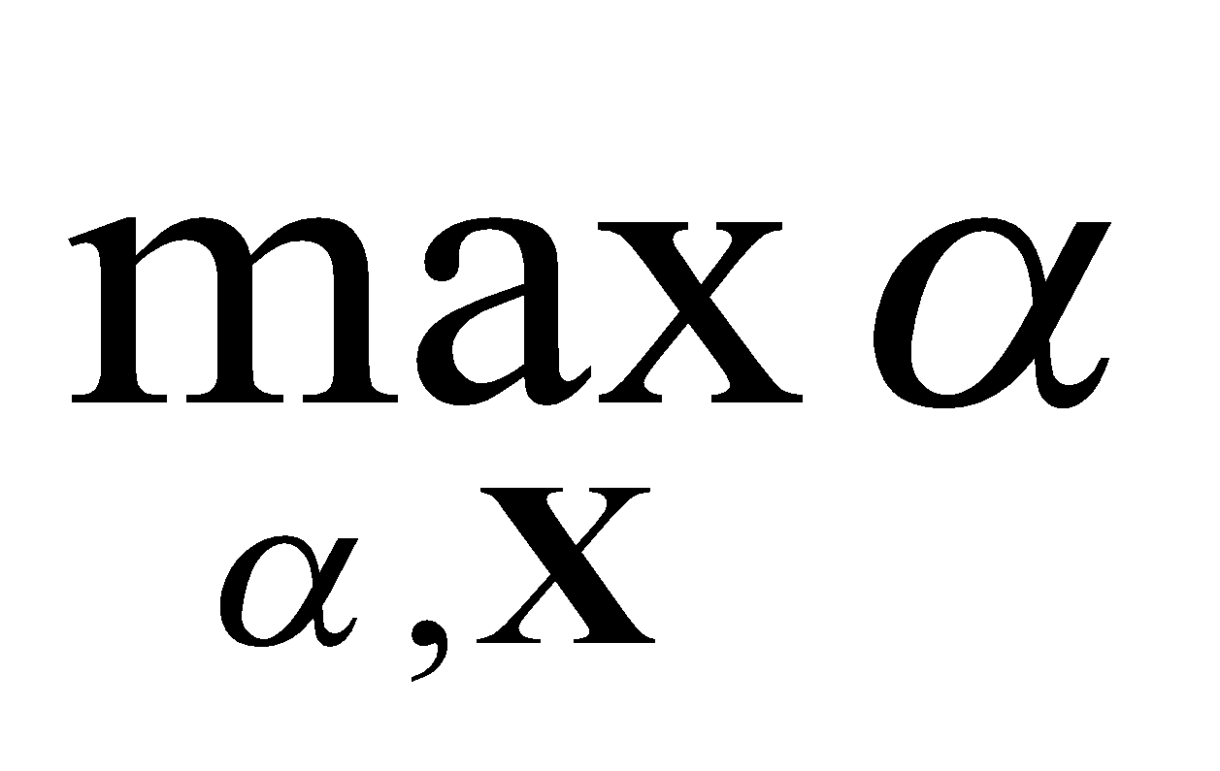
VN. Approach
The economic model of John von Neumann, or VN, is the study of maximum proportional growth. We are dealing with proportional growth when the intensities with which processes operate increase over time at the same rate, and when, for each item or good, consumption at any given moment does not exceed production from the previous moment.
In addition to the input matrix A , we have an output matrix B , allowing us to also study joint production, when a process produces more than one material. These matrices can be rectangular, and the number of processes can differ from the number of materials, enabling us to study process selection. Production occurs at a specific point in time after the inputs are consumed.
  Input-output matrices are a special case of VN, writing B as an identity matrix, a square matrix with all elements 0 except those on the diagonal which are 1.
VN can be written:
the expansion factor α (1 plus the growth or expansion rate) and the intensities X at which the processes operate for which the expansion factor is maximized are sought.
X (- A + B / α ) ≥ 0 the consumption of each material does not exceed its production from the previous
instant, taking into account the growth of the system,
X ≥ 0 the intensities of the processes are not negative,
α > 0 the expansion factor is positive.

Slide 10
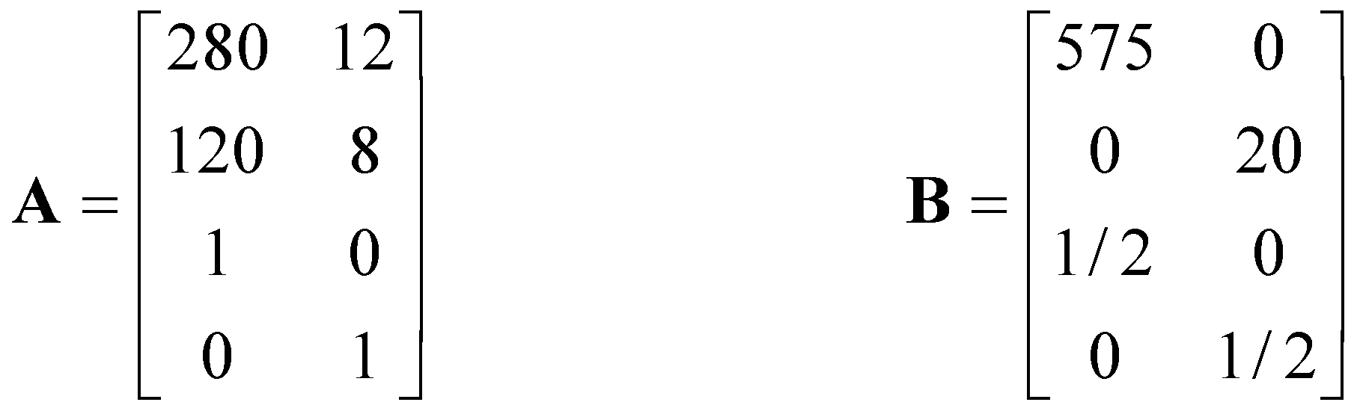
VN. Simulation processes as input-output matrices
The simulation includes two goods, wheat and iron, and three production processes.
The first two simulation processes are fixed-coefficient production functions, while the third is a linear production function. We can write the three simulation processes as a combination of four:
The first two simulation processes can be written directly as rows 1 and 2 of these matrices, since free elimination is available. The third simulation process can be written as a combination of the last two rows of the matrices.
In the simulation, each agent could only use one production process per session. But we will also study the allocation of the entire system, and therefore accept that several intensities can be positive simultaneously.

Slide 11
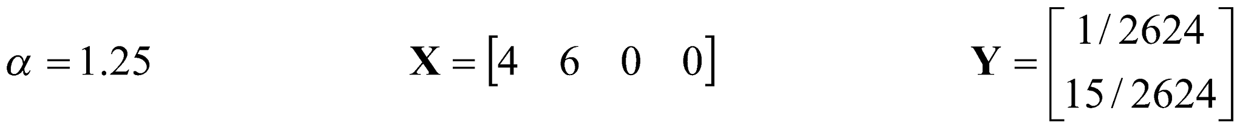
VN. Solution for our simulation
The VN solution for these matrices is:
The system grows by 25% at each time step.
The first process runs 4 times, the second 6 times, and the third process in the simulation (encoded in the last two matrices) does not run. The ratio of wheat production to iron production at any given time is 19.166666.
The price of iron is 15 times that of wheat.
Intensities grow exponentially over time, and prices decrease exponentially, with the expansion factor.

Slide 12
Maximum long-term profit (MBLP)

Slide 13
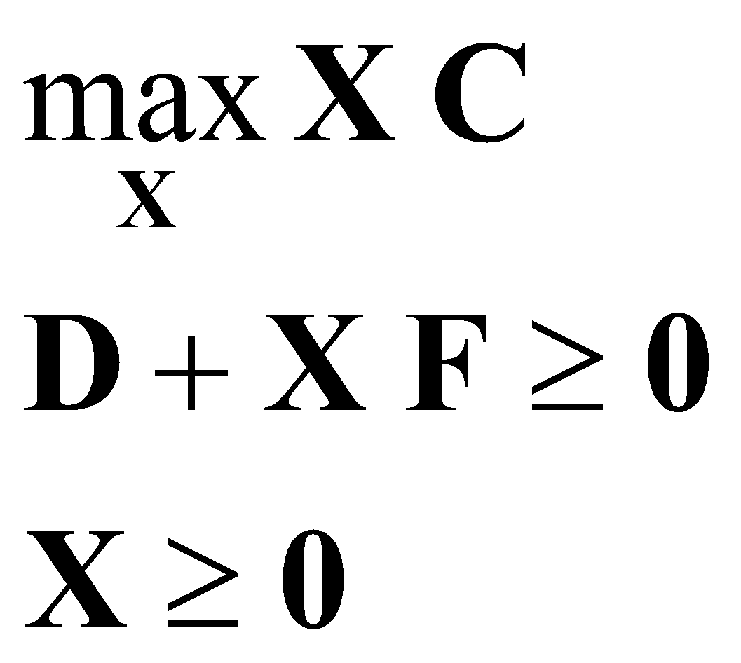
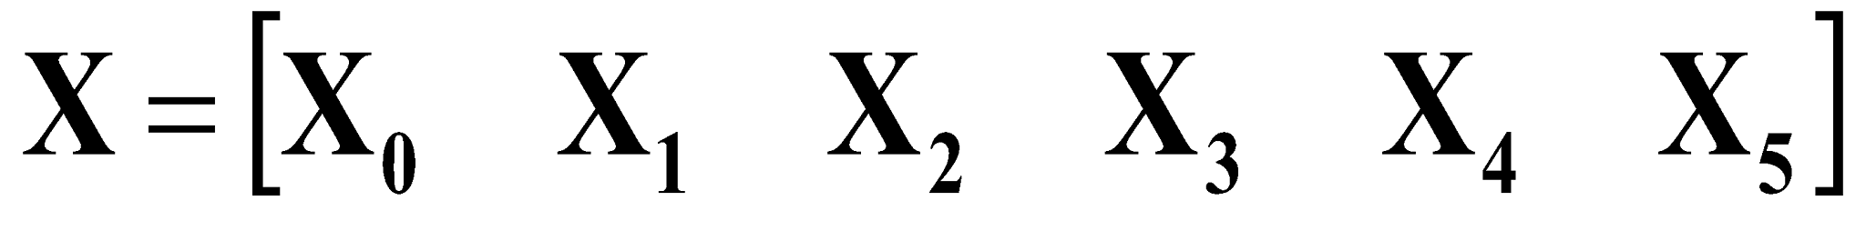
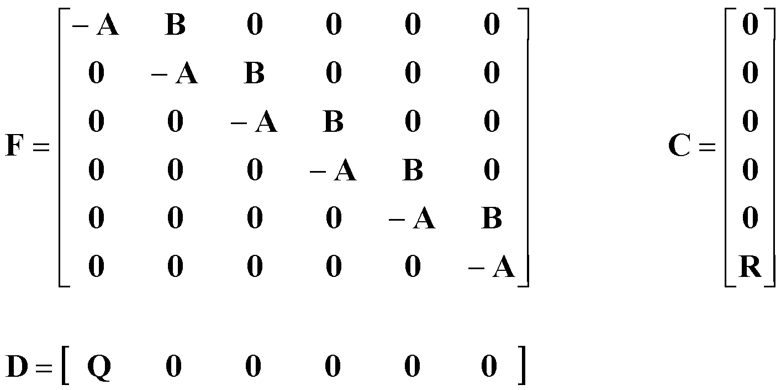
Maximum long-term profit (MBLP)
We will propose the linear program
We seek the intensities X with which the processes operate over time that, fulfilling the fact that the quantities consumed do not exceed those produced since the previous instant, D + XF ≥ 0 , and that the intensities are non-negative, X ≥ 0 , maximize the final benefit XC .
If the evolution were reduced to 6 time steps, the matrices would be
A is the input matrix and B is the output matrix, Q is the row vector of initial quantities used in the simulation, and R is the column vector of final weights used to determine the profit.

Slide 14
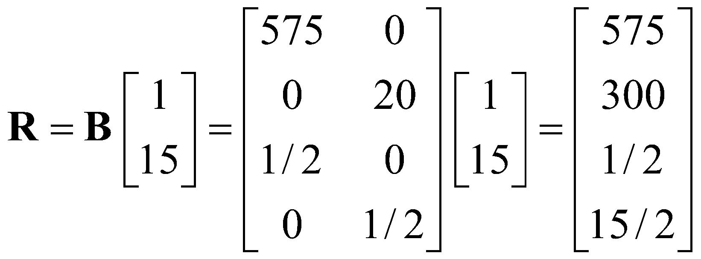
MBLP. Approach with simulation processes
With the matrices A and B seen, we construct the matrix F with 25 time steps (to give time for the highway theorems to become valid).
The vector Q is that of the quantities with which the simulation begins, with the same amount of wheat as iron for each student;
Q = [1 1]
The objective we maximize will be long-term production weighted, for example, by VN prices. We would have

Slide 15
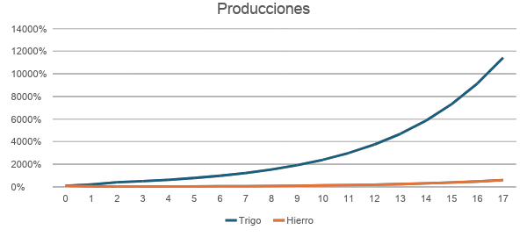
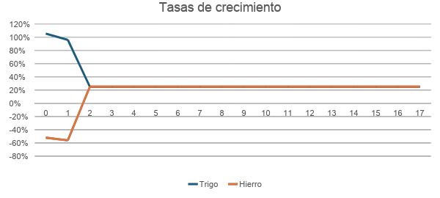
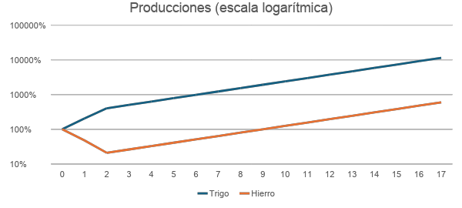
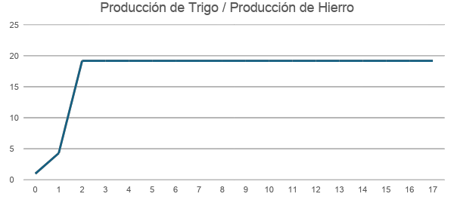
MBLP. Solution

Slide 16
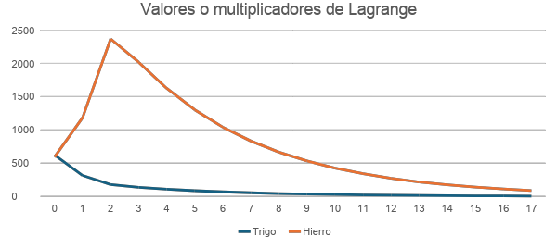
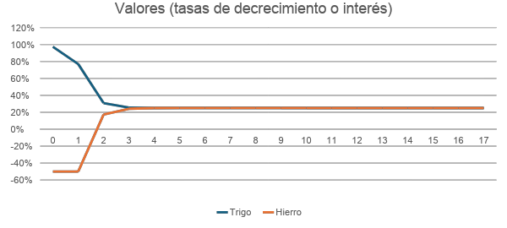
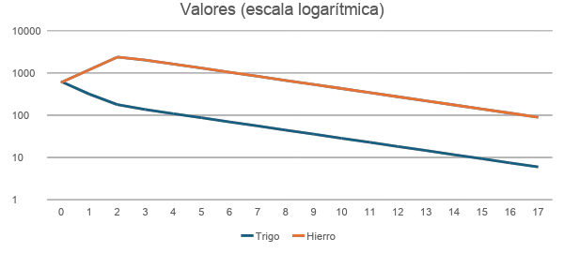
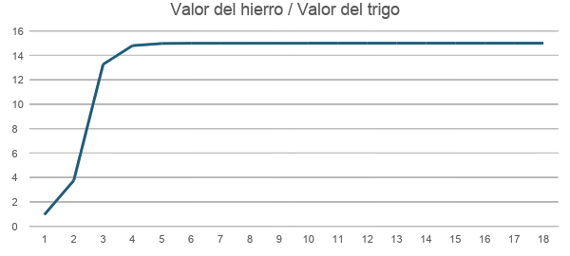
MBLP. Solution

Slide 17
Simulation

Slide 18
Simulation of pure capitalism
We seek to study capitalism in its most basic and simple functioning, in its purest and most essential form; to approach the conditions of a “perfect competition”.
Capitalism = agents who exchange and produce, maximizing profit.
We also seek a capitalism that is as simple as possible:
  To make the task easier for the students,
  To simplify the subsequent theoretical analysis.

Slide 19
Participants, duration and development
Economic agents: students from the Autonomous University of Barcelona. Three simulations, one per semester, with different groups of students.
In the semester of 2023, 60 first-year students of the Sociology degree actively participated as part of the subject "Political Economy".
  17 sessions: September 21, 26 and 28; October 10, 17, 19 and 31; November 2, 7, 9, 14, 21, 23, 28 and 30; and December 5 and 12, 2023.
In the semester of 2024, 66 students actively participated and 12 participated very punctually, from the first year of the degrees of "International Relations" and "Political Science and Public Management", as part of the subject "Political Economy".
  20 sessions: February 19, 23 and 26; March 1, 4, 11, 15, 18 and 22; April 5, 8, 15, 19, 22, 26 and 29; and May 3, 6, 13 and 17, 2024.
In the semester of 2025, 72 first-year students from the degrees of "Law" and "Criminology" participated as part of the subject "Introduction to Economics".
  12 sessions: February 21 and 28; March 14, 21 and 28; April 4, 11 and 25; and May 9, 16, 23 and 30, 2025.
In the three semesters, the first three sessions were for learning and testing, where students practiced starting with 1000 of wheat and 100 of iron each, without being taken into account in the grade of the subject.
In the fourth session, the simulation restarted with each student having 1000 units of wheat and 1000 units of iron, and it continued uninterrupted until the end of the semester. Participants were not informed of the initial quantities used in the simulation.

Slide 20
Instructions given
The activity involves a simulated capitalist system, where students start with a certain quantity of goods, exchange them among themselves, and then choose production processes that utilize the goods they acquired through these exchanges. Once production is complete, they obtain new quantities of goods as products, and the entire process is repeated.
The game is inspired by the one described in Alfons Barceló, “Simulation games with reproductive economic models”, El Trimestre Económico , Vol. 56, No. 223(3) (July-September 1989), pp. 547-569. https://www.jstor.org/stable/23397517
The game consists of obtaining the greatest profit at the end. At the beginning of the semester, each student will have a certain amount of materials (wheat and iron).
In each class:
  1. Each student may give any other student as many of their materials as they wish. They may make up to five deliveries.
  2. Each student will be able to choose only one production process:
    1) 280 of wheat and 12 of iron are used to produce 575 of wheat, or an equal ratio.
    2) 120 of wheat and 8 of iron are used to produce 20 of iron, or an equal ratio.
    3) If either of the above processes is not used, the available materials are reduced by half.
  In processes 1 and 2, all available materials are consumed, so that after production, only the wheat or iron produced will remain.
  If a student intends to deliver larger quantities than are available, they will deliver the available amount, but will be penalized.
  Contracts can be signed with up to four students; breach of contract will be severely penalized.

Slide 21
Procedure
In the simulations, the students began the semester symbolically possessing quantities of wheat and iron.
In each class or session they could negotiate with the rest of their classmates and exchange the wheat and iron they had available for about 20 minutes, completing a computer form that was closed at the end of this stage.
Next came the production stage, which lasted a few minutes. During this stage, each student had to choose one of three production processes using a different form. This process involved producing additional quantities of wheat and iron, which the student could then use in the following session.
In each class or session the entire process was reiterated.
The students' goal was to try to achieve the highest possible production levels by the end of the semester.

Slide 22
Precedents
Our simulation was inspired by the educational tool developed by Alfons Barceló in 1977.
  First and foremost, we take advantage of the idea of repeated exchange-production, of the production of goods by means of goods.
  We wanted to maintain the educational-game character of Professor Barceló's tool, but we made quite a few modifications, especially to achieve a simulation that would allow quantitative comparison with economic laws and theories.
Of course, we also consider developments in experimental economics.
At the end of the second semester, a student pointed out to us the existence of board and computer games that have similarities to our simulation, such as Catan, with repeated exchanges and production.

Slide 23
Deliveries
The exchanges were actually deliveries.
  It was not something that was sought after, but rather due to a computer limitation.
  The student could write the quantities of wheat and iron delivered and choose the recipient's name on the form.
  In each session, each student could make up to five of these submissions.
This led to some very interesting aspects of simulation, in relation to the emergence of a sense of ethics, the creation of a circle of regular customers, or the need for contracts.
Another computer limitation prevented the quantities available after a delivery from being automatically checked.
  The student had to keep track of the amounts available to him, considering the deliveries received and made, although he could ask the teacher if a delivery had been made.
  If he handed over more wheat or iron than he possessed at any given moment, he was considered to be handing over only what was available, and the student was penalized.
  This second computer limitation should perhaps be avoided in future editions.
  However, it is interesting to analyze the uncertainty it incorporated, in the sense that students could not be sure of having received the negotiated deliveries unless there was a contract or consultation with the professor.

Slide 24
Production
In each session, all the wheat and iron available to each student was used for production, and was completely consumed in the process.
The student had to choose a single production process, which could be different in each session.
  1) 280 of wheat and 12 of iron are used to produce 575 of wheat, or an equal proportion.
  2) 120 of wheat and 8 of iron are used to produce 20 of iron, or an equal ratio.
  3) If none of the above processes are used, the available materials are reduced by half.
The first two processes follow Leontief-type, or fixed-coefficient, production functions and were defined by Sraffa. The third process follows a linear function. All three exhibit constant returns to scale and can operate at any level.
  For example, the first process can use 140 wheat and 6 iron to produce 287.5 wheat for the next class.
The third process was the one that operated by default if the student could not attend class; but it could also be the one chosen, for example if the student in the exchanges did not achieve adequate proportions for the first or second processes.
The most suitable input ratio for the first process is 280/12 = 23.333333 units of wheat for each unit of iron, while for the second process it is 120/8 = 15 units of wheat for each unit of iron.
  Therefore, the students had to try to approximate some of these proportions through the exchanges, unless they sought to use the third process.
We imposed the limitation that only one production process could be used to facilitate the existence of exchanges.

Slide 25
Contracts
Since there was no guarantee that a delivery would be reciprocated, students were allowed to sign paper contracts, with the names of the participants and the specification of the amounts exchanged.
Violation of contracts was severely penalized, so in practice they were mandatory.
Very soon the contracts also included credits, exchanges over time with reference to other simulation sessions, or even investments in exchange for rents over time.
The contracts remained in the possession of the subscribers for the first semester, but in the second semester they were given to the professor.

Slide 26
Companies
The creation of companies with more than one agent was allowed; that is, the coalition of several students who signed a contract that bound them throughout the simulation.
These companies enabled coordination for the use of various production processes, since each isolated student could only use one process.
At the end of the semester, the wheat and iron obtained by each company were distributed among the participants, generally equally unless the contract specified otherwise.
The limitation of contracts to up to four students was incorporated in the second semester to prevent coalitions from playing a very important role in the overall market, and to prevent it from deviating from the beginning from “perfect competition”.

Slide 27
Information
An attempt was made to give students access to as much information as possible about the past, but there was some uncertainty about the present session.
For all previous sessions, students could consult (in an Excel spreadsheet):
  All deliveries made,
  All the selected productions,
  All available materials,
  The participating members in each company,
  Each student's ranking is based on their wheat and iron production.
In the current session:
  Students could observe the presentations in the classroom, but inevitably they could not know all of the other students' presentations in detail.
  Nor could they know what decisions the other students made when it came to production.

Slide 28

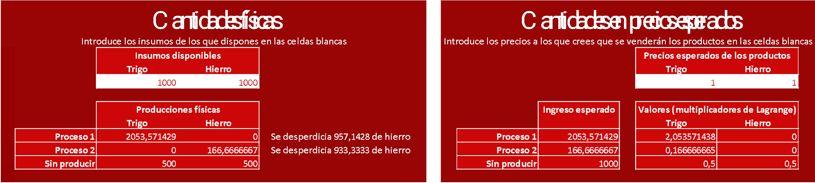
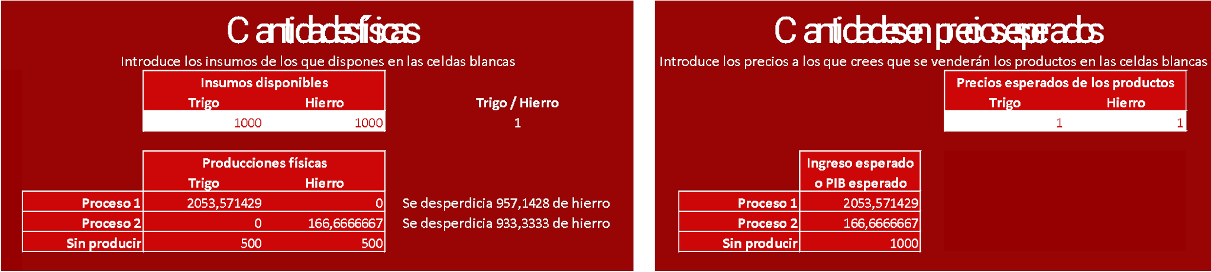
Calculator
A calculator was made available to the students on the Excel sheet.
It detailed the quantities that would be produced in each of the three processes for certain available quantities of wheat and iron, along with the quantities of these inputs that were useless in production.
It was also possible to specify the prices that the products were expected to reach in the next session, and it showed the benefits that would result from each of the processes.
There were some differences between the one used in the first, second, and third semesters.
  For example, in the first half of the year, the Lagrange multipliers corresponding to the maximization of expected revenue for each process were also shown. This information wasn't very useful, given the specific production functions we were using, so this detail was omitted in the second half of the year.
The systematic use of this calculator proved to be essential in determining the suitability of a particular exchange and also in choosing the production process.
First Semester
Second and third semesters

Slide 29
Close to perfect competition
In summary, the simulations were close to “perfect competition”:
  There were a good number of agents (60, 66 and 72), especially in relation to the number of goods (2).
  The agents did not have much influence on the market at the beginning of the simulations, where they started from a perfect equality.
  The goods were homogeneous.
  The agents were “rational” seeking maximum benefit.
  There were no barriers to entry or exit in production.
  The same technology was available to all agents.
  There were no externalities.
  There were constant returns to scale.
  The factors of production were perfectly mobile.
  There was perfect information about the past, although not perfect information about prices in the present.
  Property rights were well defined.
  There were no transaction costs.
  The contracts were mandatory.
But there were some differences:
  The number of agents could have been even greater.
  Information on current prices was not strictly perfect, because students could not be in all negotiations at the same time, although their access to it was not limited.

Slide 30
Results and comparison with the theory

Slide 31
Production
In all semesters the behavior was similar to that of MBLP (maximum long-term profit), but in a more inefficient way and with a trajectory through decreasing oscillations of a cobweb type.
In each semester, the system initially tended to increase the amount of wheat and decrease the amount of iron. Later, after some fluctuations, exponential growth was achieved.
  Limited resources were not included to simplify the simulation and subsequent analysis.
In our simulation, we see that the actions of agents who exchange with each other and maximize their individual benefits end up causing an allocation close to that which corresponds to maximizing growth, to the VN solution (of the Von Neumann model).

Slide 32
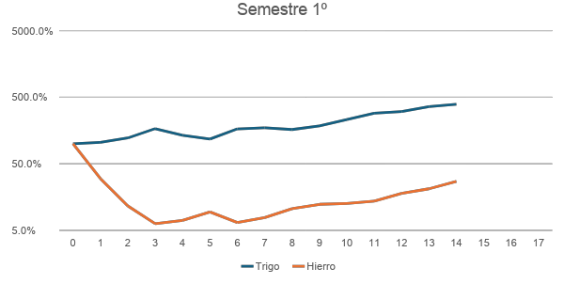
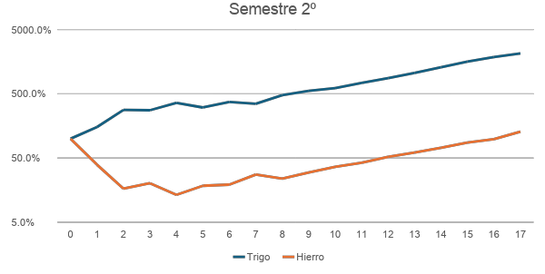
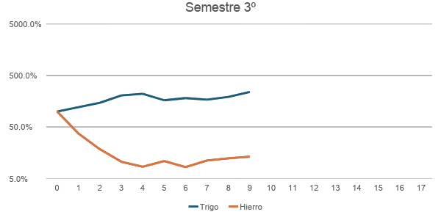
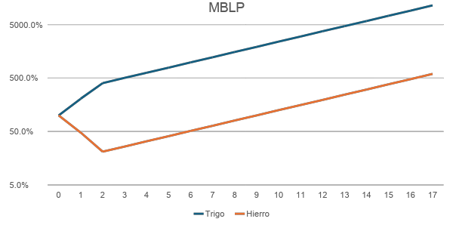
Production (logarithmic scale)

Slide 33
Values
In our simulations, the average price of iron relative to wheat can be approximated as the total amount of wheat delivered divided by the total amount of iron delivered.
  This is an approximation, because circular deliveries or those made within a company would have to be discounted.
We can therefore compare the delivery ratio with the MBLP Lagrange multiplier ratio for each session, and thus verify the distance between the simulations and MBLP.
In MBLP, at the initial moment, the value of iron is similar to that of wheat. But the value of iron increases in subsequent time steps, until one unit of iron becomes equivalent to 15 units of wheat, which is the VN solution (and also the Sraffa price).
In the simulations, at the initial moment, iron deliveries are similar to wheat deliveries. However, iron deliveries decrease relatively in subsequent time steps, fluctuating around 15 units of wheat per unit of iron.

Slide 34
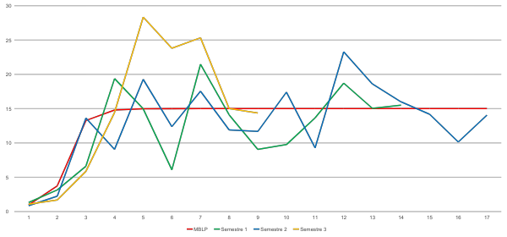
MBLP value;
Wheat deliveries / Iron deliveries

Slide 35
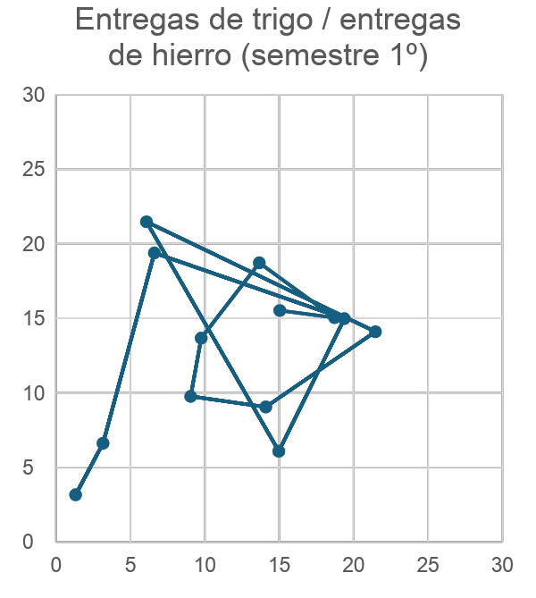
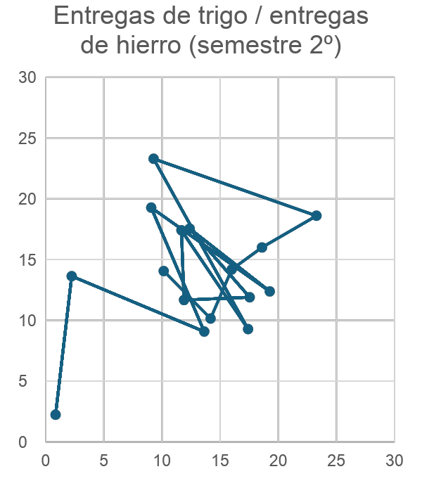
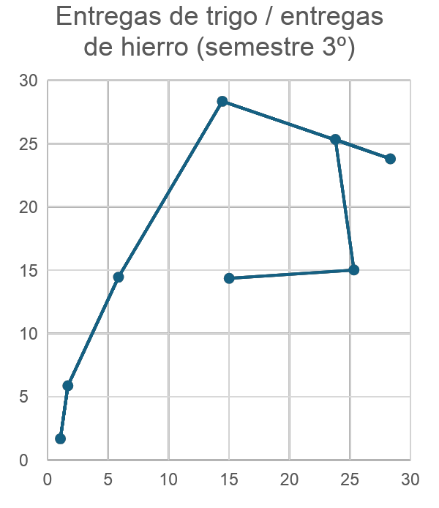
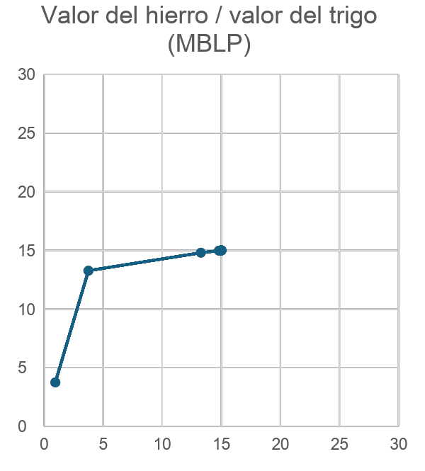
Adam Smith: ““The natural price, therefore, is, as it were, the central price, to which the prices of all commodities are continually gravitating”, The Wealth of Nations, I.VII
Horizontally, the index at time t;
Vertically, the index at time t+1.
The relative price of iron with respect to wheat in VN (and in Sraffa) is 15.

Slide 36
Results: Efficiency

Slide 37
Efficiency
Perfect efficiency was not achieved in the simulations .
  Here we understand "efficiency" to mean the distance to maximizing profit, and not other criteria such as the extent to which people's needs are met.
We will analyze efficiency using growth rates.
The VN solution implies that the growth rates are 25%.
In the first two semesters, the growth rates, already halfway through the simulation, fluctuated around 20%.
The production achieved with MBLP is also much higher than that of the simulations.
This inefficiency was due to not achieving the appropriate proportions in the first and second processes, and to the resources that were wasted.

Slide 38
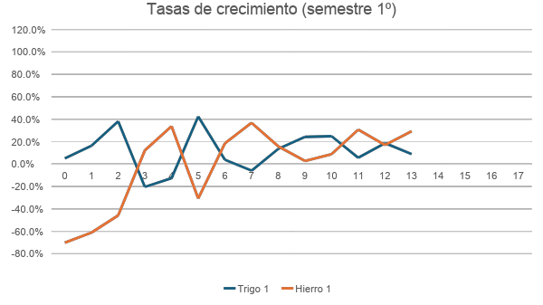
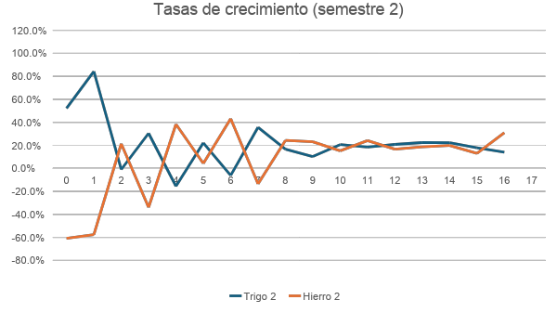
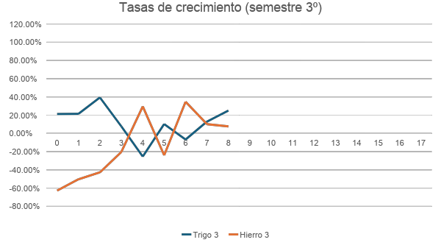
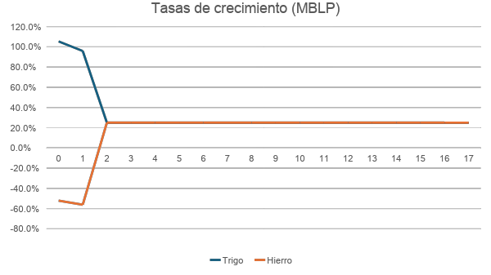

Slide 39
Results: Stability

Slide 40
Cycles
The simulations showed decreasing amplitude cycles .
We will visualize these cycles with the ratio between wheat and iron produced.
  These cycles are also evident in production, in its growth rates or in the delivery ratios, already seen.
In MBLP, in the first steps the proportion of wheat is increased until the VN solution is reached, which implies that the wheat/iron ratio is 19.166666. The system does not show cycles.
In the simulations, in the first steps the proportion of wheat increases, but it tends towards the VN solution with decreasing oscillations.
These cycles are due to the regulation of production through negative feedback via the price mechanism.

Slide 41
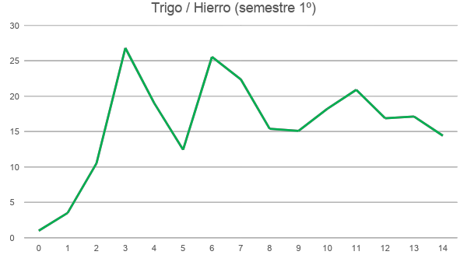
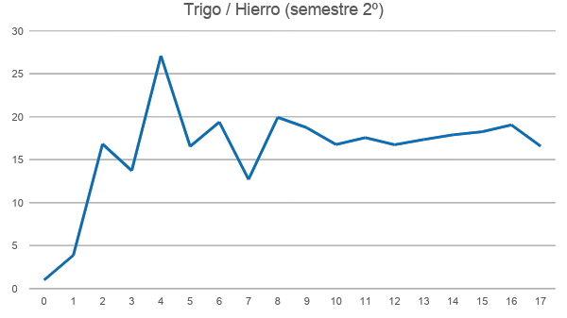
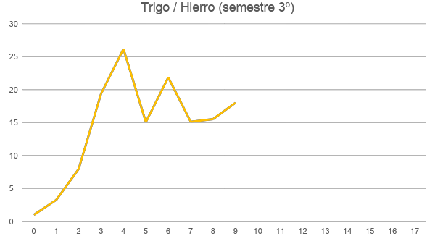
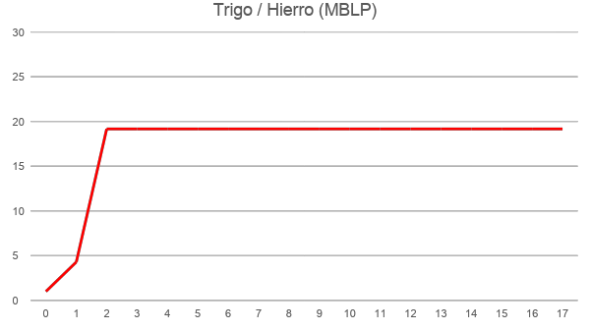

Slide 42
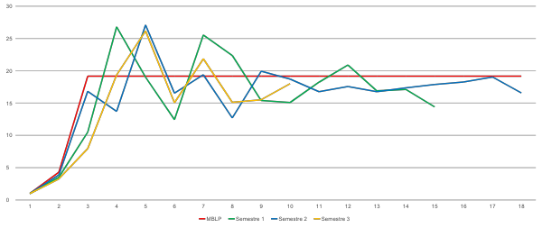
Wheat / Iron

Slide 43
Results: Inequality

Slide 44
Inequality, monopoly
Neither VN nor MBLP take into account inequality or monopolistic tendencies.
The simulations showed a strong trend towards inequality, even though they started with perfect equality.
In the three semesters, the Lorenz curves showed increasing inequality in each session (except with the redistribution), and the Gini coefficients ended up exceeding 0.9.

Slide 45
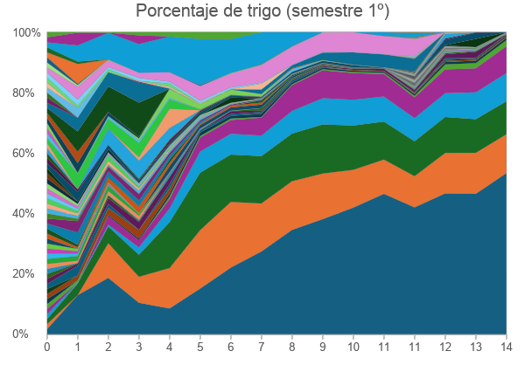
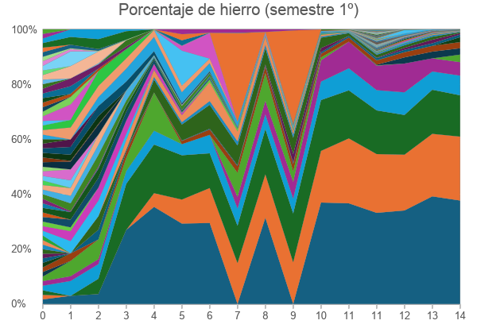
Inequality, monopoly; first semester
The student who possessed the most wheat reached 53.4% of the system's total wheat in the last session. The five students with the most wheat together accounted for 95.4%.
The largest iron ore owner ultimately held 37.7%, and the top five held 88%.
Wealth concentration was so high that many students in session 11 could no longer participate in the simulation. Therefore, a redistribution was implemented, requiring all students to contribute 10% of their wheat and iron, which was then distributed equally among them.
Despite this, in the following session the situation was not very different from before the redistribution.
In the charts, each color represents the percentage held by each student.

Slide 46
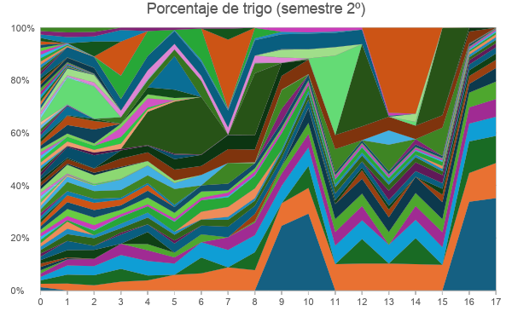
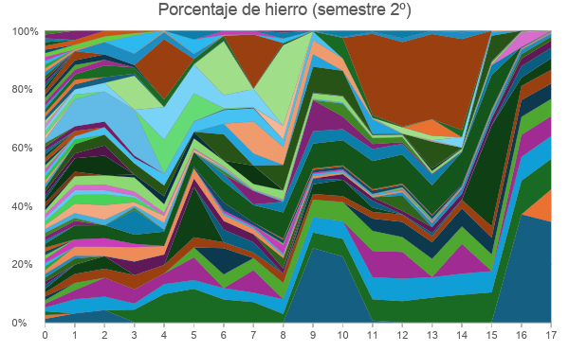
Inequality, monopoly; 2nd semester
At the end of the simulation, the largest owner had 35.2% of the total wheat, and the top five had 72.9%.
With iron, the largest owner had 34.5% and the first five had 70.8%.
In the charts, each color represents the percentage held by each student.

Slide 47
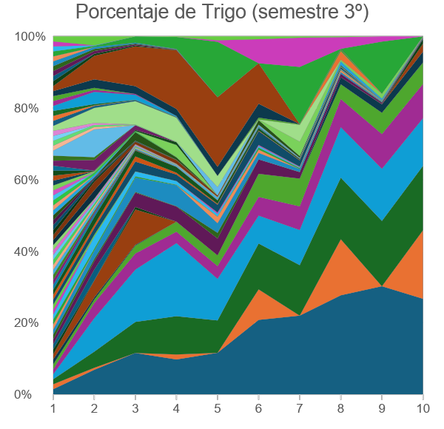
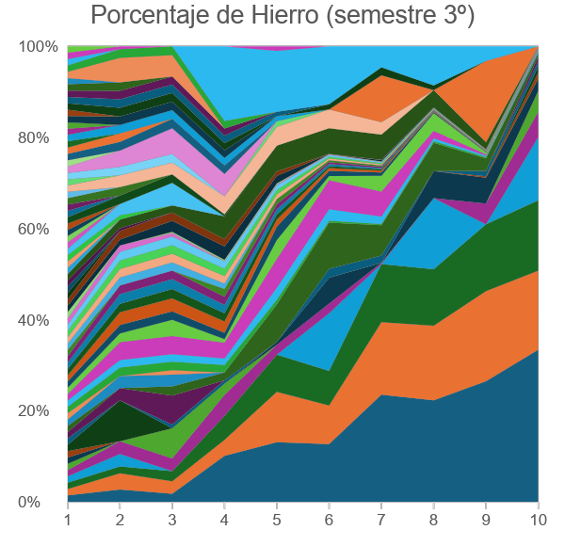
Inequality, monopoly; 3rd semester
At the end of the simulation, the largest owner had 26.6% of the total wheat, and the top five had 86.7%.
With iron, the largest owner had 33.4% and the top five had 85.6%.
In the charts, each color represents the percentage held by each student.

Slide 48
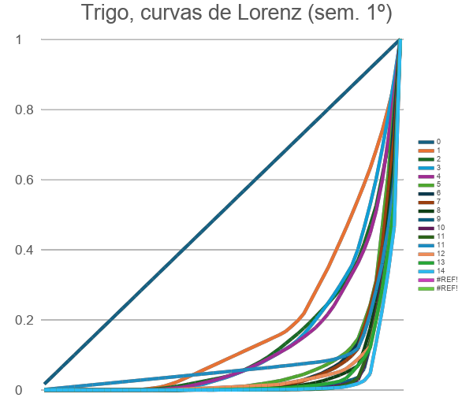
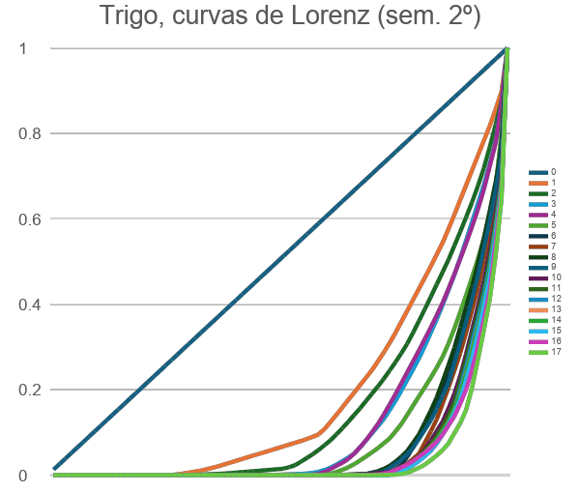
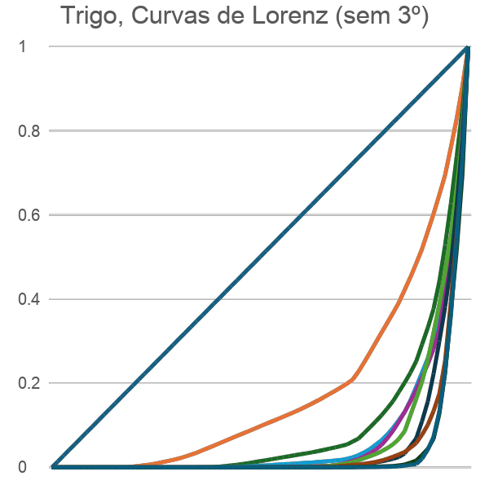

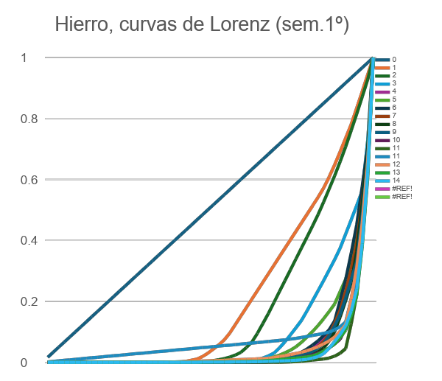
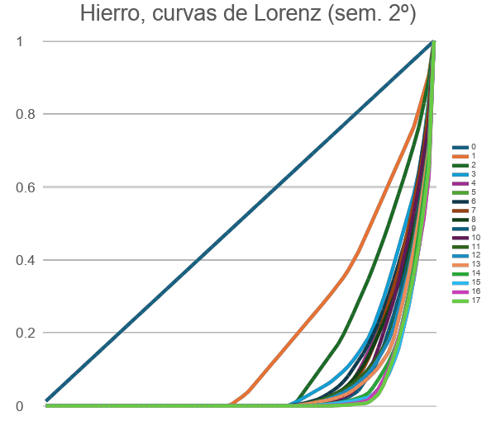
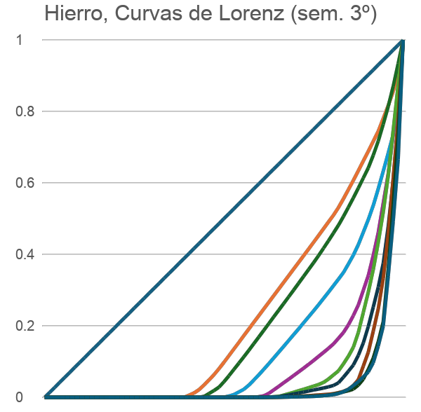

Slide 49
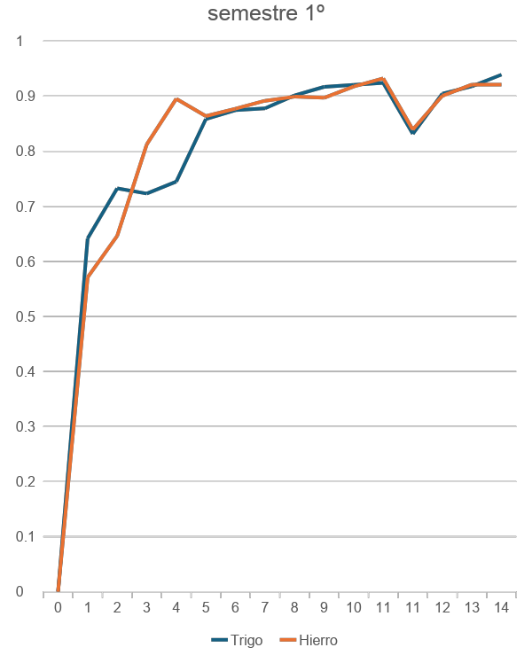


Gini coefficients

Slide 50
Origin of inequality
This growing inequality:
  It cannot be explained by advantages of scale in production.
    The processes all show constant returns at scale.
  It can only be caused by those who possess the most:
    Or they are more efficient in production.
      They achieve better proportions of inputs.
    Or they get better trades (in quantities and prices).
At this stage of the investigation, it is too early to offer a conclusive answer.
However, we will conduct a study of the most successful company in the second and third semesters.

Slide 51


Origin of inequality;
The Ironharvest company
The most successful company in the second semester, formed by four students, outperformed MBLP.
Therefore, there had to be some advantage to exchanging with other students.
  Even assuming their efficiency was at its maximum, they would not have been able to surpass MBLP otherwise.
However, this company did not commit any fraud in the exchanges. The advantage must have come from the fact that, being a large company, they obtained good prices.
However, it seems that their gap with MBLP was created in the first sessions, and that subsequently they showed similar growth rates to MBLP.

Slide 52



The origin of inequality.
The Triorama company

Slide 53
Results: Networks

Slide 54
Networks
Neither VN nor MBLP take into consideration customer networks, the interrelationships of companies.
In the simulations, the companies of several students often achieved a coordination of production, so that the bulk of the exchanges were carried out internally.
  There were companies of two students, each specializing in the production of a commodity.
  There were even companies formed by three students, the third dedicated to making use of the scraps that could not be used with processes 1 and 2.
Networks of regular customers emerged. It was common for a student to "specialize" in producing a particular subject.
  Because that way their calculations were simpler, looking for a family ratio,
  And, above all, because it generated a network of regular customers, with whom it cooperated, even without forming an explicit company.

Slide 55
Competition, cooperation, customers and ethics
Cooperation and competition
  Students who were part of a company tended to improve their collaboration substantially.
  But, in contrast, competition also increased among students from different companies.
  In some cases, this led to an exacerbation of competitiveness.
    In very isolated cases, some even attempted to break the rules of the activity. Except for one instance, a warning from the referee was sufficient to resolve the situation.
In dealings with other companies, there were two fundamental strategies:
  Those who wanted to trade with others in a mutually advantageous way.
  Those who wanted to deceive the other participant, for example, by not delivering what had been agreed upon.
These two strategies were within the rules, since deception was allowed.
  The contracts were enabled to prevent them.
Those who achieved the highest production levels relied on the first strategy.
Those who used the second option often self-excluded from the market, as the rest of the students avoided exchanging with them.
  Those who sought to gain a good position through deception did not necessarily do so because they considered deception acceptable in their personal lives. They often viewed capitalism as a system based on deception, and therefore believed that to succeed, one had to imitate the behaviors they thought led to success in real-world capitalist systems.
As a result, a certain "ethic" emerged in the exchanges; it was advisable to be "honest" so that the rest of the students would maintain the exchanges.
  Thus, in the last session of the second half of the year, when it was no longer necessary to secure a clientele, scams increased substantially.

Slide 56


Clients:
Roser and Hector
An example of a cooperative relationship maintained, without forming a company, is that maintained by two second-semester students.
One specialized in wheat production, and the other in iron production, and they traded their products.
They both also maintained exchanges with other students, but of lesser importance.
It was a very successful relationship while it lasted, achieving a production close to MBLP, the highest after Ironharvest.
There were more relationships like this, also in the first half of the year. Sometimes they were based on previous romantic relationships or friendships.

Slide 57

Number of submissions. Semester 1
(anonymized)

Slide 58

Wheat Deliveries. 1st semester
(anonymized)

Slide 59

Iron Deliveries. First Semester
(anonymized)

Slide 60

Number of deliveries. 2nd semester
(anonymized)

Slide 61

Wheat deliveries.
Second semester
(anonymized)

Slide 62

Iron Deliveries.
Second semester
(anonymized)

Slide 63

Number of Deliveries.
Third Semester
(anonymized)

Slide 64
Results: Regulation

Slide 65
Regulation; first session
The regulation in the first session is very illustrative. Let's put ourselves in the perspective of a student in the first session. They have 1000 of wheat and 1000 of iron.
  If you intend to use the first process, you need to obtain 23.333333 units of wheat per unit of iron.
  If you intend to use the second process, you need 15 units of wheat per unit of iron.
  If you use the third process, you don't need any special proportions.
Using either of the first two processes, you must sell iron and buy wheat. It is expected that the wheat will be exchanged for a large quantity of iron, and that the wheat will be relatively expensive (relative to that of VN).
Many students chose to produce wheat, so that they could have the most valued product in the next class, which they thought would still be wheat.
  In the first semester, 19 chose process 1 and 10 chose process 2. In the second semester, 33 students chose process 1 and only 2 chose process 2. In the third semester, 20 students chose process 1 and only 2 chose process 2.
  (This was observed to a lesser extent in the first semester, perhaps because the professor explained the simulation's characteristics less effectively and in less detail than in the second semester. This also seems to have been a very important factor in explaining the greater efficiency achieved in the second semester.)
Another alternative is to sell all the wheat you own at a very high price, acquire a lot of iron, and use the third process to obtain half of the accumulated iron in the next class.
  This strategy was effectively used by 6 students in the first semester, 14 in the second, and 10 in the third. It should be emphasized that this strategy is not at all obvious beforehand. Furthermore, the students were not warned that the simulation would restart with the same amount of wheat and iron, and that they developed this strategy during the time allotted for the exchange.
As a result, in the first session, in all semesters, the price of iron was similar to that of wheat, and wheat production increased significantly while iron production decreased.
This followed a similar pattern to MBLP, although certainly less efficiently.

Slide 66
Regulation; particularism, uncertainty and complexity of decisions
In a given session, the decisions to be made by each actor were complex and conditioned by uncertainty about the future and about the decisions of the other actors in the present .
Each agent made their decisions based on their own particular interests, regardless of the effects of those decisions on the other agents.
The decisions were complex.
  Each actor did not know what the exchange rates would be, nor what production processes the other actors would choose in the present;
  He made decisions in ignorance of the future.
Furthermore, prices are not absolute numbers; they depend on negotiation. The fact that prices currently tend toward an average does not mean that all exchanges are currently taking place at that rate. While the negotiation processes of other actors, and of the actor itself with others, could be observed to some extent, this did not guarantee that an exchange would be achieved at those rates. It was necessary to find another actor who not only accepted a specific exchange rate but also found the quantities to be exchanged to be advantageous.
Therefore, when negotiating exchanges and later deciding on the chosen process, each agent had to estimate the behavior of the other actors in the present and in the future based on current data and evolving exchange rates. Obviously, these estimates were bound to be subject to error.
  (Theories that presuppose full knowledge of the future and the present do not take this circumstance into account.)

Slide 67
Regulation; capitalism as a real algorithm
Despite the uncertainty and complexity of the decisions, the simulations achieved regulation of production, tending towards VN in the long term and even resembling MBLP in the first sessions.
Regulation was achieved because the actions of the actors operated in a manner similar to that of certain mathematical algorithms.
  In the simulations, for given production needs and available quantities:
    A price tends to be established in exchanges;
    There is a tendency to produce more of what is most profitable and less of what is least profitable.
  In mathematical algorithms, given initial magnitudes of the variables:
    The Lagrange multipliers are established that correspond to the fulfillment of the maximum conditions for those initial magnitudes (the prices are established in our simulation);
    It is checked whether the maximum conditions are met, and if not, the variables are set trying to make them less unmet (the most profitable processes are chosen in our simulation).
In this way, the capitalist market, operating as an "invisible algorithm", manages to gradually approximate the solution to a very complicated problem.
  Prices play the role of Lagrange multipliers and accounting plays the role of maximum conditions.
However, this solution is limited by the complexity of the decisions each actor must make, by the uncertainty surrounding the decisions of other actors, and by the uncertainty of the future. Therefore, this real-world algorithm cannot achieve the precision of the mathematical algorithms we use to solve the economic problem.
  This is the basis of the distances with MBLP and VN.

Slide 68




Regulation; price at time t as a function of the quantities existing at time t (“demand curves”)
The relative price of iron with respect to wheat in VN is 15.
The relative amount of wheat with respect to iron in VN is 19.166666; the inverse is 0.052.

Slide 69




Regulation; production at t+1 as a function of the price at t
The relative price of iron with respect to wheat in VN is 15.
The relative amount of wheat with respect to iron in VN is 19.166666.

Slide 70
Questions for theorists

Slide 71


Questions for theorists
In our simulations (in blue, green and orange) both the Wheat/Iron ratio and the price tend in the long term to be similar to those of VN, which are those of MBLP (in red) in the long term, 19.16666 and 15 respectively.
This can more or less be understood because, as Sraffa said, “There is a single set of exchange values which, if adopted by the market, restores the original distribution of products and makes it possible for the process to be repeated.”
But our simulations also resemble MBLP in the first session, even though MBLP is a long-term maximization.
How does the market manage to make the Wheat/Iron ratio in the first session resemble that of MBLP, and wheat production be close to 4 times that of iron, when later in the simulation it tends to be 19.16666 times higher?
How does the market manage to make the price in the first session resemble that of MBLP, and that of iron similar to that of wheat, when later in the simulation it tends to be 15 times higher?

Slide 72

A call for prudence, and a note for bold theorists
Perhaps we should be cautious in interpreting these coincidences, because three simulations are far too few to definitively state that markets (at least simulated ones) always, or very often, achieve this. Many more simulations would be necessary to make such a claim.
However, if confirmed, it seems clear that these regularities would be a key clue to understanding how capitalism works.
Short-term profit maximization?
We note that MBLP is indeed a long-term maximization, but that it can be broken down into a series of single-step maximizations, one for each instant. For example, if in the first session we knew the Lagrange multipliers of MBLP for the following session, Y1 , we could solve the assignment (and value) problem for the first session by solving
The issue is that, for the market to somehow "solve" this problem in the short term, it would need to "know" Y₁ to establish the target. It is unclear how a market could compute these multipliers for the next session, even assuming that it could compute the Lagrange multipliers for the current session, Y₀, through trading, and assuming that could compute the maximum conditions, B Y₁ - A Y₀ <= 0, using accounting.

