Slide 1



Structural Signatures of Income Upgrading
Evidence from OECD Inter-Country Input-Output Tables, 1995–2022
Global Value Chains, Domestic Linkages and Development Pathways

Slide 2

MOTIVATION
Key Question: What structural transformations distinguish economies that successfully move from one income group to the next?
Why do some countries upgrade while others remain stuck?
Successful upgraders
Persistent challenges
Korea
Many low-income economies
China
Resource-dependent economies
Poland
Policy implication: If a country wants to move from one income group to the next, what structural dimensions appear to matter most?
Viet Nam

Slide 3

EXISTING LITERATURE
Structural
Transformation
Capabilities and Diversification
Global
Value Chains
Through what structural channels do countries become richer?
Lewis (1954)
Hausmann & Hidalgo (2011)
Baldwin (2016)
Kuznets (1966)
OECD TiVA
Prebisch (1950)
Development depends on accumulating capabilities and moving into more sophisticated activities.
Development increasingly occurs through participation in international production networks.
Hirschman (1958)
Development occurs through changing production structures.
Using TiVA indicators we examine:
• Global integration
• Domestic production depth
• Services upgrading
• Demand linkages
• Resource dependence

Slide 4
STRUCTURAL CHANNELS
Question: What structural transformations are associated with successful income upgrading, and how do these transformations differ across stages of development?
Through what structural channels do countries become richer?
Using TiVA indicators we examine:
Global integration
Domestic production depth
Services upgrading
Demand linkages
Resource dependence

Slide 5

CONCEPTUAL FRAMEWORK
HYPOTHESES
Low Income
H1: Industrialisation
↓
Industrialisation and domestic deepening
L → LM transitions are associated with:
• Manufacturing GVC integration
• Manufacturing exports
• Domestic supplier development
Development is not one process
Different stages face different constraints.
↓
Lower-Middle
↓
H2: Domestic Deepening
Value capture
LM → UM transitions are associated with:
• Stronger domestic linkages
• Higher foreign demand for products
• Diversification
↓
Upper-Middle
↓
H3: Functional Upgrading
Functional Upgrading
UM → H transitions are associated with:
• Services embodied in exports
• Greater value capture
• Sophisticated specialisation
↓
High Income

Slide 6

DATA & METHODOLOGY
Observed Transitions
Transition
Count
Dataset & Scope
Analytical Approach
L → LM
17
Utilizing the OECD ICIO / TiVA indicators covering 80 economies from 1995 to 2022. This provides a comprehensive view of global value chain dynamics over nearly three decades.
We examine structural transformations through multiple lenses: global integration, domestic production depth, services upgrading, and resource dependence.
LM → UM
19
UM → H
9
Indicators
Classification
Source: OECD ICIO / TiVA Database & World Bank Data.
Focus on Trade in Value Added (TiVA) metrics, including Foreign Value Added (FVA), Domestic Value Added (DVA), and Domestic Intermediate Use (IDC).
Income transitions are identified using World Bank historical classifications to track movement between income groups.

Slide 7
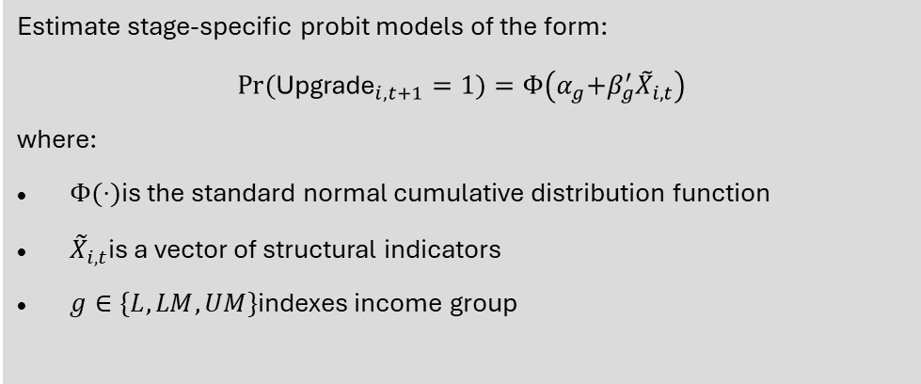
DATA & METHODOLOGY
Observed Transitions
Estimate stage-specific probit models of the form:
$$Pr⁡({\text{Upgrade}}_{i,t+1}=1)=Φ\left(α_{g} + β_{g}^{′}{\tilde{X}}_{i,t}\right)$$
where:
$Φ(⋅)$is the standard normal cumulative distribution function
${\tilde{X}}_{i,t}$is a vector of structural indicators
$g∈\{L,LM,UM\}$indexes income group
Transition
Count
Dataset & Scope
Analytical Approach
L → LM
17
Utilizing the OECD ICIO / TiVA indicators covering 104 economies from 1995 to 2022. This provides a comprehensive view of global value chain dynamics over nearly three decades.
We examine structural transformations through multiple lenses: global integration, domestic production depth, services upgrading, and resource dependence.
LM → UM
19
UM → H
9
Indicators
Classification
Source: OECD ICIO / TiVA Database & World Bank Data.
Focus on Trade in Value Added (TiVA) metrics, including Foreign Value Added (FVA), Domestic Value Added (DVA), and Domestic Intermediate Use (IDC).
Income transitions are identified using World Bank historical classifications to track movement between income groups.

Slide 8
TRANSITION: L → LM
TRANSITION: LM → UM
TRANSITION: UM → H
Take-Off
Breaking the Trap
Frontier Upgrading
GVC Entry
Value capture
Functional Upgrading
Early Domestic Embedding
Upstream Repositioning
Ecosystem Maturity
Key Drivers
Key Drivers
Key Drivers
Manufacturing GVC integration
Stronger domestic linkages
Services embodied in exports
Export take-off and assembly
Production network thickening
Innovation & productivity gains
Initial domestic supplier development
Higher final demand for products
Knowledge-intensive activities
Foreign Content (FVASH)
Moderate / Stable dependence
Domestic Linkages (IDC)
High & Persistent maturity
↑
Early embedding
↑↑ Strong
network thickening
Services DVA
Low / Not decisive
Gradual
↑
↑↑ Strongly higher
Intermediate Use
Stable / Quality-focused
↑
Entry via assembly
↑
Upstream shift

Slide 9
EXPECTED STRUCTURAL PATTERNS ACROSS DEVELOPMENT STAGES
TiVA Indicator
Comparison 1 L → LM vs Stuck L (Take-off)
Comparison 2 LM → UM vs Stuck LM (Break Middle Trap)
Comparison 3 UM → H vs Stuck UM (Frontier Upgrade)
Structural DNA
EXGR_FVASH
↑ Higher among movers (GVC entry)
Plateau or ↓ relative to stuck (less assembly dependence)
Moderate or ↓ (foreign dependence not decisive)
Comparison of TiVA indicators across different stages of development, highlighting the distinct structural signatures required for successful income transitions.
EXGR_DVASH
Low–moderate
↑ Rising domestic value capture
Persistently high
EXGR_SERV_ DVA
Low / not decisive
Gradual ↑
↑↑ Strongly higher among movers
EXGR_ INTDVASH
↑ Entry via assembly/intermediates
↑ Upstream shift toward supplying intermediates
Stable / quality-focused
IDC_share
↑ Early domestic embedding
↑↑ Strong domestic production thickening
High & persistent (ecosystem maturity)
EXGR_ DVAFXSH / FEXDVApSH
Limited forward role
↑ Increasing forward/upstream positioning
Strong & sustained forward role
FFD_DVA
Modest / secondary
↑ Demand-pull and domestic absorption
Stable / not dominant driver
Structural Risk if Stuck
Commodity trap or enclave
assembly
Participation without domestic deepening
Manufacturing without services sophistication

Slide 10
OECD Inter-Country Input-Output (ICIO) table structure
A globally balanced view of inter-country inter-industry flows of intermediate and final goods and services
A table for each year to track evolution of global production networks over time
To understand the nature, and impact, of regional and global value chains (GVCs) e.g. TiVA indicators
Notes:
We first assume that we have consistent, balanced, industry x industry global IO tables e.g. ICIO
From national IO and SUT tables, we construct our ICIO, and here is an example of three countries and two industries
“ICIO is essentially a global map of who buys from whom, across industries and countries.”
The table is globally balanced, meaning every sale has a corresponding purchase.
This provides the foundation for tracing value through global supply chains.

Slide 11

A global Leontief
Production identity: output (X) is either used as intermediate (AX) or final demand (Y)
X = AX + Y
where A is the input coefficient
Re-arranging we have:
X – AX = Y → X(1-A) = Y
Then X = (1-A)⁻¹Y → X = BY
And the global Leontief inverse
B = (I-A)⁻¹
The Leontief inverse B captures all production needed – both direct and indirect to satisfy demand.
A shock to final demand in one country generates production in many countries.
Cou s, Ind j
Cou s
Cou r, ind i
Z
Y
X
VA
∑VA = ∑Y
X
Note: this is a simplified version of ICIO and:
Value added is at basic prices and includes taxes less subsidies on intermediate products;
Final demand is at basic prices and includes direct purchases abroad by residents;
$b_{ij}^{rs}$ = direct and indirect inputs from industry i in country r for the production of one unit of output by industry j in country s.
Notes:
This slide introduces the engine behind TiVA.
We begin with the production identity:
Output equals intermediate demand plus final demand.
Rearranging gives:
X = (I − A)^−1Y
The Leontief inverse captures all direct and indirect production requirements.
A shock to final demand in Germany may require production in China, Korea, France and the United States.
The Leontief inverse captures those global ripple effects.
If a German consumer buys a car, the steel may come from Sweden, electronics from Korea, batteries from China and software from the United States. The Leontief inverse captures the entire chain.

Slide 12
Core idea: tracing value-added
From output to value-added
Va_{Y} = vBY
v = value-added per unit of output
B = global production multipliers
Y = final demand
We are transforming production flows into value-added flows.
Alternatively, Va_{e}=vBe
Where e are exports.
Cou s, Ind j
Cou s
Cou r, ind i
Z
Y
X
VA
∑VA = ∑Y
X
Note: this is a simplified version of ICIO and:
Value added is at basic prices and includes taxes less subsidies on intermediate products;
Final demand is at basic prices and includes direct purchases abroad by residents;
Instead of v being value-added per unit,
v = Co2 emissions/output → Trade in embodied Co2
v = employment/output → Trade in employment
Notes:
Once we know the production required to satisfy demand, we can convert production into value added.
We do this by applying value-added coefficients:
Value Added divided by Output.
The formula becomes:
VaY = vBY
where:
v converts output into value added,
B captures the production chain,
and Y is final demand.
This simple equation is the foundation of nearly every TiVA indicator
If we replace value added with employment coefficients, we obtain Trade in Employment.
If we replace value added with CO₂ coefficients, we obtain embodied emission

Slide 13
Global flows of goods and services
4 perspectives, 8 dimensions
Notes:
The same value chain can be viewed from multiple perspectives:
the exporter,
the importer,
the producer of value added,
or the final consumer.

Slide 14

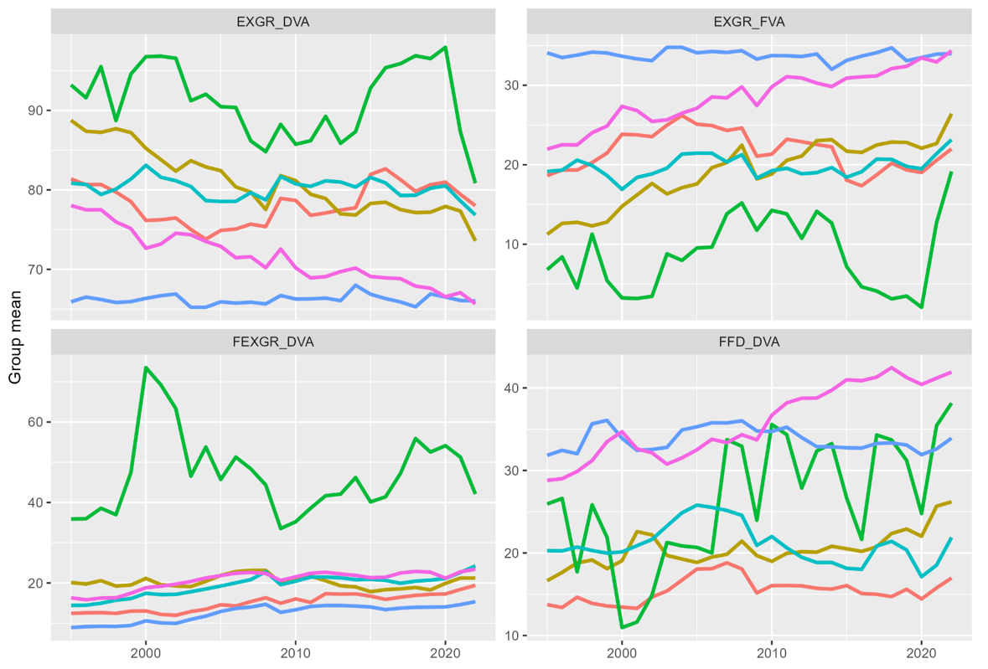
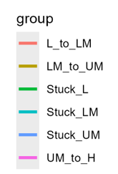
STRUCTURAL TRANSFORMATION ACROSS INCOME LEVELS

Slide 15
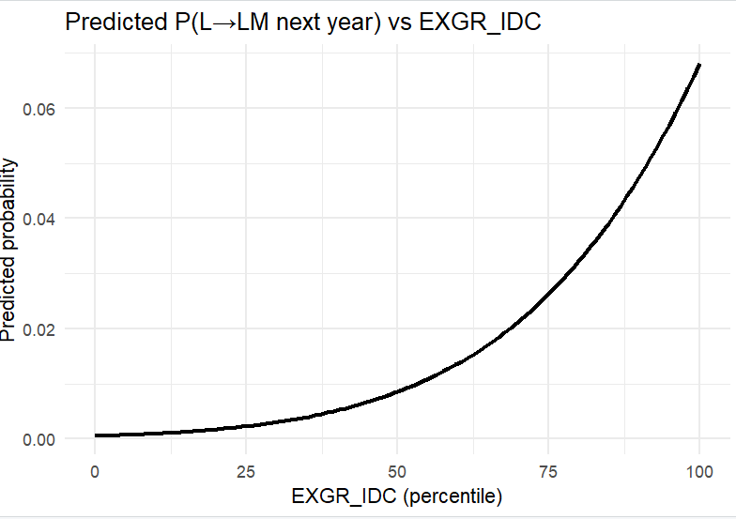
RESULTS: L → LM
Industrial Deepening Signature
P-VALUE
VARIABLE
COEFFICIENT
EXGR_FVA (manu)
1.26** (0.52)
0.52
EXGR_IDC (manu)
1.79*** (0.56)
0.56
Countries in the 75th percentile of Manufacturing IDC have an estimated 4.5% probability of upgrading to lower-middle-income status in the following year, compared with 1.1% for countries at the median and only 0.2% for countries in the lower quartile. Countries at the very top of the IDC distribution have an estimated upgrade probability of 13%, suggesting that strong domestic supplier networks and industrial deepening are closely associated with successful early-stage development transitions.

Slide 16
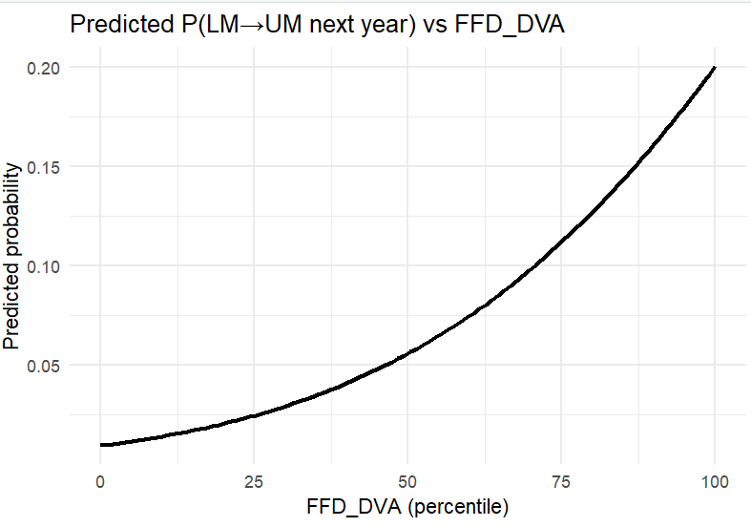
RESULTS: LM → UM
Capturing Value Signature
P-VALUE
VARIABLE
COEFFICIENT
DVA in Foreign Final Demand (FFD)
1.50***
0.55
Services VA
1.03**
0.40
Import intensity
-1.26**
0.49
Countries in the 75th percentile of FFD_DVA have an estimated 15.2% probability of upgrading to upper-middle-income status, compared with 8.3% at the median and 4.0% in the lower quartile. Countries at the top of the distribution reach an estimated probability of 24.4%. This suggests that, once basic industrial capabilities are established, the ability to generate domestic value added that is ultimately absorbed by foreign consumers becomes an increasingly important characteristic of successful upgrading economies.

Slide 17
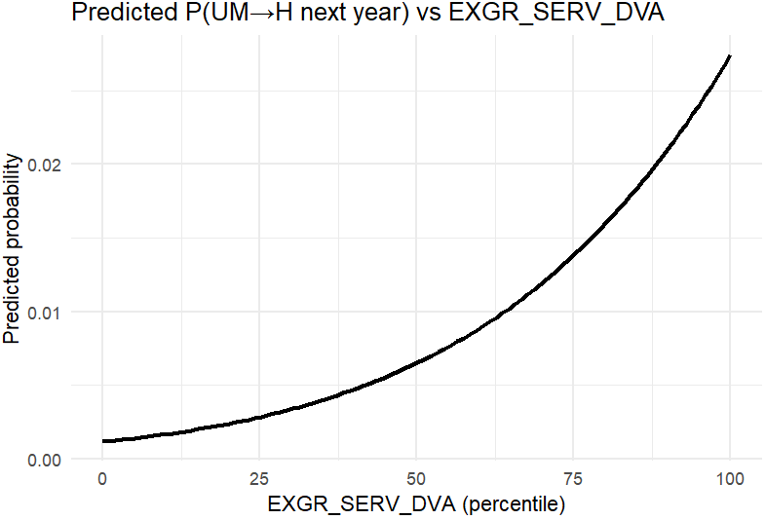
RESULTS: UM → H
Services Signature
VARIABLE
COEFFICIENT
P-VALUE
DVA in Foreign Final Demand (FFD)
1.18**
0.51
Services VA
1.13***
0.39
Countries in the 75th percentile of Services VA embodied in exports have an estimated 3.2% probability of reaching high-income status, compared with 1.8% at the median and 0.9% in the lower quartile. Countries at the top of the services value-added distribution reach an estimated probability of 5.5%. Although high-income transitions remain relatively rare events, the results suggest that greater integration of domestic services into export activities is a distinguishing feature of economies that successfully make the final transition to high-income status.

Slide 18

STRUCTURAL SIGNATURES & THE MIDDLE-INCOME TRAP
Reframing the trap:
Stagnation occurs when countries fail to generate the next structural signature.
Examples:
Integration without domestic deepening
Manufacturing without services upgrading
Weak A-matrix connectivity

Slide 19
L → LM CASE STUDIES
Pathway
Countries
Main interpretation
Manufacturing-GVC integration
China, India, Cameroon, Nigeria, Myanmar
upgrading via rising foreign content/manufacturing integration
Domestic deepening
Angola, Lao PDR, Ukraine, Viet Nam
upgrading via stronger IDC/linkages, often resource- or transition-led
Light manufacturing / assembly
Bangladesh, Cambodia, Pakistan
labour-intensive export model, but limited domestic deepening
Weak or fragile upgrading
Kenya, Côte d’Ivoire, São Tomé, Senegal, Indonesia
transition occurs, but structural indicators are mixed

Slide 20
LM → UM CASE STUDIES
Pathway
Countries
Main story
Central/Eastern European GVC integration
Poland, Slovak Republic, Romania, Bulgaria, Estonia, Latvia, Lithuania, North Macedonia
Manufacturing integration into European production networks
Resource and commodity upgrading
Kazakhstan, Russia, Peru, Colombia, South Africa
Commodity boom and resource rents support income growth
Diversified industrial upgrading
Thailand, Türkiye, Brazil
Broad industrial base with increasing sophistication
Services and knowledge upgrading
Costa Rica, Jordan
Services, electronics, business services, tourism
State-led transition economies
Belarus, Ukraine (earlier), Kazakhstan
Structural transformation mediated by state ownership and industrial policy

Slide 21
UM → H CASE STUDIES
Pathway
Countries
Main Story
Advanced manufacturing upgrading
Korea, Czechia, Slovenia, Hungary
Move into high-productivity industrial ecosystems
European convergence and institutional integration
Croatia, Malta, Greece
EU integration and productivity convergence
Resource-rent pathway
Saudi Arabia, Chile (partially)
High incomes supported by resource rents
Mixed manufacturing-services model
Malta, Croatia
Tourism, logistics and services complement industry

Slide 22
TRANSITION DOMINANT MECHANISMS
Transition
Dominant Mechanism
L → LM
Industrialisation and export take-off
LM → UM
Deepening domestic linkages and GVC integration
Productivity upgrading, innovation and knowledge-intensive activities
UM → H

Slide 23
RESOURCE CURSE QUESTION
Many countries that remain stuck are resource rich.
Angola
Nigeria
But some resource-rich countries upgraded.
Chile
Saudi Arabia
Kazakhstan
Question: What differentiates resource-led upgrading from resource-locked growth?

Slide 24
RESOURCE CURSE ANALYSIS
At low-income levels, resource intensity is negatively and significantly associated with upgrading (coefficient = -1.16, p = 0.04). This indicates that countries more specialised in extractive activities are less likely to transition into lower-middle income status.
At upper-middle income levels, a similar negative effect re-emerges (-0.84, p = 0.04), suggesting that resource dependence also constrains transitions into high-income status.

Slide 25
STATISTICAL RESULTS: RESOURCE IMPACT MATRIX
On the right, the addition of resource constraint ---------→
Variable
(1) L → LM
(2) LM → UM
(3) UM → H
(1) L → LM
(2) LM → UM
(3) UM → H
Manufacturing FVA
1.26** (0.52)
—
—
1.73*** (0.58)
—
—
Manufacturing IDC
1.79*** (0.56)
—
—
2.35*** (0.62)
—
—
DVA in Foreign Final Demand (FFD)
—
1.50*** (0.55)
1.18** (0.51)
—
0.49 (0.37)
1.24*** (0.43)
Services VA
—
1.03** (0.40)
1.13*** (0.39)
—
0.63* (0.37)
0.76* (0.41)
Resource share
-1.16 (0.57)
-0.08 (0.36)
-0.84 (0.41)
Constant
-3.28***
-2.34***
-3.05***
-3.24***
-2.17***
-2.39***
Observations
226
483
465
226
483
465
Pseudo R²
0.103
0.051
0.073
0.138
0.019
0.095

Slide 26
ALTERNATIVE PATHWAYS
Variable
Resource-poor
Resource-rich
Manufacturing FVA
1.51** (0.66)
2.05 (1.75)
Manufacturing IDC
1.77*** (0.65)
2.58** (1.20)
Constant
-3.32***
-3.62***
Observations
132
94
Pseudo R²
0.136
0.116

Slide 27
RESEARCH AGENDA
Structural Decomposition Analysis
Decompose changes into:
Technology
Demand
Trade
Resource Curse Analysis
Compare:
Successful resource-rich upgraders
Resource-rich non-upgraders
Goal: Identify "escape signatures".

Slide 28

APPENDIX

Slide 29
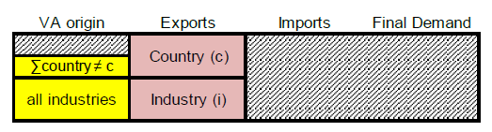

1. Foreign VA in gross exports (EXGR_FVA) a.k.a Backward participation in GVCs
Bci is the column of B corresponding to inputs used by industry i in country c, where the rows corresponding to inputs from origin industries in country c are set to zero.
Note that EXGR_FVA includes re-imported foreign value added that was previously exported by country c (c.f. EXGR_RIM)
For regions c, EXGR_FVA excludes intra-regional trade (e.g. for EU27, exports to non- EU27 only). Intra-region value added flows (e.g. German value added in French exports) are treated as domestic value added.
Calculation
$${exgr_fva}_{c,i}={\hat{V} B}_{c,i}×{EXGR}_{c,i}$$
Interpretation
High EXGR_FVA→ exports rely heavily on imported intermediates → more exposed to global disruptions.
Low EXGR_FVA → exports are driven mainly by domestic production → more insulated from foreign input shocks.
Notes:
This indicator measures the share of a country’s exports that originates from foreign inputs.
Interpretation:
A higher share suggests greater reliance on imported intermediates and stronger participation in international production networks.
A lower share indicates that a larger portion of export value is generated domestically.
Neither outcome is inherently positive or negative; it can reflect differences in economic structure, size, and specialisation.

Slide 30
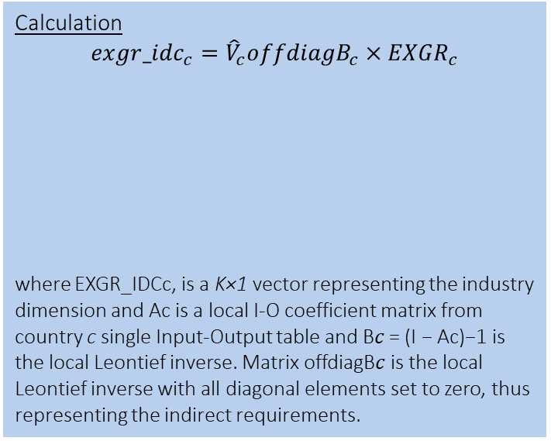
3. Decomposing domestic value added
Calculation
$${exgr_idc}_{c}={{\hat{V}}_{c}offdiagB}_{c}×{EXGR}_{c}$$
where EXGR_IDCc, is a K×1 vector representing the industry dimension and Ac is a local I-O coefficient matrix from country c single Input-Output table and B𝑐 = (I − Ac)−1 is the local Leontief inverse. Matrix offdiagB𝑐 is the local Leontief inverse with all diagonal elements set to zero, thus representing the indirect requirements.
Indirect DVA content of
Gross exports
EXGR_IDC
“France’s (c) indirect domestic value added embodied in automotive (i) gross exports to the world (p) in 2022 is 14.7 billion USD”

Slide 31
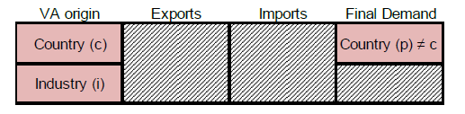

6. Domestic VA in foreign final demand
(FFD_DVA)
Policy-relevant questions
Forward dependencies: how much of my country’s value added is serving foreign final demand (i.e., household consumption)?
How much is my economy exposed to downstream demand or GVC shocks from abroad?
Example
Q: How do Ireland (a small open economy) and the US (internally driven) compare in terms of reliance on foreign final demand?
A: In 2022, US (c) and Irish (c) total (i) domestic value embodied in foreign final demand (p = world) was 2,237 and 383 bn USD, equivalent to around 9% and 72% of domestic value added (VALU_FFDDVA), respectively
Calculation
$${ffd_dva}_{c,i,p}={\left(\hat{v}B\right)}_{c,i →C,I} ×{fd}_{C,I→p}$$
The amount of industry i in country c’s value added reaching final consumers abroad in partner p
Interpretation
High DFD_FVA/VALU
→ Domestic demand is import-intensive
→ Consumers highly exposed to foreign supply conditions
→ Indicates structural openness or limited domestic production
Low DFD_FVA/VALU
→ Domestic demand mostly supported by domestic value added
→ More insulated from foreign disruptions
→ Reflects a strong domestic supply base

Slide 32
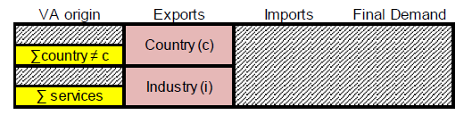
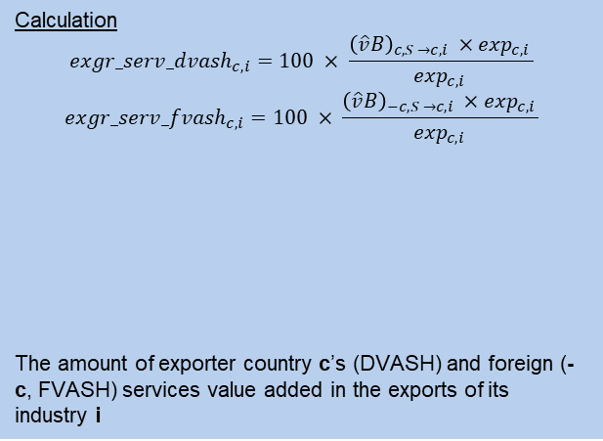
4. Services VA share of gross exports (EXGR_SERV_FVASH)
Calculation
$${exgr_serv_dvash}_{c,i}=100 × \frac{{\left(\hat{v}B\right)}_{c, S →c,i} ×\exp_{c,i }}{\exp_{c,i }}$$
$${exgr_serv_fvash}_{c,i}=100 × \frac{{\left(\hat{v}B\right)}_{−c, S →c,i} ×\exp_{c,i }}{\exp_{c,i }}$$
The amount of exporter country c’s (DVASH) and foreign (-c, FVASH) services value added in the exports of its industry i
Policy-relevant questions
How much are services indirectly (through value added linkages) participating in trade through gross exports?
The “servicification” of manufacturing
Example
Q: How has the importance of services value added embodied in manufacturing exports increased over time in Türkiye?
A: Turkish (c) services value added, both domestic and foreign, in manufacturing (i) gross exports grew from 22.7% (1995) to 28.5% of gross exports (2022).
Interpretation
High EXGR_SERV_FVASH
→ X
Low EXGR_SERV_FVASH
→ X

Slide 33
A one-unit increase in the percentile-transformed Manufacturing IDC variable increases the latent propensity to upgrade by 1.79 standard deviations.
The problem is that the probit model is estimated on an unobserved latent variable:
y∗=Xβ+εy^* = X\beta + \varepsilony∗=Xβ+ε
and we only observe:
y=1ify∗>0y = 1 \quad \text{if} \quad y^* > 0y=1ify∗>0
with
P(y=1)=Φ(Xβ)P(y=1)=\Phi(X\beta)P(y=1)=Φ(Xβ)
where Φ\PhiΦ is the cumulative normal distribution.
What does 1.79 mean?
Your Manufacturing IDC variable was transformed to a percentile:
0 = bottom of distribution
1 = top of distribution
(or 0–100 then rescaled).
So a coefficient of 1.79 means:
Moving from the bottom to the top of the Manufacturing IDC distribution increases the probit index by 1.79.
Since a standard normal distribution has a standard deviation of 1, this is actually a very large effect.

Slide 34
L to LM
ALB
CHN
GEO
MRT
SEN
SLB
ZMB
LM to UM
ALB
BLZ
DZA
FJI
IRN
MNG
TON
TUR
ZAF
L to UM
ARM
AZE
BIH
CHN
GEO
GNQ
GUY
UM to H
ATG
BRB
HUN
LVA
MLT
PLW
RUS
UM to H
BGR
CRI
EST
LTU
PAN
POL
ROU
SVK
Stuck L
AFG
BDI
BFA
CAF
COD
ERI
ETH
GMB
GNB
LBR
MDG
MLI
MOZ
MWI
NER
RWA
SLE
SOM
TCD
TGO
UGA
Stuck LM
BOL
CPV
DJI
EGY
FSM
KIR
MAR
PHL
SWZ
VUT
WSM
Stuck UM
GAB
LBY
LCA
MEX
MUS
MYS

Slide 35

H1 — TAKE-OFF (L → LM)
H2 — BREAKING THE MIDDLE-INCOME TRAP (LM → UM)
H3 — FRONTIER UPGRADING (UM → H)
Signature: GVC Entry + Early Domestic Embedding
Signature: Domestic Deepening + Upstream Repositioning
Signature: Ecosystem Maturity + High-Quality Forwardness
↑ Foreign value-added in exports (EXGR_FVASH)
↑ Initial domestic supplier integration (IDC_share)
Participation precedes sophistication
Mechanism:
External integration with emerging domestic linkages
Failure modes:
Commodity trap (low FVASH, low IDC).
Enclave trap (high FVASH, low IDC).
Plateau/decline in FVASH
↑ Domestic value capture (EXGR_DVASH)
↑ IDC_share (production network thickening)
↑ Forward / intermediate export positioning
Mechanism:
Structural consolidation and capability deepening.
Upgrading requires moving from participation to value capture.
Persistently high domestic value-added shares
Dense domestic production networks (high IDC)
Strong forward/upstream positioning
Moderate dependence on foreign inputs
Mechanism: Knowledge-intensive domestic ecosystem supporting exports.
Upgrading reflects structural sophistication, not integration intensity.

Slide 36

EXPECTED STRUCTURAL PATTERNS
The TiVA DNA
TiVA Indicator
L → LM (Take-off)
LM → UM (Capture)
UM → H (Frontier)
These indicators represent the structural signatures of development.
Transitions are not just about volume, but about the composition of value added and the depth of domestic production networks.
Foreign Content (FVASH)
Moderate / Stable dependence
↑ High
(GVC entry via assembly)
↓ Plateau
(Rising domestic capture)
Domestic Linkages (IDC)
High & Persistent maturity
↑
Early embedding
↑↑ Strong
network thickening
Services DVA
Low / Not decisive
Gradual
↑
↑↑ Strongly higher
Intermediate Use
Stable / Quality-focused
↑
Entry via assembly
↑
Upstream shift

