Slide 1
The FIGARO compilation process – a brief comprehensive overview
José Manuel Rueda-Cantuche,
Santacruz Banacloche,
Fabienne Montaigne
European Commission,
23 June 2026

Slide 2
National Supply, Use and Input-Output Tables

Slide 3
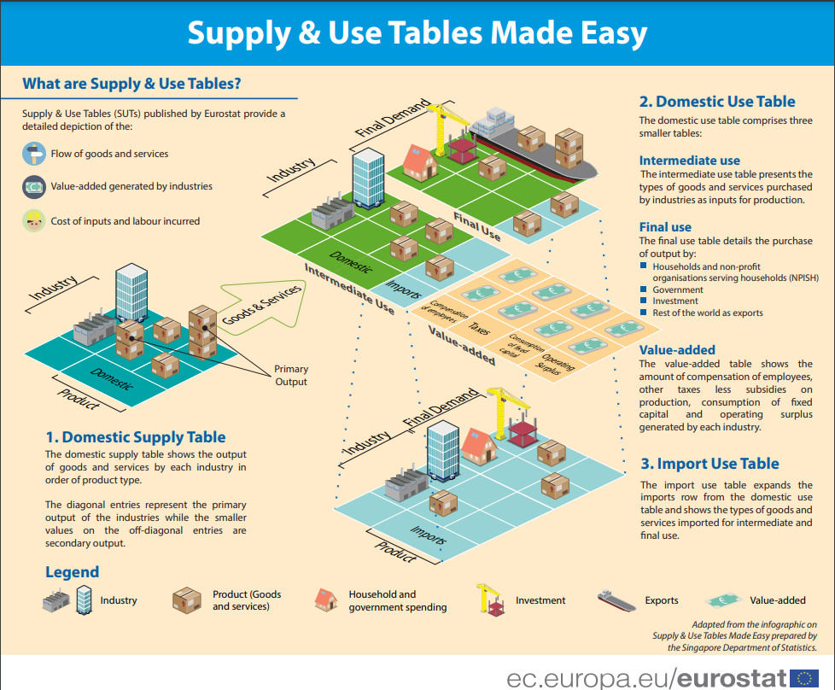
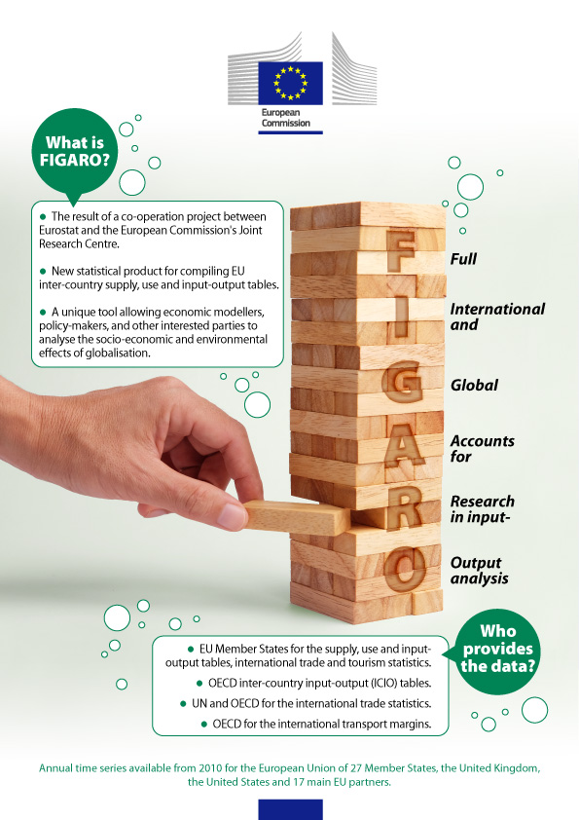

Slide 4
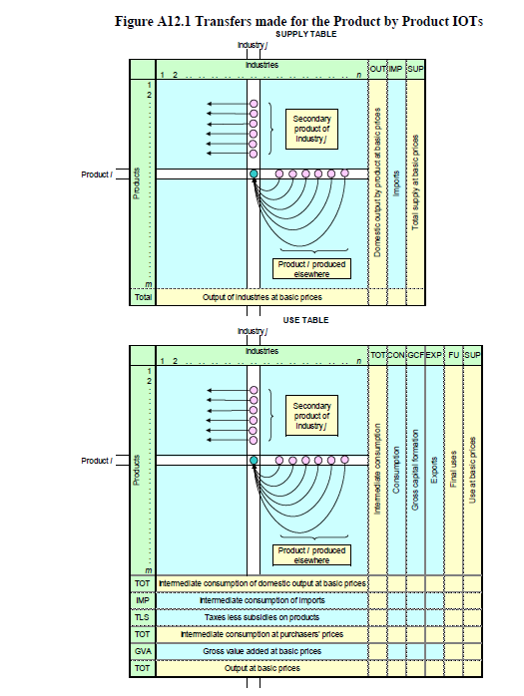
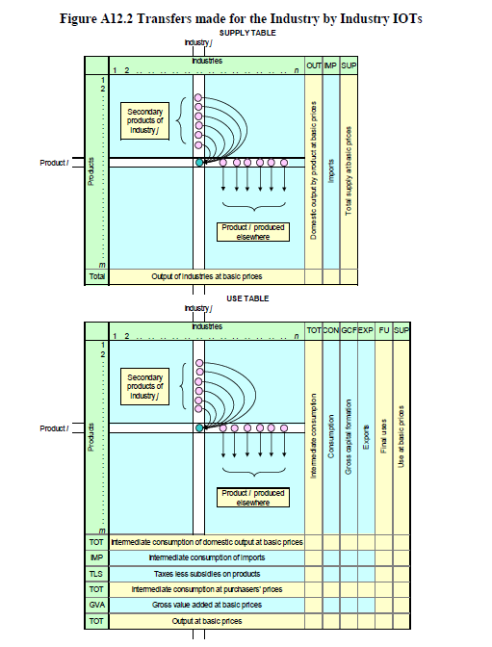

Slide 5
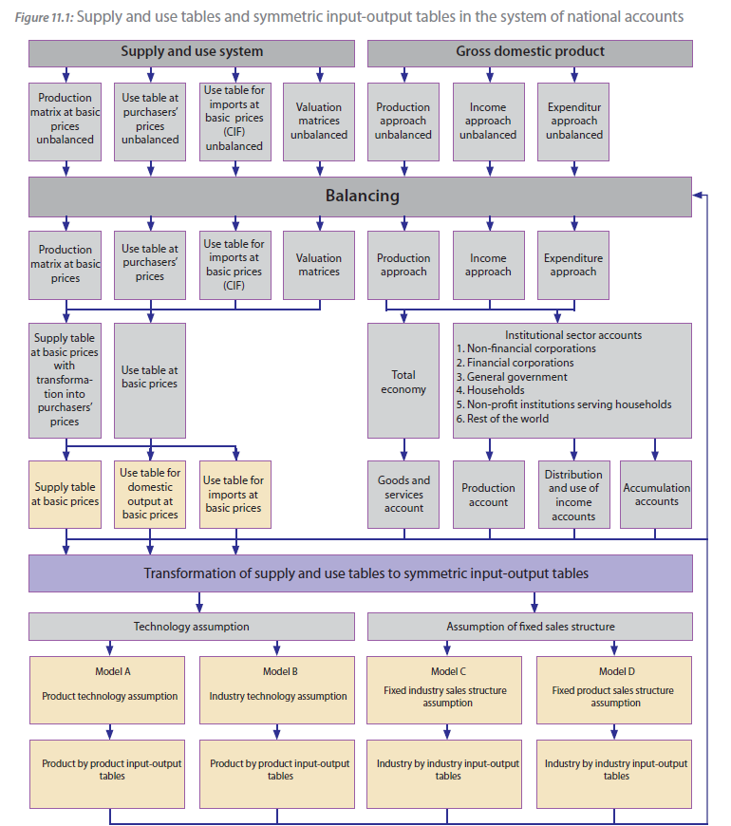

Slide 6

Multirregional Input-Output Models. FIGARO
Eurostat and Joint Research Centre

Slide 7
Introduction to FIGARO
FIGARO: ‘Full International and Global Accounts for Research in input-Output analysis’.
The EU inter-country Supply, Use and Input-Output tables, also known as the FIGARO tables, are the results of a co-operation between Eurostat and the European Commission’s Joint Research Centre.
Since 2021 it has become EU Official Statistics: benchmarked to the latest available official macroeconomic aggregates.
https://ec.europa.eu/eurostat/web/esa-supply-use-input-tables/overview

Slide 8

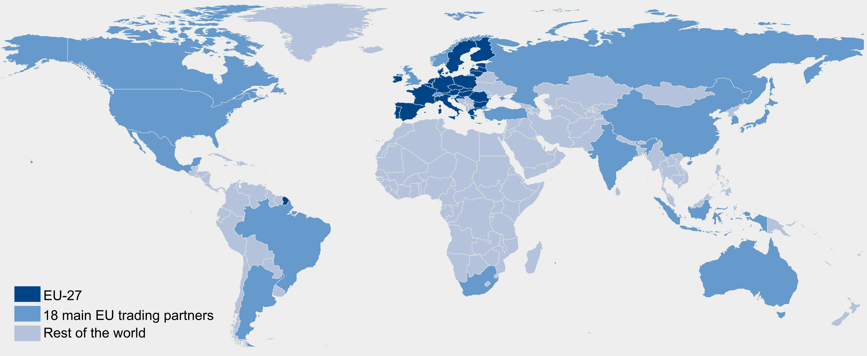
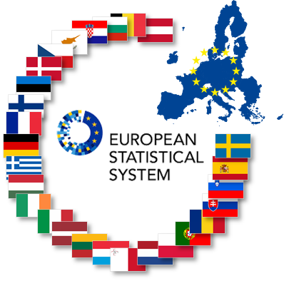

FIGARO release edition 2026 online next 20 July!!!!
22 main
trading
partners
+ RoW
+
=
Figaro
49 + RoW
Globally balanced view of National Accounts Main Aggregates, adjusted to latest national GDP main aggregates (99.1% population and 99.8% GDP)
Build upon available data from National Accounts (national SUTs) and balanced international trade statistics
  Supply-use by 64 product/industry categories (CPA/NACE Rev.2)
  Since 2021, annual production by Eurostat; since 2021, fully aligned with countries’ National Accounts official statistics.

Slide 9
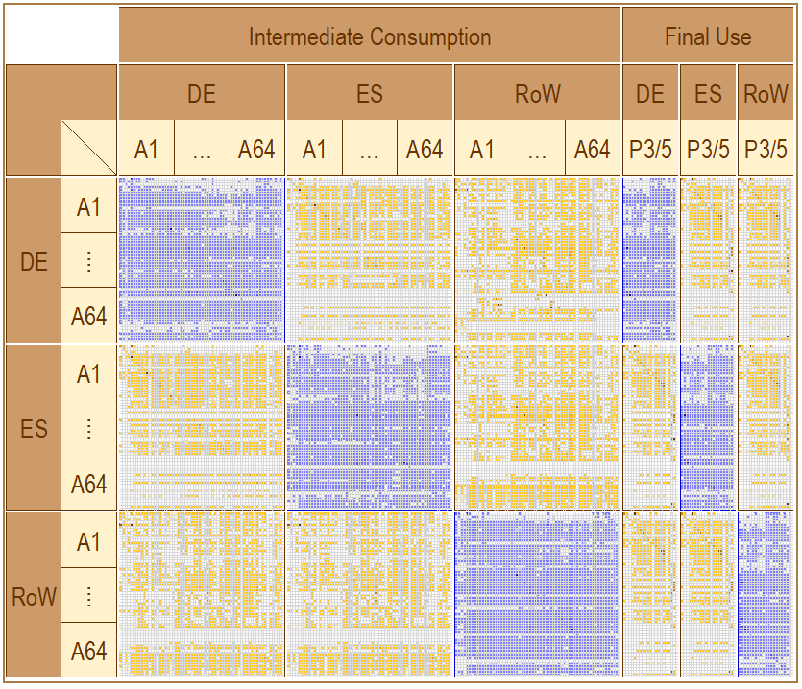
Uses
Figaro
Resources

Slide 10
From DE
to ES
(balanced)
Figaro
From ES
to DE
(balanced)

Slide 11


Mirror
trade
approach
Figaro
Full International and Global Accounts
for Research in input-Output analysis

Slide 12

Tables
Process
Global National Accounts Main Aggregates (benchmark)
RAS methods
National Supply and Use tables (purchaser’s prices, CIF)
Figaro
Trade and transport margin, TLS
National Supply and Use tables (basic prices, FOB)
Balanced view of trade in goods (QDR methodology)
Balanced view of trade in services (fully consistent)
Goods sent abroad for processing
Estimation of merchanting
Direct purchases abroad
Balanced View of trade (geographical distribution)
Inter-Country SUT (Benchmarked to National Accounts)
Technology/Sales Assumptions
Inter-Country
Input-Output tables

Slide 13
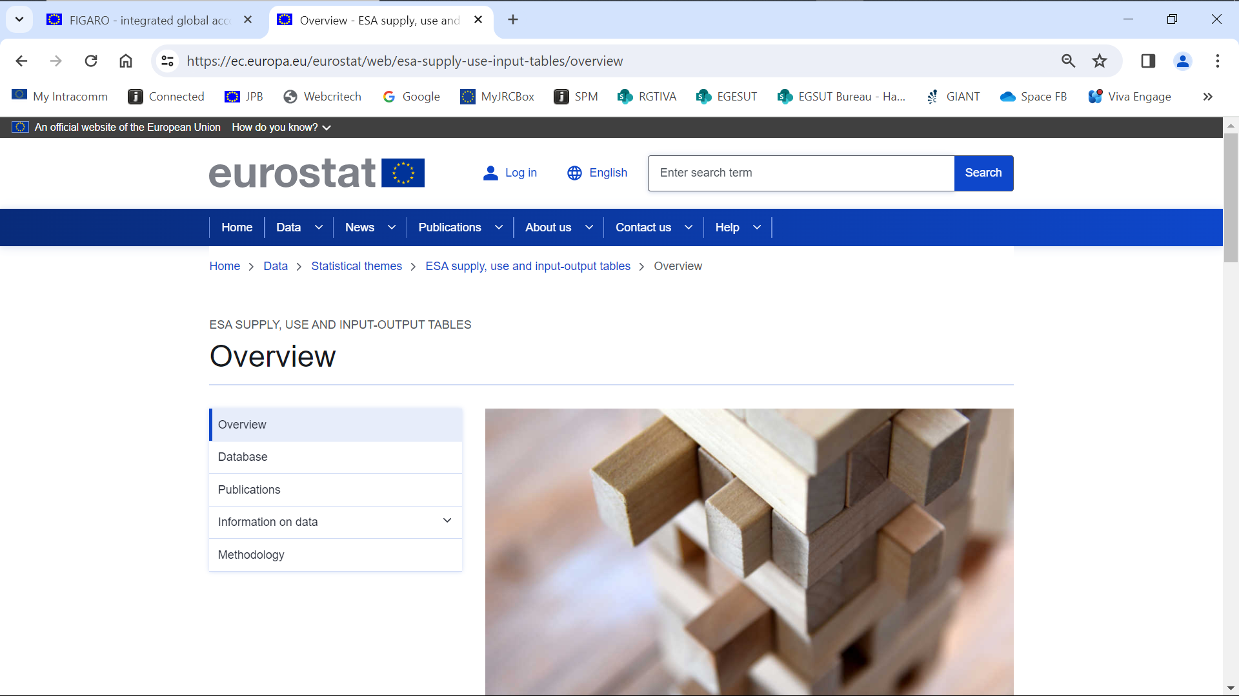

Slide 14
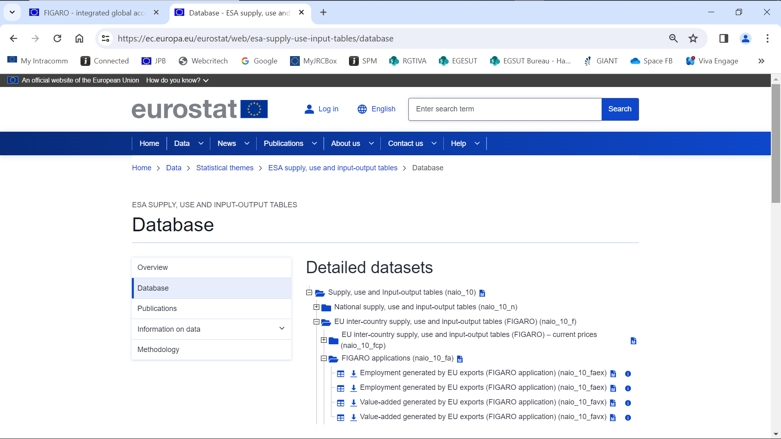

Slide 15
FIGARO Project
Eurostat and Joint Research Centre

Slide 16



FIGARO: from experimental to European statistics (1/2)
User needs:
Initial request from DG ECFIN in 2008 (EU KLEMS, WIOD…)
Focus on the EU; built on the ESA2010 methodology; should guarantee the provision of data for European policies (RRF, IDAA, tariffs, GVCs…)
Cooperation with NSIs (NAWG, TG-SUIOT, IGA EG) and intl. organisations
For the domestic part: SUT data calibrated to latest NA main aggregates
For the bilateral trade: geographical distribution based on trade stats (vs. NAs)
User feedback:
Growing visibility: EC DGs (steering committee) but also research community
Increasing demand for additional FIGARO applications/indicators (MGIs, PYP, NAM)

Slide 17

FIGARO: from experimental to European statistics (2/2)
Sound methodology: recognition from the scientific community
Publication of papers; presentations at conferences (IIOA, SHAIO…)
FIGARO handbook (Remond-Tiedrez & Rueda-Cantuche, 2019)
Production: industrialisation of the process and internal procedure
Clear workflow; use of IT corporate tools; data availability
Reliable and replicable process
Timing, future prospects and the GIANT initiative
2018-2020 Experimental statistics; 2021- Official statistics (every July)
2024 – MGIs; 2025 – NAM; 2026 – PYP (…) 2028-2029 ESUTs

Slide 18
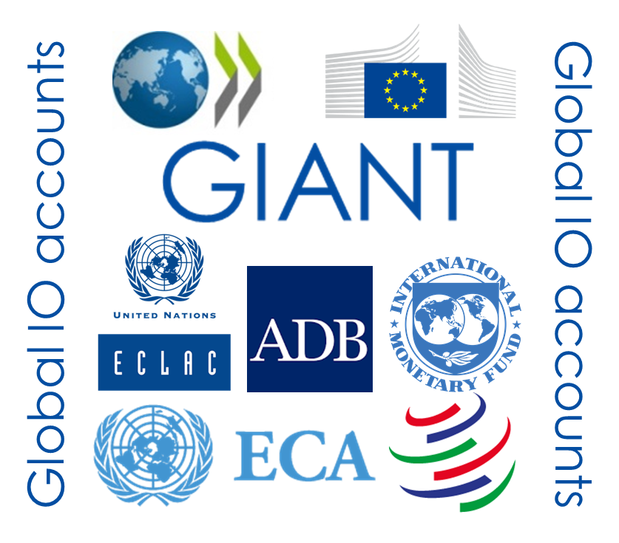
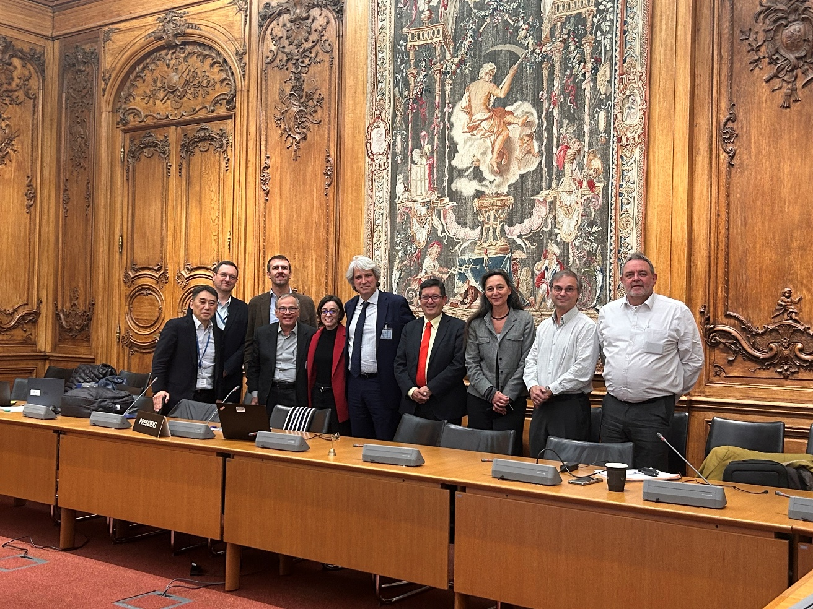
The GIANT initiative (1/2)
GIANT initiative (Global Input-output AccouNTs) 27/06/23

Slide 19
What is GIANT doing?
TASK 1: The goal of GIANT is to converge on a common global benchmark for the input data used by the partner organisations to produce global IC-SUIOTs.
The common benchmark will ensure comparability and consistency in the compilation of Global Input‑Output Accounts across different institutions and regions.
It will also provide users with consistent messages, irrespective of the specificities of any given ICIO.

Slide 20
What is GIANT doing?
TASK 2: To achieve convergence, the GIANT initiative explores the feasibility of a common repository of globally benchmarked data and work on a long-term strategy to exchange processed data and associated metadata
TASK 3: Participating organisations also work together to strengthen the technical capacity of countries in the compilation of national SUTs and IOTs as well as TiVA analysis through workshops, webinars, trainings, and other capacity-building activities.
TASK 4: Common identity signs (logo/acronym) for dissemination, long-term initiatives, releases and acknowledgements (e.g. formal agreements)

Slide 21







GIANT 2025-2026
Comparative analysis of GDP main components used by GIANT members, for common countries and inds.
➔ distribution of roles and timeline towards a common global benchmark for ICIOs
Populate the repository with more info & data
More cooperation among institutions to align ICIO data and methods (bilateral visits and agreements) and strengthen the support for technical assistance
Design of a new logo/web page including everyone.
Multilateral agreement & conferences

Slide 22
¡Muchas gracias por su atención!
Prof. Dr. José Manuel Rueda-Cantuche
Comisión Europea, Centro Común de Investigación, 23 Junio 2026

