Slide 1

Compilation of the FIGARO tables in previous years’ prices with official statistics of the EU countries including methodological discussions with oecd
International Input-Output Conference
SHAIO conference
Santacruz Banacloche
José Manuel Rueda-Cantuche
Pablo Piñero
JRC, Unit B.7
Seville, Spain,
22-26 June 2026

Slide 2
Motivation
Rising inflation and price volatility make current-price data harder to interpret.
Policymakers need to distinguish real economic changes from price effects.
MCIO analysis is essential to understand global value chains.
FIGARO PYP addresses this need by providing multi-country supply, use and input-output tables at previous year’s prices.

Slide 3
Introduction to FIGARO
FIGARO: ‘Full International and Global Accounts for Research in input-Output analysis’.
The EU inter-country Supply, Use and Input-Output tables, also known as the FIGARO tables, are the results of a co-operation between Eurostat and the European Commission’s Joint Research Centre.
Since 2021 it has become EU Official Statistics: benchmarked to the latest available official macroeconomic aggregates.
https://ec.europa.eu/eurostat/web/esa-supply-use-input-tables/overview

Slide 4

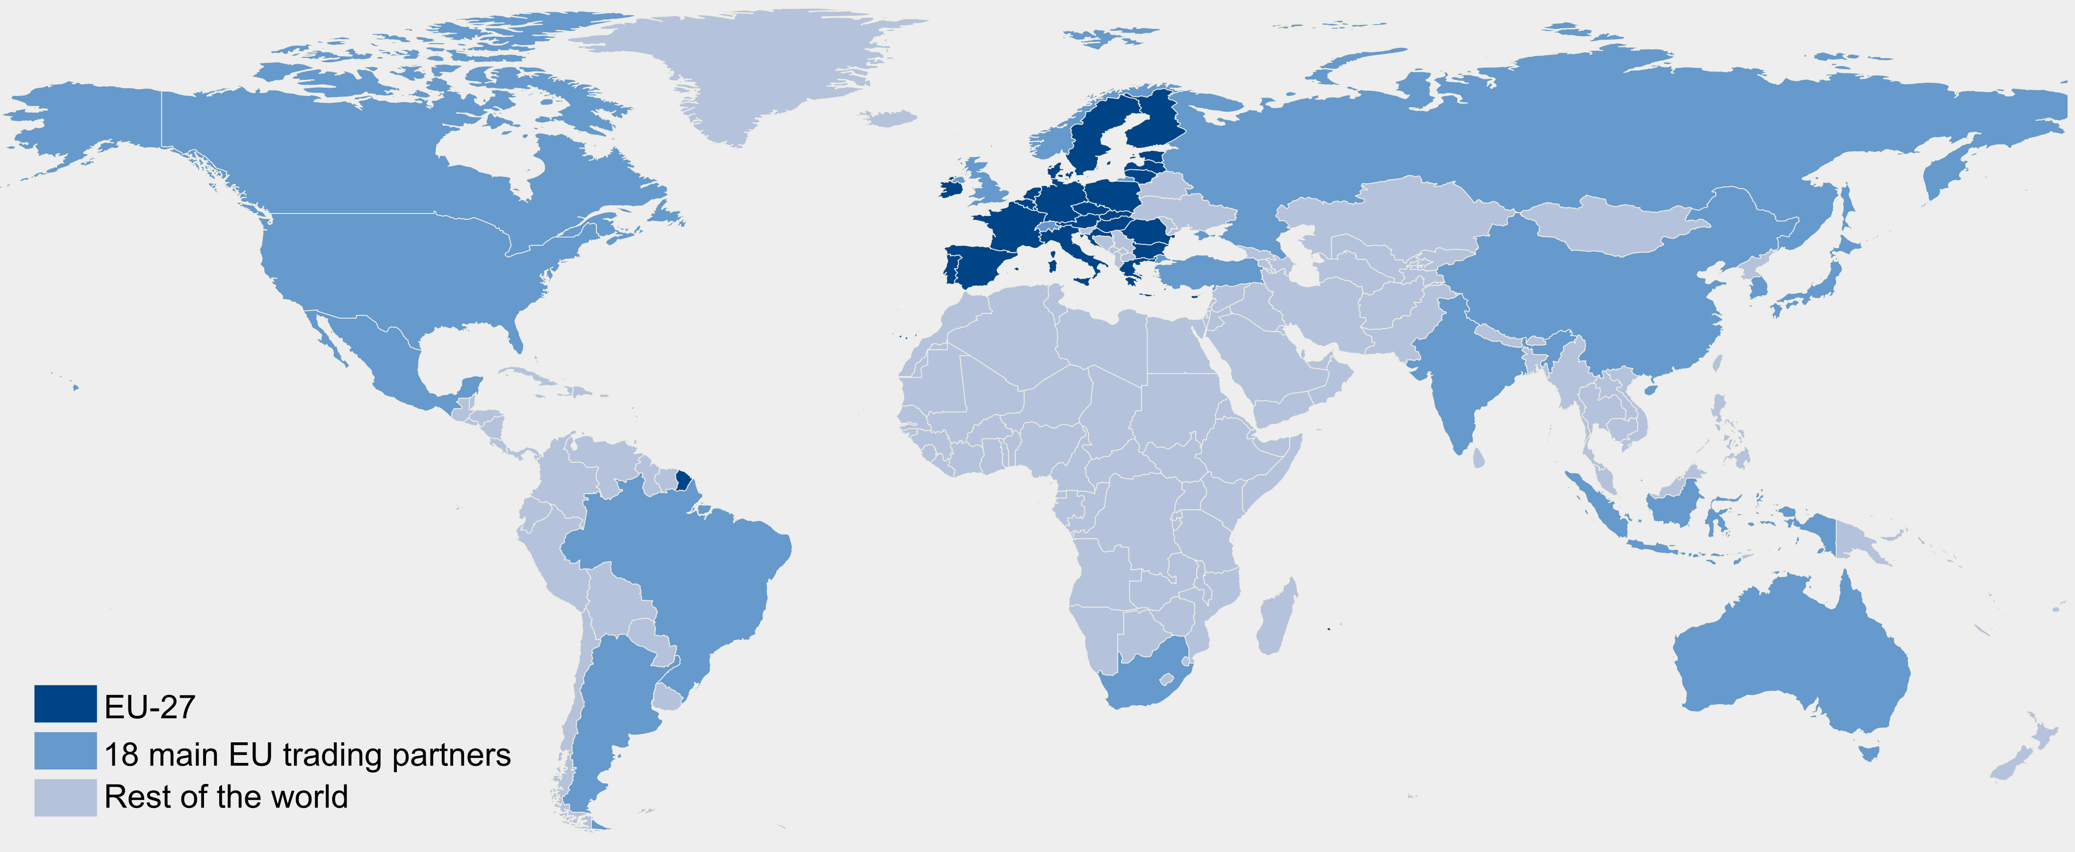
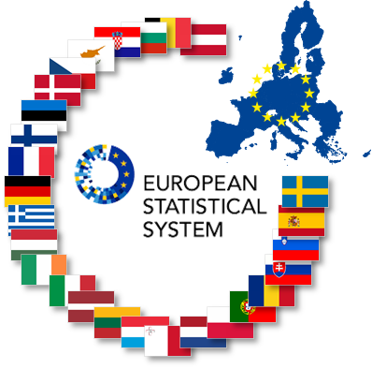

FIGARO release edition 2026 online next 20 July!!!!
22 main
trading
partners
+ RoW
+
=
Figaro
49 + RoW
Globally balanced view of National Accounts Main Aggregates, adjusted to latest national GDP main aggregates (99.1% population and 99.8% GDP)
Build upon available data from National Accounts (national SUTs) and balanced international trade statistics
  Supply-use by 64 product/industry categories (CPA/NACE Rev.2)
  Since 2021, annual production by Eurostat; since 2021, fully aligned with countries’ National Accounts official statistics.

Slide 5
What is FIGARO PYP?
Time series of multi-country supply, use and input–output tables with same activity/product breakdown and same country coverage as FIGARO tables at current prices – 2010 – 2024.
Tables expressed at previous year’s prices, enable:
  Volume analysis
  Chain-linking of time series
  Consistent comparison over time
Produced annually and aligned with existing FIGARO tables at current prices and National Accounts Main Aggregates (NAMA) at previous year’s prices.

Slide 6
Overall approach
Relevant literature: Dietzenbacher and Hoen (1998); UN Handbook on Supply, Use and IO Tables Extensions and Applications (2018), among others.
Need to develop a specific methodology for the EU case where NAMA, SUTs and other price data are available.
Start from FIGARO tables at current prices and step-wise improvement with three different stages:
  Stage 1; GRAS balancing on pre-estimated PYP values for target columns and target rows (based on NAMA PYP, wherever available) and the table in current prices as prior matrix. Although considering a SUT approach instead of an IOT approach.
  Stage 2; Use of SUTs in PYP available to calculate cell-wise implicit price deflators.
  Stage 3; Use of domestic/export price estimations, as price deflators.

Slide 7
Main data sources
Stage 1
FIGARO multi-country SUTs at current prices.
National Accounts data (current and previous year prices):
  Eurostat for EU countries;
  United Nations for non-EU countries.
  Stage 2
National SUTs at previous year’s prices (when available).
Stage 3
Domestic/export price indices to refine cross-border flows.

Slide 8
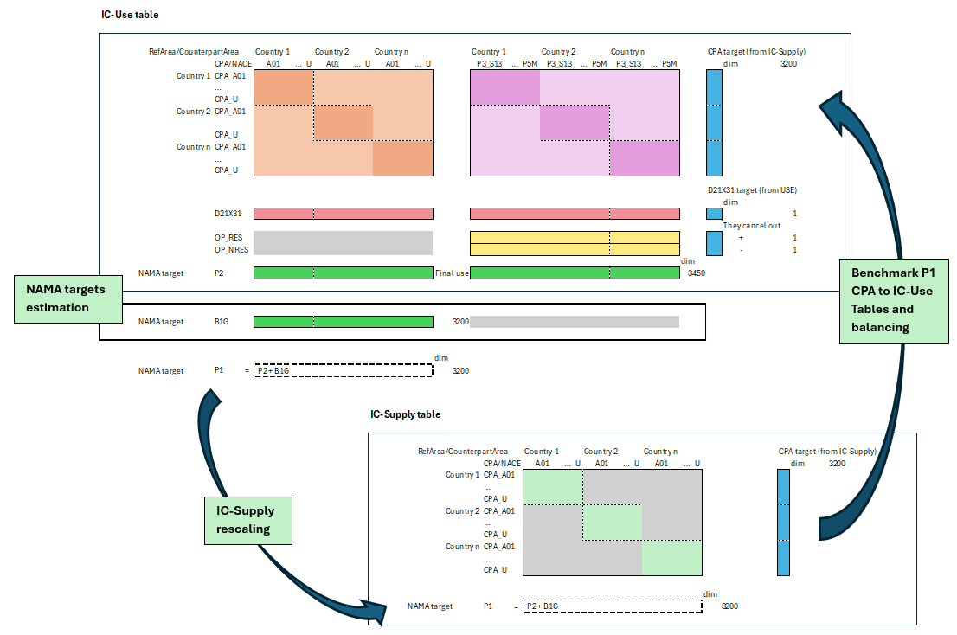
SUT-based approach
IC-use table
IC-supply table

Slide 9
From current prices to previous years’ prices
Initial FIGARO tables are improved using available price information:
  Domestic blocks: when national SUTs are available at PYP (Eurostat), we derive the implicit price indices and use them to improve the priors
  Trade blocks: we aim to apply trade price indices (by exporting country, product and destination country) on the IC-USE trade blocks and improve our priors
National Accounts price indices applied to key aggregates: output, value added, intermediate consumption, final demand components.
Balancing ensures:
  Total supply equals total use;
  Consistency across countries, industries and products.

Slide 10
Validation
NAMA price deflators should remain unchanged.
SUT PYP price deflators adjustments should be kept minimum.
Time evolution dynamics in volumes – peaks, outliers…
Supply and use balancing constraints, incl. NAMA.

Slide 11
Current limitations
FIGARO PYP tables available annually from 2010 to T–2.
Limited availability of detailed data for non-EU countries – OECD cooperation – shared responsibility?
Intermediate consumption at PYP not mandatory for EU.
Treatment of Rest of the World remains to be explored.
Do not affect overall coherence of results.

Slide 12
Next release
Late autumn 2026
Statistical Working Paper on the FIGARO PYP methodology
FIGARO tables at previous year’s prices:
  Release on Eurobase and Circabc
  MC-SUIOT database based on FIGARO 26ED
  Same industry, product and country coverage as FIGARO tables at current prices
  Time coverage: 2010 – 2024

Slide 13

Thank you
© European Union 2020
Unless otherwise noted the reuse of this presentation is authorised under the CC BY 4.0 license. For any use or reproduction of elements that are not owned by the EU, permission may need to be sought directly from the respective right holders.
Notes:
Update/add/delete parts of the copy right notice where appropriate.
More information: https://myintracomm.ec.europa.eu/corp/intellectual-property/Documents/2019_Reuse-guidelines%28CC-BY%29.pdf

